Slide 1
Week 1, Video 6
Advanced Classifiers

Slide 2
Classification
There is something you want to predict (“the label”)
The thing you want to predict is categorical
The answer is one of a set of categories, not a number

Slide 3
Neural Networks
Composes extremely complex relationships through combining “perceptrons”
Finds very complicated models

Slide 4
The classic perceptron
A perceptron takes a set of inputs
Has a weight for each input
Multiplies those weights by the inputs
Adds it all together
Adds an intercept
And then applies a step function to get {0,1}

Slide 5
For example
We have inputs M, N, P
With w weights 1, 0, -0.5 and b intercept 0.1
Then for M=1, N=-7, P=2
What is f(x)?

Slide 6
For example
We have inputs M, N, P
With w weights 1, 0, -0.5 and b intercept 0.1
Then for M=-1, N=0.003, P=8
What is f(x)?

Slide 7
But actually
Usually modern neural networks use more complex decision functions than just a step function
Logistic function
Tanh function
ReLu function
If x>0, x
If x<=0, 0
And many more

Slide 8
That’s one perceptron
And one perceptron can have multiple inputs

Slide 9
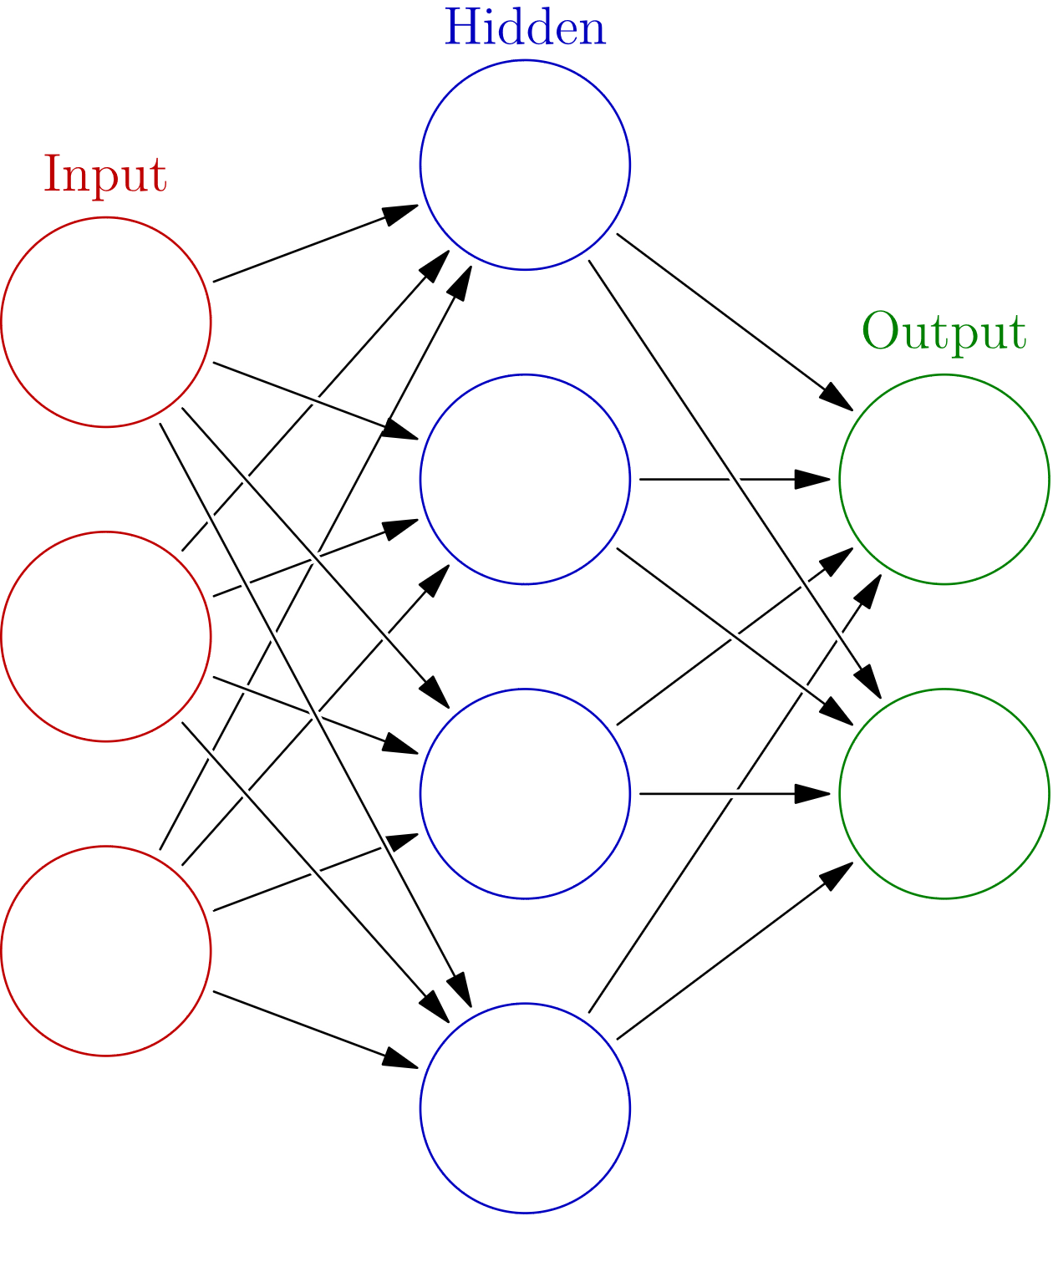
But…
But neural networks take a lot of inputs and they can produce multiple outputs
Image courtesy of glosser.ca used under Creative Commons Licensing

Slide 10
Neural network
Red circles: Predictors
Blue circles: Perceptrons
Green circles: Predicteds
Image courtesy of glosser.ca used under Creative Commons Licensing

Slide 11
What you see here
A single layer neural network
A very simple one
Generally hundreds/ thousands/millions of hidden perceptrons
Image courtesy of glosser.ca used under Creative Commons Licensing

Slide 12
But this is just a simple single-layer neural network
Image courtesy of glosser.ca used under Creative Commons Licensing

Slide 13
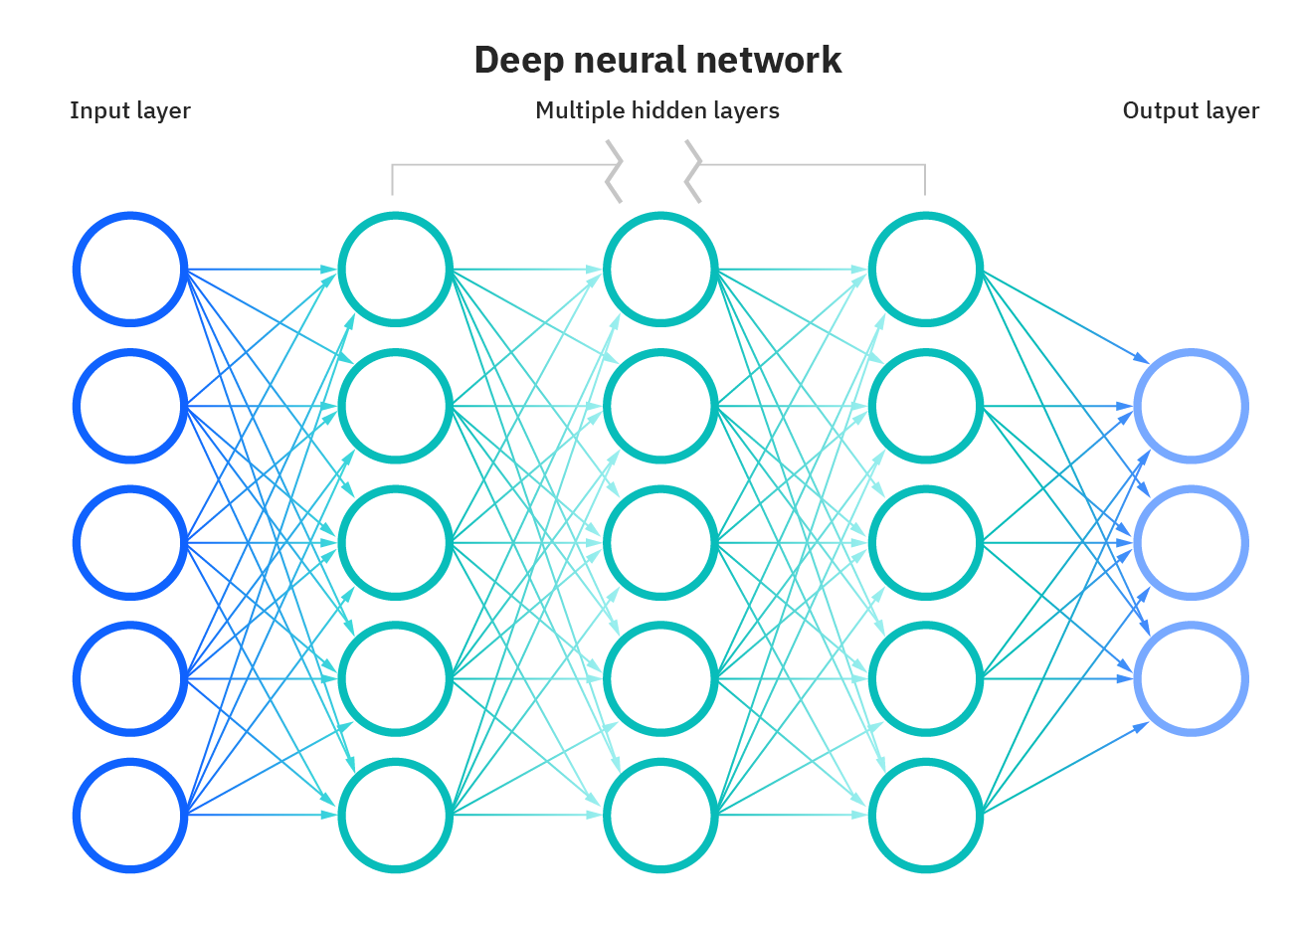
On to deep learning
Image courtesy of IBM

Slide 14
Multiple hidden layers
Image courtesy of IBM

Slide 15
Why does deep learning (sometimes) work better?
Can capture multiple layers of abstraction
Without having to do so in a way that human beings can understand

Slide 16
Any questions?

Slide 17
And…
Lots of ways to make things more complex still

Slide 18
Often the term deep learning
Reserved for recurrent neural networks (or more complex algorithms still)
Recurrent neural networks fits on sequence of events
Keeping some degree of “memory” about previous events
A different category of prediction model than classifiers that treat events as separate

Slide 19
Recurrent neural networks (RNN)
Feed back information from later layers back to earlier layers
A node can (over time) influence itself
Allows for sequence of outputs

Slide 20
Long short term memory networks
RNN variant
Replaces perceptrons with LSTM units
Information propagation reduces over time for given piece of information (long-term memory)
Activation patterns in network change once per time step (short-term memory)
Will not go into full details; linear algebra required

Slide 21
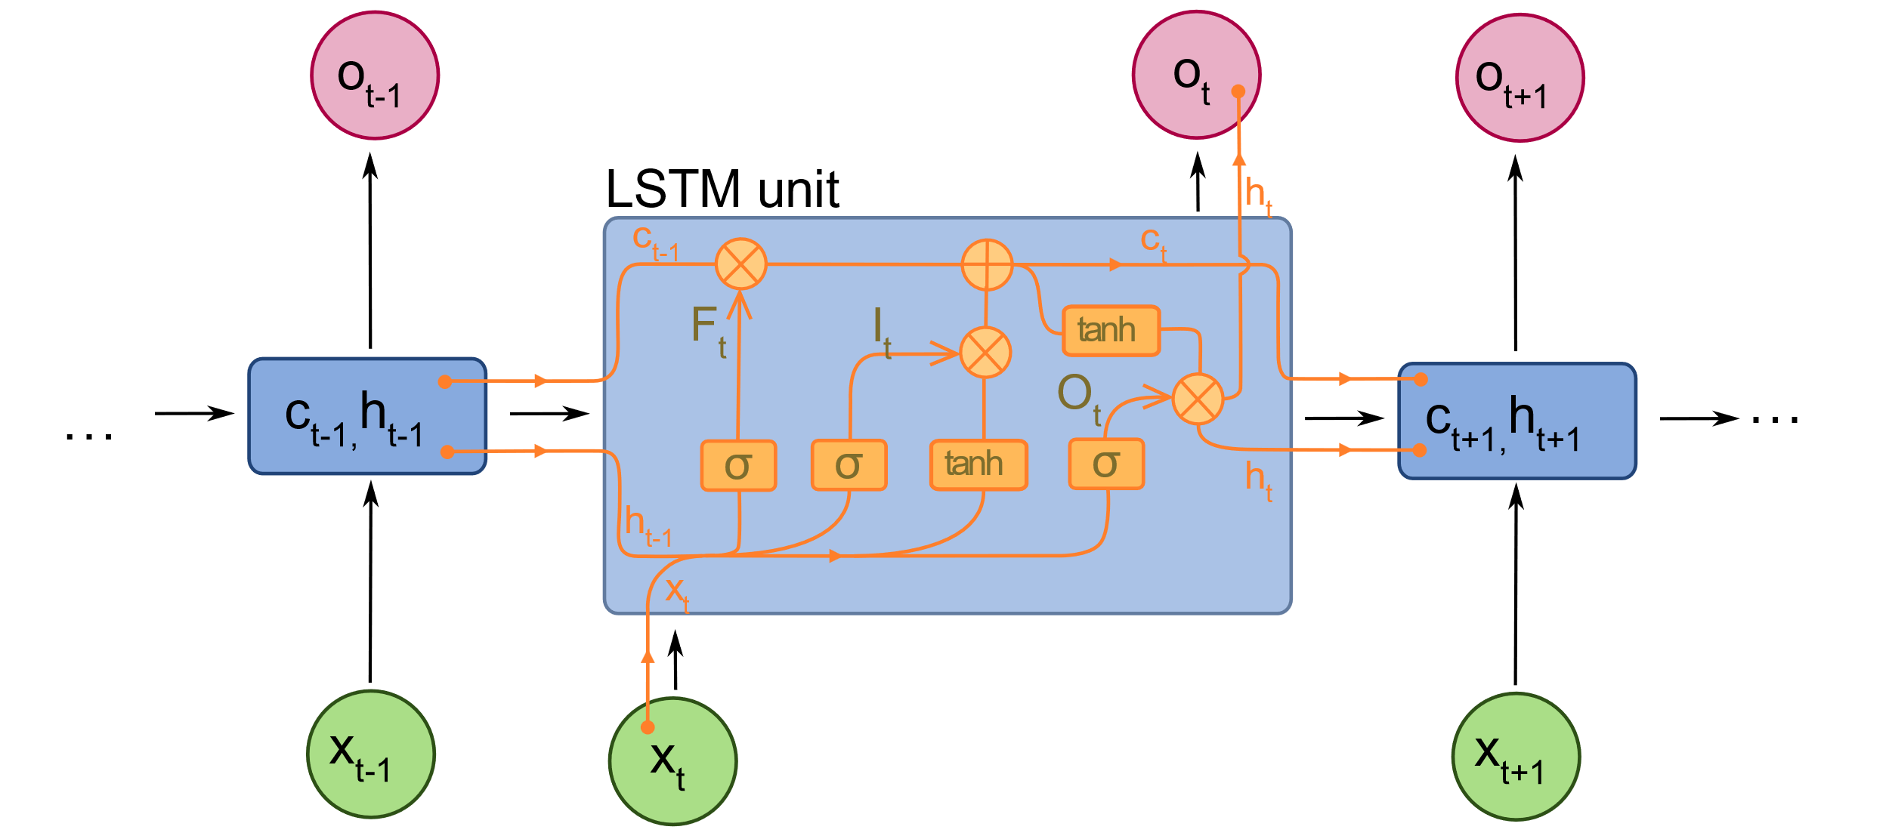
LSTM Unit
Note the:
Hidden state (h) Forget gate (Ft)
Input gate (It) Output gate (Ot)
Image by fdeloche - CC BY-SA 4.0

Slide 22
Transformer/Foundation Models
BERT, MathBERT, GPT-2, GPT-3/3.5, DALL-E 2, StableDiffusion
As of when I’m writing this slide

Slide 23
Transformer/Foundation Models
Can predict
Words
Sentences
Pixels
Computer program text
Mathematical equations
Anything?

Slide 24
Transformer/Foundation Models
Can predict
Words
Sentences
Pixels
Computer program text
Mathematical equations
Anything?
And, in a sudden light-switch transformation, prediction becomes generation

Slide 25
Transformer/Foundation Models
Neural networks trained on enormous data sets
Enable impressive performance for new problems with minimal or even no training data
AKA Zero-shot learning
We will discuss them in detail in week 7
They only work for a subset of problems, but where they work it’s amazing

Slide 26
Next Lecture
eXplainable AI

