Slide 1
Week 4 Video 6
Knowledge Inference: DKT Family

Slide 2
Deep Knowledge Tracing (DKT) (Piech et al., 2015)
Based on long short term memory networks
Fits on sequence of student performance across skills
Predicts performance on future items within system
Can fit very complex functions
Very complex relationships between items over time

Slide 3
DKT
Initial paper reported massively better performance than original BKT or PFA (Piech et al., 2015)
Seemed at first too good to be true, and (Xiong et al., 2016) reported that (Piech et al., 2015) had used the same data points for both training and test

Slide 4
DKT
(Khajah et al., 2016) compared DKT to modern extensions to BKT on same data set
Particularly beneficial to re-fit item-skill mappings
(Wilson et al., 2016) compared DKT to temporal IRT on same data set
Bottom line: All three approaches appeared to perform comparably well

Slide 5
But this was the beginning of what could be called DKT-Family algorithms
A range of knowledge tracing algorithms based on different variants on Deep Learning
Now literally hundreds of published variants
Most of them tiny tweaks to get tiny gains in performance
But in aggregate, there appear to be some real improvements to predictive performance (see comparison in Gervet et al., 2020 for example)
I will discuss some of the key issues that researchers have tried to address, and what their approaches were

Slide 6
Degenerate behavior
(Yeung & Yeung, 2018) reported degenerate behavior for DKT
Getting answers right leads to lower knowledge
Wild swings in probability estimates in short periods of time

Slide 7
Degenerate behavior
(Yeung & Yeung, 2018) reported degenerate behavior for DKT
Getting answers right leads to lower knowledge
Wild swings in probability estimates in short periods of time
They proposed adding two types of regularization to moderate these swings
Increasing weight of current prediction for future prediction
Reducing amount model is allowed to change future estimates

Slide 8
Impossible to interpret in terms of skills
DKT Family predicts individual item correctness, not skills
What do you do for entirely new items?
What information can you provide teachers?

Slide 9
Extension for Latent Knowledge Estimation
(Zhang et al., 2017) proposed an extension to DKT, called DKVMN, that fits an item-skill mapping too
Based on Memory-Augmented Neural Network, that keeps an external memory matrix that neurons update and refer back to
Latent skill difficult to interpret

Slide 10
Extension for Latent Knowledge Estimation
(Lee & Yeung, 2019) proposed an alternative to DKT, called KQN, that attempts to output more interpretable latent skill estimates
Again, fits an external memory network to fit skills
Also attempts to fit amount of information transfer between skills
Still not that interpretable

Slide 11
Extension for Latent Knowledge Estimation
(Scruggs et al., 2020) proposed an extension to any DKT-family algorithm
Human-derived skill-item mapping used
Predicted performance on all items in skill averaged
Including both unseen and already-seen items
Led to successful prediction of post-tests outside the learning system

Slide 12
What is DKT really learning?
Ding & Larson (2019) demonstrated theoretically that a lot of what DKT learns is how good a student is overall

Slide 13
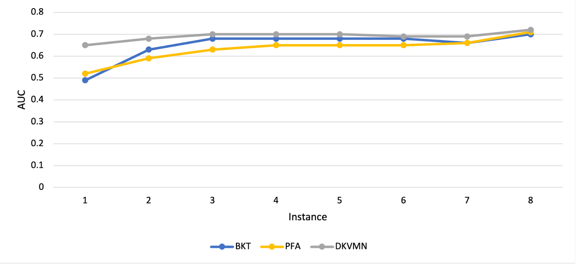
What is DKT really learning?
Zhang et al. (2021) followed this up with empirical work showing that most of the improvement in performance for DKVMN is in the first attempt on a new skill

Slide 14
What is DKT really learning?
In particular, there’s essentially no benefit to deep learning after several attempts on a skill (about the point where students often reach mastery, if they didn’t already know skill)

Slide 15
Other Important DKT variants: SAKT
Pandey & Karypis (2019) proposed a DKT variant, called SAKT, which fits attentional weights between exercises and more explicitly predicts performance on current exercise from performance on past exercises
Gets a little better fit, doubles down a little more on some limitations we’ve already discussed

Slide 16
Other Important DKT variants: AKT
Ghosh et al. (2020) proposed a DKT variant, called AKT, which
Explicitly stores and uses learner’s entire past practice history for each prediction
Uses exponential decay curve to downweight past actions
Uses Rasch-model embeddings to calculate item difficulty

Slide 17
Adding in more information: SAINT+
Shin et al. (2021) added elapsed time and lag time as additional inputs, leading to better performance

Slide 18
Adding in more information: Process-BERT
Scarlatos et al. (2022) added timing and use of resources such as calculator
Additional information leads to better performance

Slide 19
Curious methodological note
Most DKT-family papers report large improvements over previous algorithms, including other DKT-family algorithms
Improvements that seem to mostly or entirely dissipate in the next paper

Slide 20
Some reasons
Poor validation and over-fitting
A lot of DKT-family papers don’t use student-level cross-validation
Poor cross-validation benefits DKT-family algorithms more than other algorithms, because DKT-family fits more aggressively
A lot of DKT-family papers fit their own hyperparameters but use past hyperparameters for other algorithms

Slide 21
An evaluation
Gervet et al. (2020) compares KT algorithms on several data sets
Key findings
Different data sets have different winners
DKT-family performs better than other algorithms on large data sets, but worse on smaller data sets
DKT-family algorithms perform worse than LKT-family on data sets with very high numbers of practices per skill (i.e. language learning)
DKT-family algorithms do better at predicting if exact order of items matters (which can occur if items within a skill vary a lot)
DKT-family algorithms reach peak performance faster than other algorithms (also seen in Zhang et al., 2021)

Slide 22
Next Frontier for DKT-family: Beyond Correctness
Option Tracing (Ghosh et al., 2021) extends output layer to predict which multiple choice item the student will select

Slide 23
Next Frontier for DKT-family: Beyond Correctness
Open-Ended Knowledge Tracing (Liu et al., 2022) integrates KT with
A GPT-2 model fine-tuned on 2.1 million Java code exercises and written descriptions of them
In order to generate predicted student code which makes predicted specific errors

Slide 24
DKT-family: work continues
Dozens of recent papers trying to get better results by adjusting the deep learning framework in various ways

Slide 25
Next Up
Memory Algorithms

