Slide 1
Week 5 Video 5
Relationship Mining Network Analysis

Slide 2
Today’s Class
Network Analysis

Slide 3
Network Analysis
Analysis of anything that can be seen as connections between nodes
Most common – social networks
Connections between friends on the internet
Connections between students in a class
Connections between collaborators in a work project

Slide 4
Network Analysis
Could also be considered structure discovery
Placed here in the course because of how it’s typically used in practice

Slide 5
General Postulates of Network Analysis
There are things, referred to as nodes or vertices
Nodes have connections to other nodes, referred to as ties or links
Nodes can have different types or identities
Links can have different types or identities
Links can have different strengths

Slide 6
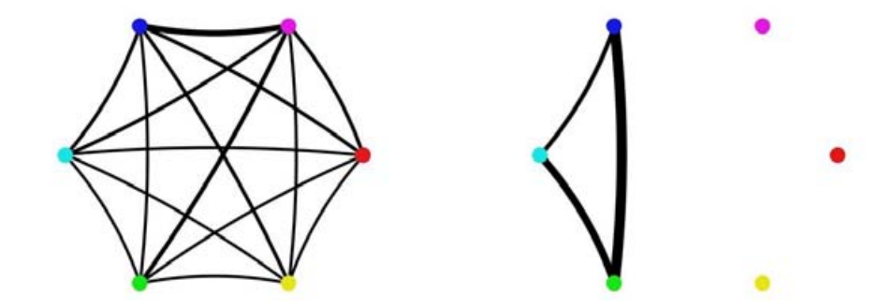
Example: (Student work groups – Kay et al., 2006)

Slide 7
Example: (Student work groups – Kay et al., 2006)
nodes

Slide 8
Example: (Student work groups – Kay et al., 2006)
ties

Slide 9
Example: (Student work groups – Kay et al., 2006)
Strong ties
Weak ties

Slide 10
Which student group works together better?

Slide 11
Which is the most collaborative pair?

Slide 12
Which is the most collaborative pair?

Slide 13
Who is the most collaborative student?

Slide 14
Who is the most collaborative student?

Slide 15
Types
In a graph of classroom interactions, there could be several different types of nodes
Teacher
TA
Student
Project Leader
Project Scribe

Slide 16
Types
In a graph of classroom interactions, there could be several types of links
Leadership role (X leads Y)
Working on same learning resource
Helping act
Criticism act
Insult
Note that links can be directed or undirected

Slide 17
Strength
In a graph of classroom interactions, links could be stronger or weaker due to
Intensity of act
Frequency of act

Slide 18
Network Analysis
Use network graphs to study the patterns and regularities of the relationships between the nodes

Slide 19
Density
Proportion of possible lines that are actually present in graph
What is the density of these graphs?

Slide 20
Density
Proportion of possible lines that are actually present in graph
What is the density of these graphs?
100%
3/15=20%

Slide 21
Density
Could be used to figure out how collaborative a class is overall

Slide 22
Reachability
A node is “reachable” if a path goes from any other node to it
Which nodes are unreachable?

Slide 23
Reachability
A node is “reachable” if a path goes from any other node to it
Which nodes are unreachable?

Slide 24
Reachability
Are there any students who don’t collaborate with anybody?

Slide 25
Geodesic Distance
The number of edges between one node N and another node M, in the shortest path connecting them

Slide 26
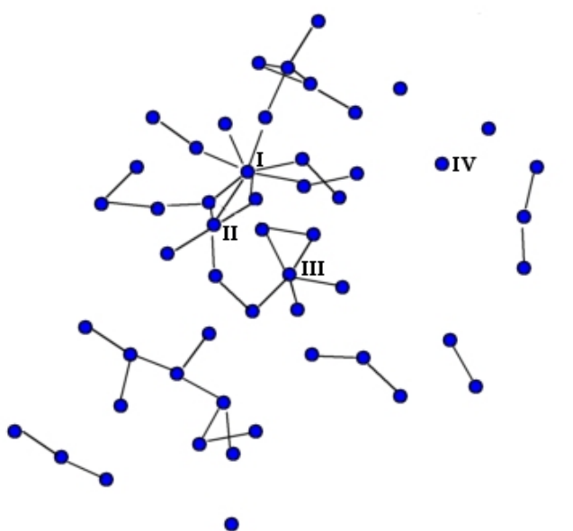
Student social network: (Dawson, 2008)

Slide 27
What is the geodesic distance?

Slide 28
Geodesic distance = 3
1
2
3

Slide 29
What is the geodesic distance?

Slide 30
Geodesic Distance = 7
5
6
7
4
3
1
2

Slide 31
What is the geodesic distance?

Slide 32
Geodesic Distance = Infinite

Slide 33
Quiz What is the geodesic distance?
6
7
8
9

Slide 34
Geodesic Distance
How many people does an idea need to go through to get between people?

Slide 35
Flow
How many possible paths are there between node N and node M, that do not repeat a node?

Slide 36
What is the flow?

Slide 37
1

Slide 38
2

Slide 39
3

Slide 40
Flow
How many possible paths are there for an idea to go between people?

Slide 41
Centrality
How important is a node within the graph?
Which kids are the popular or influential kids?

Slide 42
Centrality
Four common measures
Degree centrality
Closeness centrality
Betweeness centrality
Eigenvector centrality

Slide 43
Nodal Degree
Number of lines that connect to a node

Slide 44
The node with the highest nodal degree

Slide 45
Nodal Degree
Indegree: number of lines that come into a node
Outdegree: number of lines that come out of a node

Slide 46
Closeness
A node N’s closeness is defined as the sum of its distance to other nodes
The most central node in terms of closeness is the node with the lowest value for this metric
Note that strengths can be used as a distance measure for calculating closeness
Higher strength = closer nodes

Slide 47
Betweenness
Betweeness centrality for node N is computed as:
The percent of cases where
For each pair of nodes M and P (which are not N)
The shortest path from M to P passes through N

Slide 48
What is this node’s betweenness

Slide 49
Betweenness is high; each group can only get to other groups through this point

Slide 50
What is this node’s betweenness?

Slide 51
Low, only one point connects through it

Slide 52
What is this node’s betweenness?

Slide 53
Betweenness = 0

Slide 54
Reciprocity
What percentage of ties are bi-directional?
Can be computed as number of bi-directional ties over total number of connected pairs

Slide 55
Eigenvector Centrality
Complex math, but assigns centrality to nodes through recursive process where
More and stronger connections are positive
Connections to nodes with higher eigenvector centrality contribute more than connections to nodes with lower eigenvector centrality

Slide 56
Eigenvector Centrality
A key part of the original PageRank in Google

Slide 57
Lots of uses
There are lots of uses for network analysis
But particularly useful for studying collaboration
Group-based learning
Teacher collaboration
Networks of influence
Why do some educational interventions seem to be dominant in specific regions?

Slide 58
Next lecture: Epistemic Networks

