Slide 1
Week 6 Video 7
Knowledge Inference: Other Structures

Slide 2
How do we get a skill-item mapping?
Hand-development and refinement
Automatic model discovery
Hybrid approaches

Slide 3
Hybrid Approaches
The most popular hybrid approach is called Learning Factors Analysis
Cen, H., Koedinger, K., Junker, B. (2006) Learning Factors Analysis – A General Method for Cognitive Model Evaluation and Improvement. Proceedings of the International Conference on Intelligent Tutoring Systems, 164-175.

Slide 4
Learning Factors Analysis (LFA)
Uses a mathematical model similar to Performance Factors Analysis
Adds a student parameter, has only one learning parameter per skill

Slide 5
Learning Factors Analysis (LFA)
Take an existing skill-item mapping
Add a set of potential candidate “learning factors”
Repeatedly tries to split skills based on learning factors
Using A* space search algorithm
For Skill A, Learning Factor B
Test new skills (A and B), (A and not B)

Slide 6
Three Ways to Improve Skill-Item Mappings
Hand-development and refinement
Automatic model discovery
Hybrid approaches

Slide 7
Why is this important?
A good skill-item mapping is a prerequisite to using algorithms like BKT, PFA
If you consider irrelevant evidence (student performance at hockey when predicting math)
You’ll have ineffective prediction

Slide 8
A limitation of Q-Matrices
Assumes no relationship between skills
Except that a specific item can involve multiple skills

Slide 9
A definite limitation
Several ways that skills can interconnect

Slide 10
Partial Order Knowledge Spaces
Desmarais, M.C., Maluf, A., Liu, J. (1996) User-expertise modeling with empirically derived probabilistic implication networks. User Modeling and User-Adapted Interaction, 5(3–4), 283–315.
Desmarais, M.C., Meshkinfam, P., Gagnon, M. (2006) Learned Student Models with Item to Item Knowledge Structures. User Modeling and User-Adapted Interaction, 16, 5, 403-434.

Slide 11
Partial Order Knowledge Spaces
Postulate relationships between items
Mastery of one item is prerequisite to mastery of another item

Slide 12
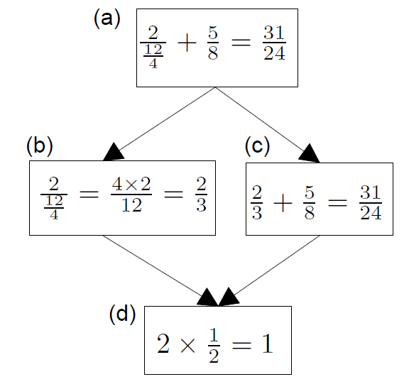
Example (Desmarais et al., 2006)
B does not inform us about C
If student succeeds at C, they will succeed at D;
D is prerequisite to C

Slide 13
Extension to skills
POKS can be extended rather easily to use skills (interchangeable items) rather than items

Slide 14
Bayesian Networks
Less restricted set of models that also infer relationships between skills and items, and between skills
Can infer more complicated relationships between material than the very restricted set of relationships modeled in POKS
Can infer {skill-skill, item-item, skill-item} relationships at the same time
Can model hierarchies of skills and meta-skills
Can integrate very diverse types of information
That extra flexibility can lead to over-fitting (cf. Desmarais et al., 2006)

Slide 15
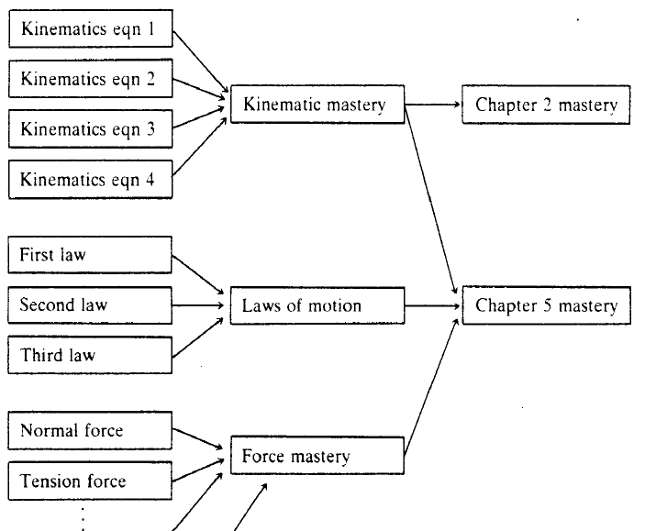
Martin & VanLehn (1995)

Slide 16
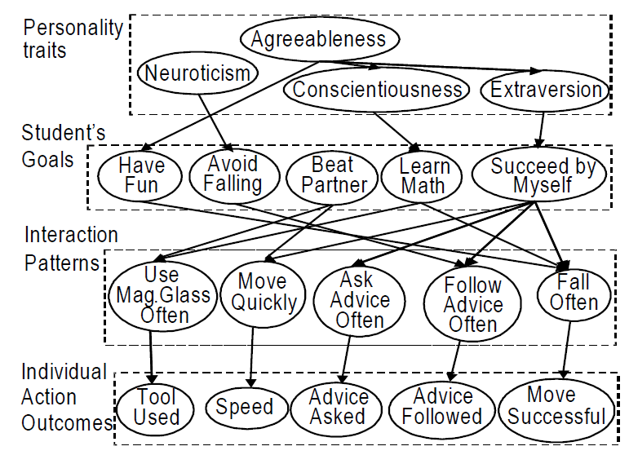
Conati et al., 2009

Slide 17
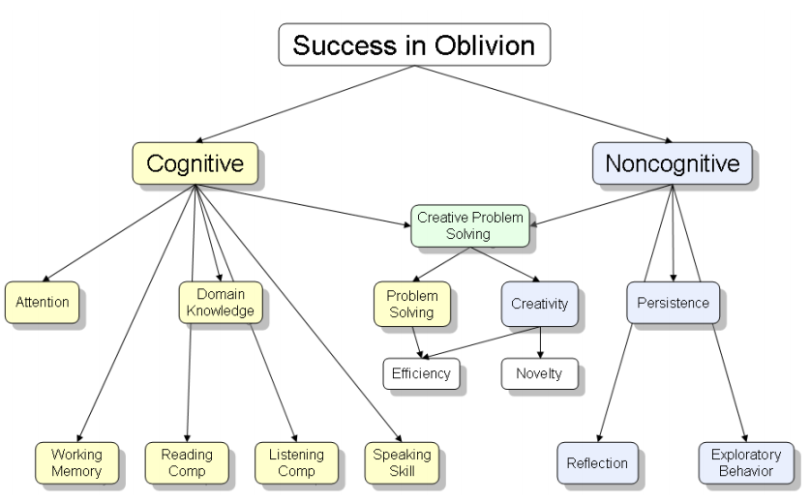
Shute et al., 2009

Slide 18
Propagation of Information
Several algorithms are used for propagating information around a Bayes Net
If we know that a student has skill A
Then this provides us with information about all of that skill’s prerequisite skills
And some information for skills for which skill A is a prerequisite
And some information about relevant meta-skills

Slide 19
Bayes Net or Simpler Model?
How much do the interconnections between your skills matter in the context of your learning system?
How much do you care about hierarchy in skills?
The cost of a Bayes Net is complexity, over-fitting, and over-propagation of information

Slide 20
Tools for creating Bayes Nets
Netica
http://www.norsys.com/netica.html
SamIam
http://reasoning.cs.ucla.edu/samiam/

Slide 21
Next Up
A deep dive into learning curves
Notes:
Re-record this slide

