Slide 1
Advanced Methods and Analysis for the Learning and Social Sciences
PSY505 Spring term, 2012
March 16, 2012

Slide 2
Today’s Class
Association Rule Mining

Slide 3
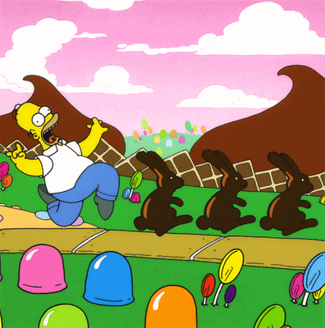
Today’s Class
The Land of Inconsistent Terminology

Slide 4
Association Rule Mining
Try to automatically find simple if-then rules within the data set
Another method that can be applied when you don’t know what structure there is in your data
Unlike clustering, association rules are often obviously actionable

Slide 5
Example
Famous (and fake) example:
People who buy more diapers buy more beer
If person X buys diapers,
Person X buys beer
Conclusion: put expensive beer next to the diapers

Slide 6
Interpretation #1
Guys are sent to the grocery store to buy diapers, they want to have a drink down at the pub, but they buy beer to get drunk at home instead

Slide 7
Interpretation #2
There’s just no time to go to the bathroom during a major drinking bout

Slide 8
Serious Issue
Association rules imply causality by their if-then nature
But causality can go either direction

Slide 9
Intervention
Put expensive beer next to the diapers in your store

Slide 10
If-conditions can be more complex
If person X buys diapers, and person X is male, and it is after 7pm, then person Y buys beer

Slide 11
Then-conditions can also be more complex
If person X buys diapers, and person X is male, and it is after 7pm, then person Y buys beer and Cornish pasties
Can be harder to use, sometimes eliminated from consideration

Slide 12
Association Rule Mining
Find rules
Evaluate rules

Slide 13
Association Rule Mining
Find rules
Evaluate rules

Slide 14
Rule Evaluation
What would make a rule “good”?

Slide 15
Rule Evaluation
Support/Coverage
Confidence
“Interestingness”

Slide 16
Support/Coverage
Number of data points that fit the rule, divided by the total number of data points
(Variant: just the number of data points that fit the rule)

Slide 17
Example
Rule: If a student took PSY503, the student took PSY505
Support/coverage?
Took PSY503 | Took PSY505
1 | 1
0 | 1
0 | 1
0 | 1
0 | 1
0 | 1
1 | 0
1 | 0
1 | 0
1 | 0
1 | 1

Slide 18
Example
Rule: If a student took PSY503, the student took PSY505
Support/coverage?
2/11 = 0.22
Took PSY503 | Took PSY505
1 | 1
0 | 1
0 | 1
0 | 1
0 | 1
0 | 1
1 | 0
1 | 0
1 | 0
1 | 0
1 | 1

Slide 19
Confidence
Number of data points that fit the rule, divided by the number of data points that fit the rule’s IF condition
Equivalent to precision in classification
Also referred to as accuracy, just to make things confusing
NOT equivalent to accuracy in classification

Slide 20
Example
Rule: If a student took PSY503, the student took PSY505
Confidence?
Took PSY503 | Took PSY505
1 | 1
0 | 1
0 | 1
0 | 1
0 | 1
0 | 1
1 | 0
1 | 0
1 | 0
1 | 0
1 | 1

Slide 21
Example
Rule: If a student took PSY503, the student took PSY505
Confidence?
2/6 = 0.33
Took PSY503 | Took PSY505
1 | 1
0 | 1
0 | 1
0 | 1
0 | 1
0 | 1
1 | 0
1 | 0
1 | 0
1 | 0
1 | 1

Slide 22
Shockingly…
The association rule mining community differs from most other methodological communities by acknowledging that cut-offs for support and confidence are arbitrary
Researchers typically adjust them to find a desirable number of rules to investigate, ordering from best-to-worst…
Rather than arbitrarily saying that all rules over a certain cut-off are “good”

Slide 23
Why?
Why aren’t support and confidence enough?

Slide 24
Why?
Why aren’t support and confidence enough?
Possible to generate large numbers of trivial associations
Students who took a course took its prerequisites (Vialardi et al., 2009)

Slide 25
Why?
Why aren’t support and confidence enough?
Possible to generate large numbers of trivial associations
Students who took a course took its prerequisites (Vialardi et al., 2009)
Students who do poorly on the exams fail the course (El-Halees, 2009)

Slide 26
Why?
Why aren’t support and confidence enough?
Possible to generate large numbers of trivial associations
Students who took a course took its prerequisites (Vialardi et al., 2009)
Students who do poorly on the exams fail the course (El-Halees, 2009)
Students who game the system don’t learn as much

Slide 27
Why?
Why aren’t support and confidence enough?
Possible to generate large numbers of trivial associations
Students who took a course took its prerequisites (Vialardi et al., 2009)
Students who do poorly on the exams fail the course (El-Halees, 2009)
Students who game the system don’t learn as much (umpteen papers by some bozo named Baker)

Slide 28
Why?
Why aren’t support and confidence enough?
Possible to generate large numbers of trivial associations
Students who took a course took its prerequisites (Vialardi et al., 2009)
Students who do poorly on the exams fail the course (El-Halees, 2009)
Students who game the system don’t learn as much (umpteen papers by some bozo named Baker)

Slide 29
Interestingness
Not quite what it sounds like
Typically defined as the other measures of the degree of statistical support in other fashions
Rather than an actual measure of the novelty or usefulness of the discovery
Would be great if researchers would pay more attention to this
A hard problem

Slide 30
Potential Interestingness Measures
Cosine
P(A^B)
sqrt(P(A)*P(B))
Measures co-occurrence
Merceron & Yacef approved for being easy to interpret (numbers closer to 1 than 0 are better; over 0.65 is desirable)

Slide 31
Potential Interestingness Measures
Lift
Confidence(A->B)
P(B)
Measures whether data points that have both A and B are more common than data points only containing B
Merceron & Yacef approved for being easy to interpret (lift over 1 indicates stronger association)

Slide 32
Merceron & Yacef recommendation
Rules with high cosine or high lift are interesting

Slide 33
Other Interestingness Meaures (Tan, Kumar, & Srivastava, 2002)

Slide 34
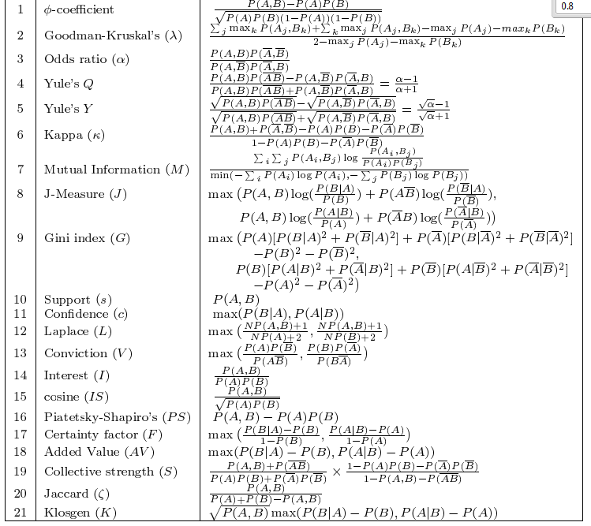

Slide 35
Other idea for selection
Select rules based both on interestingness and based on being different from other rules already selected (e.g. involve different operators)

Slide 36
Open debate in the field…

Slide 37
How could we get at “Real Interestingness”?

Slide 38
Association Rule Mining
Find rules
Evaluate rules

Slide 39
The Apriori algorithm (Agrawal et al., 1996)
Generate frequent itemset
Generate rules from frequent itemset

Slide 40
Generate Frequent Itemset
Generate all single items, take those with support over threshold – {i1}
Generate all pairs of items from items in {i1}, take those with support over threshold – {i2}
Generate all triplets of items from items in {i2}, take those with support over threshold – {i3}
And so on…
Then form joint itemset of all itemsets

Slide 41
Generate Rules From Frequent Itemset
Given a frequent itemset, take all items with at least two components
Generate rules from these items
E.g. {A,B,C,D} leads to {A,B,C}->D, {A,B,D}->C, {A,B}->{C,D}, etc. etc.
Eliminate rules with confidence below threshold

Slide 42
Finally
Rank the resulting rules using your interest measures

Slide 43
Other Algorithms
Typically differ primarily in terms of style of search for rules

Slide 44
Questions? Comments?

Slide 45
Variant on association rules
Negative association rules (Brin et al., 1997)
What doesn’t go together? (especially if probability suggests that two things should go together)
People who buy diapers don’t buy car wax, even though 30-year old males buy both?
People who take PSY505 don’t take PSY503?
Students who don’t game the system don’t go off-task?

Slide 46
Rules in Education
What might be some reasonable applications for Association Rule Mining in education?

Slide 47
Asgn. 8
Questions?
Comments?

Slide 48
Reminder
Wednesday’s class cancelled
I will be at an NSF meeting
In fact, I’m leaving for the airport… now

Slide 49
Next Class
Monday, March 26
3pm-5pm
AK232
Sequential Pattern Mining
Readings
Srikant, R., Agrawal, R. (1996) Mining Sequential Patterns: Generalizations and Performance Improvements. Research Report: IBM Research Division. San Jose, CA: IBM. [pdf]
Perera, D., Kay, J., Koprinska, I., Yacef, K., Zaiane, O. (2009) Clustering and Sequential Pattern Mining of Online Collaborative Learning Data. IEEE Transactions on Knowledge and Data Engineering, 21, 759-772
Assignments Due: 8. SEQUENTIAL PATTERN MINING

Slide 50
The End

