Slide 1
Advanced Methods and Analysis for the Learning and Social Sciences
PSY505 Spring term, 2012
April 2, 2012

Slide 2
Today’s Class
Learning Curves

Slide 3
The Classic Learning Curve

Slide 4
Assumptions
The student is practicing the same skill several times in the same fashion

Slide 5
Assumptions
The student is practicing the same skill several times in the same fashion
In what kinds of learning situations does this occur?

Slide 6
Assumptions
Similar methods and considerations apply to situations where the student is recalling the same knowledge several times

Slide 7
Assumptions
We have some way to measure student performance over time
Speed or accuracy

Slide 8
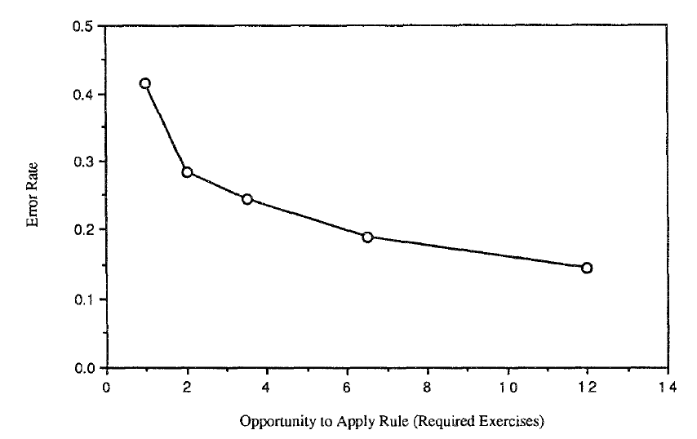
Learning LISP programming in the LISP Tutor (Corbett & Anderson, 1995)

Slide 9
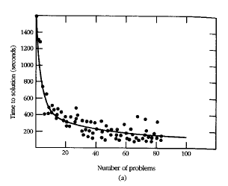
Learning in Cognitive Tutor Geometry (Ritter et al., 2007)

Slide 10
A certain characteristic pattern

Slide 11
Power Law of Learning*

Slide 12
Power Law of Learning*
Performance (both speed and accuracy) improves with a power function

Slide 13
Power Law of Learning*
* -- may be an exponential function rather than a power function

Slide 14
Called Power Law
Because speed and accuracy both follow a power curve
Radical improvement at first which slows over time towards an asymptote
Passing the asymptote usually involves developing entirely new strategy

Slide 15
Passing the Asymptote
Famous example: Fosbury Flop
http://www.youtube.com/watch?v=Id4W6VA0uLc

Slide 16
Passing the Asymptote
Famous example: Fosbury Flop
Can you think of any other examples?

Slide 17
Power Law of Learning proven to apply across many domains
Simple domains
Pressing correct button on stimulus
Complex problem-solving domains
Math
Programming
Real-world domains
Cigar-making in factories (Crossman, 1959)

Slide 18
Real-world data
Are rarely perfectly smooth…
(At least not without hundreds of students or more)

Slide 19
Example from a minute ago

Slide 20
Making inference from learning curves

Slide 21
Making inference from learning curves
Via visual inspection of the curve form

Slide 22
“Normal learning”

Slide 23
What might this graph mean?

Slide 24
No learning going on

Slide 25
Why might this be occurring?

Slide 26
What might this graph mean?

Slide 27
Student has already learned skill for the most part

Slide 28
What might this graph mean?

Slide 29
Student learned a new strategy and “broke through” the asymptote

Slide 30
What might this graph mean?

Slide 31
Two skills treated as the same skill (Corbett & Anderson, 1995)

Slide 32
Uses
To study and refine item-skill mappings in educational software
Pittsburgh Science of Learning Center DataShop (Koedinger et al., 2010) is a common tool for doing this
But you can also do it in Excel!

Slide 33
Any questions?

Slide 34
Moment-by-Moment Learning Curves
Based on models that infer probability that student learned skill at each practice opportunity (Baker, Goldstein, & Heffernan, 2010, in press)

Slide 35
How does it work?
The model takes an action, and the probability the student knows the skill at that point, according to Bayesian Knowledge Tracing (Corbett & Anderson, 1995)
The model looks at the next two actions and applies Bayes’ Theorem

Slide 36
High-Level
5% probability student knew skill
W W W
Skill was probably not learned at red action

Slide 37
High-Level
90% probability student knew skill
R R R
Skill was probably not learned at red action

Slide 38
High-Level
30% probability student knew skill
R R R
Skill was quite possibly learned at red action (or previous action)

Slide 39
High-Level
30% probability student knew skill
W R R
Skill was quite possibly learned at red action (or next action)

Slide 40
High-Level
30% probability student knew skill
W W R
Skill was probably not learned at red action

Slide 41
The model algorithm…
Is out of scope for today
The math can take a while
But what it gives us is moment-by-moment assessments of learning

Slide 42
Model
Correlates to probability of learning
Though it underestimates high probabilities of learning
E.g. for “true values” of 20% and 5%, it might predict 6% and 3%
Predicts final knowledge and preparation for future learning (Baker, Goldstein, & Heffernan, 2010; Baker, Gowda, & Corbett, 2011)

Slide 43
Can be used to create a Moment-by-Moment Learning Curve
X axis: Opportunity to practice skill
Y axis: Moment-by-Moment learning assessments

Slide 44
Moment-by-moment learning curves
Are meaningful to interpret for individual students
Much harder to do this with traditional learning curves
Accuracy = 0 or 1
Time much more vulnerable to noise

Slide 45
Let’s look at a few graphs

Slide 46
What might this graph mean?

Slide 47
Steady learning

Slide 48
Corresponds to

Slide 49
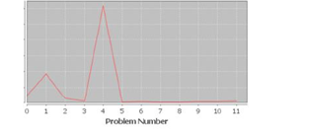
What might this graph mean?

Slide 50
A Eureka moment

Slide 51
What would that model correspond to
In a traditional learning curve?

Slide 52
What might this graph mean?

Slide 53
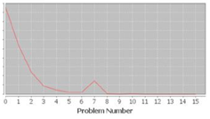
What might this graph mean?

Slide 54
Skill already known but need to map it into current learning situation

Slide 55
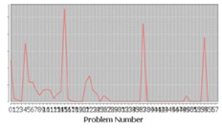
What might this graph mean?

Slide 56
Multiple skills treated as a single skill

Slide 57
Corresponds to

Slide 58
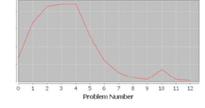
What might this graph mean?

Slide 59
Thanks for your ideas – it’s a mystery to me…

Slide 60
(It turns out to be quite common)

Slide 61
Uses
Any ideas what you could use this for?

Slide 62
Uses
To study relationships between learning trajectories and learning outcomes

Slide 63
Uses
If you catch a spike, you can infer learning early
Potentially using this information to “skip a student ahead”

Slide 64
Any questions?

Slide 65
Asgn. 9
Questions?
Comments?

Slide 66
Next Class
Wednesday, April 4
3pm-5pm
AK232
Discovery with Models
Readings
Baker, R.S.J.d., Gowda, S.M. (2010) An Analysis of the Differences in the Frequency of Students' Disengagement in Urban, Rural, and Suburban High Schools. Proceedings of the 3rd International Conference on Educational Data Mining, 11-20.
Assignments Due: None

Slide 67
The End

