Slide 1
Special Topics in Educational Data Mining
HUDK5199 Spring term, 2013
February 6, 2013

Slide 2
Today’s Class
Diagnostic Metrics

Slide 3
Accuracy

Slide 4
Accuracy
One of the easiest measures of model goodness is accuracy
Also called agreement, when measuring inter-rater reliability
# of agreements
total number of codes/assessments

Slide 5
Accuracy
There is general agreement across fields that agreement/accuracy is not a good metric
What are some drawbacks of agreement/accuracy?

Slide 6
Accuracy
Let’s say that my new Fnord Detector achieves 92% accuracy
For a coding scheme with two codes
Good, right?

Slide 7
Non-even assignment to categories
Percent accuracy does poorly when there is non-even assignment to categories
Which is almost always the case
Imagine an extreme case
Fnording occurs 92% of the time
My detector always says “Fnord”
Accuracy of 92%
But essentially no information

Slide 8
Kappa

Slide 9
Kappa
(Agreement – Expected Agreement)
(1 – Expected Agreement)
Notes:
HERE!

Slide 10
Kappa
Expected agreement computed from a table of the form
 | Model Category 1 | Model Category 1
Ground Truth Category 1 | Count | Count
Ground Truth Category 2 | Count | Count
Notes:
HERE!

Slide 11
Cohen’s (1960) Kappa
The formula for 2 categories
Fleiss’s (1971) Kappa, which is more complex, can be used for 3+ categories
I have an Excel spreadsheet which calculates multi-category Kappa, which I would be happy to share with you

Slide 12
Expected agreement
Look at the proportion of labels each coder gave to each category
To find the number of agreed category A that could be expected by chance, multiply pct(coder1/categoryA)*pct(coder2/categoryA)
Do the same thing for categoryB
Add these two values together and divide by the total number of labels
This is your expected agreement

Slide 13
Example
 | Detector Off-Task | Detector On-Task
Ground Truth Off-Task | 20 | 5
Ground Truth On-Task | 15 | 60

Slide 14
Example
What is the percent agreement?
 | Detector Off-Task | Detector On-Task
Ground Truth Off-Task | 20 | 5
Ground Truth On-Task | 15 | 60

Slide 15
Example
What is the percent agreement?
80%
 | Detector Off-Task | Detector On-Task
Ground Truth Off-Task | 20 | 5
Ground Truth On-Task | 15 | 60

Slide 16
Example
What is Ground Truth’s expected frequency for on-task?
 | Detector Off-Task | Detector On-Task
Ground Truth Off-Task | 20 | 5
Ground Truth On-Task | 15 | 60

Slide 17
Example
What is Ground Truth’s expected frequency for on-task?
75%
 | Detector Off-Task | Detector On-Task
Ground Truth Off-Task | 20 | 5
Ground Truth On-Task | 15 | 60

Slide 18
Example
What is Detector’s expected frequency for on-task?
 | Detector Off-Task | Detector On-Task
Ground Truth Off-Task | 20 | 5
Ground Truth On-Task | 15 | 60

Slide 19
Example
What is Detector’s expected frequency for on-task?
65%
 | Detector Off-Task | Detector On-Task
Ground Truth Off-Task | 20 | 5
Ground Truth On-Task | 15 | 60

Slide 20
Example
What is the expected on-task agreement?
 | Detector Off-Task | Detector On-Task
Ground Truth Off-Task | 20 | 5
Ground Truth On-Task | 15 | 60

Slide 21
Example
What is the expected on-task agreement?
0.65*0.75= 0.4875
 | Detector Off-Task | Detector On-Task
Ground Truth Off-Task | 20 | 5
Ground Truth On-Task | 15 | 60

Slide 22
Example
What is the expected on-task agreement?
0.65*0.75= 0.4875
 | Detector Off-Task | Detector On-Task
Ground Truth Off-Task | 20 | 5
Ground Truth On-Task | 15 | 60 (48.75)

Slide 23
Example
What are Ground Truth and Detector’s expected frequencies for off-task behavior?
 | Detector Off-Task | Detector On-Task
Ground Truth Off-Task | 20 | 5
Ground Truth On-Task | 15 | 60 (48.75)

Slide 24
Example
What are Ground Truth and Detector’s expected frequencies for off-task behavior?
25% and 35%
 | Detector Off-Task | Detector On-Task
Ground Truth Off-Task | 20 | 5
Ground Truth On-Task | 15 | 60 (48.75)

Slide 25
Example
What is the expected off-task agreement?
 | Detector Off-Task | Detector On-Task
Ground Truth Off-Task | 20 | 5
Ground Truth On-Task | 15 | 60 (48.75)

Slide 26
Example
What is the expected off-task agreement?
0.25*0.35= 0.0875
 | Detector Off-Task | Detector On-Task
Ground Truth Off-Task | 20 | 5
Ground Truth On-Task | 15 | 60 (48.75)

Slide 27
Example
What is the expected off-task agreement?
0.25*0.35= 0.0875
 | Detector Off-Task | Detector On-Task
Ground Truth Off-Task | 20 (8.75) | 5
Ground Truth On-Task | 15 | 60 (48.75)

Slide 28
Example
What is the total expected agreement?
 | Detector Off-Task | Detector On-Task
Ground Truth Off-Task | 20 (8.75) | 5
Ground Truth On-Task | 15 | 60 (48.75)

Slide 29
Example
What is the total expected agreement?
0.4875+0.0875 = 0.575
 | Detector Off-Task | Detector On-Task
Ground Truth Off-Task | 20 (8.75) | 5
Ground Truth On-Task | 15 | 60 (48.75)

Slide 30
Example
What is kappa?
 | Detector Off-Task | Detector On-Task
Ground Truth Off-Task | 20 (8.75) | 5
Ground Truth On-Task | 15 | 60 (48.75)

Slide 31
Example
What is kappa?
(0.8 – 0.575) / (1-0.575)
0.225/0.425
0.529
 | Detector Off-Task | Detector On-Task
Ground Truth Off-Task | 20 (8.75) | 5
Ground Truth On-Task | 15 | 60 (48.75)

Slide 32
So is that any good?
What is kappa?
(0.8 – 0.575) / (1-0.575)
0.225/0.425
0.529
 | Detector Off-Task | Detector On-Task
Ground Truth Off-Task | 20 (8.75) | 5
Ground Truth On-Task | 15 | 60 (48.75)

Slide 33
Interpreting Kappa
Kappa = 0
Agreement is at chance
Kappa = 1
Agreement is perfect
Kappa = negative infinity
Agreement is perfectly inverse
Kappa > 1
You messed up somewhere

Slide 34
Kappa<0
This means your model is worse than chance
Very rare to see unless you’re using cross-validation
Seen more commonly if you’re using cross-validation
It means your model is crap

Slide 35
0<Kappa<1
What’s a good Kappa?
There is no absolute standard

Slide 36
0<Kappa<1
For data mined models,
Typically 0.3-0.5 is considered good enough to call the model better than chance and publishable

Slide 37
0<Kappa<1
For inter-rater reliability,
0.8 is usually what ed. psych. reviewers want to see
You can usually make a case that values of Kappa around 0.6 are good enough to be usable for some applications
Particularly if there’s a lot of data
Or if you’re collecting observations to drive EDM

Slide 38
Landis & Koch’s (1977) scale
κ | Interpretation
< 0 | No agreement
0.0 — 0.20 | Slight agreement
0.21 — 0.40 | Fair agreement
0.41 — 0.60 | Moderate agreement
0.61 — 0.80 | Substantial agreement
0.81 — 1.00 | Almost perfect agreement

Slide 39
Why is there no standard?
Because Kappa is scaled by the proportion of each category
When one class is much more prevalent
Expected agreement is higher than
If classes are evenly balanced

Slide 40
Because of this…
Comparing Kappa values between two studies, in a principled fashion, is highly difficult
A lot of work went into statistical methods for comparing Kappa values in the 1990s
No real consensus
Informally, you can compare two studies if the proportions of each category are “similar”

Slide 41
Kappa
What are some advantages of Kappa?
What are some disadvantages of Kappa?

Slide 42
Kappa
Questions? Comments?

Slide 43
ROC
Receiver-Operating Curve

Slide 44
ROC
You are predicting something which has two values
True/False
Correct/Incorrect
Gaming the System/not Gaming the System
Infected/Uninfected

Slide 45
ROC
Your prediction model outputs a probability or other real value
How good is your prediction model?

Slide 46
Example
PREDICTION TRUTH
0.1 0
0.7 1
0.44 0
0.4 0
0.8 1
0.55 0
0.2 0
0.1 0
0.9 0
0.19 0
0.51 1
0.14 0
0.95 1
0.3 0

Slide 47
ROC
Take any number and use it as a cut-off
Some number of predictions (maybe 0) will then be classified as 1’s
The rest (maybe 0) will be classified as 0’s

Slide 48
Threshold = 0.5
PREDICTION TRUTH
0.1 0
0.7 1
0.44 0
0.4 0
0.8 1
0.55 0
0.2 0
0.1 0
0.9 0
0.19 0
0.51 1
0.14 0
0.95 1
0.3 0

Slide 49
Threshold = 0.6
PREDICTION TRUTH
0.1 0
0.7 1
0.44 0
0.4 0
0.8 1
0.55 0
0.2 0
0.1 0
0.9 0
0.19 0
0.51 1
0.14 0
0.95 1
0.3 0

Slide 50
Four possibilities
True positive
False positive
True negative
False negative

Slide 51
Which is Which for Threshold = 0.6?
PREDICTION TRUTH
0.1 0
0.7 1
0.44 0
0.4 0
0.8 1
0.55 0
0.2 0
0.1 0
0.9 0
0.19 0
0.51 1
0.14 0
0.95 1
0.3 0

Slide 52
Which is Which for Threshold = 0.5?
PREDICTION TRUTH
0.1 0
0.7 1
0.44 0
0.4 0
0.8 1
0.55 0
0.2 0
0.1 0
0.9 0
0.19 0
0.51 1
0.14 0
0.95 1
0.3 0

Slide 53
Which is Which for Threshold = 0.9?
PREDICTION TRUTH
0.1 0
0.7 1
0.44 0
0.4 0
0.8 1
0.55 0
0.2 0
0.1 0
0.9 0
0.19 0
0.51 1
0.14 0
0.95 1
0.3 0

Slide 54
Which is Which for Threshold = 0.11?
PREDICTION TRUTH
0.1 0
0.7 1
0.44 0
0.4 0
0.8 1
0.55 0
0.2 0
0.1 0
0.9 0
0.19 0
0.51 1
0.14 0
0.95 1
0.3 0

Slide 55
ROC curve
X axis = Percent false positives (versus true negatives)
False positives to the right
Y axis = Percent true positives (versus false negatives)
True positives going up

Slide 56
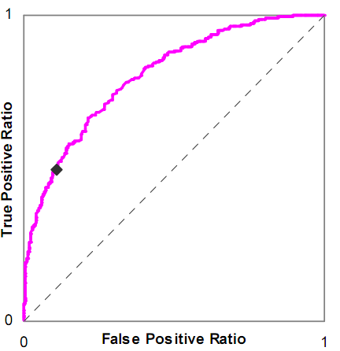
Example

Slide 57
What does the pink line represent?

Slide 58
What does the dashed line represent?

Slide 59
Is this a good model or a bad model?

Slide 60
Let’s draw an ROC curve on the whiteboard
PREDICTION TRUTH
0.1 0
0.7 1
0.44 0
0.4 0
0.8 1
0.55 0
0.2 0
0.1 0
0.9 0
0.19 0
0.51 1
0.14 0
0.95 1
0.3 0

Slide 61
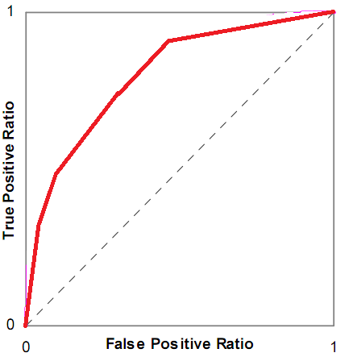
What does this ROC curve mean?

Slide 62
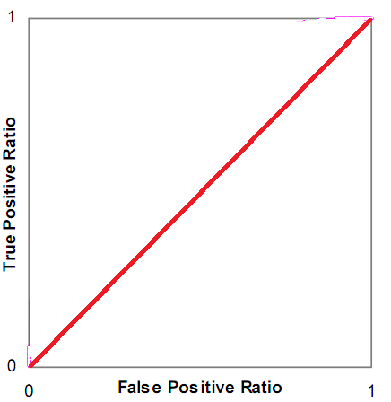
What does this ROC curve mean?

Slide 63
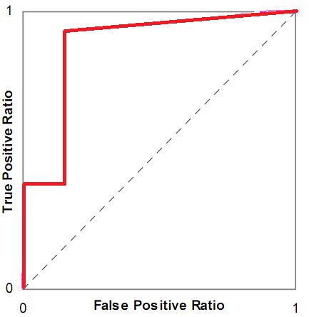
What does this ROC curve mean?

Slide 64
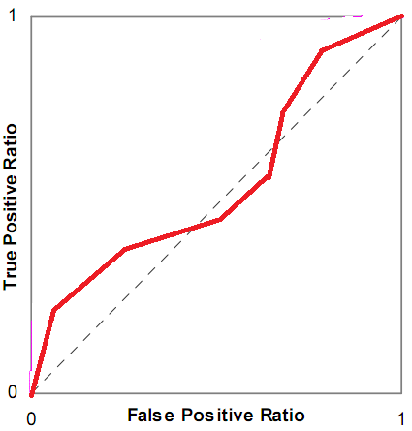
What does this ROC curve mean?

Slide 65
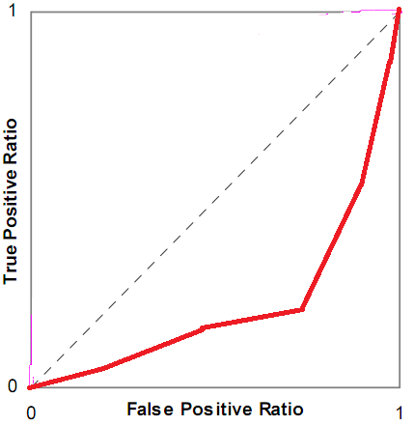
What does this ROC curve mean?

Slide 66
ROC curves
Questions? Comments?

Slide 67
A’
The probability that if the model is given an example from each category, it will accurately identify which is which

Slide 68
Let’s compute A’ for this data (at least in part)
PREDICTION TRUTH
0.1 0
0.7 1
0.44 0
0.4 0
0.8 1
0.55 0
0.2 0
0.1 0
0.9 0
0.19 0
0.51 1
0.14 0
0.95 1
0.3 0

Slide 69
A’
Is mathematically equivalent to the Wilcoxon statistic (Hanley & McNeil, 1982)
A really cool result, because it means that you can compute statistical tests for
Whether two A’ values are significantly different
Same data set or different data sets!
Whether an A’ value is significantly different than chance

Slide 70
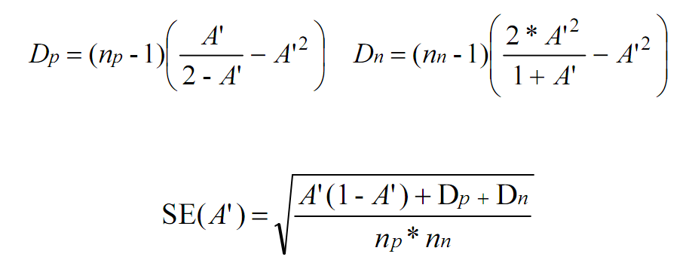
Equations

Slide 71
Comparing Two Models (ANY two models)

Slide 72
Comparing Model to Chance
0.5
0

Slide 73
Is the previous A’ we computed significantly better than chance?

Slide 74
Complication
This test assumes independence
If you have data for multiple students, you should compute A’ for each student and then average across students (Baker et al., 2008)

Slide 75
A’
Closely mathematically approximates the area under the ROC curve, called AUC (Hanley & McNeil, 1982)
The semantics of A’ are easier to understand, but it is often calculated as AUC
Though at this moment, I can’t say I’m sure why – A’ actually seems mathematically easier

Slide 76
Notes
A’ somewhat tricky to compute for 2 categories
Not really a good way to compute A’ for 3 or more categories
There are methods, but I’m not thrilled with any; the semantics change somewhat

Slide 77
More Caution
The implementations of AUC/A’ are buggy in all major statistical packages that I’ve looked at
Special cases get messed up
There is A’ code on my webpage that is more reliable for known special cases
Uses the Wilcoxon approximation rather than the more mathematically difficult integral calculus

Slide 78
A’ and Kappa
What are the relative advantages of A’ and Kappa?

Slide 79
A’ and Kappa
A’
more difficult to compute
only works for two categories (without complicated extensions)
meaning is invariant across data sets (A’=0.6 is always better than A’=0.55)
very easy to interpret statistically

Slide 80
A’
A’ values are almost always higher than Kappa values
Why would that be?
In what cases would A’ reflect a better estimate of model goodness than Kappa?
In what cases would Kappa reflect a better estimate of model goodness than A’?

Slide 81
A’
Questions? Comments?

Slide 82
Precision and Recall
Precision = TP
TP + FP
Recall = TP
TP + FN

Slide 83
What do these mean?
Precision = TP
TP + FP
Recall = TP
TP + FN

Slide 84
What do these mean?
Precision = The probability that a data point classified as true is actually true
Recall = The probability that a data point that is actually true is classified as true

Slide 85
Precision-Recall Curves
Thought by some to be better than ROC curves for cases where distributions are highly skewed between classes
No A’-equivalent interpretation and statistical tests known for PRC curves

Slide 86
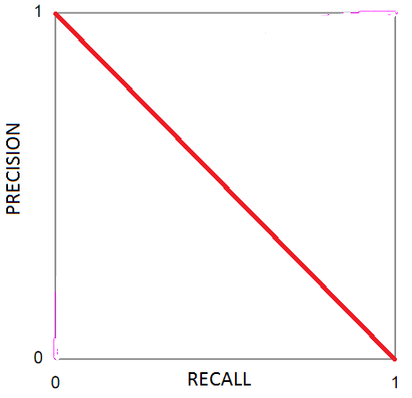
What does this PRC curve mean?

Slide 87
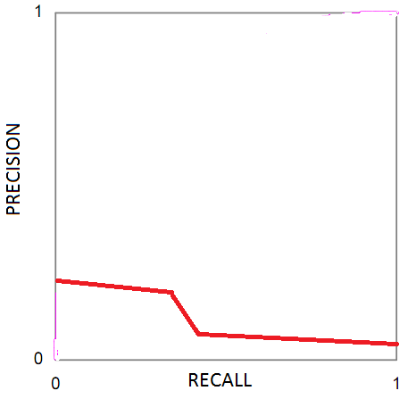
What does this PRC curve mean?

Slide 88
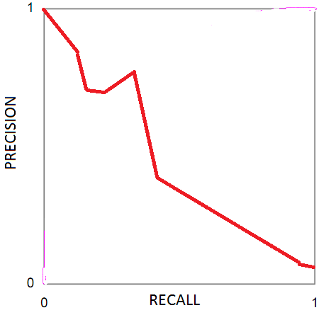
What does this PRC curve mean?

Slide 89
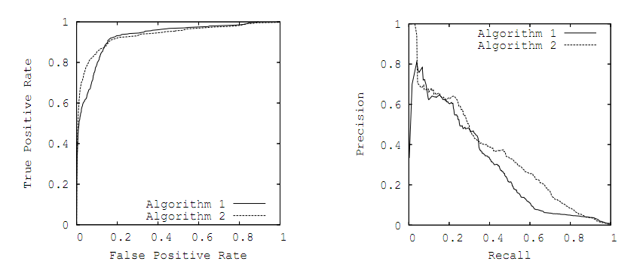
ROC versus PRC: Which algorithm is better?

Slide 90
Precision and Recall: Comments? Questions?

Slide 91
BiC and friends

Slide 92
BiC
Bayesian Information Criterion (Raftery, 1995)
Makes trade-off between goodness of fit and flexibility of fit (number of parameters)
Formula for linear regression
BiC’ = n log (1- r²) + p log n
n is number of students, p is number of variables

Slide 93
BiC
Values over 0: worse than expected given number of variables
Values under 0: better than expected given number of variables
Can be used to understand significance of difference between models (Raftery, 1995)

Slide 94
BiC
Said to be statistically equivalent to k-fold cross-validation for optimal k
We’ll talk more about cross-validation in the classification lecture
The derivation is… somewhat complex
BiC is easier to compute than cross-validation, but different formulas must be used for different modeling frameworks
No BiC formula available for many modeling frameworks

Slide 95
AIC
Alternative to BiC
Stands for
An Information Criterion (Akaike, 1971)
Akaike’s Information Criterion (Akaike, 1974)
Makes slightly different trade-off between goodness of fit and flexibility of fit (number of parameters)

Slide 96
AIC
Said to be statistically equivalent to Leave-Out-One-Cross-Validation

Slide 97
AIC or BIC: Which one should you use?
“The aim of the Bayesian approach motivating BIC is to identify the models with the highest probabilities of being the true model for the data, assuming that one of the models under consideration is true. The derivation of AIC, on the other hand, explicitly denies the existence of an identiﬁable true model and instead uses expected prediction of future data as the key criterion of the adequacy of a model.” – Kuha, 2004

Slide 98
AIC or BIC: Which one should you use?
“AIC aims at minimising the Kullback-Leibler divergence between the true distribution and the estimate from a candidate model and BIC tries to select a model that maximises the posterior model probability” – Yang, 2005

Slide 99
AIC or BIC: Which one should you use?
“There has been a debate between AIC and BIC in the literature, centering on the issue of whether the true model is finite-dimensional or infinite-dimensional. There seems to be a consensus that, for the former case, BIC should be preferred, and AIC should be chosen for the latter.” – Yang, 2005

Slide 100
AIC or BIC: Which one should you use?
“Nyardely, Nyardely, Nyoo ” – Moore, 2003

Slide 101
All the metrics: Which one should you use?
“The idea of looking for a single best measure to choose between classifiers is wrongheaded.” – Powers (2012)

Slide 102
Information Criteria
Questions? Comments?

Slide 103
Diagnostic Metrics
Questions?
Comments?

Slide 104
Next Class
Monday, February 11
Special Guest Lecturer: Maria “Sweet” San Pedro
Advanced BKT
Beck, J.E., Chang, K-m., Mostow, J., Corbett, A. (2008) Does Help Help? Introducing the Bayesian Evaluation and Assessment Methodology. Proceedings of the International Conference on Intelligent Tutoring Systems.
Pardos, Z.A., Heffernan, N.T. (2010) Modeling individualization in a bayesian networks implementation of knowledge tracing. Proceedings of User Modeling and Adaptive Personalization.
You may also want to re-scan the Baker et al. (2008) from Jan. 28
Assignments Due: NONE

Slide 105
The End

