Slide 1
Core Methods in Educational Data Mining
HUDK4050 Fall 2014

Slide 2
Did you have a nice week?

Slide 3
My week

Slide 4
Towards Better and More General Prediction Models of Engagement
Ryan Baker
Teachers College, Columbia University

Slide 5
Learning Analytics (Analítica de Aprendizaje)
Ryan Baker
Teachers College, Columbia University

Slide 6
Criamos modelos de una forma…
Que es
Automatizado: Puede hacer estimaciónes sobre estudiante en tiempo real, sin juicio humano
De Grano Fino: Puede hacer estimaciónes sobre estudiantes, segundo-por-segundo
Con Validación: Mostrado a aplicar a estudiantes nuevos y contextos nuevos

Slide 7
The Homework
Any questions about the homework due Wednesday?

Slide 8
Note
The VLOOKUP and Pivot Table tutorials assigned for Wednesday will be very useful for Assignment C2
Also see the video in the textbook assigned for today

Slide 9
Textbook

Slide 10
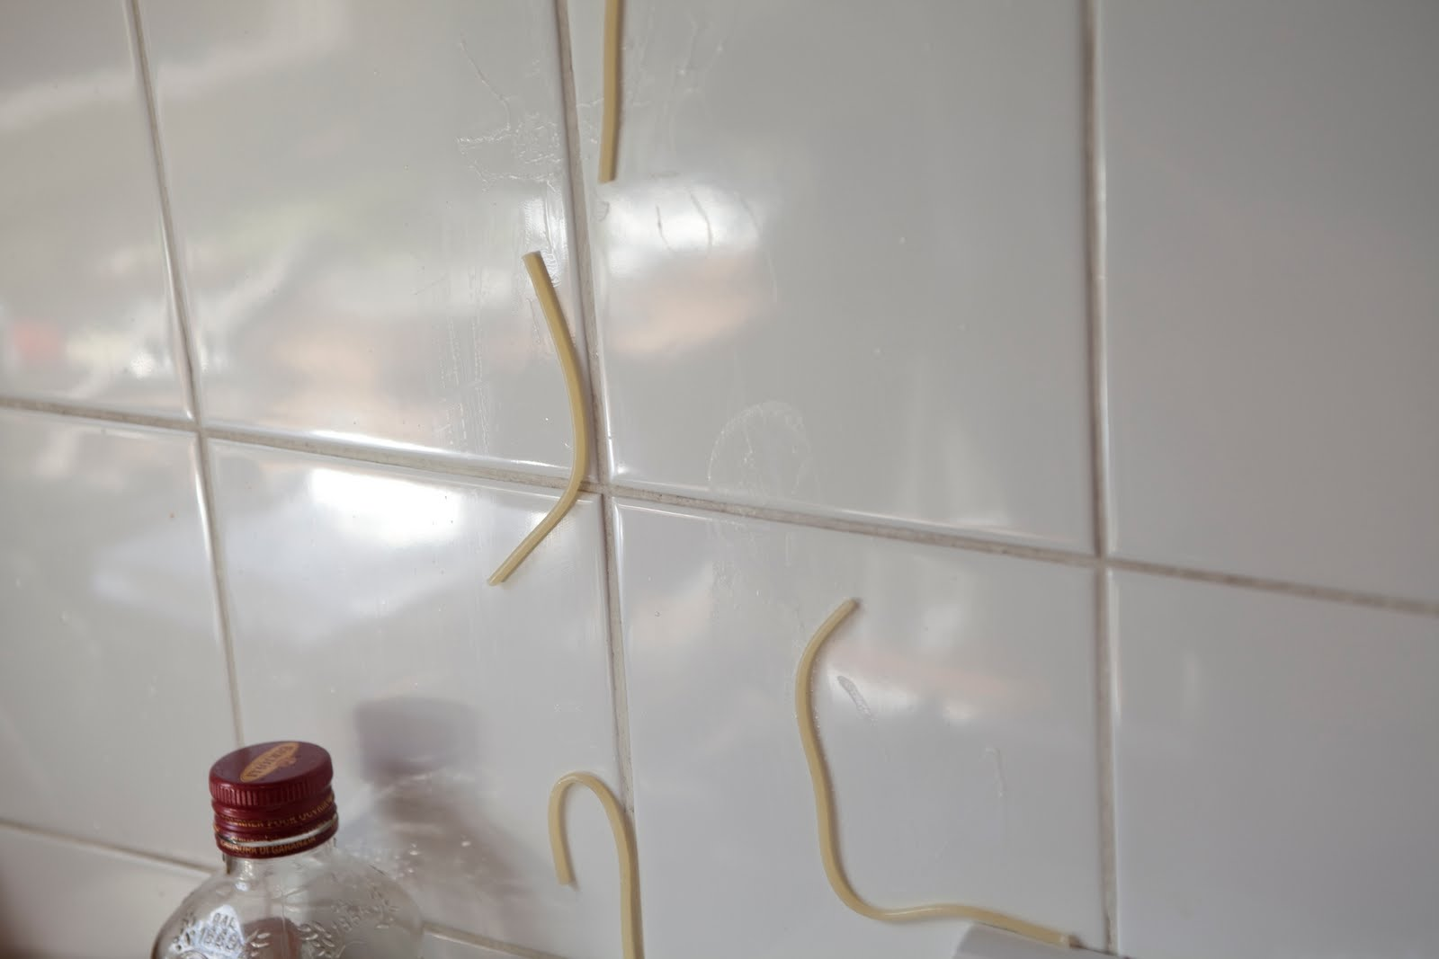
Feature Engineering
Not just throwing spaghetti at the wall and seeing what sticks

Slide 11
Construct Validity Matters!
Crap features will give you crap models
Crap features = reduced generalizability/more over-fitting
Nice discussion of this in the Sao Pedro paper

Slide 12
What’s a good feature?
A feature that is potentially meaningfully linked to the construct you want to identify

Slide 13
Baker’s feature engineering process
Brainstorming features
Deciding what features to create
Creating the features
Studying the impact of features on model goodness
Iterating on features if useful
Go to 3 (or 1)

Slide 14
What’s useful?
Brainstorming features
Deciding what features to create
Creating the features
Studying the impact of features on model goodness
Iterating on features if useful
Go to 3 (or 1)

Slide 15
What’s missing?
Brainstorming features
Deciding what features to create
Creating the features
Studying the impact of features on model goodness
Iterating on features if useful
Go to 3 (or 1)

Slide 16
How else could it be improved?

Slide 17
IDEO tips for Brainstorming
1. Defer judgment
2. Encourage wild ideas
3. Build on the ideas of others
4. Stay focused on the topic
5. One conversation at a time
6. Be visual
7. Go for quantity
http://www.openideo.com/fieldnotes/openideo-team-notes/seven-tips-on-better-brainstorming

Slide 18
Your thoughts?

Slide 19
Deciding what features to create
Trade-off between the effort to create a feature and how likely it is to be useful
Worth biasing in favor of features that are different than anything else you’ve tried before
Explores a different part of the space

Slide 20
General thoughts about feature engineering?

Slide 21
Other questions, comments, concerns about textbook?

Slide 22
Activity

Slide 23
Special Rules for Today
Everyone Votes
Everyone Participates

Slide 24
Let’s look at some features used in real models

Slide 25
Let’s look at some features used in real models
Split into 6 groups
Take a sheet of features
Which features (or combinations) can you come up with “just so” stories for why they might predict the construct?
Are there any features that seem utterly irrelevant?

Slide 26
Each group
Tell us what your construct is
Tell us your favorite “just so story” (or two) from your features
Tell us which features look like junk
Everyone else: you have to give the feature a thumbs-up or thumbs-down

Slide 27
Second task
Break into *different* 3-4 person groups than last time
No overlap allowed

Slide 28
Second task
Make up features for Assignment C2
You need to
Come up with a new feature
Justify how you can would it from the data set
Justify why it would work

Slide 29
I need a volunteer

Slide 30
I need a volunteer
Your task is to write down the features suggested
And the counts for thumbs up/thumbs down

Slide 31
Now…
Each group needs to read their favorite feature to the class and justify it
Who thinks this feature will improve prediction of off-task behavior?
Who doesn’t?
Thumbs up, thumbs down!

Slide 32
Questions or comments?

Slide 33
Special Request
Bring a print-out of your Assignment C2 solution to class

Slide 34
Next Class
Wednesday, October 8
Feature Engineering – How
Baker, R.S. (2014) Big Data and Education. Ch. 3, V4, V5.
vlookup Tutorial 1
vlookup Tutorial 2
Pivot Table Tutorial 1
Pivot Table Tutorial 2

Slide 35
The End

