Slide 1
Core Methods in Educational Data Mining
HUDK4050 Fall 2015

Slide 2
Correlation Mining
The simplest form of relationship mining

Slide 3
What is a post-hoc control, and why do we need it?

Slide 4
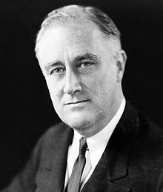
Questions about FDR vs FWER?

Slide 5
Questions about Bonferroni?

Slide 6
Questions about Stigler’s Law of Eponomy?

Slide 7
Questions about p versus q?

Slide 8
Questions about p versus q?
p = probability that the results could have occurred if there were only random events going on
q = probability that the current test is a false discovery, given the post-hoc adjustment

Slide 9
Other questions about post-hoc controls?

Slide 10
Questions about ideas behind causal data mining?

Slide 11
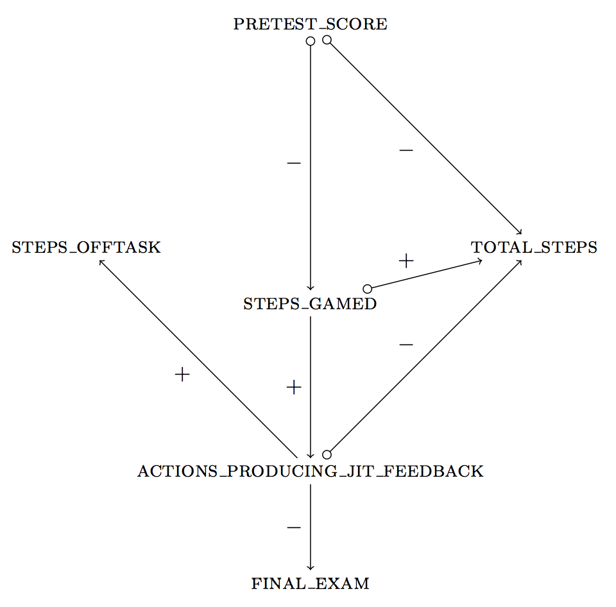
Fancsali (2013) Example
This example uses an algorithm that allows for
unmeasured common causes of measured
variables. pretest_score → total_steps can signify
(1) pretest_score is a cause of total_steps;
(2) pretest_score & total_steps share a
common cause;
(3) both!

Slide 12
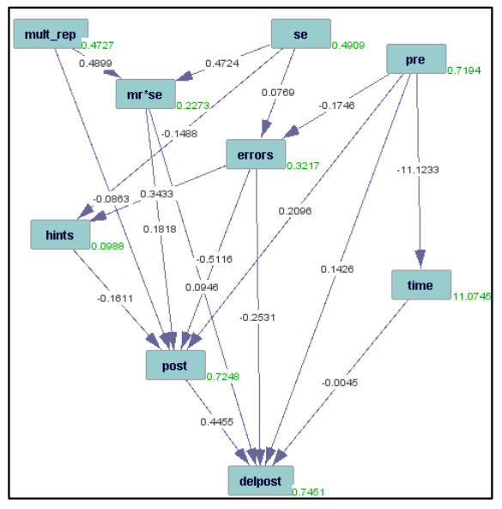
Rau & Scheines (2012)

Slide 13
Rai et al. (2011)

Slide 14
Rai et al. (2011) What’s wrong with this graph?

Slide 15
Rai et al. (2011) What’s wrong with this graph?

Slide 16
Solution
Use domain knowledge to constrain search.
The future can’t cause the past.

Slide 17
Result

Slide 18
Does this seem OK?

Slide 19
Does this seem OK?
Or does it call the whole method into question?
If we can get future->past relationships, why should we trust any causal arrows tetrad produces?

Slide 20
Other questions or comments?

Slide 21
“Extra Slides”

Slide 22
Next Class
Thursday, Nov 12
Baker, R.S. (2014) Big Data and Education. Ch. 8, V1, V2.
Fancsali, S. (2014). Causal Discovery with Models: Behavior, Affect, and Learning in Cognitive Tutor Algebra. Proceedings of the International Conference on Educational Data Mining 2014.
Hershkovitz, A., Baker, R.S.J.d., Gobert, J., Wixon, M., Sao Pedro, M. (2013) Discovery with Models: A Case Study on Carelessness in Computer-based Science Inquiry. American Behavioral Scientist, 57 (10), 1479-1498.

Slide 23
The End

