Slide 1
Meta-Cognition, Motivation, and Affect
PSY504 Spring term, 2011
February 16, 2010

Slide 2
Extrinsic and Intrinsic Motivation (Deci & Ryan, 1985; Ryan & Deci, 2000)
Intrinsic motivation -- doing something because it is inherently interesting or enjoyable
Extrinsic motivation -- doing something because it leads to a separable (positive) outcome

Slide 3
Extrinsic or Intrinsic?
Can you give examples of someone having
intrinsic motivation?
extrinsic motivation?
both?
neither?

Slide 4
Sub-categories of extrinsic motivation (Ryan & Deci, 2000)
Varying from most internally controlled (autonomous) to most externally controlled (controlled)
Internalization – self-internalization of external values as being one’s own values in order to be part of group
Identification – identifying with value of activity and participating in it voluntarily
Introjected regulation – behavior to comply with internal pressure (pursuit of self-worth, avoidance of guilt or shame)
External regulation – behavior completely coerced or determined by external forces
Can you give examples of these?

Slide 5
Assessing intrinsic motivation
“Free choice” paradigm (Deci, 1971)
Does participant choose activity when there are other options and no pressure to engage in activity
Used frequently in evaluating games (Malone & Lepper, 1981; Ainsworth & Habgood, 2009)

Slide 6
Assessing motivation
Self-report
Several questionnaires
Most commonly used is
Motivational Strategies for Learning Questionnaire (Pintrich & de Groot, 1990)
Important to avoid either/or scales (cf. Harter, 1980, 1981) as people can have both types of motivation

Slide 7
Selected Items From MSLQ
1. I prefer class work that is challenging so I can learn new things.
5. I like what I am learning in this class
10. I often choose paper topics I will learn something from even if they require more work
32. I work on practice exercises and answer end of chapter questions even when I don’t have to
43. I work hard to get a good grade even when I don’t like a class

Slide 8
Questions? Comments?

Slide 9
What leads to intrinsic motivation?

Slide 10
What leads to intrinsic motivation?
The development of feelings of competence for a task (Deci & Ryan, 1985)
Related to FOK, JOL
But more closely related to self-efficacy, which we’ll talk about later in the semester
Must be accompanied by sense of autonomy
A sense that you are choosing to do the task

Slide 11
What leads to intrinsic motivation?
Choice (Zuckerman et al., 1978), even trivial choice (Cordova & Lepper, 1996)

Slide 12
What leads to intrinsic motivation?
Challenge (Koestner et al., 1987; Mitchell, 1996)

Slide 13
What leads to intrinsic motivation?
Curiosity
Asserted repeatedly in literature, starting with Malone & Lepper (1978), but I couldn’t find any empirical proof of this

Slide 14
What leads to intrinsic motivation?
Fantasy Context (Lepper & Cordova, 1992; Cordova & Lepper, 1996)
Although it’s worth noting that their comparisons were between “fantasy” and “no context at all”, which is confounded

Slide 15
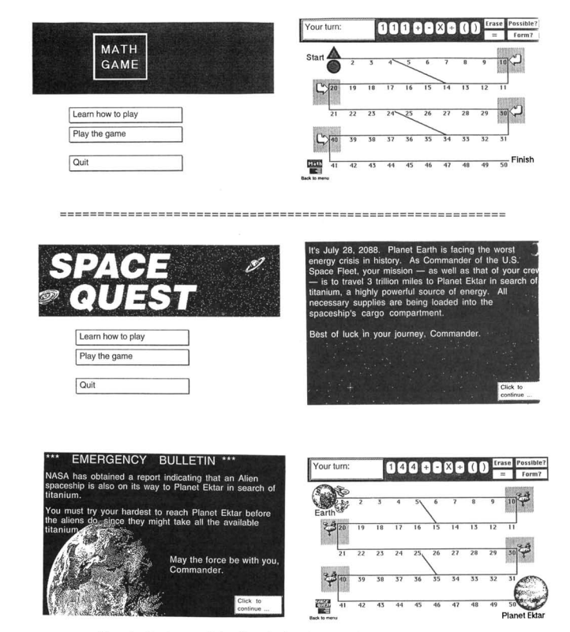

Slide 16
Questions? Comments?

Slide 17
What reduces intrinsic motivation?

Slide 18
What reduces intrinsic motivation?
Being rewarded to do a task (more in a sec)
Threats of punishment (Deci & Cascio, 1972)
Time pressure (Amabile et al., 1976)
Overly close surveillance (Lepper & Greene, 1975)

Slide 19
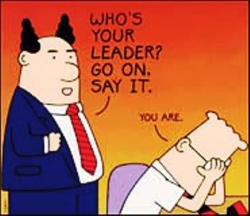
What reduces intrinsic motivation?
Being rewarded to do a task (more in a sec)
Threats of punishment (Deci & Cascio, 1972)
Time pressure (Amabile et al., 1976)
Overly close surveillance (Lepper & Greene, 1975)

Slide 20
Rewards (Lepper & Greene, 1978; Lepper & Henderlong, 2000)
Contingent rewards (e.g. rewards given for performance, task engagement, task completion) reduce intrinsic motivation much more than non-contingent rewards
Unexpected rewards may actually increase intrinsic motivation
Intangible rewards (praise, status) are less harmful than tangible rewards
Rewards combined with information on competence/ability are less harmful than no-information rewards

Slide 21
Rewards (Lepper & Greene, 1978; Lepper & Henderlong, 2000)
Rewards most harmful for intrinsic motivation among students with lots of intrinsic motivation
Rewards can be beneficial for intrinsic motivation among students with no intrinsic motivation

Slide 22
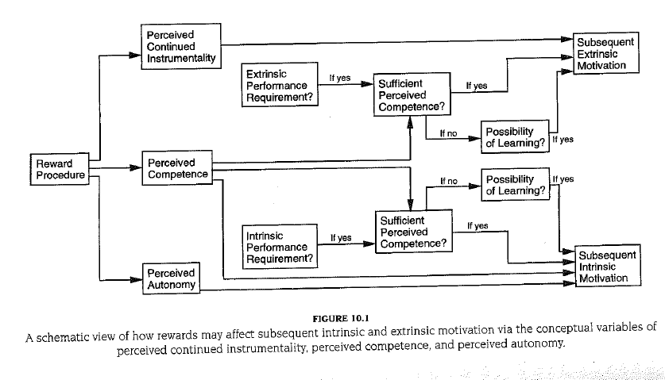
Lepper & Henderlong (2000) Model of Impact of Rewards

Slide 23
Questions? Comments?

Slide 24
Outcomes from motivation

Slide 25
Outcomes from motivation
More intrinsic motivation associated with
better conceptual learning (Vansteenkiste et al., 2005) but not improvement to factual learning
better arithmetic learning (Cordova & Lepper, 1996)
better course grades (Gottfried, 1985; Henderlong & Lepper, 1997)
less dropout (Dollinger & Sellers, 1988)

Slide 26
Outcomes from motivation
More autonomous extrinsic motivation associated with
better performance (Miserandino, 1996)
less dropping out (Vallerand & Bissonnette, 1992)
better grades (Grolnick & Ryan, 1987)
deeper cognitive processing (Vansteenkiste et al., 2004)

Slide 27
Discussion question
To what degree does the intrinsic/extrinsic motivation axis map to the mastery/performance goal axis?

Slide 28
Next Class (Monday)
Interest (Taught by Mike Wixon)
Readings
Renninger, K.A. (2000) Individual Interest and Its Implications for Understanding Intrinsic Motivation. In Sansone, J., Harackiewicz, J.M. (Eds.) Intrinsic and Extrinsic Motivation: The Search For Optimal Motivation and Performance, Ch. 13, 373-404.
Schraw, G., Lehman, S. (2001) Situational Interest: A Review of the Literature and Directions for Future Research.Educational Psychology Review, 13 (1), 23-52.
Durik, A.M., Harackiewicz, J.M. (2007) Different Strokes for Different Folks: How Individual Interest Moderates the Effects of Situational Factors on Task Interest. Journal of Educational Psychology, 99 (3),597-610.

