Slide 1
Meta-Cognition, Motivation, and Affect
PSY504 Spring term, 2011
February 23, 2010

Slide 2
Course Project Methods Paper
Was due yesterday
So far I’ve only received one
When will I get them?

Slide 3
Different Rules Today
I still have bronchitis
And am not even supposed to be here today
(doctor’s orders: no work through tomorrow)
So I’m going to let you guys do most of the talking

Slide 4
Attribution Theory
Weiner’s model of Attribution

Slide 5
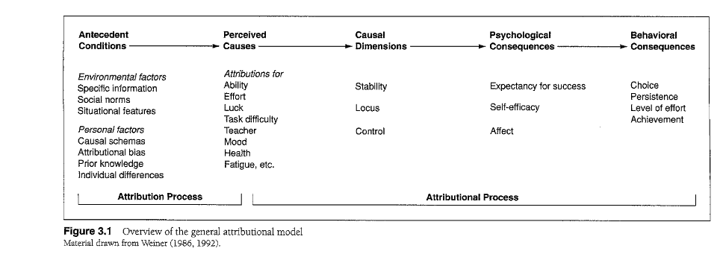
Can anyone talk us through this?

Slide 6
Worth noting: perceptions of causes may be incorrect

Slide 7
Stability: How stable cause is
Also called Globality
Locus: Internal or external to person
Control: Controllable or not
What would be examples of causes high and low on each of these three dimensions?

Slide 8
Possible to have something external but controllable (someone else is controlling it)

Slide 9
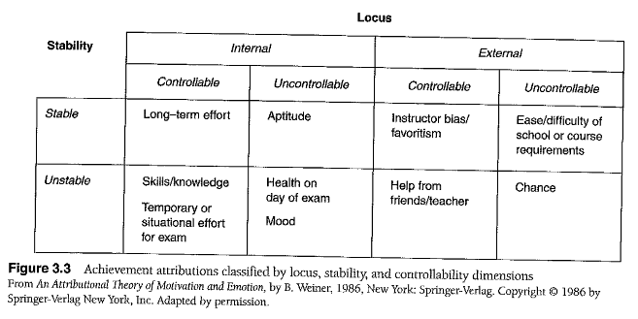

Slide 10
Where did these dimensions come from?
Factor analyses, replicated many times (see Weiner, 1985 for review)

Slide 11
Aspects of Situation Used To Make Attributions (Kelley, 1967)
Distinctiveness – Is the behavior or result unique to the situation?
Suggests it’s something about the situation
Consensus – Is the behavior or result replicated across students in the same situation?
Suggests it’s something about the situation
Consistency – Does the behavior or result replicate across situations?
Suggests it’s something about the person

Slide 12
Most frequently used by teachers (Kruglanski, 1977; Major, 1980; Olson et al., 1983)
Distinctiveness – Is the behavior or result unique to the situation?
Suggests it’s something about the situation
Consensus – Is the behavior or result replicated across students in the same situation?
Suggests it’s something about the situation
Consistency – Does the behavior or result replicate across situations?
Suggests it’s something about the person

Slide 13
Least frequently used by teachers (Kruglanski, 1977; Major, 1980; Olson et al., 1983)
Distinctiveness – Is the behavior or result unique to the situation?
Suggests it’s something about the situation
Consensus – Is the behavior or result replicated across students in the same situation?
Suggests it’s something about the situation
Consistency – Does the behavior or result replicate across situations?
Suggests it’s something about the person

Slide 14
Influence on Perception of Causes
Feedback (Weiner & Kukla, 1970)
Other Students’ Performance (Weiner, 1992)
Prior Beliefs (Clark & Peterson, 1986)
Attributional Biases

Slide 15
Attributional Biases
Fundamental Attribution Error – tendency to over-attribute causes to traits
Actor-Observer Perspective – tendency to over-attribute causes to traits for other people, and to over-attribute causes to situational factors for yourself
Self-serving bias – tendency to over-attribute one’s successes to traits, and failures to situations

Slide 16
Attributional Biases
Replicated many times in laboratory and real-world settings

Slide 17
Explanatory Style (Peterson & Seligman, 1984)
To what degree does an individual person see causes as internal, stable, global?

Slide 18
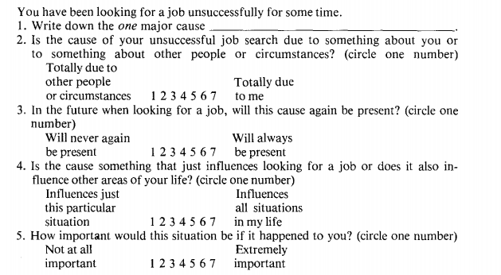
Attribution Style Questionnaire (Peterson et al., 1982)

Slide 19
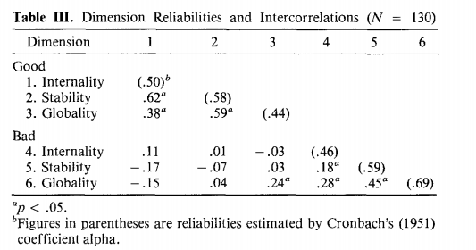
Attribution Style Questionnaire (Peterson et al., 1982)

Slide 20
Results of Attributions

Slide 21
Self-Efficacy/Expectancy
Stability more strongly linked to future expectancy than other dimensions (review of many studies in Weiner, 1986)

Slide 22
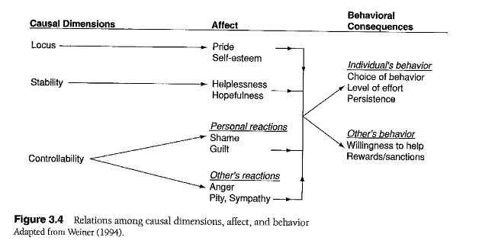
Affect/emotion

Slide 23
Learned Helplessness (Seligman, 1975)
Belief that there is no link between behavior and outcomes, or that causes are entirely internal, stable, global, and negative
Leading to complete effort withdrawal, feelings of depression
Very problematic, but pretty rare in the real world

Slide 24
Attribution Theory, Expectancy-Value Theory
What are some of the key similarities and differences?
Which one appears to be “more right”?
Could they be harmonized to eliminate the “toothbrush theories” problem?

Slide 25
Altering Attributions and Expectancies
We will discuss this in detail in the next class on Self-Theories

Slide 26
Next Class (MARCH 14)
Self-Theories (Theories of Intelligence, Stereotype Threat)
Readings
Dweck, C.S. (2000) Self-Theories, Ch. 1-7, pp. 1-50.
Blackwell, L., Trzesniewski, K.H., Dweck, C.S. (2007) Implicit Theories of Intelligence Predict Achievement Across an Adolescent Transition: A Longitudinal Study and an Intervention.Child Development, 78 (1), 246-263.
Steele, C.M., Aronson, J. (1995) Stereotype Threat and the Intellectual Test Performance of African Americans.Journal of Personality and Social Psychology, 5, 797-811.
Good, C., Aronson, J., Inzlicht, M. (2003)Improving adolescents’ standardized test performance: An intervention to reduce the effects of stereotype threat . Applied Developmental Psychology, 24, 645-662.

