Slide 1
Meta-Cognition, Motivation, and Affect
PSY504 Spring term, 2011
March 15, 2010

Slide 2
Today…
We are going to review the key models of affect
We will not go into full detail on the evidence and coding for basic emotions
We will talk about that in detail tomorrow
But we will go into some of the key differences between the different models and the kinds of evidence they use

Slide 3
Today…
I am going to try to run through the basic models quickly
Leaving more time for discussion and specifically comparison at the end

Slide 4
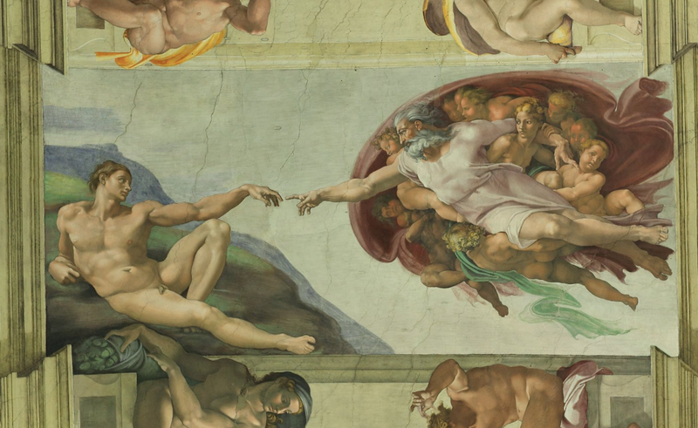
In the Beginning…

Slide 5
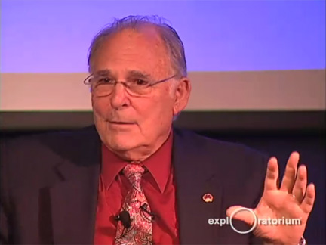
In the Beginning…
There was Ekman

Slide 7
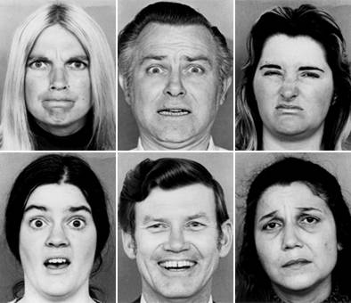
Basic Emotions

Slide 8
What are these emotions?

Slide 9
Who are these people?

Slide 10
Does anyone really look like this in real life?

Slide 11
Ekman’s Basic Emotions
Anger
Fear
Sadness
Disgust
Enjoyment
Surprise
Contempt
Shame
Guilt
Embarassment
Interest
Awe
Excitement

Slide 12
What makes these basic emotions?

Slide 13
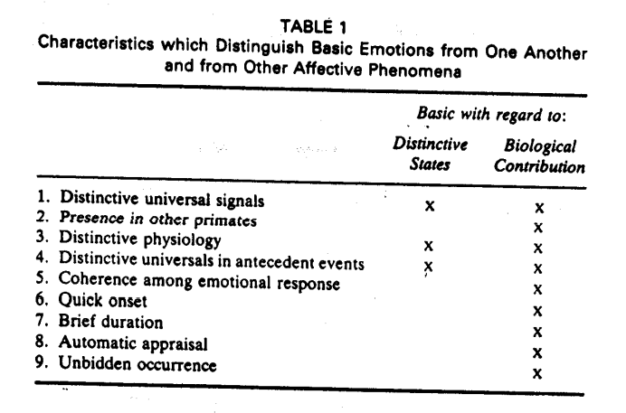

Slide 14
Emotion Families
Each of these emotions is the core of an emotion family
A theme: characteristics unique to that family
Variations: Individual differences, cultural differences, situational differences

Slide 15
Note
Not all forms of evidence available for all of the “basic emotions”
Surprise does not have the same facial expressions in all cultures
Only evidence of distinctive neurological patterns for anger, fear, disgust, sadness

Slide 16
Questions? Comments?
Only brief ones here please
Note that we will have a full session on Ekman’s basic emotions next class
And we will have opportunities to discuss Ekman in relation to other models in just a few minutes

Slide 17
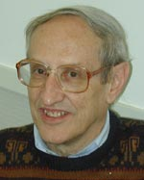
Clore & Ortony model
Also referred to as OCC model (Ortony, Clore, & Collins, 1988)
“According to this theory, emotions derive from cognitive appraisal of the current situation, which consists of events, agents, and objects. The outcome of the appraisal depends on how the situation fits with one’s goals and preferences.” – Conati & Maclaren, 2002

Slide 18
Key Difference From Ekman
Emotional appraisal is not automatic but involves complex cognitive processing and categorization
Which seems automatic because it is so ingrained
Some physiological components of emotion precede cognition, but cognition is necessary for determining which affective state emerges

Slide 19
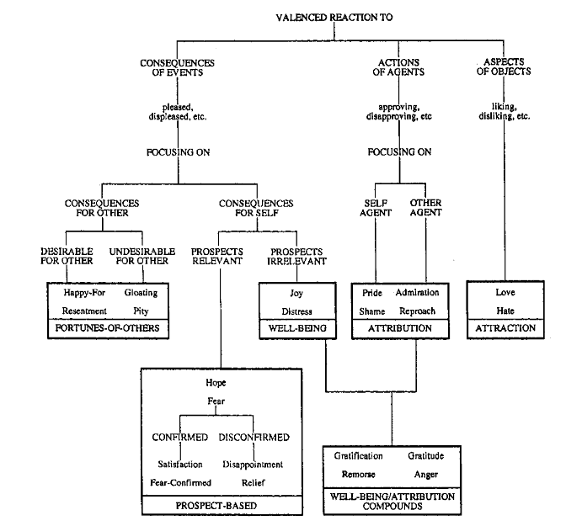

Slide 20
Key Difference From Ekman
Emotions are not unitary but hierarchical

Slide 21
Key Difference From Ekman
Opposite emotions (positive, negative) come from the same processes
Love, Hate
Pride, Shame

Slide 23
Key Difference From Ekman
Many positive emotions
Ekman lumps all positive emotions together in “Enjoyment”
Though acknowledging the possible existence of awe, excitement

Slide 24
Key Difference From Ekman: Theory Generation
Ekman theory generation very bottom-up
Comes from extensive study of video, and studies showing pictures of actors to peoples around the world
OCC theory generation much more top-down
Based on knowledge of cognitive theories, laboratory studies, and extensive reading of first-person accounts of emotion

Slide 25
Note
Only two emotions common between OCC model and Ekman
Anger, Fear
Sadness becomes {Distress, Remorse, Disappointment, Pity}?
Disgust becomes {Reproach, Pity}?
Surprise goes away?

Slide 26
Sadness
Should there be sadness as a separate construct in OCC?
Or is sadness the physiological/facial component of OCC states like {Distress, Remorse, Disappointment}?
What does pity map to? Sadness or disgust?

Slide 27
Questions? Comments?

Slide 28
Russell (2003)
Even if facial and physiological expressions of emotion – such as fear – are culturally universal
Is that meaningful?

Slide 29
Russell (2001)
Conceptualization of what emotions mean differ across cultures
In Luganda, anger and sadness are denoted by the same word and it is difficult for researchers to explain the difference
Experiences that cause anger in USA lead to crying among Buganda people (Leff, 1973)
Brazilians cry when they are angry (personal communication, Ryan Baker)

Slide 30
Russell (2001)
Conceptualization of what emotions mean differ across cultures
Shame and Fear not distinguished by Gidjingalia people (Hiatt, 1978)
Shame, Guilt, and Embarrassment not distinguished by Japanese and Javanese (Lebra, 1983; Keeler, 1983)
Can anyone here confirm this?
Shame almost impossible to translate into many languages

Slide 31
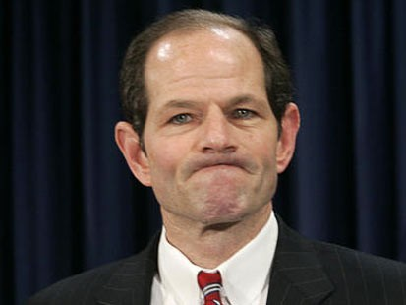
Russell (2001)
Conceptualization of what emotions mean differ across cultures
Shame and Fear not distinguished by Gidjingalia people (Hiatt, 1978)
Shame, Guilt, and Embarrassment not distinguished by Japanese and Javanese (Lebra, 1983; Keeler, 1983)
Can anyone here confirm this?
Shame almost impossible to translate into many languages
Also unknown among American politicians

Slide 32
Russell (2001)
Conceptualization of what emotions mean differ across cultures
Hatred and Disgust not separated by Samoans (Gerber, 1975)

Slide 33
Russell (2001)
Emotions considered “basic” in other cultures have no translation in English and/or are hard to explain to Americans
Schadenfreude (German)

Slide 34
Russell (2001)
Emotions considered “basic” in other cultures have no translation in English and/or are hard to explain to Americans
Schadenfreude (German)
Litost (Czech)
Milan Kundera wrote a chapter in a novel about Litost, and then five years later, decided he hadn’t explained it right, and wrote another chapter in another novel

Slide 35
Russell (2001)
Emotions considered “basic” in other cultures have no translation in English and/or are hard to explain to Americans
Schadenfreude (German)
Litost (Czech)
Saudades (Portuguese)

Slide 36
Russell (2001)
Emotions considered “basic” in other cultures have no translation in English and/or are hard to explain to Americans
Schadenfreude (German)
Litost (Czech)
Saudades (Portuguese)
Duende (Spanish)

Slide 37
Leading to the question
Is there something more basic than Ekman’s set of emotions?
Termed “core affect”
“…neurophysiological state consciously accessible as the simplest raw (nonreflective) feelings evident in moods and emotions.” (Russell, 2003)

Slide 38
Core Affect Dimensions
Activation/Deactivation
Also called Arousal
Pleasure/Displeasure
Also called Valence
These dimensions did not start with Russell
Some early uses of these constructs:
Arousal: Hebb (1955)
Valence: Vroom (1968)

Slide 39
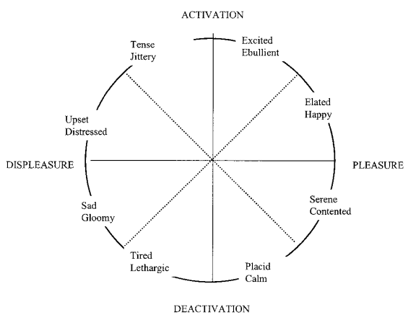

Slide 40
Note that
Pretty much any emotion can be mapped onto this framework
But is it sufficient to distinguish between different emotions?
How can disgust and upset be distinguished?
Isn’t there something psychologically interesting in the difference between disgust and upset?

Slide 41
Questions? Comments?

Slide 42
D’Mello and Graesser’s perspective
D’Mello, Taylor, & Graesser, 2007
Graesser et al., 2007
Baker, D’Mello, Rodrigo, & Graesser, 2010

Slide 43
D’Mello and Graesser’s perspective
The affect that is relevant to study differs based on the context of research, and the research questions
Affect that is relevant during learning is different than the affect that is relevant in other situations

Slide 44
Especially relevant during learning (D’Mello et al., 2007; Baker et al., 2010)
Boredom (Csikszentmihalyi, 1990; Miserandino, 1996)
Confusion (Craig et al., 2004; Graesser et al., 2008; Kort et al., 2001)
Delight (Fredrickson and Branigan, 2005; Silvia and Abele, 2002)
Engaged concentration (cf. Csikszentmihalyi, 1990)
The affect associated with “Flow”
Frustration (Kort et al., 2001; Patrick et al., 1993)
Surprise (Schutzwohl and Borgstedt, 2005)
These will be discussed in detail in future classes…

Slide 45
Note…
None of these show up in other models we’ve discussed except for surprise
And surprise will probably be taken out of D’Mello’s models soon, as it has repeatedly been rare in studies of affect during learning (D’Mello et al., 2007, 2008, 2010; Rodrigo et al., 2007a, 2007b, 2008, 2009; Baker et al., 2010)

Slide 46
Not relevant during learning
Basic emotions
They occur but they are rare

Slide 47
D’Mello, Lehman, & Person (2010)
Asked students to describe their affect during a learning task with reference to
Five of the six learning-specific affective states from D’Mello et al. (2007)
Not including engaged concentration/flow, delight
I’m not sure why
Ekman’s basic emotions
Four other affective states: anxiety, contempt, curiosity, eureka

Slide 48
Proportions (Ekman basic emotions in Red)
Curiosity 13.8%
Boredom 10.6%
Frustration 10.5%
Confusion 9.2%
Happiness 5.5%
Anxiety 4.2%
Disgust 3.0%
Contempt 2.7%
Surprise 2.7%
Eureka 2.5%
Anger 2.2%
Sadness 1.2%
Fear 0.8%

Slide 49
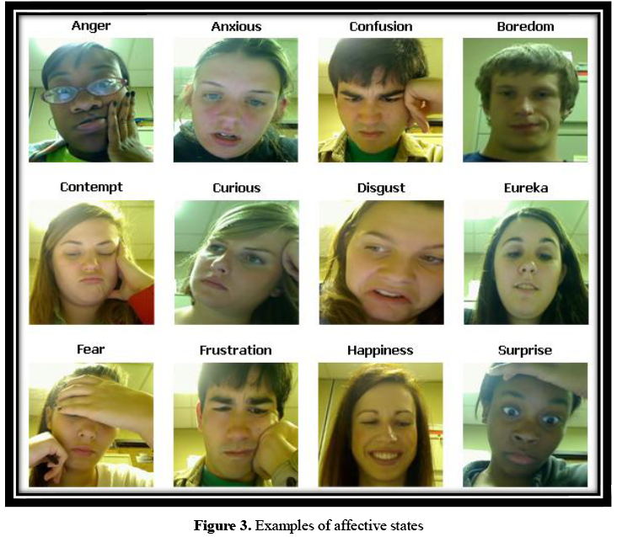

Slide 50
Note
Many of these affective states not recognizable just from facial expression
Other sensors, such as interaction logs, skin conductance, and butt sensor required (D’Mello & Graesser, 2010)
Suggests that Ekman’s focus on facial expressions may not be sufficient
More on this in affect detection class

Slide 51
Questions? Comments?

Slide 52
Next Class (MARCH 16)
Basic Emotions (Jaclyn Delprete)
Readings
Sayette, M.A., Cohn, J.F., Wertz, J.M., Perrott, M.A., Parrott, D.J. (2001) A psychometric evaluation of the facial action coding sytem for assessing spontaneous expression. Journal of Nonverbal Behavior, 25 (3), 167-185.
Ekman, P., Friesen, W.V., Hager, J.C. (2002) Facial Action Coding System Investigator's Guide.

