Slide 1
Meta-Cognition, Motivation, and Affect
PSY504 Spring term, 2011
March 16, 2010

Slide 2
Today…
More detail on Ekman’s Basic Emotions
And in specific, how they are coded
And the evidence for the coding scheme’s goodness

Slide 3
Quick Review

Slide 5
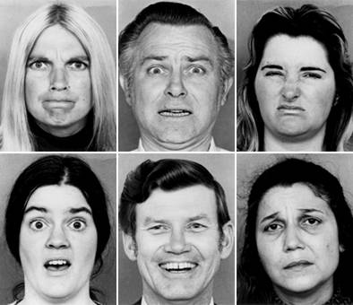
Basic Emotions, Presented by Actors

Slide 6
Ekman’s Basic Emotions
Anger
Fear
Sadness
Disgust
Enjoyment
Surprise
Contempt
Shame
Guilt
Embarassment
Interest
Awe
Excitement

Slide 7
Key Point
These Basic Emotions can be distinguished solely by facial expression
No other information needed
Recall that to detect cognitive-affective states such as those in D’Mello et al. (2007)
You need additional information such as
Behavior
Posture
Fidgeting
Skin Galvanic Response

Slide 8
And the way they are distinguished…
Facial Action Coding System (Ekman, 1977; Ekman, Friesen, & Hager, 2002)

Slide 9
Facial Action Coding System
Detailed coding on the positions of facial muscles, as detected by looking at high-quality images of the face

Slide 10
Facial Action Coding System
Not qualitiative descriptions of the face
"aggressive frown" (Grant, 1969)
"lower lip pout" (Blurton Jones, 1971)
"smile tight-loose 0" (Birdwhistell, 1970)

Slide 11
Facial “Action Units”

Slide 12
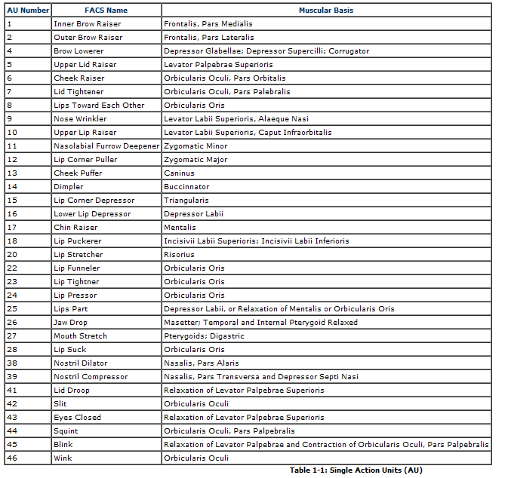

Slide 13
Let’s go through some of these

Slide 14
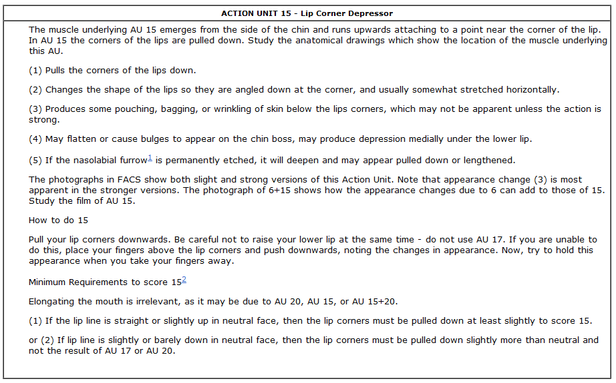

Slide 15
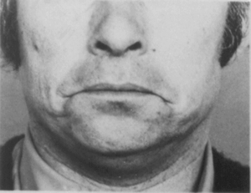
AU 15

Slide 16
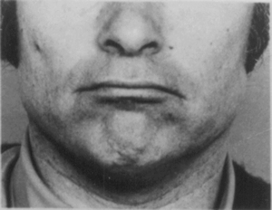
AU17

Slide 17
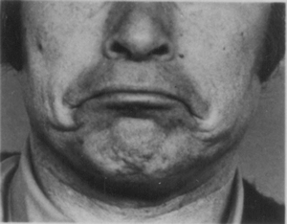
AU15 + AU17

Slide 18
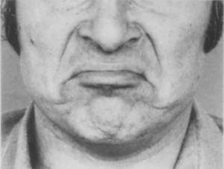
AU15 + AU17 + AU10

Slide 19
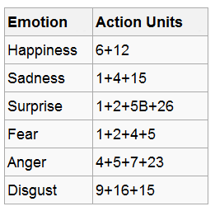
Coding Basic Emotions (Friesen & Ekman, 1983)
Denoted by specific combinations of facial action units characteristic to those emotions

Slide 20
Fake and Genuine Smiles
Fake “Pan American” smile: AU 12
Real “Duchenne” smile: AU 12, AU42
Can you make the “fake smile”?

Slide 21
Fake and Genuine Smiles
Fake “Pan American” smile: AU 12
Real “Duchenne” smile: AU 12, AU42
Can you fake the “real smile”?

Slide 22
Happiness
*Not* the same as a Duchenne smile!
Smile (AU12)
Raised cheeks (AU6)

Slide 23
FACS
Can be learned just from the coding manual
Estimated to take ~100 hours according to Ekman’s webpage
Or you can pay for a 5-day workshop that “certifies” you as a trained FACS coder who achieves good inter-rater reliability
http://www.erikarosenberg.com/the-facial-action-coding-system-facs/facs-workshops/

Slide 24
Evaluation of FACS (Sayette et al., 2001)

Slide 25
Ekman’s evaluations of reliability…
All based on accuracy as metric rather than kappa…
All based on either-or for each AU or emotion, averaged across AUs and emotions
Signifying that chance will be above 50%
And making it hard to identify if specific emotions or AUs are not being captured

Slide 26
Sayotte
Attempt to “do it right”
We can discuss whether they do indeed “do it right”

Slide 27
Four forms of inter-rater reliability studied
How reliable are individual observations of facial action units?
How reliable are ratings of onset of facial action units?
How reliable are ratings of intensity of facial action units?
How reliable are ratings of individual observations of specific basic emotions?

Slide 28
Most important for use of FACS in emotion research
How reliable are individual observations of facial action units?
How reliable are ratings of onset of facial action units?
How reliable are ratings of intensity of facial action units?
How reliable are ratings of individual observations of specific basic emotions?

Slide 29
Method
Laboratory studies
Video of subjects’ face and chest
Codings by two certified FACS coders
Random selection of video segments to be coded (selection made in blocks of time rather than disconnected images)

Slide 30
Method
Study 1: Subjects asked to rate pleasantness of 8 odors
Coconut
Peppermint
Banana
Lemon
Vicks
Vinegar
“Floral Odor”
Water

Slide 31
Method
Study 2: Smokers deprived of nicotine for 7 hours, or not deprived of nicotine
Expressions when
Given unlit cigarette
Cigarette lit (and subject holds cigarette)
Allowed to smoke

Slide 32
Method
Study 3: Subjects asked to describe what they liked and disliked about their body and physical appearance
Subjects told their videos would be evaluated by psychologists to study their psychology

Slide 33
Three studies combined
And analyzed together

Slide 34
Metric
Cohen’s Kappa

Slide 35
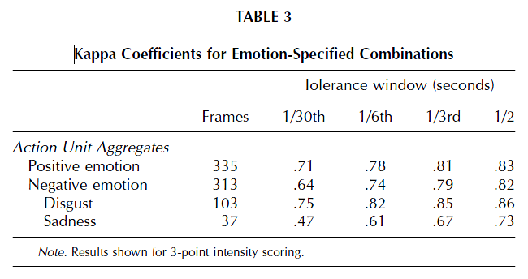

Slide 36
Some emotions not broken down due to lack of sufficient data

Slide 37
Some emotions not broken down due to lack of sufficient data
Do you buy that?
173 observations of negative affect that were not sadness or disgust
Divided among 3 other negative emotions
Not enough data to compute Kappa?
They computed Kappa for disgust (37 observations)

Slide 38
Comments? Questions?

Slide 39
Next Class (MARCH 16)
Flow, Concentration, Joy, and Delight
Readings
Csikszentmihalyi, M. (1990) Flow: The Psychology of Optimal Experience, Ch. 1-4, pp. 1-95.

