Slide 1
Meta-Cognition, Motivation, and Affect
PSY504 Spring term, 2011
March 21, 2010

Slide 2
Positive Emotions/Affect
Ekman: All variations on happiness
Other researchers: Distinguishable and worth distinguishing

Slide 3
Mihalyi Csikszentmihalyi
Leading theorist and researcher in auto-telic and optimal experience

Slide 4
Mihalyi Csikszentmihalyi
Leading theorist and researcher in auto-telic and optimal experience
And all-round cheerful guy

Slide 5
Mihalyi Csikszentmihalyi
Leading theorist and researcher in auto-telic and optimal experience
And all-round cheerful guy

Slide 6
Flow (Csikszentmihalyi, 1977)
"the holistic sensation that people feel when they act with total involvement"
when in the flow state the person will “shift into a common mode of experience when they become absorbed in their activity. This mode is characterized by a narrowing of the focus of awareness, so that irrelevant perceptions and thoughts are filtered out; by loss of self-consciousness; by a responsiveness to clear goals and unambiguous feedback; and by a sense of control over the environment...it is this common flow experience that people adduce as the main reason for performing the activity"

Slide 7
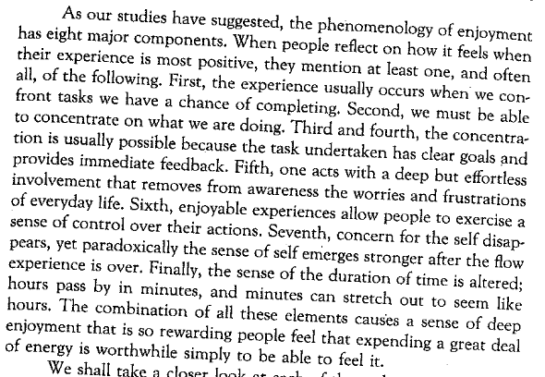
Components of Flow (Csikszentmihalyi, 1990)

Slide 8
Where did this definition come from?
Extensive interviews with individuals from a wide variety of areas of life, from world-class experts in music and scientists, to factory workers
Experience Sampling Method studies
Beeper and Diary
Construct originally developed through qualitative analysis of these data sources

Slide 9
Use of this definition
Measures of flow developed by Csikszentmihalyi and colleagues that treat flow as unitary construct
Alternatively, many of this group’s analyses operationally define flow as high challenge plus high engagement (Shernoff, Csikszentmihalyi, Schneider, & Shernoff, 2003)
This paper reported significant correlation between these two constructs, but in an analysis that violated independence assumptions in a way that biases towards significance…

Slide 10
Factor analysis
I am not aware of a factor analysis showing that flow is unitary, coming from Csikszentmihalyi and colleagues
However, factor analyses by
Jackson & Marsh (1996) – athletes
Vlachopolous, Karagheorghis, & Terry (2000) – professional dancers and participants in aerobics classes
found that
neither a single “flow” factor, nor a hierarchical multi-dimensional model of “flow” fit the data from the different subscales of flow
nearly as well as having 9 separate factors did

Slide 11
Structure of Flow
However, many constructs which Csikszentmihalyi conceives as part of flow do serve as precursors for engagement
In a questionnaire study, perception of skill and challenge predict perception of control, which in turn predicts enjoyment and concentration (Ghani & Deshpande, 1994)

Slide 12
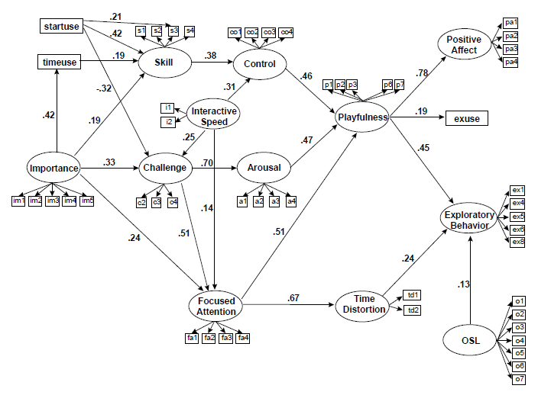
Structure of Flow (Survey Research: Novak, Hoffman, & Yung, 2000)

Slide 13
Model was cross-validated!!!

Slide 14
Major Impacts of Flow
Experience of flow (measured by coding of interviews) predictive of whether gifted children will develop their gifts and achieve success, or fail to develop their gifts (Csikszentmihalyi & Rathunde, 1996)
Experience of flow in teenagers (measured by self report of high challenge and high engagement) predictive of
course grades (Rathunde & Csikszentmihalyi, 1993)
later career choices (Csikszentmihalyi & Schneider, 2001)
Expert rater assessment of engaged concentration (more on this in a sec) during intro CS labs predictive of
midterm grades (Rodrigo et al., 2009)

Slide 15
Engaged Concentration and Flow
“Engaged concentration is a state of engagement with a task such that concentration is intense, attention is focused, and involvement is complete. However, it need not involve some of the task-related aspects which Csikszentmihalyi associates with flow, such as clear goals, balanced challenge, or direct and immediate feedback. It also may not involve some of the aspects of Csikszentmihalyi’s conceptualization which refer to extreme intensity, such as time distortion or loss of self-consciousness.” – Baker, D’Mello, Rodrigo, & Graesser, 2010

Slide 16
Behaviors (Baker, D’Mello, Rodrigo, & Graesser, 2010)
“…immersion, focus, and concentration on the system, with the appearance of positive engagement (as opposed to frustration); leaning towards the computer; mouthing solutions; pointing to parts of screen”

Slide 17
Other distinguishable positive emotions

Slide 18
Delight, Joy
Typically not defined directly
OCC model defines joy, but in terms of processes leading to joy, not what joy is…

Slide 19
Behaviors (Baker, D’Mello, Rodrigo, & Graesser, 2010)
Clapping hands
Laughing with pleasure
Exclaiming ‘‘Yes!’’ or ‘‘I got it!’’

Slide 20
Positive Emotion Frequency During Learning
(Baker, D’Mello, Rodrigo, & Graesser, 2010)
(Rodrigo & Baker, in press)

Slide 21
Research Method
Intelligent Tutor (Computer Literacy)
Undergrads, lab setting
Self-judgments every 20 seconds
Other Environments
Simulation Game, Intelligent Tutor (Algebra), Intelligent Tutor (Ecology), Intelligent Tutor (Scatterplots), Drill Game (Fractions, Arithmetic)
Middle to high school students, classroom setting
Expert coder judgments every 1-3 minutes (quant. field obs.)
Kappa = 0.6-0.8

Slide 22
Delight
Intelligent Tutor (Computer Literacy) – 3%
Simulation Game – 6%
Intelligent Tutor (Algebra) – 5%
Intelligent Tutor (Ecology) – 3%
Intelligent Tutor (Scatterplots) – 1%
Drill Game – 12%

Slide 23
Engaged Concentration
Intelligent Tutor (Computer Literacy) – 20%
Simulation Game – 61%
Intelligent Tutor (Algebra) – 73%
Intelligent Tutor (Ecology) – 65%
Intelligent Tutor (Scatterplots) – 41%
Drill Game – 63%

Slide 24
Computer Literacy Tutor
Far less Engaged Concentration
Far more Neutral state
Affordance of the coding method?

Slide 25
Effects of agents
Two versions of Ecology Tutor
With and without motivational agent Paul (cf. Rebolledo-Mendez, 2003)
Two versions of Scatterplot Tutor
With and without gaming-response agent Scooter (cf. Baker et al., 2006)

Slide 26
“Be bold and take a challenge!”

Slide 27
Effects of agents
Two versions of Ecology Tutor
With and without motivational agent Paul (cf. Rebolledo-Mendez, 2003)
Two versions of Scatterplot Tutor
With and without gaming-response agent Scooter (cf. Baker et al., 2006)
No impact on frequency of affective states

Slide 28
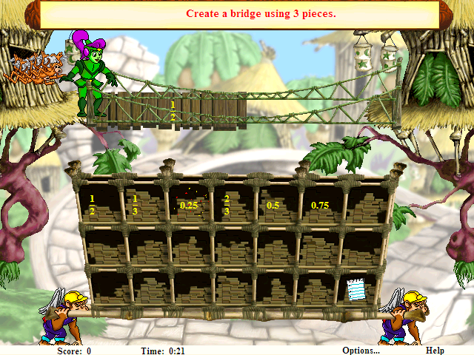
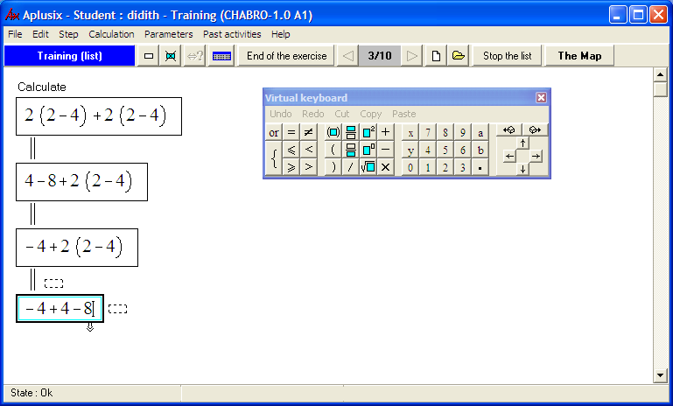
Aplusix .vs. MB
Game and tutor with same mathematics content (arithmetic and fractions drill)

Slide 29
Aplusix .vs. MB
Game and tutor with same mathematics content (arithmetic and fractions drill)
Delight, marginally significant
Game 12%
Tutor 6%
Engaged Concentration, significant
Game 63%
Tutor 76%

Slide 30
Aplusix .vs. MB
Game and tutor with same mathematics content (arithmetic and fractions drill)
Delight, marginally significant
Game 12%
Tutor 6%
Engaged Concentration, significant
Game 63%
Tutor 76%
What might be some of the impacts of these differences in affect?

Slide 31
Positive Emotion Persistence During Learning
(D’Mello, Taylor, & Graesser, 2007)
(Baker, D’Mello, Rodrigo, & Graesser, 2010)
(Rodrigo & Baker, in press)

Slide 32
Metric
D’Mello’s L
1 = transition always occurs, 0 = chance
L Computed for each student, then statistical significance computed across students

Slide 33
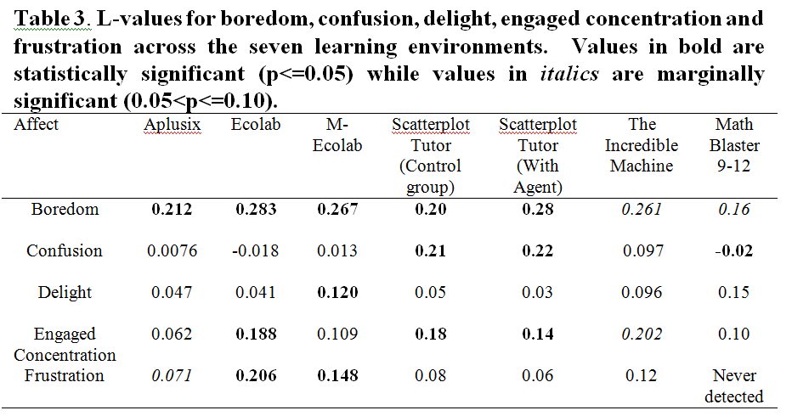

Slide 34
Methodological Note
Four methods used to assess positive emotions
Experience Sampling Method
Interviews
Questionnaires
Expert Judgments
What can you learn from each method that is not possible with the other methods?

Slide 35
Questions? Comments?

Slide 36
Next Class (MARCH 28)
Frustration, Anxiety, & Boredom (Cameron Betts)
Readings
Hembree, R. (1988) Correlates, Causes, Effects, and Treatment of Test Anxiety. Review of Educational Research, 58 (1), 47-77.
Berkowitz, L. (1989) Frustration-Aggression Hypothesis: Examination and Reformulation.Psychological Bulletin, 107 (1), 59-73.
Harris, M.B. (2000) Correlates and Characteristics of Boredom Proneness and Boredom. Journal of Applied Social Psychology, 30 (3), 576-598.
Pekrun, R., Goetz, T., Daniels, L., Stupinsky, R.H., Perry, R.P. (2010) Boredom in achievement settings: Exploring control-value antecedents and performance outcomes of a neglected emotion. Journal of Educational Psychology, 102(3), 531-549.

