Slide 1
Meta-Cognition, Motivation, and Affect
PSY504 Spring term, 2011
January 19, 2010

Slide 2
Rooms
Rooms have now been scheduled for all Tuesday sessions
See the schedule online
Note that rooms vary on different Tuesdays

Slide 3
Topics
Please look at the course schedule
Who would like to teach which topics?

Slide 4
Topic List
Help-Seeking, Planning, Metacognitive-SRL Scaffolding, Expectancy-Value Theories, Achievement Goals/Goal Orientation, Extrinsic/Intrinsic Motivation, Interest, Self-Efficacy, Attribution Theory, Self-Theories, Basic Emotions,
Flow/Concentration/Joy/Delight, Frustration/Anxiety/Boredom, Affect and Achievement Goals, Affect Detection, Affective/Motivational Agents, Educational Games/Serious Games, Gaming the System, Off-Task Behavior/Carelesness, Procrastination, Drop-out

Slide 5
Brief Discussion Rule Change
During this first portion of today’s class
I’ll ask most of you to each present on something
Only the person presenting will talk
Clarification questions are OK, but no comments
Save your comments for after this period (it won’t be too long)

Slide 6
Your models of MMA

Slide 7
First Person
Explain your model to the class

Slide 8
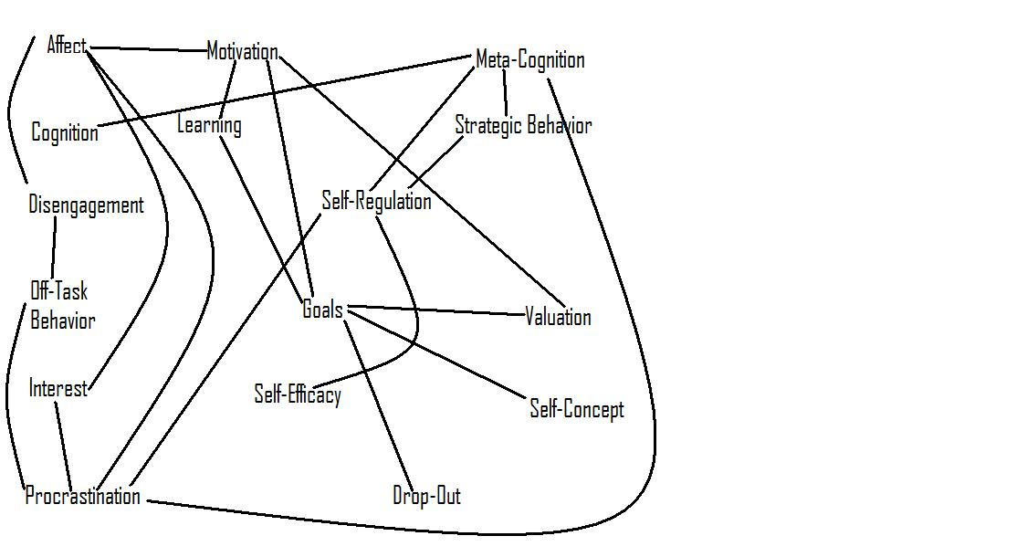
Notes:
Mike Wixon

Slide 9
Second/Subsequent People
Explain how your model differs from the previous models
Focus on explaining what’s different about your model, not on explaining your model in general

Slide 10
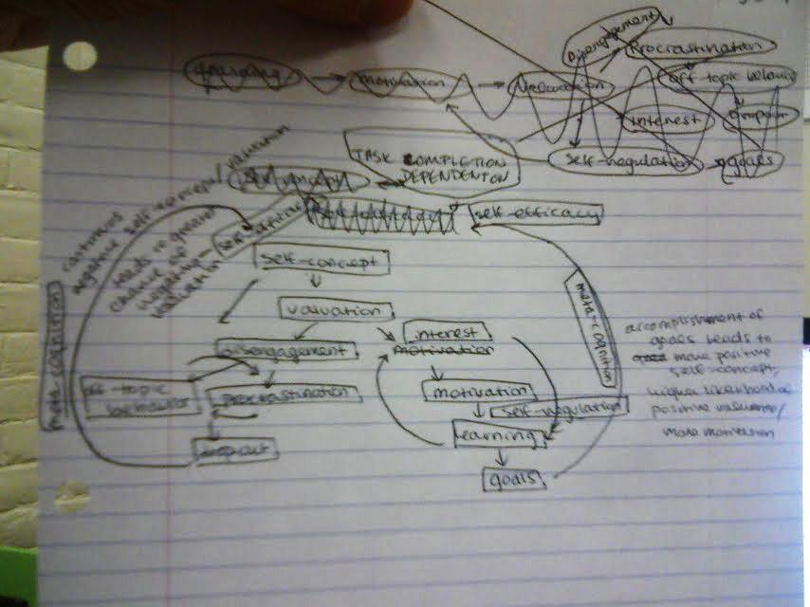
Notes:
Jaclyn

Slide 11
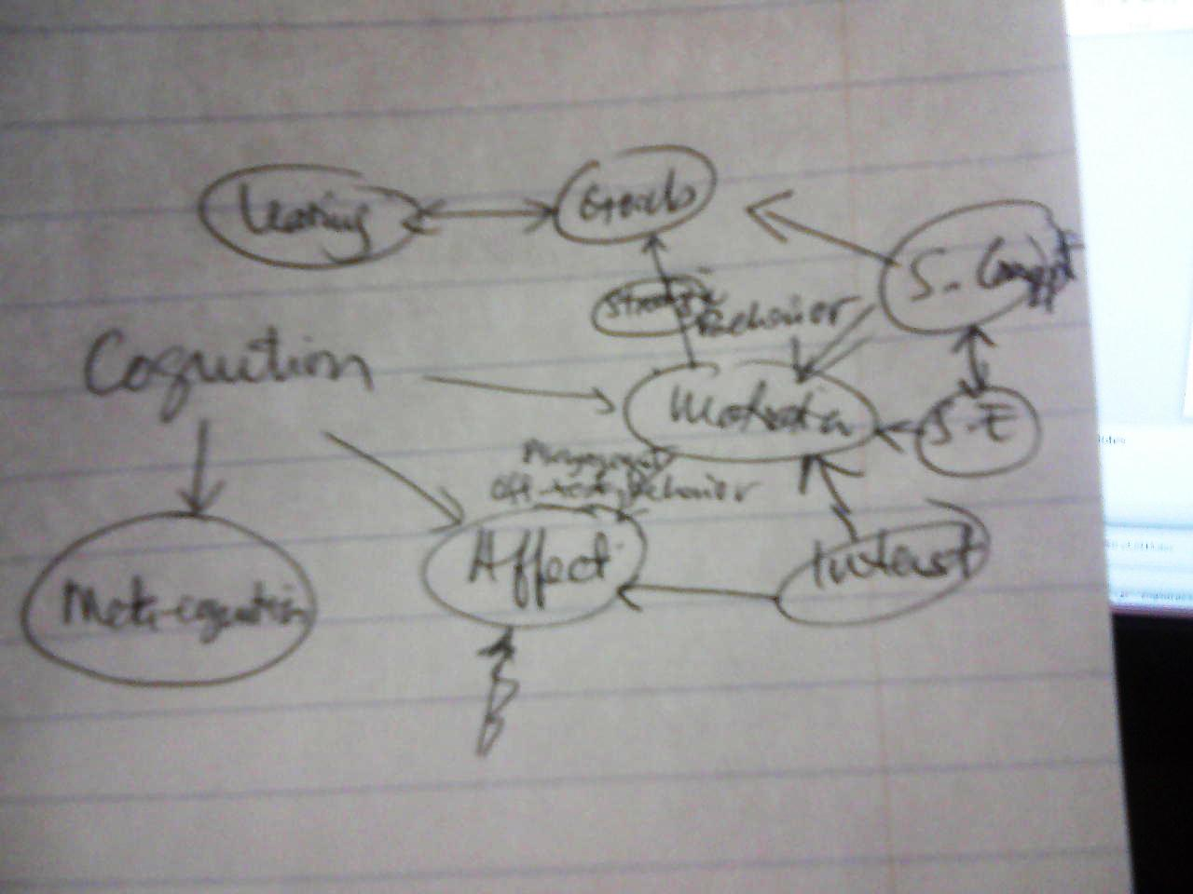
Notes:
Juelaila

Slide 12
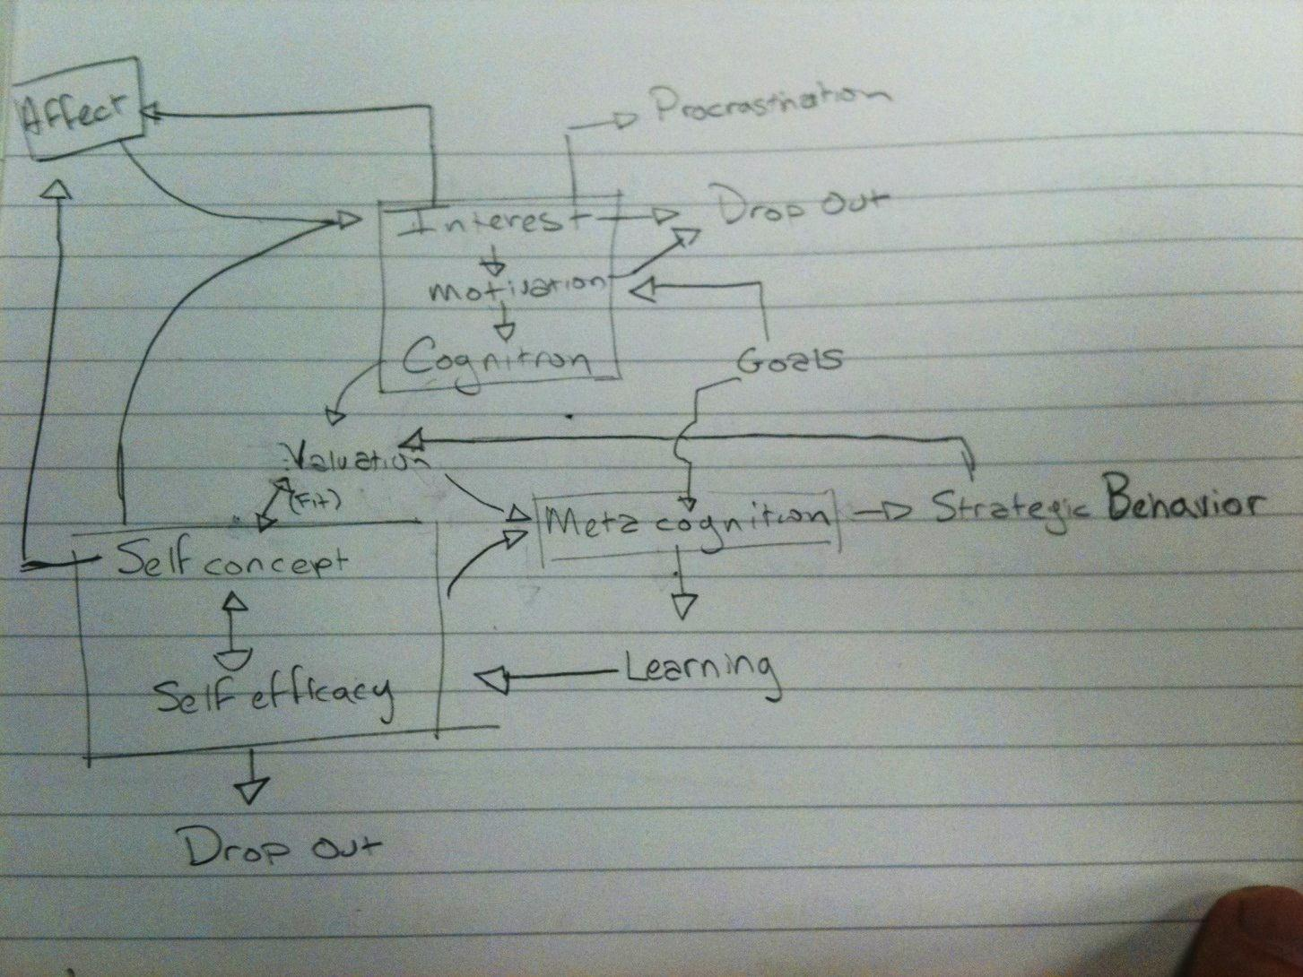
Notes:
Cameron

Slide 13
Cog
Everything in the outer boxes is interconnected
Self-Concept
Self-efficacy
Affect
Interest
Metacog
Motivation
Disengagement
Strategic Behavior
Valuation
Goals
Self-Regulation
Latents
Learning
Drop-Out
Off-task behav
Procrastination
Observables
Notes:
Mike SP

Slide 14
A is above B if B is not strictly necessary for A to occur, and A is more important
Learning
Self-Concept
Self-Efficacy
Motivation
Valuation
Affect
Strategic Behavior
Goals
Cognition
Meta-Cognition
Off-Task Behavior
Procrastionation
Disengagement
Drop-out

Slide 15
Back to normal
Everyone can now express themselves normally again
Anyone have anything they’ve been bursting to say for the last few minutes?

Slide 16
What were
The key points of agreement?

Slide 17
What were
The key points of disagreement?

Slide 18
We’ll revisit these issues
A few times over the course of this semester, particularly in connection to Winne and Azevedo’s models of self-regulated learning

Slide 19
Meta-cognition

Slide 20
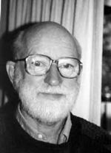
Meta-cognition
Coined by John Flavell

Slide 21
Definitions
Last week, Adam successfully played the “predict what is on Professor Baker’s next slide” game and came up with “Cognition about cognition”

Slide 22
Definitions
What other definitions does Hacker introduce in this chapter?

Slide 23
Definitions
“ ‘Active monitoring and consequent regulation and orchestration’ of cognitive processes to achieve cognitive goals”. (Hacker citing Flavell, 1976)
Thoughts? Comments?

Slide 24
Definitions
Hacker’s
“Should include at least these notions: knowledge of one’s knowledge, processes, and cognitive and affective states; and the ability to consciously and deliberately monitor and regulate one’s knowledge, processes, and cognitive and affective states.”
Thoughts? Comments?

Slide 25
Components of meta-cognition (according to Flavell, 1979)
Meta-cognitive knowledge – knowledge about your tasks/goals/actions/experiences, or about someone else’s
Meta-cognitive experiences – conscious cognitive or affective experiences that accompany thinking
Meta-cognitive strategies – strategies for accomplishing cognitive objectives (expressed in Flavell as separate goals and strategies)

Slide 26
Potential modifications
Meta-cognitive knowledge – knowledge about your tasks/goals/actions/experiences, or about someone else’s

Slide 27
Potential modifications
Meta-cognitive experiences – conscious cognitive or affective experiences that accompany thinking
Caution: What Flavell meant by affect might not be the same thing we’ll talk about later in the semester…

Slide 28
Potential modifications
Meta-cognitive skills – abilities for accomplishing meta-cognitive objectives

Slide 29
Can you give examples?
Meta-cognitive knowledge
Meta-cognitive experiences
Meta-cognitive strategies/skills

Slide 30
Meta-cognitive processes
Another way to look at meta-cognition is that it is a set of processes that interact with all three of these constructs (Paris & Winograd, 1990)
Self-appraisal
Self-monitoring
Self-management/self-regulation

Slide 31
What are the implications
Of looking at meta-cognition as processes
Instead of as knowledge, experiences, strategies?

Slide 32
Meta-cognitive strategies you use
Which meta-cognitive strategies do you regularly use in your academic life?

Slide 33
Is all meta-cognition equally useful?
Are some meta-cognitive strategies more beneficial for learning and functioning than others?
How could this be evaluated?

Slide 34
Other Comments and Questions?

Slide 35
Next Class
Monday, January 24
4pm-5:10pm
Monitoring/Self-Assessment
Wagoner, S.A. (1983) Comprehension Monitoring: What It Is and What We Know About It. Reading Research Quarterly, 18 (3), 328-346.
Koriat, A. (1993) How Do We Know That We Know? The Accessibility Model of the Feeling of Knowing.<i>Psychological Review</i>, 100 (4), 609-639.
Kimball, D.R., Metcalfe, J. (2003) Delaying judgments of learning affects memory, not metamemory. Memory & Cognition , 31 (6), 918-929.

Slide 36
The End

