Slide 1
Meta-Cognition, Motivation, and Affect
PSY504 Spring term, 2011
April 11, 2011

Slide 2
Affect and Achievement Goals

Slide 3
Key questions (to me)
How do students’ achievement goals impact their affect during learning?
In particular, in the face of challenges
How does a student’s affect change their achievement goals over time?
How does affect mediate the relationship between achievement goals and learning?

Slide 4
Affect and Achievement Goals
Only lightly studied
And many of the papers studying this have focused on “positive affect” and “negative affect”
Reviewed in Pekrun et al. (2006)
Today I’ll discuss a few papers that study the relationship between specific affective states and achievement goals

Slide 5
Questions studied (not quite the same)
How much do students’ achievement goals impact their affect during learning?
Which affect mediates the relationship between achievement goals and learning, and how much?

Slide 6
Questions studied (more on this later)
How much do students’ achievement goals impact their affect during learning?
Which affect mediates the relationship between achievement goals and learning, and how much?

Slide 7
Test Anxiety
Most frequently studied affective state in studies of connection between specific affective states and achievement goals

Slide 8
Test Anxiety
The affective experience of anxiety
Specifically directed towards the situation of testing
(Mandler & Sarason, 1952; Sarason, 1958, 1977, 1980)

Slide 9
Test Anxiety
Associated with poor attention during test-taking (Mandler & Watson, 1968)
Thinking of things other than the test
Associated with significantly poorer test performance (Mandler & Sarason, 1952; replicated many times)

Slide 10
Test Anxiety: State and Trait
State TA: feeling of anxiety experienced during testing situation
Trait TA: stable differences in frequency and intensity of state TA, between people (Spielberger, 1972, cited in Elliot & McGregor, 1999)

Slide 11
Intervention to Reduce Test Anxiety
(Spielberg, 1982)

Slide 12
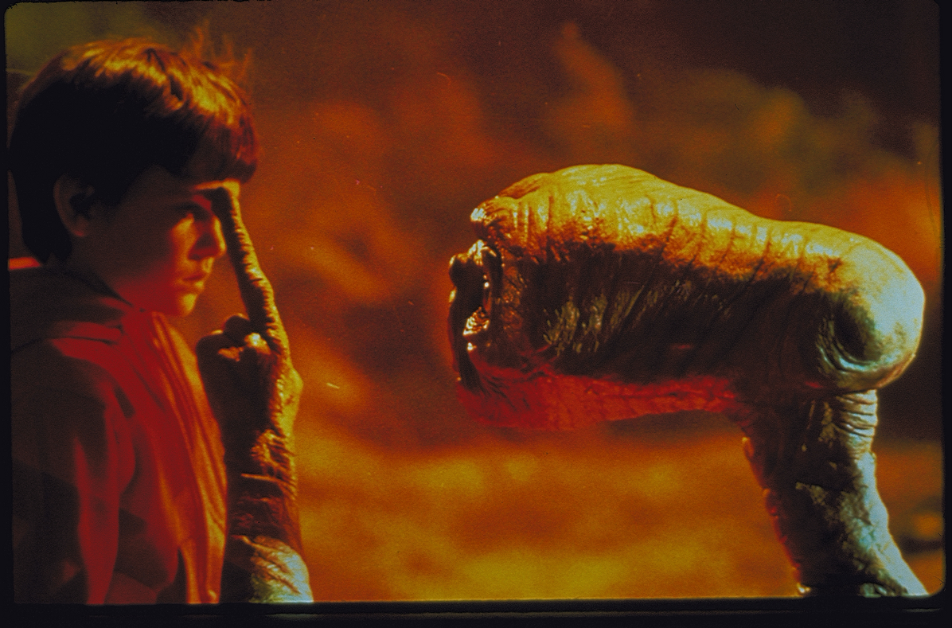
Intervention to Reduce Test Anxiety
(Spielberg, 1982)

Slide 13
Elliot & McGregor (1999)
Investigated the links between
State TA
Trait TA
Performance-Approach Goals
Performance-Avoidance Goals

Slide 14
Measuring State TA, Trait TA
State-Trait Anxiety Inventory (Spielberger, Gorsuch, & Lushene, 1970, 1983, 1989; Ramanaiah, Franzen, & Schill, 1983)

Slide 15
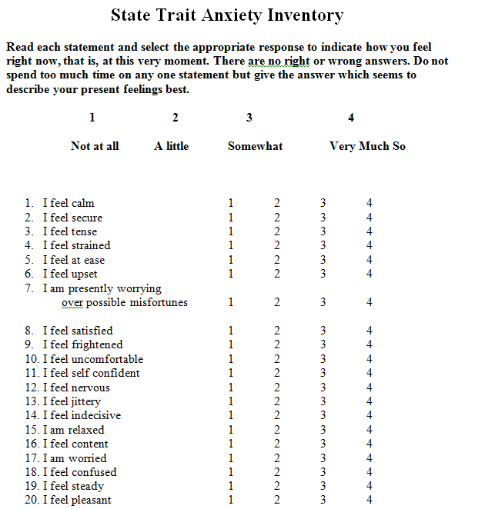
State Version

Slide 16
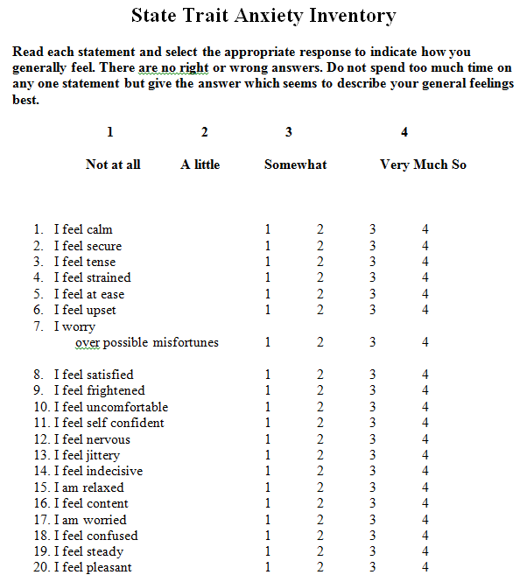
Trait Version

Slide 17
Elliot & McGregor (1999) Study One
150 undergrads in intro psychology course
Achievement goals assessed in 2nd week
Exam given in 5th week
Self-report of State TA after exam

Slide 18
Elliot & McGregor (1999) Study One
150 undergrads in intro psychology course
Achievement goals assessed in 2nd week
Exam given in 5th week
Self-report of State TA after exam

Slide 19
Elliot & McGregor (1999) Study Two
172 undergrads in intro psychology course
Trait TA assessed in 2nd week
Achievement goals assessed in 4th week
Exam given in 6th week
Self-report of State TA after exam

Slide 20
Elliot & McGregor (1999) Study Two
172 undergrads in intro psychology course
Trait TA assessed in 2nd week
Achievement goals assessed in 4th week
Exam given in 6th week
Self-report of State TA after exam

Slide 21
Other studies
Wolters, Yu, & Pintrich (1996) found
Positive correlation between extrinsic goals and test anxiety
No correlation between learning goals and test anxiety

Slide 22
Other studies
Middleton & Midgley (1996) found
Positive correlation between performance-approach goals and test anxiety
Positive correlation between performance-avoidance goals and test anxiety
Mastery goals not included in study (???)

Slide 23
Beyond Test Anxiety

Slide 24
Pekrun, Elliot, & Maier (2006)
Investigated the links between
A range of affective states
Goal orientation

Slide 25
Pekrun, Elliot, & Maier (2006) Study One
102 undergrads in intro psychology course in Germany
Achievement goals assessed in 3rd week
Affective states assessed in questionnaire in 15th week (right before final exam)

Slide 26
Pekrun, Elliot, & Maier (2006) Study One
Affective states measured using Achievement Emotions Questionnaire (Pekrun et al., 2002)
75 items
Assesses general prevalence of 8 affective states
Enjoyment of learning
Hope
Pride
Anger
Anxiety
Hopelessness
Shame
Items focus on affect while studying

Slide 27
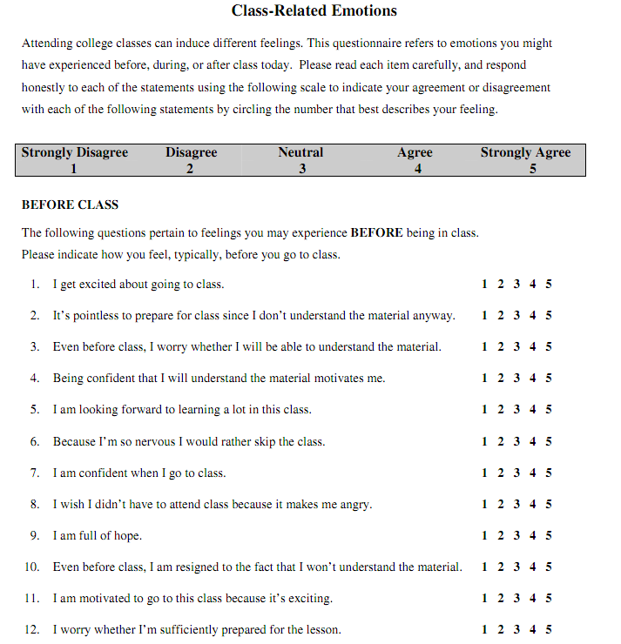
Excerpts from AEQ (Berg, 2007)

Slide 28
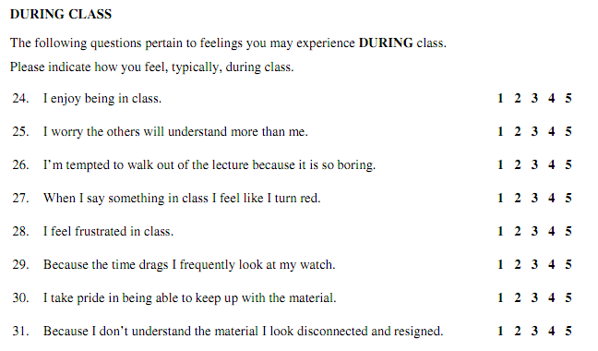
Excerpts from AEQ (Berg, 2007)

Slide 29
Pekrun, Elliot, & Maier (2006) Study One
Mastery Goals
Positive: Enjoyment, Hope, Pride
Negative: Boredom
Performance-Approach Goals
Positive: Pride, Anger, Shame
Performance-Avoidance Goals
Positive: Anger, Anxiety, Shame

Slide 30
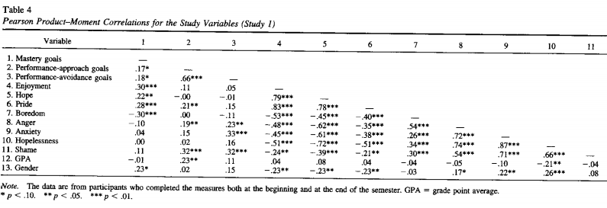
Pekrun, Elliot, & Maier (2006) Study One

Slide 31
Pekrun, Elliot, & Maier (2006) Study Two
Replication with 267 undergrads in intro psychology course in USA
Achievement goals assessed in 2nd week
Affective states assessed in questionnaire in 16th week (right before final exam)
Added measurements of other constructs not germane to today’s topic

Slide 32
Pekrun, Elliot, & Maier (2006) Study Two
Mastery Goals
Positive: Enjoyment, Hope, Pride
Negative: Boredom, Anger, Hopelessness
Performance-Approach Goals
Positive: Pride
Performance-Avoidance Goals
Positive: Boredom, Anger, Anxiety, Hopelessness

Slide 33
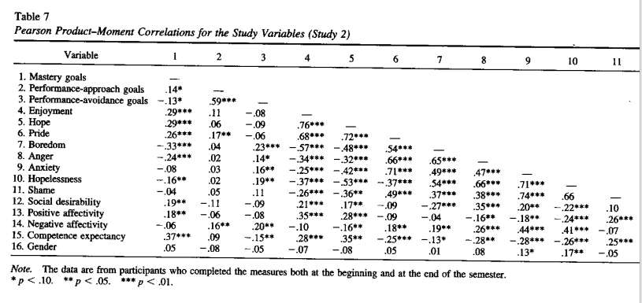
Pekrun, Elliot, & Maier (2006) Study Two

Slide 34
Pekrun, Elliot, & Maier (2009)
Replicated Pekrun et al. (2006), adding measure of midterm exam performance
Same population and method otherwise
Minor tweaks to instruments

Slide 35
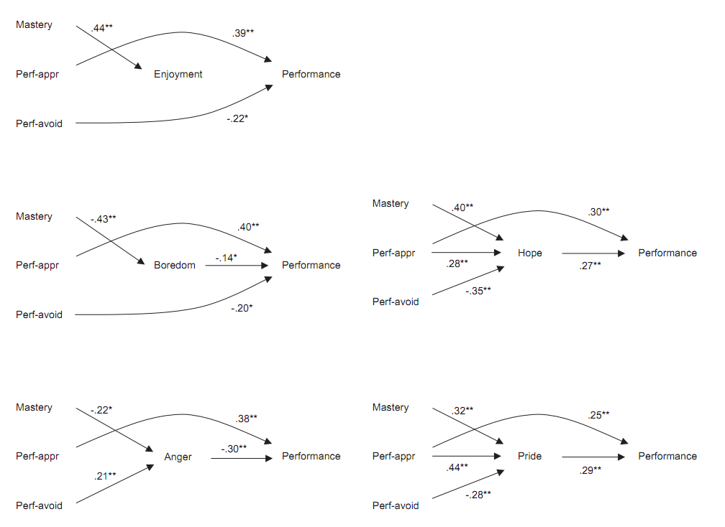

Slide 36
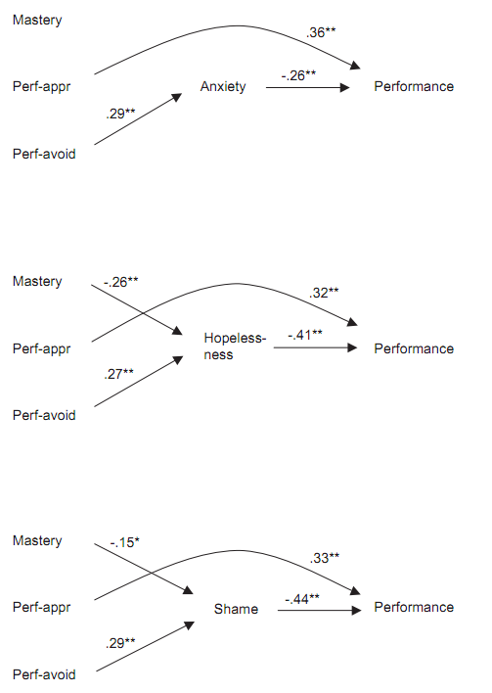

Slide 37
Summary
Through questionnaire studies, links have been found between specific affective states and achievement goals
And it has been studied how affect mediates the relationship between achievement goals and learning

Slide 38
Woo-hoo?

Slide 39
How do these effects happen?
How does affect mediate the relationship between achievement goals and learning?
How and under what conditions do achievement goals impact affect?

Slide 40
How do these effects happen?
How does affect mediate the relationship between achievement goals and learning?
How and under what conditions do achievement goals impact affect?
How could the field answer these questions?

Slide 41
Next Class (APRIL 12)
Affective/Motivational Agents
Readings
Klein, J., Moon, Y., Picard, R.W. (2002) This computer responds to user frustration: Theory, design, and results. Interacting with Computers, 14, 119-140.
Rebolledo-Mendez, G., du Boulay, B., Luckin, R. (2006) Motivating the Learner: An Empirical Evaluation. Proceedings of the International Conference on Intelligent Tutoring Systems, 545-554.
Robison, J., McQuiggan, S., Lester, J. (2009) Evaluating the Consequences of Affective Feedback in Intelligent Tutoring Systems. Proceedings of the International Confereence on Affective Computing and Intelligent Interaction, 37-42.

