Slide 1
Meta-Cognition, Motivation, and Affect
PSY504 Spring term, 2011
April 12, 2011

Slide 2
Affective/Motivational Agents
Agents who interact with students and help improve their affect and/or motivation
Through a variety of dialogue and non-verbal strategies

Slide 3
A lot of diversity
In agent appearance
In motivational strategies
Field still trying to come to consensus on how to do this “right”

Slide 4
An inspirational story (Klein, Moon, & Picard, 2002)

Slide 5
An inspirational story (Klein, Moon, & Picard, 2002)
A student at MIT is working in MATLAB 3.5 on a problem set
He becomes “frustrated to the point of despair over problems with MATLAB’s syntax”
He types “FUCK”

Slide 6
An inspirational story (Klein, Moon, & Picard, 2002)
A student at MIT is working in MATLAB 3.5 on a problem set
He becomes “frustrated to the point of despair over problems with MATLAB’s syntax”
He types “FUCK”
MATLAB says “Your place or mine?”

Slide 7
An inspirational story (Klein, Moon, & Picard, 2002)
“Bob’s mood changed instantly. From utter frustration came surprise and delight… the strong, negative state that Bob was experiencing suddenly dissolved. Bob became intrigued by the phenomenon, played around with the feature for a while, contacting friends to share the revelation of this hidden treasure, and then settled back down to work.”

Slide 8
An inspirational story (Klein, Moon, & Picard, 2002)
Is this a positive example of how computers should respond to affect?
In what ways were the results positive?
In what ways were the results negative?

Slide 9
Klein et al proposed design principles for affective agents
Actively solicit information about the individual’s state (particularly emotional)
Solicit information in a timely fashion
Make sure the user is able to express what she is feeling (e.g. affective label choices are appropriate)
Provide feedback, especially on emotional content
Allow for repair if the feedback is judged wrong
Convey a sense of sympathy to the user
Communicate a sense of empathy to the user as well
Convey to the user the sense that his emotional state is valid

Slide 10
Are these principles reasonable?
Actively solicit information about the individual’s state (particularly emotional)
Solicit information in a timely fashion
Make sure the user is able to express what she is feeling (e.g. affective label choices are appropriate)
Provide feedback, especially on emotional content
Allow for repair if the feedback is judged wrong
Convey a sense of sympathy to the user
Communicate a sense of empathy to the user as well
Convey to the user the sense that his emotional state is valid

Slide 11
We’ll discuss later
To what degree they are instantiated in agents developed since then, and to what degree they are proven to be correct (or not)

Slide 12
Agents

Slide 13
Laura (Bickmore, 2003; Bickmore & Picard, 2004)

Slide 14
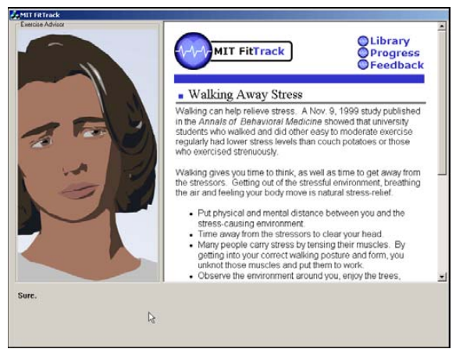
Laura (Bickmore, 2003; Bickmore & Picard, 2004)

Slide 15
Laura (Bickmore, 2003; Bickmore & Picard, 2004)
Laura
coaches undergraduates on exercise behaviors over several sessions
uses speech and non-verbal gestures to provide empathic feedback based on student responses
Concerned expression if student says they were not feeling well
Happy expression if student says they have exercised a lot lately
“Empathy dialogues” for
students reporting continuing illness, stress, tiredness, injury
students reporting anger, disappointment, frustration

Slide 16
Laura (Bickmore, 2003; Bickmore & Picard, 2004)
Two versions
Empathic feedback, no empathic feedback
Between-subjects comparison
Users liked empathic version better (self-report measures)
No difference in exercise behaviors

Slide 17
Paul (M-Ecolab) (Rebolledo-Mendez, du Boulay & Luckin, 2005, 2006)

Slide 18
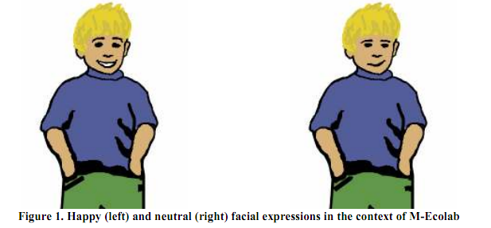
Paul (M-Ecolab)

Slide 19
Paul (M-Ecolab)
Incorporated into ITS for ecology for late elementary-school students
Paul assesses effort, confidence, and independence with machine-learned models

Slide 20
Paul (M-Ecolab)
Paul responds with changes of tone of voice, gestures, and motivational messages
Expression of concern when student does poorly
Encouraging messages
“For the next node try to make fewer errors”
“Be bold and take on a challenge”

Slide 21
Paul (M-Ecolab)
Paul leads to more help-seeking, but reduces self-perception of independence
Paul leads to higher learning for students who performed average or poorly on post-test
Paul does not lead to differences in affect frequency, but delight is more persistent (Rodrigo, Rebolledo-Mendez, Baker, et al., 2008)

Slide 22
Casey (Burleson, 2006)

Slide 23
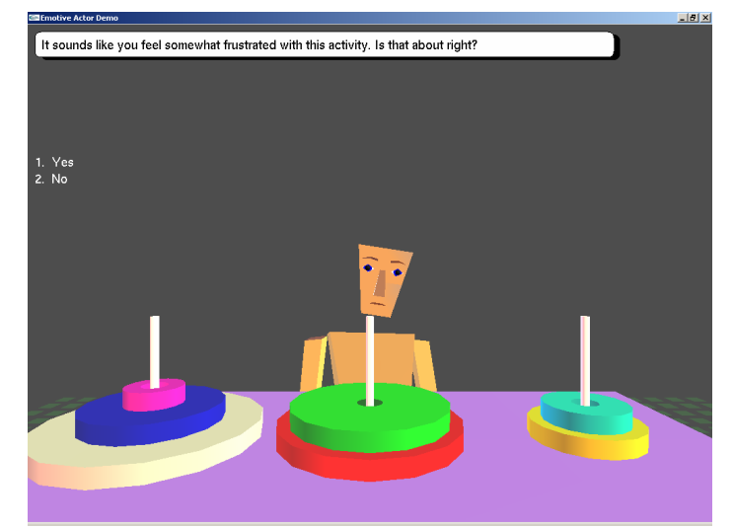
Casey (Burleson, 2006)

Slide 24
Casey (Burleson, 2006)
Children taught about Towers of Hanoi in lab setting
Affect monitored by sensors
Flow, Stuck/Frustration

Slide 25
Casey (Burleson, 2006)
Agent 2x2 intervention
non-verbal mirroring of affect, or unrelated affect
affect support or task-related support
Affect support
“On a scale from 1 to 7, how frustrated are you feeling right now?”
“It sounds like you feel somewhat frustrated with this activity. Is that about right?”

Slide 26
Results
No effect on motivation or self-reported frustration
Affect interventions reduced persistence in activity
Learning not measured

Slide 27
Jake and Jane (Arroyo, Woolf, Royer, & Tai, 2009; Woolf et al., 2010)

Slide 28
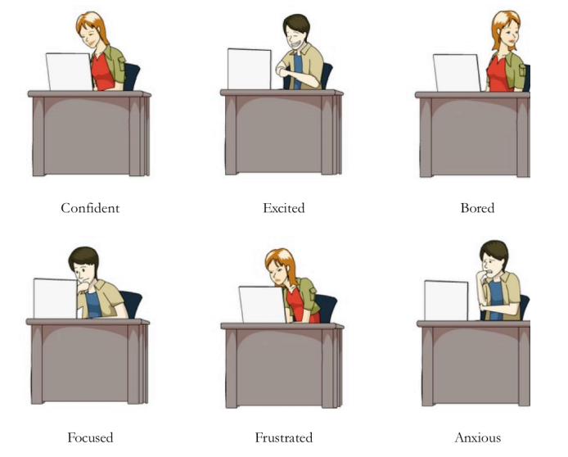
Jake and Jane

Slide 29
Jake and Jane
Incorporated into Wayang Outpost, ITS for high school mathematics

Slide 30
Jake and Jane
System asks how student is feeling every five minutes
Confident, Anxious, Frustrated, Excited, Interested, Bored
Learning companion displays affect student reported in their most recent self-report

Slide 31
Jake and Jane
Learning companion gives meta-cognitive/motivational message after each first attempt by the student

Slide 32
Jake and Jane
Agent randomly assigned to high-school students: Male, female, none
Stratified by student gender

Slide 33
Jake and Jane
No effects on learning for having agent .vs. no agent
Marginally better learning when agent was different gender than student, than when agent was same gender as student
Students who received Jane reported less frustration, higher confidence, higher interest
No effect for Jake

Slide 34
Jin (Robison, McQuiggan, & Lester, 2009; McQuiggan, Robison, & Lester, 2010)

Slide 35
Jin (Robison, McQuiggan, & Lester, 2009)

Slide 36
What’s different about Jin?

Slide 37
Jin
Embedded in Crystal Island, a narrative-centered learning environment for middle school biology

Slide 38
Jin
Reacts in three different ways
Parallel empathy – shows same affect as student
“Yes, I’m very frustrated as well!”
Reactive empathy – tries to alter student’s affective state
“I can understand why you are frustrated, but if you keep working, I’m sure you will figure it out.”
Task-based (non-empathic) feedback

Slide 39
Jin
Assesses student affect by asking student their affect every time an interaction starts or ends between Jin and the student
“Hi Alex, how are you feeling?”
“How are you feeling now?”
Anger, anxiety, boredom, confusion, curiosity, delight, excitement, flow, frustration, sadness, fear
Sadness and fear almost never reported

Slide 40
Jin
Parallel empathy sustains affective states better than reactive empathy
Leading flow to be more sustained
But also leading frustration, boredom, anxiety to be more sustained
I could not find learning gains reported

Slide 41
AutoTutor (Graesser & Person, 2010; D’Mello, Craig, Fike, & Graesser, 2010)

Slide 42
AutoTutor

Slide 43
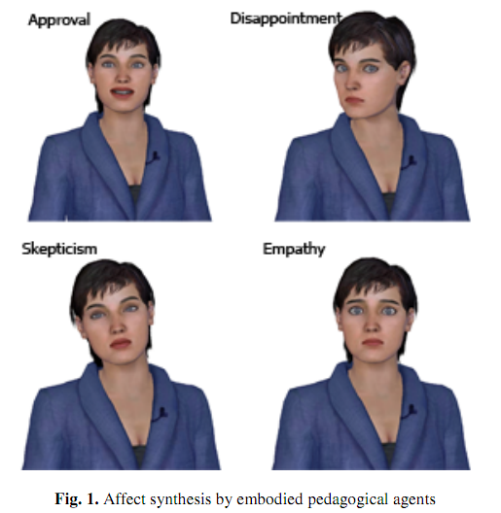
AutoTutor

Slide 44
AutoTutor
Detects a range of affective states, as discussed last week
Boredom, Frustration, Delight, Confusion, Flow

Slide 45
AutoTutor: Affect Response Modalities
Supportive
Attributes emotion to material instead of learner
“This stuff can be kind of dull sometimes, so I’m gonna try and help you get through it. Let’s go.”
“Hang in there a bit longer. Things are about to get interesting.”
“Some of this material can be confusing. Just keep going and I am sure you will get it.”
“I know I do not always convey things clearly. I am always happy to repeat myself if you need it. Try this one.”
“I know this material can be difficult, but I think you can do it, so let’s see if we can get through the rest of this problem.”

Slide 46
AutoTutor: Affect Response Modalities
Shake-up
Attributes emotion to learner
“This material has got you confused, but I think you have the right idea. Try this.”
“You are not as confused as you might think. I’m actually kind of impressed. Keep it up.”
“Geez this stuff sucks. I’d be bored too, but I gotta teach what they tell me.”

Slide 47
AutoTutor: Affect Response Modalities
Rude
Rude/sarcastic responses
“Aren’t you the little genius.”
“I thought you were bright, but I sure pegged you wrong.”
“You know, confusion is just God’s way of telling you that you’re not smart enough for this material.”

Slide 48
Results (Published)
Supportive tutor significantly improves learning
(Undergraduate) students find rude tutor hilarious

Slide 49
Results (Personal communication, Art Graesser)
Supportive tutor significantly improves learning for struggling students
Shake-up tutor significantly improves learning for students who are generally performing well

Slide 50
Summary
Report of liking agent version better
Laura
Improvements to motivation or affect
Jane, Jin
Improvements to SRL behavior
Paul
Improvements to Learning
Paul, AutoTutor

Slide 51
Are these principles instantiated in agents?
Actively solicit information about the individual’s state (particularly emotional)
Solicit information in a timely fashion
Make sure the user is able to express what she is feeling (e.g. affective label choices are appropriate)
Provide feedback, especially on emotional content
Allow for repair if the feedback is judged wrong
Convey a sense of sympathy to the user
Communicate a sense of empathy to the user as well
Convey to the user the sense that his emotional state is valid

Slide 52
Have any been proven beneficial?
Actively solicit information about the individual’s state (particularly emotional)
Solicit information in a timely fashion
Make sure the user is able to express what she is feeling (e.g. affective label choices are appropriate)
Provide feedback, especially on emotional content
Allow for repair if the feedback is judged wrong
Convey a sense of sympathy to the user
Communicate a sense of empathy to the user as well
Convey to the user the sense that his emotional state is valid

Slide 53
What else
What else seemed to characterize the more successful agents?

Slide 54
Next Class (APRIL 13)
Gaming the System
Readings
Baker, R.S., Corbett, A.T., Koedinger, K.R., Wagner, A.Z. (2004) Off-Task Behavior in the Cognitive Tutor Classroom: When Students "Game The System". Proceedings of ACM CHI 2004: Computer-Human Interaction, 383-390.
Shih, B., Koedinger, K., Scheines, R.A. (2008) A Response Time Model For Bottom-Out Hints as Worked Examples. Proceedings of the 1st International Conference on Educational Data Mining, 117-126.
Baker, R.S.J.d., de Carvalho, A.M.J.A., Raspat, J., Aleven, V., Corbett, A.T., Koedinger, K.R. (2009) Educational Software Features that Encourage and Discourage "Gaming the System". Proceedings of the 14th International Conference on Artificial Intelligence in Education, 475-482.
Muldner, K., Burleson, W., Van de Sande, B., VanLehn, K. (in press) An analysis of students' gaming behaviors in an intelligent tutoring system: predictors and impacts. To appear in User Modeling and User-Adapted Interaction.

