Slide 1
Meta-Cognition, Motivation, and Affect
PSY504 Spring term, 2011
April 13, 2011

Slide 2
Gaming the System (Baker, Corbett, Koedinger, & Wagner, 2004; Baker et al., 2006)

Slide 3
Gaming the System
“Attempting to get correct answers and advance in a curriculum by taking advantage of the software’s help or feedback, rather than by actively thinking through the material” (Baker et al., 2004, 2006)

Slide 4
Gaming in Intelligent Tutors
Help Abuse
(cf. Wood and Wood, 2000; Aleven, 2001; Aleven et al., 2004)

Slide 5
Gaming in Intelligent Tutors
Systematic Guessing
(cf. Baker et al., 2004)

Slide 6
Gaming in Intelligent Tutors
Systematic Guessing
(cf. Baker et al., 2004)
Alternately conceptualized as “hasty guessing”/ ”rapid guessing” (Beck, 2005; Muldner et al., 2010)

Slide 7
Gaming in Intelligent Tutors
Intentional Rapid Mistakes
(cf. Murray & VanLehn, 2007; Baker, Mitrovic, & Mathews, 2010)

Slide 8
Gaming the System
First documented in 1972 (Tait, Hartley, & Anderson, 1972)
Has been documented in many learning environments
Intelligent Tutors (Baker et al, 2004; Beck et al, 2005; Murray & VanLehn, 2005; Walonoski & Heffernan, 2006; Johns & Woolf, 2006)
Puzzle-Solving Games (Rodrigo et al, 2007)
Collaborative Games (Magnussen & Misfeldt, 2004)
Graded-Participation Newsgroups (Cheng & Vassileva, 2005)

Slide 9
Methods for Assessing Gaming
Quantitative Field Observations
Text Replays
Machine-Learned/Data-Mined Models
Rational/Knowledge-Engineered Models

Slide 10
Quantitative Field Observations (Baker et al., 2004)
Each student’s behavior observed several times as they used tutor (by 2-3 observers)
Pre-determined coding categories and observation order
Peripheral vision
20 second observation window

Slide 11
Quantitative Field Observations
Historically unsynchronized
Recent work in Baker’s lab has developed methods for synchronizing field observations with log files using Android handhelds (personal communication, Ryan Baker)

Slide 12
Inter-rater reliability
κ = 0.74 (Baker, Corbett, & Wagner, 2006)
κ = 0.71, 0.78 (Baker, D’Mello, Rodrigo, & Graesser, 2010)

Slide 13
Text Replays (Baker, Corbett, & Wagner, 2006)

Slide 14
Text replays
Pretty-prints of student interaction behavior from the logs

Slide 15
Real Examples

Slide 16
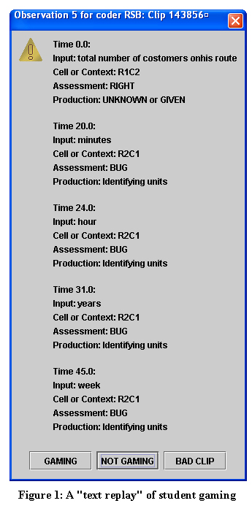

Slide 18
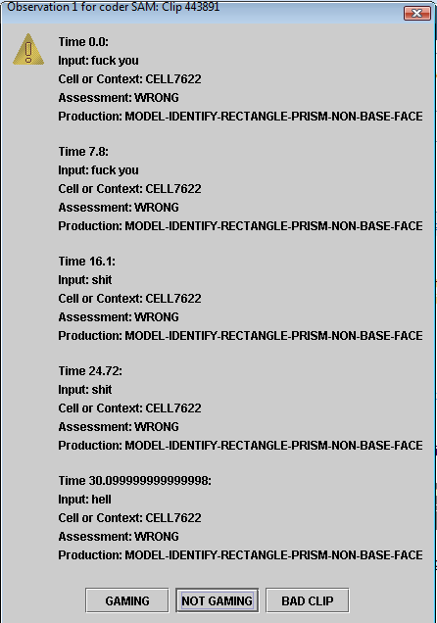

Slide 19
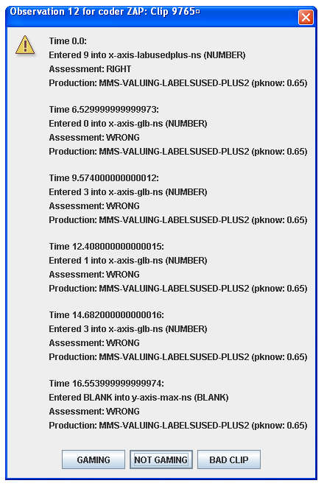

Slide 20
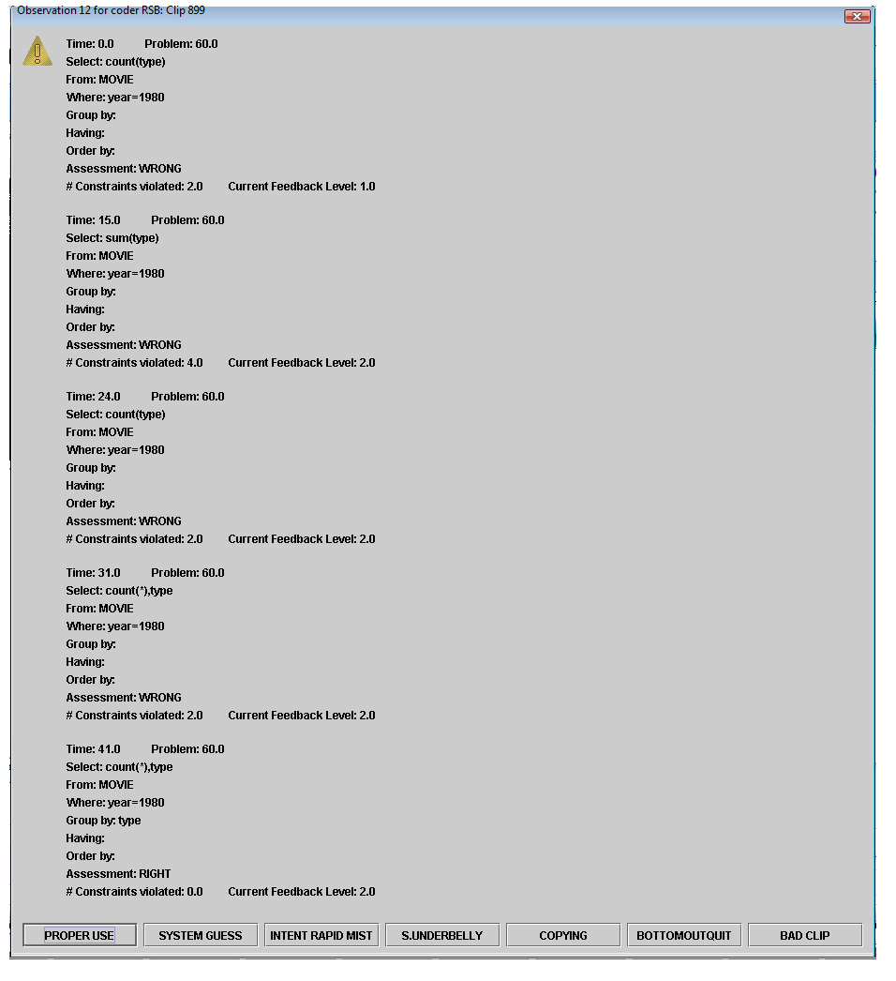

Slide 21
Inter-rater reliability (for gaming)
κ = 0.58 (Baker, Corbett, & Wagner, 2006)
κ = 0.80 (Baker, Mitrovic, & Mathews, 2010)

Slide 22
Machine Learned/Data Mined Models
Developed using data from text replays and quantitative field observations

Slide 23
Accuracy
The latest model versions can
Distinguish a gaming student from a non-gaming student 96% of the time (not relevant for off-task; in the USA, almost everyone goes off-task sometimes)
Achieve a correlation to frequency of gaming behavior of 0.9, and a correlation to off-task behavior of 0.62
Distinguish off-task behavior from when a student is talking to the teacher
Determine exactly when gaming behavior and off-task behavior occurred, 40% better than chance
Predict student behavior accurately for new students and new tutor lessons
Not yet clear if detectors can transfer between tutors, but gaming detectors developed for high school Algebra can predict learning gains in college Genetics

Slide 24
Rational Model (Gong, Beck,& Heffernan, 2010)
“Rapid Guessing: submit answers less than 2 seconds apart at least twice in a row.
Rapid Response: perform any action after a hint or starting a problem before a reasonable amount of time has passed (where “reasonable” is a fast reading speed for the content of the hint or problem body. We chose a reading rate of 400wpm).
Repeatedly Bottom-out Hinting: reach a bottom out hint on three consecutive problems.”

Slide 25
Rational Model (Muldner, Burleson, Van de Sande, VanLehn, 2010)
“Skipping a hint: the tutor presents a hint and the student skips the hint by quickly asking for another hint (under 3 seconds)
Copying a hint: the tutor presents a bottom-out hint and the student quickly generates a solution entry, suggesting a shallow copy of the hint instead of learning of the underlying domain principle (under 4 seconds)
Guessing: after the tutor signals an incorrect entry, the student quickly generates another incorrect entry, suggesting s/he is guessing instead of reasoning about why the entry is incorrect (under 4 seconds)
Lack of planning: after the tutor signals a correct entry, the student quickly asks for a hint, suggesting reliance on hints for planning the solution (under 4 seconds)”
Thresholds set by visual inspection of data

Slide 26
Other Rational Models
Aleven et al. (2004, 2006)
Beck (2005)
Johns & Woolf (2006)
Beal, Qu, & Lee (2007)

Slide 27
Advantages/Disadvantages
What are the advantages and disadvantages of each method of assessing gaming?

Slide 28
Gaming and Learning

Slide 29
Gaming and Learning in Cognitive Tutors (5 field observation studies, 2003-2005)

Slide 30
Beck (2005)
Gaming studied in Project LISTEN reading tutor for elementary school students
Measured using rational model
Gaming associated with significantly lower learning

Slide 31
Aleven et al. (2006)
Gaming studied in Cognitive Tutor
measured using rational model
Gaming associated with significantly lower learning

Slide 32
Walonoski & Heffernan (2006)
Gaming studied in ASSISTments for mathematics
measured using data mined model constructed from field observations
Trend towards gaming being associated with lower learning, but not significant

Slide 33
Gong et al. (2010)
Gaming studied in ASSISTments for mathematics
measured using rational model
Gaming associated with significantly lower learning

Slide 34
Gobel (2010)
Gaming studied in college classroom in Japan using ESL software
measured using quantitative field observations
No relationship to learning (p value and correlation not reported)

Slide 35
Special Case

Slide 36
Shih, Koedinger, & Scheines (2008)

Slide 37
Shih, Koedinger, & Scheines (2008)
If student games the system, obtains the answer, enters the answer
And
Then pauses for a substantial period of time
Interpreted as self-explanation
This behavior is associated with successful learning (in Cognitive Tutor for Geometry)

Slide 38
Factors Predicting Gaming

Slide 39
Factors Predicting Gaming: State or Trait?
Baker (2007) found that gaming varies more by lesson-level factors than student-level factors
Using machine-learned detector
Muldner et al. (2010) and Gong et al. (2010) found that gaming varies more by student-level factors than problem-level factors
Using rational models

Slide 40
Factors Predicting Gaming: Trait
Baker et al. (2008) studied gaming and student characteristics using gaming detector, in Cognitive Tutor and ASSISTments
Disliking mathematics (r=0.19), lack of grit (r=0.22) significantly associated with gaming
Performance goals and other constructs not associated

Slide 41
Factors Predicting Gaming: State
Baker et al. (2009) developed taxonomy of 79 tutor features
Labeled data from 58 students and 20 lessons in terms of taxonomy and gaming (using text replays)
Split taxonomy using factor analysis to produce 6 factors for tutor design
1 factor statistically significant predictor of gaming

Slide 42
(Some) tutor lesson features associated with gaming
Hints are not associated with better future performance (more gaming)
Proportion of hints in each hint sequence that refer to abstract principles (more gaming)
Average number of words in problem statements not directly related to math (less gaming)
No problem statement (less gaming)
Not immediately apparent what icons in toolbar mean (to teacher coder with tutor experience) (more gaming)

Slide 43
Final Model
Achieves r² = 0.56

Slide 44
Next Class (APRIL 18)
Off-Task Behavior and Carelessness
Readings
Karweit, N., Slavin, R.E. (1982) Time-On-Task: Issues of Timing, Sampling, and Definition. Journal of Experimental Psychology, 74 (6), 844-851.
Baker, R.S.J.d. (2007) Modeling and Understanding Students' Off-Task Behavior in Intelligent Tutoring Systems. Proceedings of ACM CHI 2007: Computer-Human Interaction, 1059-1068.
Clements, M.A. (1982) Careless Errors Made by Sixth-Grade Children on Written Mathematical Tasks. Journal for Research in Mathematics Education, 13 (2), 136-144.

