Slide 1
Meta-Cognition, Motivation, and Affect
PSY504 Spring term, 2011
April 20, 2011

Slide 2
Class Notes
Please hand in topic paper
Course project presentations are
Monday: Cameron, Juelaila/Mike W.
Tuesday: Dovan, Adam Nakama
Any questions on course project presentations?

Slide 3
Class Notes
Course evaluations at the end of class today

Slide 4
Today’s class
I was going to start preparing early, really I was…

Slide 5
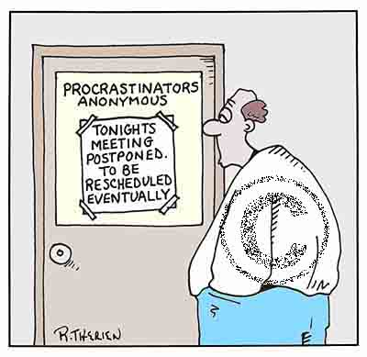
Procrastination

Slide 6
Procrastination
“An irrational tendency to delay tasks that should be completed” (Lay, 1986)
“Delay of a task or assignment that is under one’s control” (Ackerman & Gross, 2005)

Slide 7
Procrastination
“An irrational tendency to delay tasks that should be completed” (Lay, 1986)

Slide 8
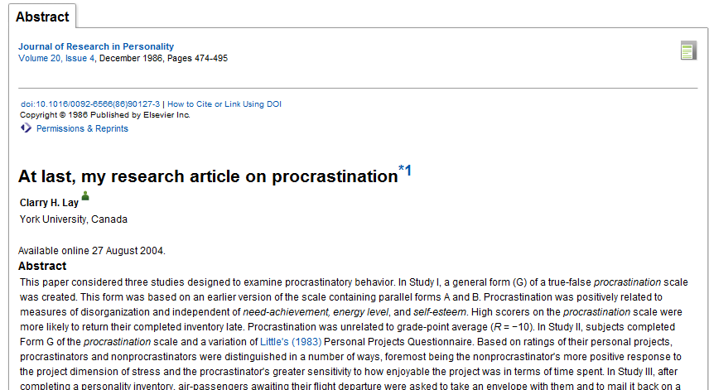

Slide 9
Measuring Procrastination

Slide 10
General Questionnaire Measures

Slide 11
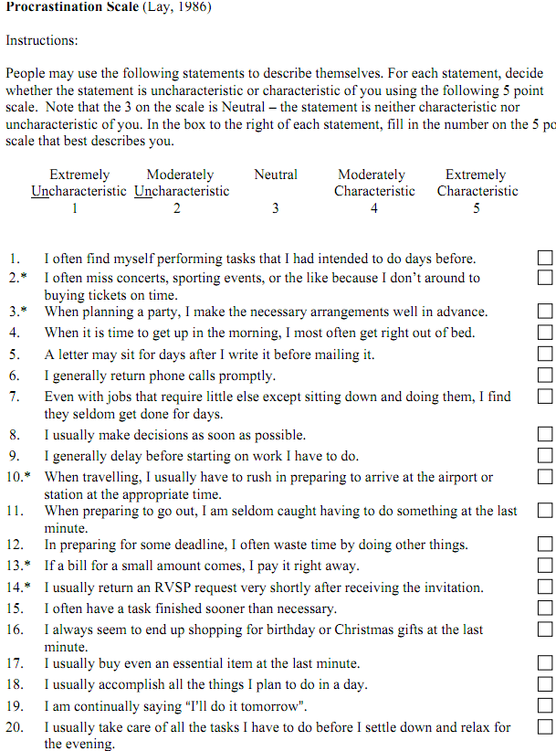

Slide 12
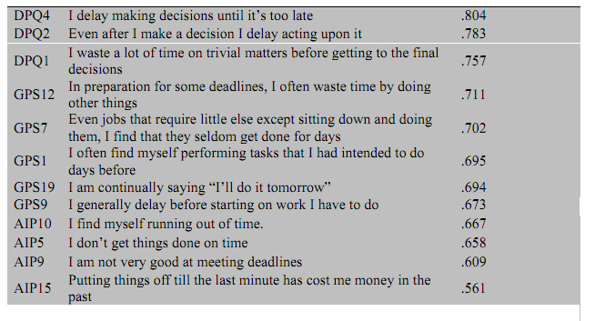
Pure Procrastination Scale (Steel, 2010)

Slide 13
Pure Procrastination Scale
Created by taking several procrastination scales, administering them to the same students, doing a factor analysis, and finding the most central items across all scales (Steel, 2010)

Slide 14
Specific Questionnaire Measure

Slide 15
(Ackerman & Gross, 2005)
“Students were first asked to think about an important assignment they had completed during the past semester and briefly describe it on the questionnaire form (example responses included term paper, analytical report, industry analysis, and case analysis). Next, the questionnaire asked, “How many days or weeks did your instructor give you to complete the assignment?” (M = 6.5 weeks), and, “How many days or weeks before the due date did you start the assignment?” (M = 3 weeks). This measured actual procrastination behavior on an assignment.”

Slide 16
Behavior Measure
Assignments could be turned in late for penalty
The later, the higher the penalty
The later on average, the more procrastination
(Steel et al., 2001)

Slide 17
Behavior Measure
Assignments turned in online for class
When do students turn in assignment, between first possible day and last possible day?
(Moon & Illingworth, 2004)

Slide 18
Advantages/Disadvantages?
Of each method

Slide 19
Procrastination and Performance
Undergraduates taking health science courses who procrastinate (Lay’s scale) get lower grades on assignments (Tice & Baumeister, 1997)
Undergraduates taking ed psych course who procrastinate (another scale) perform more poorly on final exam (Tuckman, 1998)
However, regular quizzes reduce negative effects from procrastination
Undergraduates taking intro psych course online who procrastinate (lateness of assignments) perform more poorly on final exam (Steel et al., 2001)

Slide 20
Procrastination and Performance
Undergraduates taking ed psych course online who procrastinate (another scale) perform more poorly on course grade (Tuckman, 2002)
Undergraduates who procrastinate (another scale) achieve lower college GPA (Wesley, 1994)

Slide 21
Procrastination and Performance: Meta-Analysis

Slide 22
Why do people procrastinate?

Slide 23
State or Trait?
20% of adults state that they are “chronic procrastinators” (Harriott & Ferrari, 1996)
Contrasting findings on what proportion of undergraduates report engaging in procrastination at least some of the time (Solomon & Rothblum, 1984; review in Ackerman & Gross, 2005; review in Moon & Illingworth, 2005)
25%-95%

Slide 24
Individual Differences
Self-reported anxiety is correlated with self-reported procrastination (Solomon & Rothblum, 1984; Senecal et al., 1995)
Self-efficacy is negatively correlated with self-reported procrastination (Steel et al., 2007)
Intrinsic motivation for subject is negatively correlated with self-reported procrastination (Senecal et al., 1995)

Slide 25
Individual Differences
Conscientiousness associated with self-reported procrastination (Moon & Illingworth, 2005; Steel et al., 2007)
Neuroticism associated with self-reported procrastination (Steel et al., 2007)

Slide 26
Individual Differences
Impulsiveness and boredom proneness associated with self-reported procrastination (Steel et al., 2007)

Slide 27
Individual Differences
High personal perfectionism “I demand nothing less than perfection of myself” not associated with more procrastination
(Flett et al., 1992)

Slide 28
Individual Differences
Perception of high social perfectionism “The people around me expect me to succeed at everything I do” associated with more procrastination
But only in males, not in females
(Flett et al., 1992)

Slide 29
Situational Factors Leading to Less Procrastination (Ackerman & Gross, 1995)
More interesting assignments (according to students)
Assignments involving fewer skills
Clearer instructions
Interdependence between assignments

Slide 30
Situational Factors Not Affecting Procrastination (Ackerman & Gross, 1995)
Instructor pressure about deadlines
Longer assignments
Harder assignments

Slide 31
Other Situational Factors (Moon & Illingworth, 2005)
Procrastination goes up over the course of the semester

Slide 32
Other Situational Factors (Moon & Illingworth, 2005)
Procrastination goes up over the course of the semester
No, really?

Slide 33
Special Case
“Positive Procrastinators” – individuals who believe that they work best under pressure
(Chun Chu & Choi, 2005)
Scale developed measuring this construct
“I tend to work better under pressure”
“I intentionally put off work to maximize my motivation”
“Since I often start working on things at the last moment, I have trouble finishing assigned tasks most of the time” [reverse coded]
“I feel that putting work off until the last minute does not do me any good” [reverse coded]

Slide 34
Special Case
Positive Procrastinators do not have worse learning than non-procrastinating students
And motivationally they look similar to non-procrastinating students

Slide 35
Course evaluations
Can I get a volunteer to
Find people who aren’t here today
Take the final set to the registrar
You can fill this out, whether you are taking the class for a grade or just auditing

Slide 36
Next Class (APRIL 19)
Course Project Presentations!

