Slide 1
Meta-Cognition, Motivation, and Affect
PSY504 Spring term, 2011
April 27, 2011

Slide 2
Class Notes
Course project results paper is due Monday
We’ll talk about the content of Monday’s class at the end

Slide 3
And speaking of the end…

Slide 4
Dropout

Slide 5
Dropout

Slide 6
Dropout
Leaving high school before completing the course and receiving a high school diploma

Slide 7
Dropout
Also: leaving college without a B.S./B.A./etc.
Typically called “withdrawal” rather than “dropout” in the research literature
Related to: non-retention in major

Slide 8
Dropout
Today we will focus on high school drop-out

Slide 9
Drop-Out
Getting better, but still a problem

Slide 10
Finn (1989)
Dropout is conceptualized as a developmental process
“a youngster's leaving school before graduation may be just one more event, albeit a conspicuous event, in a chain that may have begun years before”

Slide 11
Drop-out as the end of a process
“…a youngster's leaving school before graduation may be just one more event, albeit a conspicuous event, in a chain that may have begun years before.” (Finn, 1989)
"In fact, dropping out itself might better be viewed as a process of disengagement from school, perhaps for either social or academic reasons” (Rumberger, 1987)

Slide 12
Early predictors of drop out
Skipping class (review in Finn, 1989)
Off-task behavior, disruptive behavior (Finn, 1989; Rumberger & Larson, 1998; Rumberger & Lim, 2008), particularly if the behavior leads to disciplinary referrals and school suspensions (Altenbaugh et al., 1995)
Low educational performance (meta-analysis in Rumberger & Lim, 2008)

Slide 13
Why do students drop-out?

Slide 14
Why do students drop-out? (in their own words) (Rotermund, 2007)
“missed too many school days” (44 percent);
“thought it would be easier to get a GED” (41 percent)
“getting poor grades/failing school” (38 percent)
“did not like school” (37 percent)
“could not keep up with schoolwork” (32 percent)

Slide 15
But what are the underlying causes?

Slide 16
Motivational/attitudinal correlates of drop out
Low self-esteem (review in Finn, 1989)
However, more recent meta-analysis finds support in only 3 of 22 studies (Rumberger & Lim, 2008)

Slide 17
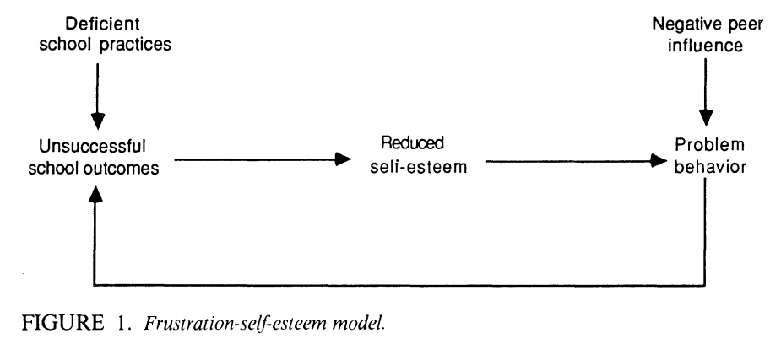
Finn (1989) (key early model, now thought to be wrong)
Drop out

Slide 18
Finn (1989) (key early model, now thought to be wrong)
Drop out

Slide 19
Motivational/attitudinal correlates of drop out (Hardre & Reeve, 2003)
Lack of intrinsic motivation
Low self-efficacy
Lack of perceived support for autonomy from teacher

Slide 20
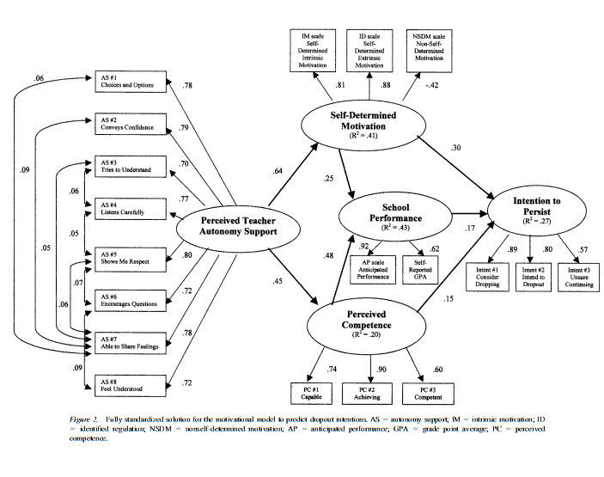

Slide 21
Motivational/attitudinal correlates of drop out
Identification with school
Internalized belief that student belongs in school
Perception that school and school goals are important
(reviewed in Finn, 1989; also see Marcus et al., 2001)

Slide 22
Behavioral correlate of drop out
Lower participation in school-related extracurricular activities (Finn, 1989; Rumberger & Lim, 2008)

Slide 23
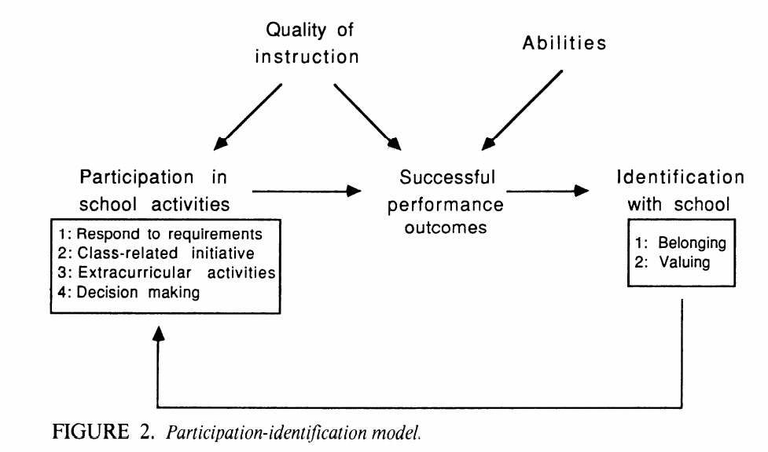
Finn (1989) Key early model, still respected
Less drop out

Slide 24
Finn (1989) Key early model, still respected
Less drop out
Including lower off-task behavior

Slide 25
Finn (1989)

Slide 26
Background correlates of drop out
Poverty (Alexander et al., 2001; meta-analysis in Rumberger & Lim, 2008)
Lower educational resources at home (review in Finn, 1989; meta-analysis in Rumberger & Lim, 2008)
Lower parental support for education (meta-analysis in Strom & Boster, 2007)
Frequent moves between schools during high school (Rumberger & Larson, 1998; meta-analysis in Rumberger & Lim, 2008)
Repeating a grade in elementary school or junior high (meta-analysis in Jimerson et al., 2002; also see Rumberger & Lim, 2008)

Slide 27
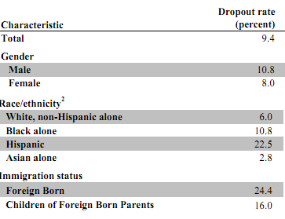
Cultural/Group Differences in Drop-Out

Slide 28
Cultural/Group Differences in Drop-Out
40% in very remote schools in the USA (review in Hardre & Reeve, 2003)
40% in very poor urban districts in the USA (Alexander et al., 2001)

Slide 29
Cultural/Group Differences in Drop-Out
The U.S. has the expectation that all students will complete high school
Not shared among all nations

Slide 30
Brazil
High-school drop-out is much more “normal” in Brazil
28% drop-out (Bruns et al., 2003)
Almost 4 times U.S. rate
In favelas in Northeastern Brazil, estimated 50-55% total drop-out (Cardoso & Verner, 2006)

Slide 31
Brazil’s Most Famous High School Dropout

Slide 32
Singapore
High-school drop-out is much less “normal” in Brazil
1.6% drop-out (MOE, 2008)
Barely 1/5 of U.S. rate
Considered a national crisis (MOE, 2008)

Slide 33
Comments? Questions?

Slide 34
Last Class (May 2)
What do you want to talk about?
One idea:
We could all draw our models of the phenomena in MMA and then compare them to the models from the first class
Other ideas?

