Slide 1
Meta-Cognition, Motivation, and Affect
PSY504 Spring term, 2011
January 25, 2010

Slide 2
Self-Explanation

Slide 3
Self-Explanation
When the student explains the content or meaning of a text they have just read (or a result they have just obtained, or a step in a worked example, etc., etc.) to themselves, in their own words

Slide 4
Self-Explanation
Does not include
monitoring statements
paraphrases
translations of individual words
bridging inferences (inferences that two sentences are referring to the same thing)

Slide 5
What are the effects of self-explanation?

Slide 6
What are the effects of self-explanation?
Better understanding, controlling for prior knowledge
True for spontaneous self-explanation (which could be selection bias), from worked examples or on-demand hints (Chi et al., 1989; Pirolli & Recker, 1994; Shih, Koedinger, & Scheines, 2008)

Slide 7
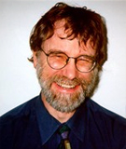
What are the effects of self-explanation?
Also true for when students are scaffolded in self-explaining (in experimental studies) (Bielaczyc & Recker, 1991; Chi et al., 1994; Conati & VanLehn, 2000; Aleven et al., 2002)

Slide 8
What characterizes good self-explanation?

Slide 9
Self-Explanation
“…Good students seem to generate explanations which relate to the principles stated in the text, as well as relating the consecutive example statements to each other” (Chi et al., 1989)

Slide 10
Qualities of Good Self-Explanation (Chi et al., 1989; Chi & VanLehn, 1991)
Considering conditions under which specific actions are advisable
Inferring consequences of an action
Considering meaning of mathematical expression

Slide 11
Qualities of Good Self-Explanation (Renkl, 1997)
Identifying the sub-goal achieved by each operator
Attempting to anticipate the next solution step

Slide 12
Qualities of Bad Self-Explanation (Chi et al., 1989; Renkl, 1997)
Simply re-phrasing the content
Making trivial inferences

Slide 13
Different kinds of self-explainers?
Renkl (1997) argues that some self-explainers focus on principles, and others focus on attempting to understand and anticipate the goal structure
Both groups are successful
As compared to students who self-explain superficially or only to a minor degree

Slide 14
Questions? Comments?

Slide 15
Why is self-explanation beneficial?

Slide 16
Why is self-explanation beneficial?
Self-explanation helps fill in gaps in student knowledge that are not immediately clear from the text or worked example (Chi & Bassok, 1989)

Slide 17
Why is self-explanation beneficial?
By self-explaining, the learner re-derives the process used to conduct the step, and can then make analogies to that process later (VanLehn et al., 1991)

Slide 18
Why is self-explanation beneficial?
Self-explanation is targeted to exactly what a student is struggling to comprehend (Chi, 2000)

Slide 19
Why is self-explanation beneficial?
Self-explanation leads to revision of incorrect or incomplete mental models (Chi, 2000)

Slide 20
Other possible explanations?

Slide 21
Which…
Which of these explanations do you think are true? Why?

Slide 22
However…
Many students do not self-explain even when they need to (Chi et al., 1989; Renkl, 1997; Chi, 2000)
Leading to the question

Slide 23
How can we scaffold self-explanation?

Slide 24
Non-interactive scaffolds

Slide 25
Chi et al., 1994
“The following is a chapter on the human circulatory system which was taken from a high school text book. We are trying to learn more about how students read and learn from a textbook, as well as what makes some textbooks better than others. In order for us to assess what information the text book is good at making understandable, it is important that you read every line very carefully–as if studying for an exam. The text is presented one sentence at a time so that you will have time to really think about what information each sentence provides and how I this relates to what you've already read. We would like you to read each sentence out loud and then explain what it means to you. That is, what new information does each line provide for you, how does it relate to what you've already read, does it give you a new insight into your understanding of how the circulatory system works, or does it raise a question in your mind. Tell us whatever is going through your mind–even if it seems unimportant. You may need to go back and re-read parts of the text to really understand all the material. Also, some people find it helpful, when reading difficult material, to draw a picture or take notes. Please feel free to do what is best for you–please use these transparencies for this purpose. Let me know when you'd like to start a new transparency”

Slide 26
Chi et al., 1994
Combined with prompts to explain
“Why?”
“Why would you say that?”

Slide 27
Renkl et al., 1998
“On the basis of a ﬁrst warm-up problem, hints to self-explain the rationale of the presented solution steps were given. The hints in this conditions focused on the subgoal of each step and the operator used to achieve it (i.e., explication of goal-operator combinations). Afterward, the learners had to try to self-explain the solution of a second warm-up problem on their own, coached by the experimenter. The coaching procedure consisted primarily of two elements: (a) If important self-explanations were omitted, this was indicated and the learners were asked to supplement the missing explanations; (b) the learners’ questions concerning the self-explanations they were expected to provide were answered… When the learners stopped self-explaining for more than 15 seconds, the experimenter asked them to go on in self-explaining”

Slide 28
Interactive scaffolds

Slide 29
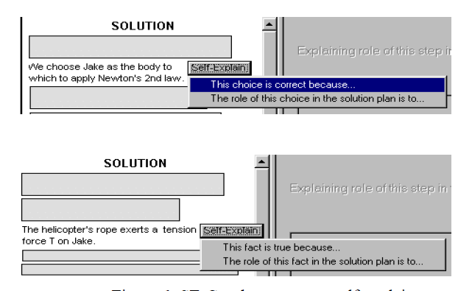
Conati & VanLehn, 2000

Slide 30
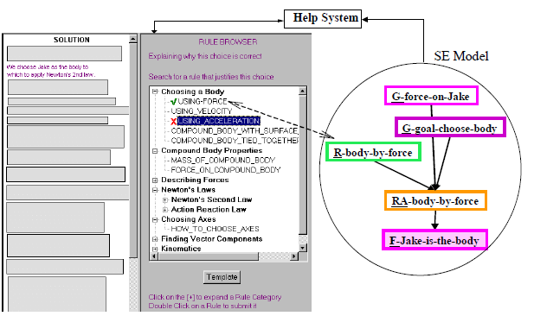
Conati & VanLehn, 2000

Slide 31
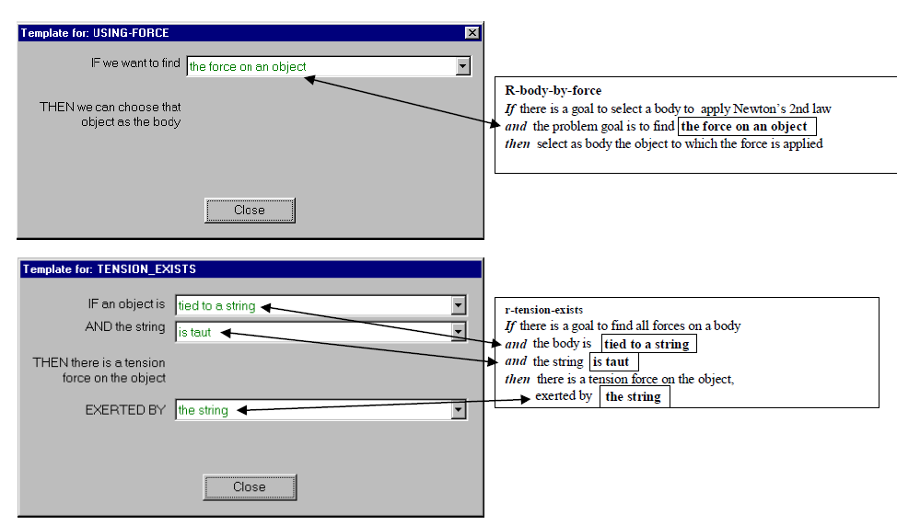
Conati & VanLehn, 2000

Slide 32
Conati & VanLehn, 2000
Student model is used to infer which steps student does not understand
Student is required to self-explain those steps

Slide 33
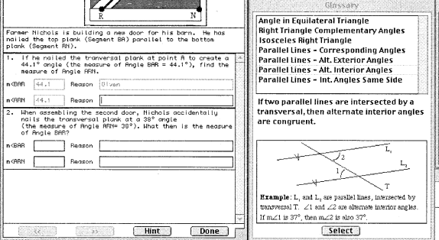
Aleven & Koedinger, 2002

Slide 34
Aleven & Koedinger, 2002
Student is required to self-explain all steps

Slide 35
Input modality
In Conati & VanLehn (2002) and in Aleven & Koedinger (2002), students select a rule or theorem from a list
In (Aleven et al., 2004), having students self-explain in natural language did not improve learning

Slide 36
One interesting aspect of Aleven, Conati
They flag incorrect self-explanations
Why might this be a good idea?

Slide 37
Which approach seems most effective?
What are the benefits and limitations of each approach?

Slide 38
Fit Hypothesis (Hausmann et al., 2008)
Students will have different learning needs in different situations
Different types of SE are beneficial in different situations
By matching SE prompts to student needs, we can improve learning

Slide 39
Fit Hypothesis (Hausmann et al., 2008)
a. Justification-based Prompts (Conati & VanLehn, 2000)
What principle is being applied on this step?
This choice is correct because…
What is the justification for this step? Why is it correct?
What law, definition, or rule allows one to draw that conclusion?
b. Meta-cognitive Prompts (Chi, et al., 1994)
What new information does each step provide for you?
How does it relate to what you've already seen?
Does it give you a new insight into your understanding of how to solve the problems?
Does it raise a question in your mind?

Slide 40
However
Thus far, the fit hypothesis has not been confirmed
Hausmann et al., 2008 found that the meta-cognitive prompts were less effective across the board
Students appeared to ignore them
Bad theory or bad implementation of prompts?

Slide 41
Questions? Comments?

Slide 42
Measurement Methods
Think-aloud studies (Chi et al., 1994)
Examining contents of self-explanations given in scaffolded interface (Conati & VanLehn, 2000; Aleven et al., 2002, 2004)
Looking for pauses at the right times in log files (Shih et al., 2008)
E.g. immediately after the student has read a hint

Slide 43
Thoughts on these types of measurement?
Any other plausible measurements?

Slide 44
Next Class
Wednesday, January 26
4am-6:10pm
Help-Seeking
Aleven, V., Stahl, E., Schworm, S., Fischer, F., Wallace, R. (2003) Help Seeking and Help Design in Interactive Learning Environments. Review of Educational Research, 73 (3), 277-320.
Karabenick, S.A. (2004) Perceived Achievement Goal Structure and College Student Help Seeking. Journal of Educational Psychology, 96 (3), 569-581.
Aleven, V., McLaren, B., Roll, I., Koedinger, K.R. (2006) Toward Meta-Cognitive Tutoring: A Model of Help-Seeking with a Cognitive Tutor. International Journal of Artificial Intelligence in Education, 16, 101-130.

Slide 45
Survey
Please complete this survey, to help me make this class better

Slide 46
The End

