Slide 1
Qualitative Methods Part One
January 20, 2010

Slide 2
Today’s Class
Probing Question for today
Qualitative Methods
Probing Question for next class

Slide 3
Probing Question
Think of something awesome that Stigler & Hiebert could do with their coded data
What could be done?
How would one go about doing it, at a very high level?
If you want, you can also pretend that Stigler & Hiebert handed out and coded any kind of paper survey or measure, as long as a student can fill it out in less than an hour

Slide 4
Why didn’t they do it?

Slide 5
Why didn’t someone else do it?

Slide 6
Open Repositories: A Major Modern Advancement
TalkBank – for video and textual data
PSLC DataShop – for software interaction data

Slide 7
Today’s Class
Probing Question for today
Qualitative Methods
Probing Question for next class

Slide 8
Qualitative Field Methods
As should be clear from the juxtaposition of Lave and Schofield, there are very different ways to do qualitative analysis

Slide 9
Where does Lave fit on this diagram?
HOLISTIC
EXISTENTIALIST
ESSENTIALIST
ENTITATIVE

Slide 10
Where does Schofield fit on this diagram?
HOLISTIC
EXISTENTIALIST
ESSENTIALIST
ENTITATIVE

Slide 11
What can we learn…
About the use of mathematics in real-life context from Lave?

Slide 12
What can we learn…
About student responses to educational technology from Schofield?

Slide 13
What are some of the key similarities between Lave and Schofield?
(in terms of methods)

Slide 14
What are some of the key similarities between Lave and Schofield?
Qualitative, observational-interviewing methods

Slide 15
What are some of the key differences between Lave and Schofield?
Both attend to the individual in terms of how they are impacted by their contexts
How shoppers are influenced by the changes in the price of noodles
How students are influenced by the tutor and by the changes it creates in the classroom

Slide 16
What are some of the key differences between Lave and Schofield?
(in terms of methods)

Slide 17
What are some of the key differences between Lave and Schofield?
“Interviewer” versus “Observer”
Does this difference reflect anything real?

Slide 18
What are some of the key differences between Lave and Schofield?
More targeted questions in Schofield, more responsive interaction in Lave

Slide 19
What are some of the key differences between Lave and Schofield?
More immediate questions in Lave

Slide 20
What are some of the key differences between Lave and Schofield?
Schofield is more interested in interactions between individuals (competition, changes in helping behavior), whereas Lave is more interested in interactions between individuals and the supermarket itself

Slide 21
What are some of the key differences between Lave and Schofield?
Schofield is more interested normative aspects of the tutor (e.g. changes to motivation and learning) whereas Lave is more interested in the interaction itself

Slide 22
What are some of the key differences between Lave and Schofield?
Phenomenology versus dialectic

Slide 23
What are some of the key differences between Lave and Schofield?
Phenomenology versus dialectic
Say what?

Slide 24
Before we go on…
Comments or questions on what we’ve discussed so far?

Slide 25
Well, here’s a question

Slide 26
Locus of interpretation
Whose interpretations (Lave’s or Schofield’s) are closer to the subject’s own interpretations of their activity?

Slide 27
Dialectic in Lave
Some examples
Do they reflect an attempt to interpret things as the subject would interpret them?

Slide 28
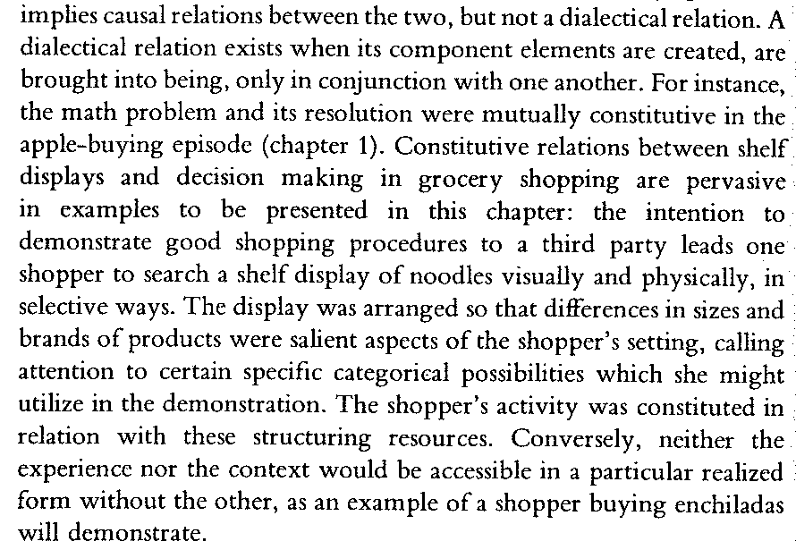
Dialectic in Lave

Slide 29
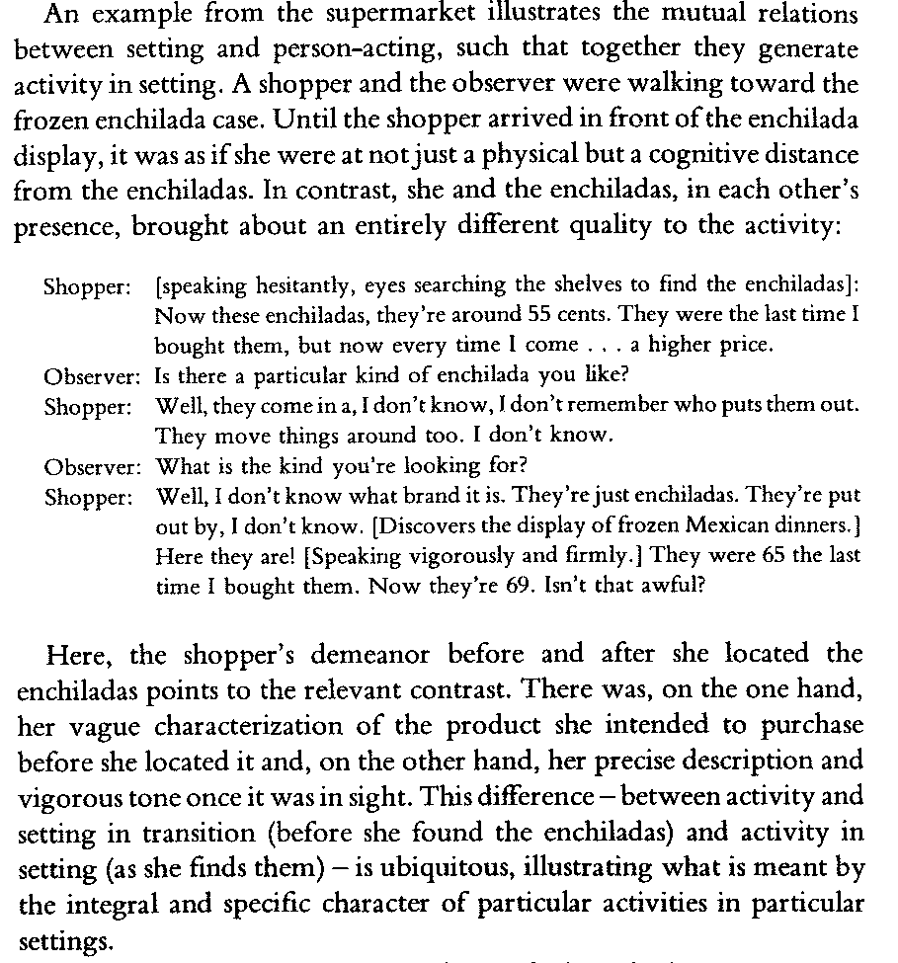
Dialectic

Slide 30
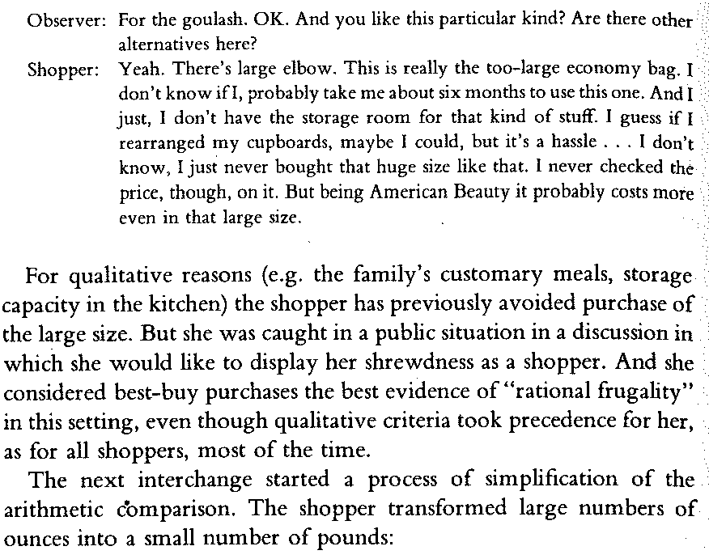

Slide 32
Locus of interpretation
Is with the analyst/the researcher
It’s hard to envision it otherwise in dialectic thought
If you are trying to model the relationship between an individual and a system, the individual’s view is less important than an objective picture of the situation, which is easier to analyze at a distance

Slide 33
Phenomenology
Understanding the subject of study as the subject of study understands her/himself
In a way that as closely as possibly approximates the subject’s understanding

Slide 34
Phenomenology
Term coined by Edmund Husserl in the 19th century
Empirical methods that attempt to gain phenomenological understanding are often referred to as ethnography
Anthropology is a discipline that focuses on this method
The method is ethnography, the goal is phenomenological understanding
There is non-empirical phenomenology as well (e.g. Kierkegaard in philosophy, James in literature) but that is not a focus of this class

Slide 35
Phenomenology/ Ethnography
The big idea:
To understand someone’s thinking, their motivation, how they understand their activity, ask them

Slide 36
Schofield does this
In interviews outside of class
On Friday, we will discuss Contextual Inquiry (CI), a method that can be used to do this in real-time
Appropriate in some situations
And not in others

Slide 37
The Ethnographic Cycle
Observe
Interpret
Ask about Interpretation

Slide 38
The Ethnographic Cycle
Observe
Interpret
Ask about Interpretation
Can be done more or less bluntly, depending on social presentation issues

Slide 39
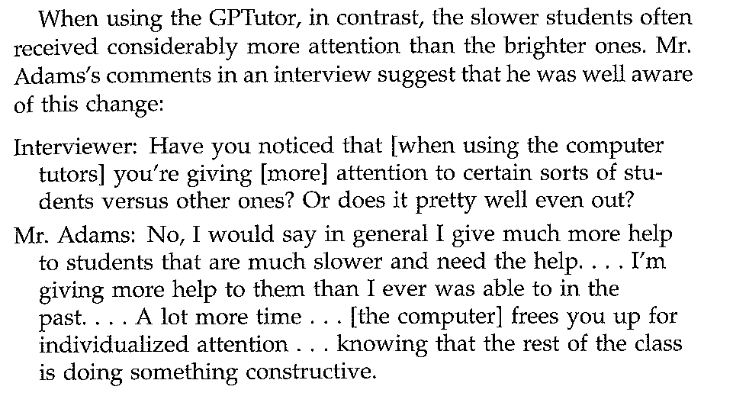

Slide 40
The Ethnographic Cycle
Observe
Interpret
Ask about Interpretation
Note that Schofield asks multiple students the same question in order to get the diversity of perspectives across the students (instead of biasing on a specific student)

Slide 41
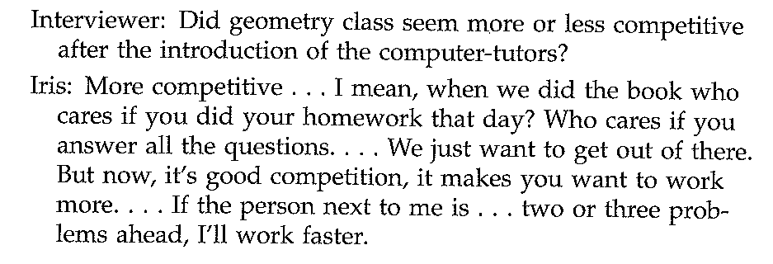

Slide 42
Locus of interpretation
Is much more with the subject

Slide 43
Another interesting dimension

Slide 44
Degree of Interference with Subject
Pure observation (Lehrer, Schauble)
Essentially what Schofield did in class sessions
Mostly observation (Lave)
With clarification questions and “keep talking” prompts
Ethnographic interviewing (Schofield)

Slide 45
Key limit to phenomenological research
You can only study a subject phenomenologically…
If the subject understands themselves well enough (with reference to the domain)
If the subject is willing to comply and answer honestly

Slide 46
Key limit to phenomenological research
You can only study a subject phenomenologically…
If the subject understands themselves well enough (with reference to the domain)
Perhaps not so useful for understanding students’ context in the educational system, or how a student is affected by teacher training programs
If the subject is willing to comply and answer honestly
Perhaps not so useful for studying bullying

Slide 47
Two Exercises
Let’s do two exercises on thinking in these different ways

Slide 48
Before we go on…
Comments or questions on what we’ve discussed so far?

Slide 49
Exercise #1: The Bully
Let’s say we are studying bullying

Slide 50
I need a bully to interview
Any volunteers?

Slide 51
Establishing Expertise
How many people have you bullied?

Slide 52
To do pure observation
We could instrument SUBJECT for the next 10 years, and every time he/she bullies someone, we’ll videotape it

Slide 53
What are some pure observation questions about SUBJECT and bullying?

Slide 54
What are some pure observation questions about SUBJECT and bullying?
How often does SUBJECT bully someone?
How long in duration is a bullying session?
Who does SUBJECT bully?
What bullying strategies does SUBJECT use most frequently?
In what situations does SUBJECT bully?

Slide 55
Note…
We could also interview SUBJECT
Some responses might be less accurate about these kinds of questions
Perhaps SUBJECT is ashamed about bullying small children and stuffed animals

Slide 56
Note…
We could also interview SUBJECT
Some responses might be less accurate about these kinds of questions
Perhaps SUBJECT is ashamed about bullying small children and stuffed animals

Slide 57
Note…
We could also interview SUBJECT
Some responses might be less accurate about these kinds of questions
Perhaps SUBJECT is ashamed about bullying small children and stuffed animals
Perhaps SUBJECT does not even realize that he/she is bullying someone

Slide 58
What are some phenonmenological questions about SUBJECT and bullying?

Slide 59
What are some phenonmenological questions about SUBJECT and bullying?
Why does SUBJECT bully small children and pets?
Why does SUBJECT like to go bullying with friends?
How does SUBJECT decide to bully at a specific moment?
Why does SUBJECT never pick on someone his/her own size?

Slide 60
What are some dialectical questions about SUBJECT and bullying?

Slide 61
What are some dialectical questions about SUBJECT and bullying?
How is SUBJECT’s bullying influenced by the pre-dominant inter-group relationships in American society?
How does the person who is bullied actively respond to the challenges created by SUBJECT’s bullying?
How does SUBJECT’s bullying differ from the predominant theoretical account for how bullying occurs?

Slide 62
Thanks for being a good sport!

Slide 63
Before we go on…
Comments or questions on what we’ve discussed so far?

Slide 64
Exercise #2: The Classroom

Slide 65
Phenomenological Observations
Watch the following video
Make interpretations about the students’ behaviors (or the teacher’s behavior)
Focusing on interpretations that we could verify with a phenomenological question

Slide 66
Phenomenological Observations
http://www.youtube.com/watch?v=lmoEWCejQIg&feature=related
From 0:00 to 2:30

Slide 67
Phenomenological Observations
Please give your interpretations

Slide 68
Phenomenological Observations
For each interpretation, what question could you ask the student (or teacher) later to understand whether your interpretation is correct?

Slide 69
Dialectical Observations
Watch the following video
Make interpretations about the students’ decisions (or teacher’s decisions) that are of a dialectical nature
What are the patterns, the dialectical conflicts, the relationships, the positioning of students within a system (and their cooperation or resistance of that situation)?

Slide 70
Dialectical Observations
http://www.youtube.com/watch?v=lmoEWCejQIg&feature=related
From 0:00 to 2:30

Slide 71
Dialectical Observations
Please give your interpretations

Slide 72
Dialectical Observations
How could you validate your interpretations?

Slide 73
Comments or Questions?
On anything…

Slide 74
Today’s Class
Probing Question for today
Qualitative Methods
Probing Question for next class

Slide 75
None
You all seem pretty busy with the assignment!

Slide 76
The End

