Slide 1
HUDM4122 Probability and Statistical Inference
April 27, 2015

Slide 2
Given that we ran behind last class…
I will be compressing the last three lectures a little, and switching order
To ensure that we thoroughly cover the most important remaining points

Slide 3
In the remainder of today’s lecture
We will start our discussion of ANOVA
Analysis of Variance

Slide 4
In the previous lecture on χ²
We discussed comparing proportions between categorical variables

Slide 5
What if we want to compare several means?
Which in its simplest form is
One categorical variable
One quantitative variable

Slide 6
Like the two-group t-test
But more than two groups!

Slide 7
Example
The Mt. Vernon City School District is considering 5 science curricula
Interactive Science
Holt Science Spectrum
McDougal Littell Science
CK-12 Science
Bob’s Discount Science Curriculum
They randomly divide students into five groups, and each classroom uses one curriculum

Slide 8
You could just…
Run (5 choose 2)=10 statistical significance tests
But there’s an issue with that
You’re running 10 statistical significance tests
Which means you have a high chance that one or more will be significant just by chance

Slide 9
And if you just cherry-pick from the set…
For example, comparing the best curriculum to the worst one
You have that same risk, you’re just hiding it from yourself

Slide 10
There are valid ways to run several tests
They’re called post-hoc tests
If we have time at the very end of the semester, I will briefly cover one such test, Benjamini & Hochberg
If we don’t make it there, see
Chapter 5, Video 1 in http://www.columbia.edu/~rsb2162/bigdataeducation.html
Important note: Many stats courses will teach you to use the Bonferroni procedure, or Tukey’s HSD (Ch. 11-6!), in these situations
Not preferred today by most statisticians

Slide 11
Typically what people do is
First run an omnibus ANOVA to see if there are any differences between groups at all
Then do the post-hoc tests for individual comparisons

Slide 12
Idea behind ANOVA
How much variance is there in the data overall?
Use that to compute whether there’s a difference between groups

Slide 13
Idea behind ANOVA
We take the total variation in the data
And we divide it into the amount that can be attributed to each factor of interest
This can be used for much more complex analyses than just one categorical, one quantitative!

Slide 14
Assumptions of ANOVA
There are k groups
Your data within each group is normally distributed
There is a common variance σ² across groups

Slide 15
ANOVA is not just one test
It’s an entire family of tests
Starting with simple multi-group extensions of two-group t-tests and paired t-tests
And going to extensions like MANOVA where you’re predicting multiple variables at once

Slide 16
And again…
The reason to look for overall differences before hunting for individual differences between groups
Is to avoid running lots and lots and lots of tests

Slide 17
Single-factor ANOVA
One categorical variable
One quantitative variable

Slide 18
Single-factor ANOVA
H₀ : All groups have the same mean μ
H_{a} : At least one group has a mean that is statistically significantly different than the other means

Slide 19
Example Again
The Mt. Vernon City School District is considering 5 science curricula
Interactive Science
Holt Science Spectrum
McDougal Littell Science
CK-12 Science
Bob’s Discount Science Curriculum
They randomly divide students into five groups, and each classroom uses one curriculum

Slide 20
You have k samples from k populations
In this case 5 samples from 5 populations
With sample means
${\overline{x}}_{1},$ ${\overline{x}}_{2},$ ${\overline{x}}_{3},$ ${\overline{x}}_{4},$ ${\overline{x}}_{5}$
And sample standard deviations are close enough to hypothesize that there is a common σ²
Is at least one mean higher or lower than the rest?

Slide 21
Common variance but different means

Slide 22
What we do
Take $x_{ij}$, the j-th data point for the i-th sample
And take the overall sample mean, $\overline{x}$
In that case, we can assess the total variation in the experiment as the total sum of squares

Slide 23

Total Sum of Squares
Can be written two ways
Total SS = $\sum{{(x_{ij} − \overline{x})}^{2}}$
Total SS = $\sum{{x_{ij}}^{2}−\frac{{(\sum{x_{ij}})}^{2}}{n}}$
Easier to compute
Theoretically useful

Slide 24
Total Sum of Squares
Is made up of two components
The sum of squares for treatments (SST)
The sum of squares for errors (SSE)
Total SS = SST + SSE

Slide 25
Sum of Squares for Treatments (SST)
The variance attributable to the difference between treatments
SST = $\sum{n_{i}{({\overline{x}}_{i}−\overline{x})}^{2}}$

Slide 26
Sum of Squares for Errors (SSE)
The pooled variation in the k samples
SSE = $\left(n_{1}−1\right){s_{1}}^{2}+\left(n_{2}−1\right){s_{2}}^{2}$ + … + $\left(n_{k}−1\right){s_{k}}^{2}$

Slide 27
Note
Since Total SS = SST + SSE
You only need to calculate two of them…
Although calculating all three can be a good way to check yourself…

Slide 28
Once you have Total SS, SST, SSE
You can find the degrees of freedom for each
And then compute the mean squares
Which are used to conduct an ANOVA

Slide 29
Degrees of freedom
Degrees of freedom on total SS = (n-1)
Degrees of freedom on SST = (k-1)
Degrees of freedom on SSE = n-k

Slide 30
Mean squares
MSS = TSS/df(TSS)
MST = SST/df(SST)
MSE = SSE/df(SSE)
MSE is a pooled estimate of σ²

Slide 31
Now we can test our null hypothesis
H₀ : All groups have the same mean μ
H_{a} : At least one group has a mean that is statistically significantly different than the other means

Slide 32
How do we test it?
Well, if H₀ is true
Then MST = MSE
Because the variation between groups will be the same as the variation within all groups

Slide 33
How do we test it?
But if H₀ is false
Then MST > MSE
Because the variation between groups will be different than the variation within all groups

Slide 34
So we can compute
F = $\frac{MST}{MSE}$
Where F is a new distribution that we haven’t seen before

Slide 35
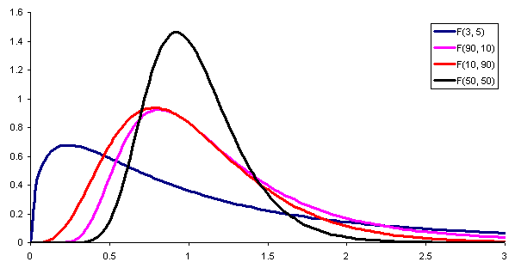
F Distribution
From www.epixanalytics.com

Slide 36
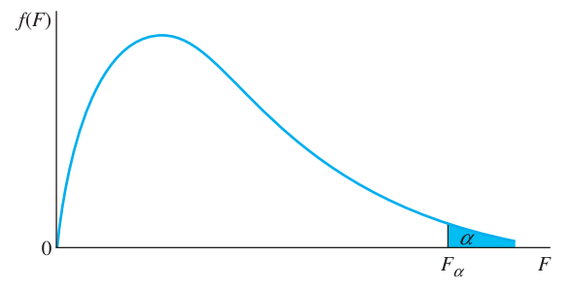
Rejection Region

Slide 37
F Distribution
Is the ratio of two χ² distributions
F = χ₁² (df₁)/ χ₂² (df₂)

Slide 38
F Distribution
And as such, it has two types of degrees of freedom
F = χ₁² (df₁)/ χ₂² (df₂)
numerator df
denominator df

Slide 39
F distribution
Numerator degrees of freedom
MST degrees of freedom
k-1
Denominator degrees of freedom:
MSE degrees of freedom
n-k

Slide 40
Finding the p value
For a given F value, denominator degrees of freedom df (MST), and numerator degrees of freedom df (MSE)
=FDIST(F,df(MST),df(MSE)
Written F(df(MST),df(MST))=f, p =

Slide 41
Comments? Questions?

Slide 42
Example: Student Attitudes
Interactive Science: 3, 4, 5
Holt Science Spectrum: 5, 5, 4
McDougal Littell Science: 4, 4, 5
CK-12 Science: 3, 3, 4
Bob’s Discount Science Curriculum: 1, 1, 2

Slide 43
$$\overline{x}=3.5333$$
Interactive Science: 3, 4, 5
Holt Science Spectrum: 5, 5, 4
McDougal Littell Science: 4, 4, 5
CK-12 Science: 3, 3, 4
Bob’s Discount Science Curriculum: 1, 1, 2

Slide 44
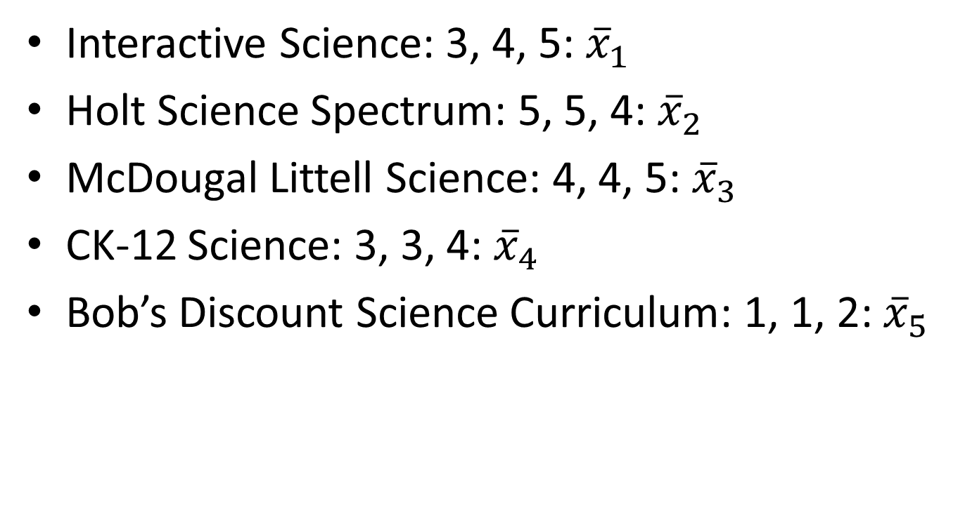
$$\overline{x}=3.5333$$
Interactive Science: 3, 4, 5: ${\overline{x}}_{1}$
Holt Science Spectrum: 5, 5, 4: ${\overline{x}}_{2}$
McDougal Littell Science: 4, 4, 5: ${\overline{x}}_{3}$
CK-12 Science: 3, 3, 4: ${\overline{x}}_{4}$
Bob’s Discount Science Curriculum: 1, 1, 2: ${\overline{x}}_{5}$

Slide 45
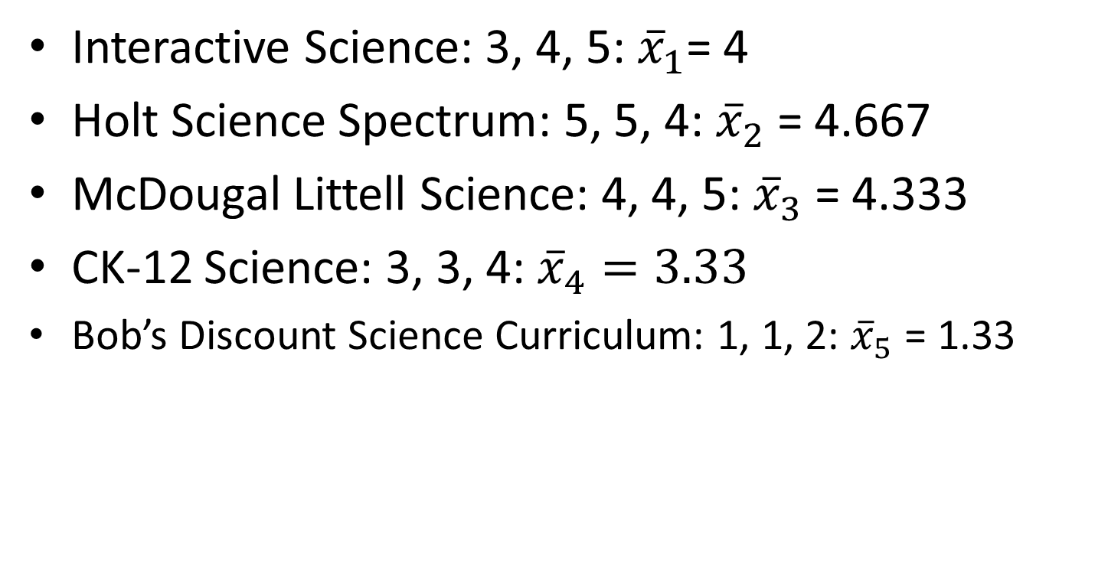
$$\overline{x}=3.5333$$
Interactive Science: 3, 4, 5: ${\overline{x}}_{1}$= 4
Holt Science Spectrum: 5, 5, 4: ${\overline{x}}_{2}$ = 4.667
McDougal Littell Science: 4, 4, 5: ${\overline{x}}_{3}$ = 4.333
CK-12 Science: 3, 3, 4: ${\overline{x}}_{4}=3.33$
Bob’s Discount Science Curriculum: 1, 1, 2: ${\overline{x}}_{5}$ = 1.33

Slide 46
$$\text{Total} \text{SS}\text{ = }\sum{{(x_{ij} − \overline{x})}^{2}}$$
Interactive Science: 3, 4, 5: ${\overline{x}}_{1}$= 4
Holt Science Spectrum: 5, 5, 4: ${\overline{x}}_{2}$ = 4.667
McDougal Littell Science: 4, 4, 5: ${\overline{x}}_{3}$ = 4.333
CK-12 Science: 3, 3, 4: ${\overline{x}}_{4}=3.33$
Bob’s Discount Science Curriculum: 1, 1, 2: ${\overline{x}}_{5}$ = 1.33

Slide 47
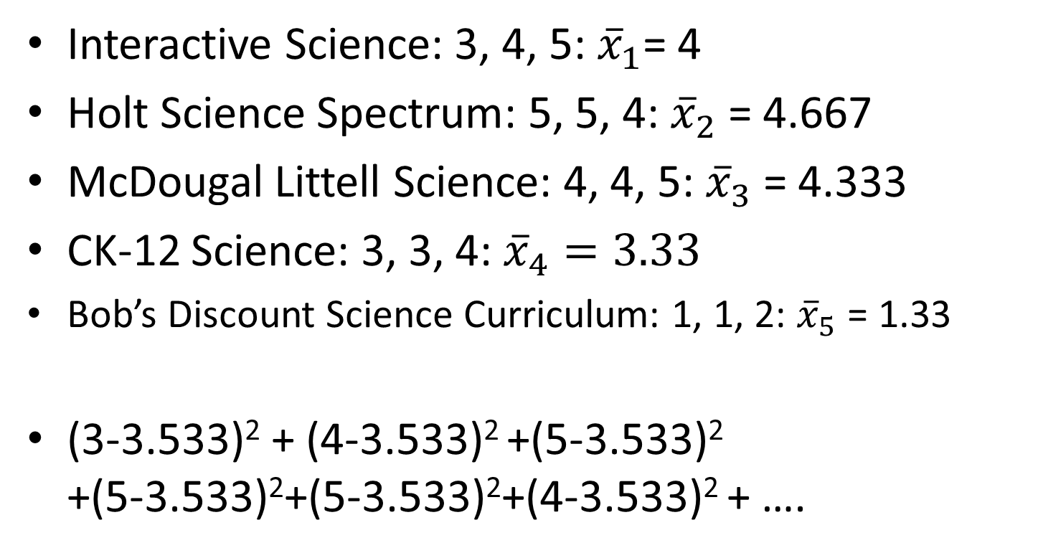
$$\text{Total} \text{SS}\text{ = }\sum{{(x_{ij} − \overline{x})}^{2}}$$
Interactive Science: 3, 4, 5: ${\overline{x}}_{1}$= 4
Holt Science Spectrum: 5, 5, 4: ${\overline{x}}_{2}$ = 4.667
McDougal Littell Science: 4, 4, 5: ${\overline{x}}_{3}$ = 4.333
CK-12 Science: 3, 3, 4: ${\overline{x}}_{4}=3.33$
Bob’s Discount Science Curriculum: 1, 1, 2: ${\overline{x}}_{5}$ = 1.33
(3-3.533)² + (4-3.533)² +(5-3.533)² +(5-3.533)²+(5-3.533)²+(4-3.533)² + ….

Slide 48
$$\text{Total} \text{SS}\text{ = }\sum{{(x_{ij} − \overline{x})}^{2}=25.7333}$$
Interactive Science: 3, 4, 5: ${\overline{x}}_{1}$= 4
Holt Science Spectrum: 5, 5, 4: ${\overline{x}}_{2}$ = 4.667
McDougal Littell Science: 4, 4, 5: ${\overline{x}}_{3}$ = 4.333
CK-12 Science: 3, 3, 4: ${\overline{x}}_{4}=3.33$
Bob’s Discount Science Curriculum: 1, 1, 2: ${\overline{x}}_{5}$ = 1.33
(3-3.533)² + (4-3.533)² +(5-3.533)² +(5-3.533)²+(5-3.533)²+(4-3.533)² + ….

Slide 49
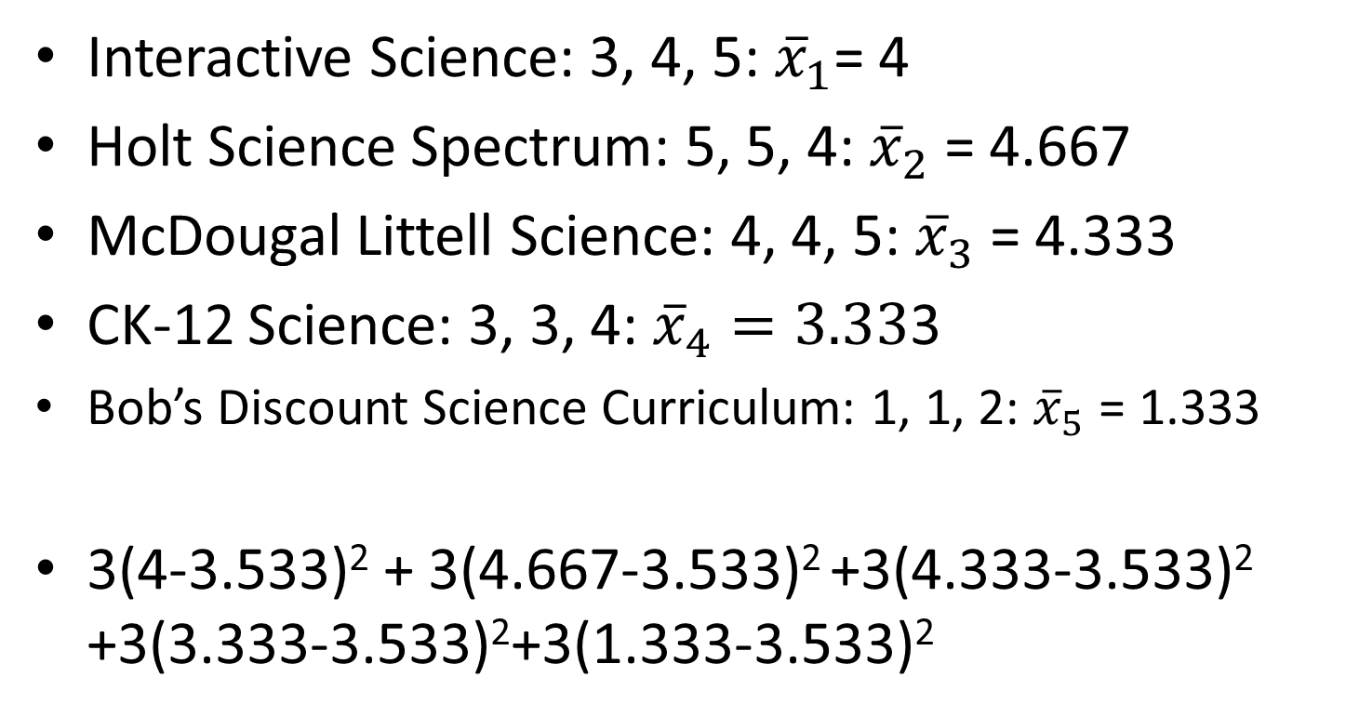
$$\text{SST}\text{ = }\sum{n_{i}{({\overline{x}}_{i}−\overline{x})}^{2}}$$
Interactive Science: 3, 4, 5: ${\overline{x}}_{1}$= 4
Holt Science Spectrum: 5, 5, 4: ${\overline{x}}_{2}$ = 4.667
McDougal Littell Science: 4, 4, 5: ${\overline{x}}_{3}$ = 4.333
CK-12 Science: 3, 3, 4: ${\overline{x}}_{4}=3.33$3
Bob’s Discount Science Curriculum: 1, 1, 2: ${\overline{x}}_{5}$ = 1.333
3(4-3.533)² + 3(4.667-3.533)² +3(4.333-3.533)² +3(3.333-3.533)²+3(1.333-3.533)²

Slide 50
$\text{SST}\text{ = }\sum{n_{i}{({\overline{x}}_{i}−\overline{x})}^{2}}$ = 21.0667
Interactive Science: 3, 4, 5: ${\overline{x}}_{1}$= 4
Holt Science Spectrum: 5, 5, 4: ${\overline{x}}_{2}$ = 4.667
McDougal Littell Science: 4, 4, 5: ${\overline{x}}_{3}$ = 4.333
CK-12 Science: 3, 3, 4: ${\overline{x}}_{4}=3.33$3
Bob’s Discount Science Curriculum: 1, 1, 2: ${\overline{x}}_{5}$ = 1.333
3(4-3.533)² + 3(4.667-3.533)² +3(4.333-3.533)² +3(3.333-3.533)²+3(1.333-3.533)²

Slide 51
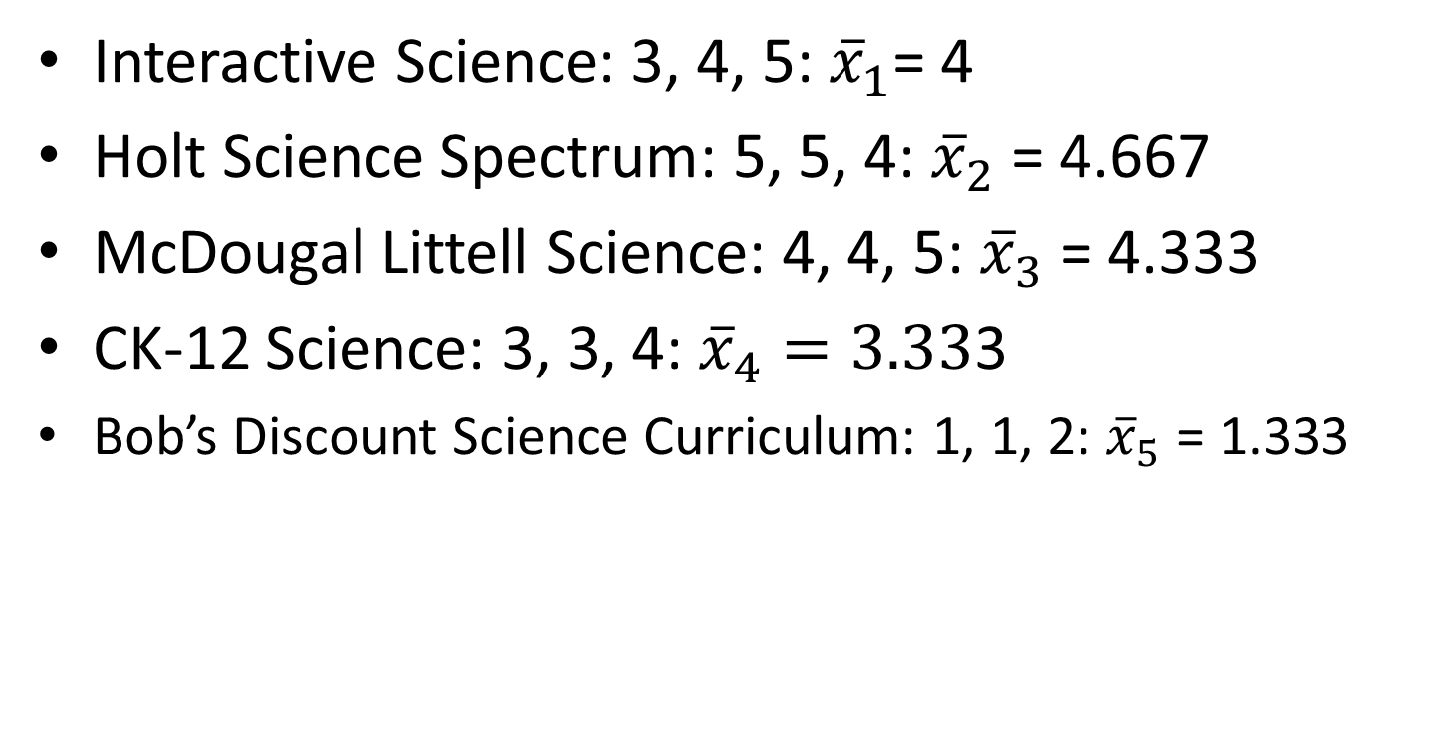
Total SS = SST + SSE
Interactive Science: 3, 4, 5: ${\overline{x}}_{1}$= 4
Holt Science Spectrum: 5, 5, 4: ${\overline{x}}_{2}$ = 4.667
McDougal Littell Science: 4, 4, 5: ${\overline{x}}_{3}$ = 4.333
CK-12 Science: 3, 3, 4: ${\overline{x}}_{4}=3.33$3
Bob’s Discount Science Curriculum: 1, 1, 2: ${\overline{x}}_{5}$ = 1.333

Slide 52
Total SS = SST + SSE $25.7333$ = 21.0667 + SSE
Interactive Science: 3, 4, 5: ${\overline{x}}_{1}$= 4
Holt Science Spectrum: 5, 5, 4: ${\overline{x}}_{2}$ = 4.667
McDougal Littell Science: 4, 4, 5: ${\overline{x}}_{3}$ = 4.333
CK-12 Science: 3, 3, 4: ${\overline{x}}_{4}=3.33$3
Bob’s Discount Science Curriculum: 1, 1, 2: ${\overline{x}}_{5}$ = 1.333

Slide 53
$25.7333$ = 21.0667 + SSE SSE = 4.6667
Interactive Science: 3, 4, 5: ${\overline{x}}_{1}$= 4
Holt Science Spectrum: 5, 5, 4: ${\overline{x}}_{2}$ = 4.667
McDougal Littell Science: 4, 4, 5: ${\overline{x}}_{3}$ = 4.333
CK-12 Science: 3, 3, 4: ${\overline{x}}_{4}=3.33$3
Bob’s Discount Science Curriculum: 1, 1, 2: ${\overline{x}}_{5}$ = 1.333

Slide 54
DF
Degrees of freedom on SST = (k-1)
DF(SST) = (5-1)=4
Degrees of freedom on SSE = n-k
DF(SSE) = 15-4 = 11

Slide 55
Mean Squares
MST = SST/df(SST) = 21.0667/4 = 5.2667
MSE = SSE/df(SSE) = 4.6667/11 = 0.4242

Slide 56
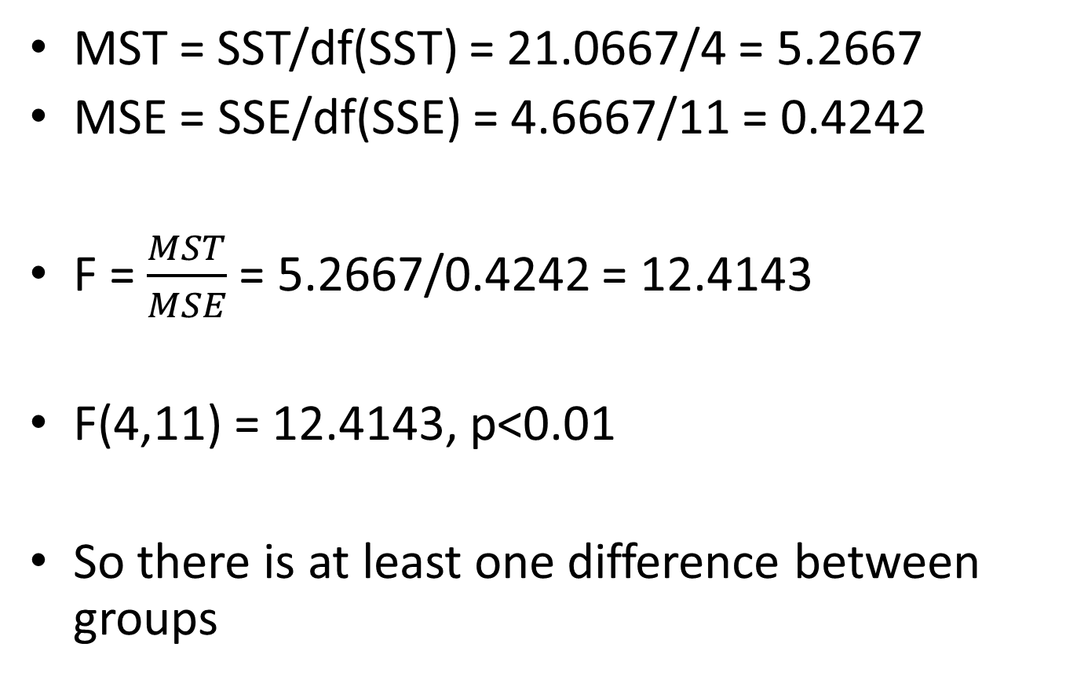
F
MST = SST/df(SST) = 21.0667/4 = 5.2667
MSE = SSE/df(SSE) = 4.6667/11 = 0.4242
F = $\frac{MST}{MSE}$ = 5.2667/0.4242 = 12.4143
F(4,11) = 12.4143, p<0.01
So there is at least one difference between groups

Slide 57
Questions? Comments?

Slide 58
You Try It
Student Numbers of Complaints by Class
Interactive Science: 2, 4, 4
Holt Science Spectrum: 4, 4, 5
McDougal Littell Science: 3, 2, 3
CK-12 Science: 3, 4, 3
Bob’s Discount Science Curriculum: 4, 3, 4

Slide 59
Upcoming Classes
5/4 HW 11 due
5/6 HW 12 due
5/6 3pm REVIEW SESSION, RUSSELL 302
5/8 noon REVIEW SESSION, GRACE DODGE 453
5/11 FINAL EXAM

