Slide 1
HUDM4122
Probability and Statistical Inference
February 25, 2015

Slide 2
HW
You guys did well on this HW overall! Nice job!

Slide 3
Let’s start with the one with the wrong answer
In the famous words of U.S. President Ulysses S. Grant, "I only know two tunes: one of them is Yankee Doodle, and the other isn't."
Let's say a band is playing a tune at the White House. In general, there's a 5% chance the tune is Yankee Doodle, and a 95% chance the tune isn't.
President Grant observes that when the tune is Yankee Doodle, people sing along 70% of the time. When the tune isn't Yankee Doodle, people sing along 20% of the time.
A tune is being played, and people are singing along.
What's the probability that the tune is Yankee Doodle, given that people are singing along?

Slide 4
Mapping the variables
A= singing
S1 = Yankee Doodle
S2 = Not Yankee Doodle

Slide 5
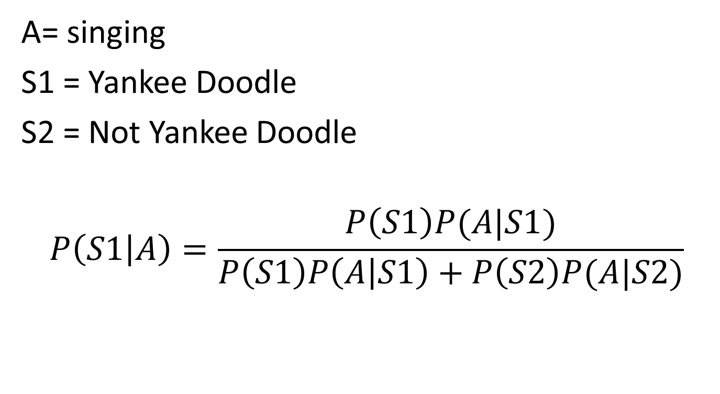
Bayes Rule
A= singing
S1 = Yankee Doodle
S2 = Not Yankee Doodle
$$P\left(S1 | A\right)=\frac{P\left(S1\right)P(A|S1)}{P\left(S1\right)P\left(A | S1\right)+P\left(S2\right)P(A|S2)}$$

Slide 6
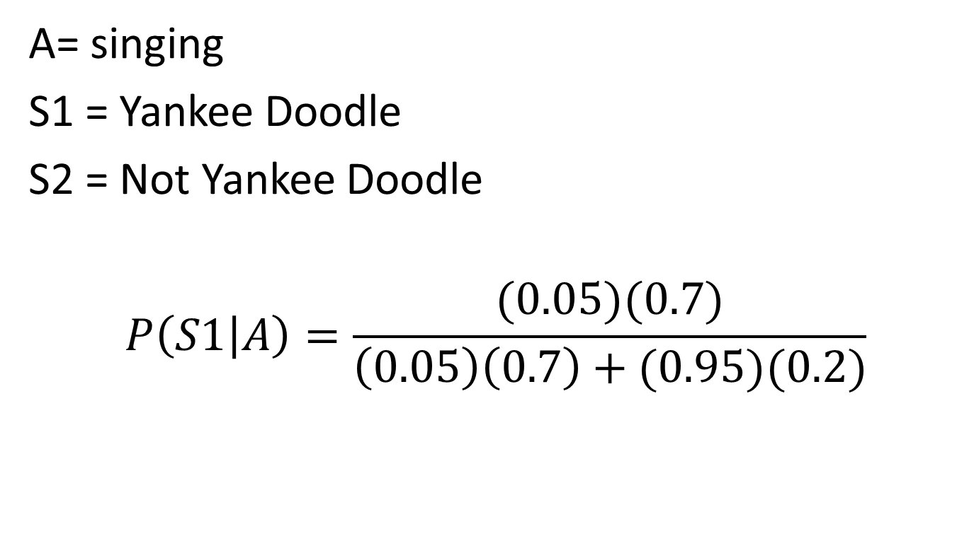
Plugging in Numbers
A= singing
S1 = Yankee Doodle
S2 = Not Yankee Doodle
$$P\left(S1 | A\right)=\frac{(0.05)(0.7)}{\left(0.05\right)\left(0.7\right)+(0.95)(0.2)}$$

Slide 7
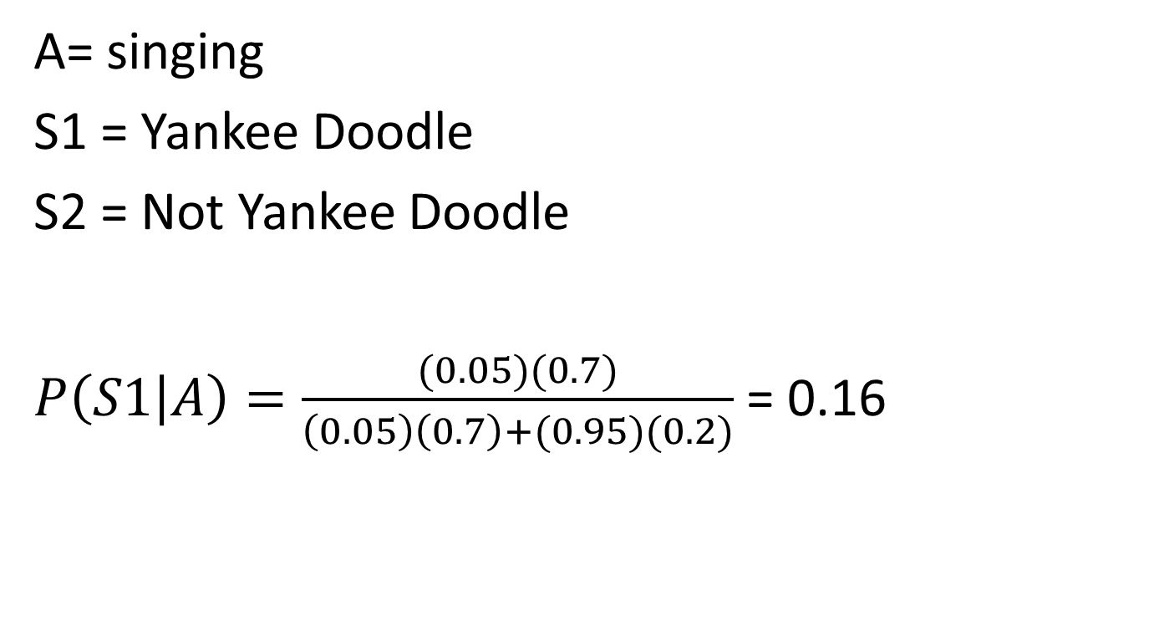
Plugging in Numbers
A= singing
S1 = Yankee Doodle
S2 = Not Yankee Doodle
$P\left(S1 | A\right)=\frac{(0.05)(0.7)}{\left(0.05\right)\left(0.7\right)+(0.95)(0.2)}$ = 0.16

Slide 8
Any questions?
Almost everyone got this one right
and then got incorrected by the system

Slide 9
Difficult Problem
A researcher is using the BROMP protocol for coding student affect in classroom settings. In BROMP, a researcher codes each student's affect in terms of a set of mutually exclusive categories. The observer finds that 25% of students are bored, 15% of students are frustrated, 10% of students are confused, and 30% of students are in a state of engaged concentration. If a student is bored, there is a 30% chance they are off-task. If a student is frustrated, there is a 10% chance they are off-task. If a student is confused, there is a 10% chance they are off-task. If a student is in a state of engaged concentration, there is a 5% chance they are off-task. Can the Law of Total Probability be applied in this case?

Slide 10
What’s the answer?
A researcher is using the BROMP protocol for coding student affect in classroom settings. In BROMP, a researcher codes each student's affect in terms of a set of mutually exclusive categories. The observer finds that 25% of students are bored, 15% of students are frustrated, 10% of students are confused, and 30% of students are in a state of engaged concentration. If a student is bored, there is a 30% chance they are off-task. If a student is frustrated, there is a 10% chance they are off-task. If a student is confused, there is a 10% chance they are off-task. If a student is in a state of engaged concentration, there is a 5% chance they are off-task. Can the Law of Total Probability be applied in this case?

Slide 11
No, because B+F+C+E=80% and it needs to add to 100%
A researcher is using the BROMP protocol for coding student affect in classroom settings. In BROMP, a researcher codes each student's affect in terms of a set of mutually exclusive categories. The observer finds that 25% of students are bored, 15% of students are frustrated, 10% of students are confused, and 30% of students are in a state of engaged concentration. If a student is bored, there is a 30% chance they are off-task. If a student is frustrated, there is a 10% chance they are off-task. If a student is confused, there is a 10% chance they are off-task. If a student is in a state of engaged concentration, there is a 5% chance they are off-task. Can the Law of Total Probability be applied in this case?

Slide 12
Other questions about HW?

Slide 13
In the last class
We studied Probability Distributions

Slide 14
Probability Distribution
A probability distribution for random variable X
  gives the possible values of X, x₁…x_{n}
  And the probability p(x_{i}) associated with each value of X
  Each value of X is mutually exclusive
  The sum of p(x_{i}) adds to 1

Slide 15
Example
I flip a coin twice
The number of heads can be 0, 1, or 2
TT: 0
TH:1
HT:1
HH:2

Slide 16
Example
I flip a coin twice
The number of heads can be 0, 1, or 2
TT: 0
TH:1
HT:1
HH:2
x | P(x)
0 | 1/4
1 | 1/2
2 | 1/4

Slide 17
Probability Histogram
x | P(x)
0 | 0.25
1 | 0.5
2 | 0.25

Slide 18
Today
Chapter 5.2 in Mendenhall, Beaver, & Beaver
Binomial Probability Distribution

Slide 19
What we just looked at
Was a binomial probability distribution

Slide 20
What we just looked at
Was a binomial probability distribution
A distribution coming out of two possible outcomes, repeated multiple times

Slide 21
“Binomial”
“Bi” means two
Like “Biplane” – Plane with two wings
Or “Biathlon” – Two athletic events
Or “Bicorn” – An animal with two horns, seen in Harry Potter and My Little Pony

Slide 22
Where it comes from
A binomial probability distribution comes from a binomial experiment

Slide 23
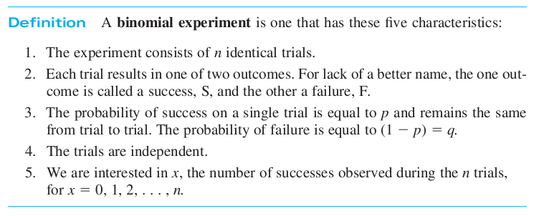
Definition (from the book)

Slide 24
Examples
You flip the same coin ten times and count the number of heads

Slide 25
Examples
You flip the same coin ten times and count the number of heads
You study the proportion of students in a school who are gang members

Slide 26
Examples
You flip the same coin ten times and count the number of heads
You study the proportion of students in a school who are gang members
You study the proportion of Teachers College faculty who belong to the American Educational Research Association

Slide 27
Examples
You flip the same coin ten times and count the number of heads
You study the proportion of students in a school who are gang members
You study the proportion of Teachers College faculty who belong to the American Educational Research Association (a.k.a gang members)

Slide 28
Examples
You flip the same coin ten times and count the number of heads
You study the proportion of students in a school who are gang members
You study the proportion of Teachers College faculty who belong to the American Educational Research Association (a.k.a gang members)
You study the number of students who have ever gotten an A+

Slide 29
Expanding it out

Slide 30
Expanding it out
You study 10,000 students, and count the number who have ever gotten an A+

Slide 31
Expanding it out
You study 10,000 students, and count the number who have ever gotten an A+
Each trial is identical – you select a student and see whether or not they have gotten an A+
There are two outcomes: Ever A+, Never A+
P(Ever A+) is the same across the population.
The students are independent (if randomly sampled)
You are interested in the number who have ever gotten an A+

Slide 32
Are these binomial experiments?
Your friend throws a basketball 100 times; you want to see how often it goes in

Slide 33
Are these binomial experiments?
Your friend throws a basketball 100 times; you want to see how often it goes in
  Yes

Slide 34
Are these binomial experiments?
You take a bag of M&Ms with 5 green M&Ms out of 20
8 of your friends each takes an M&M out of the bag
How many green M&Ms should you expect to get?

Slide 35
Are these binomial experiments?
You take a bag of M&Ms with 5 green M&Ms out of 20
8 of your friends each takes an M&M out of the bag
How many green M&Ms should you expect to get?
  No, because there is a finite pool of M&Ms, so the probability changes each time you take out an M&M

Slide 36
Are these binomial experiments?
You ask 1,000 randomly sampled students if they have ever cheated on a test

Slide 37
Are these binomial experiments?
You ask 1,000 randomly sampled students if they have ever cheated on a test
  Yes

Slide 38
Are these binomial experiments?
Three candidates are running for political office. You randomly poll 1000 people as to who they plan to vote for, to see the proportion of probable voters for each candidate

Slide 39
Are these binomial experiments?
Three candidates are running for political office. You randomly poll 1000 people as to who they plan to vote for, to see the proportion of probable voters for each candidate
  No, but it could easily be turned into a binomial experiment by just treating the data as “Candidate A” versus “Not Candidate A”

Slide 40
Are these binomial experiments?
You randomly select 10,000 people and measure their height, to determine the average height in the population

Slide 41
Are these binomial experiments?
You randomly select 10,000 people and measure their height, to determine the average height in the population
  No, because height is numerical rather than binomial

Slide 42
Questions? Comments?

Slide 43
The Green M&M question
Note that the difference between the Green M&M question and the other questions is that the Green M&M question had a small population
We weren’t looking at the population of all M&Ms
We were looking at the population of M&Ms in that bag

Slide 44
Big populations and little populations
If the sample size is close to the population size
Then the probabilities will vary from trial to trial, and the experiment isn’t binomial

Slide 45
Book Rule of Thumb
Take sample size n
Take population size N
If n/N >= 0.05, do not treat experiment as binomial
That 0.05 is a magic number
We’ll see it again later in the semester…

Slide 46
Important Note
P(S) and P(~S) do not have to be 0.5!
They just have to be the same (or very very very close to the same) every time

Slide 47
Example
Your friend throws a basketball 100 times; you want to see how often it goes in

Slide 48
Example
Your friend throws a basketball 100 times; you want to see how often it goes in
  Perhaps, if your friend is DeAndre Jordan, P(S) = 72%

Slide 49
Example
Your friend throws a basketball 100 times; you want to see how often it goes in
  Perhaps, if your friend is DeAndre Jordan, P(S) = 72%
  Perhaps, if your friend is Joe Fulks, the worst NBA player in the Hall of Fame (in terms of this statistic), P(S) = 30%

Slide 50
Example
Your friend throws a basketball 100 times; you want to see how often it goes in
  Perhaps, if your friend is DeAndre Jordan, P(S) = 72%
  Perhaps, if your friend is Joe Fulks, the worst NBA player in the Hall of Fame (in terms of this statistic), P(S) = 30%
  Perhaps, if your friend is Ryan Baker, P(S) = 0.001%

Slide 51
Questions? Comments?

Slide 52
Computing the mean/expected value
You can imagine that for large numbers of trials, and percentages of p that are not 50%, the math might get kind of complicated

Slide 53
Computing the mean/expected value
You can imagine that for large numbers of trials, and percentages of p that are not 50%, the math might get kind of complicated
And you’re right

Slide 54
Computing the mean/expected value
Fortunately, although the formula for probabilities is a bit awkward
  We’ll look at it in a minute
The formulas for mean/expected value, and standard deviation are quite simple

Slide 55
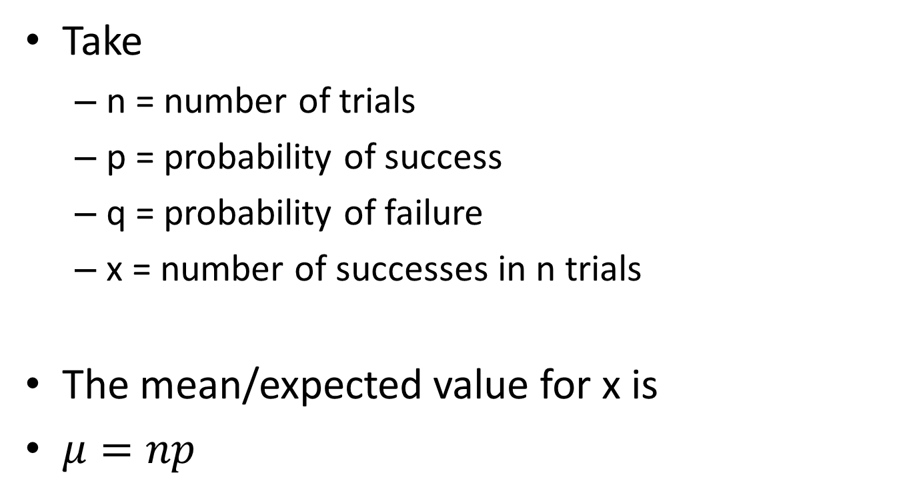
Computing the mean/expected value
Take
  n = number of trials
  p = probability of success
  q = probability of failure
  x = number of successes in n trials
The mean/expected value for x is
$μ=np$

Slide 56
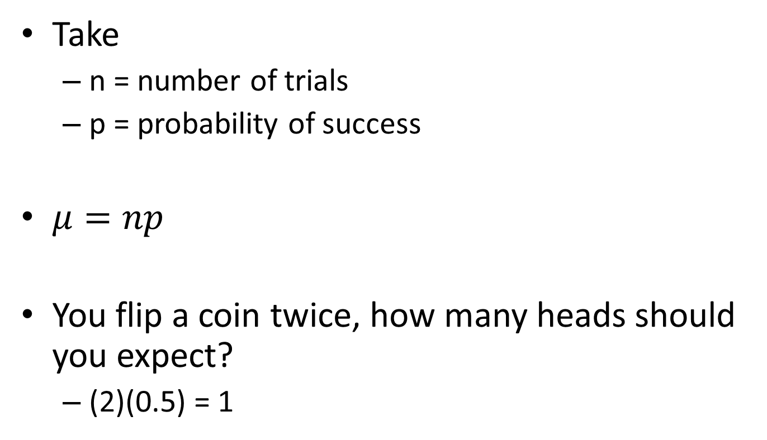
Example
Take
  n = number of trials
  p = probability of success
$μ=np$
You flip a coin twice, how many heads should you expect?
  (2)(0.5) = 1

Slide 57
Which you may remember, is the right answer!
x | P(x)
0 | 0.25
1 | 0.5
2 | 0.25
(0)(0.25)+(1)(0.5)+(2)(0.25)

Slide 58
“But I could have done that by hand!”
I hear you say

Slide 59
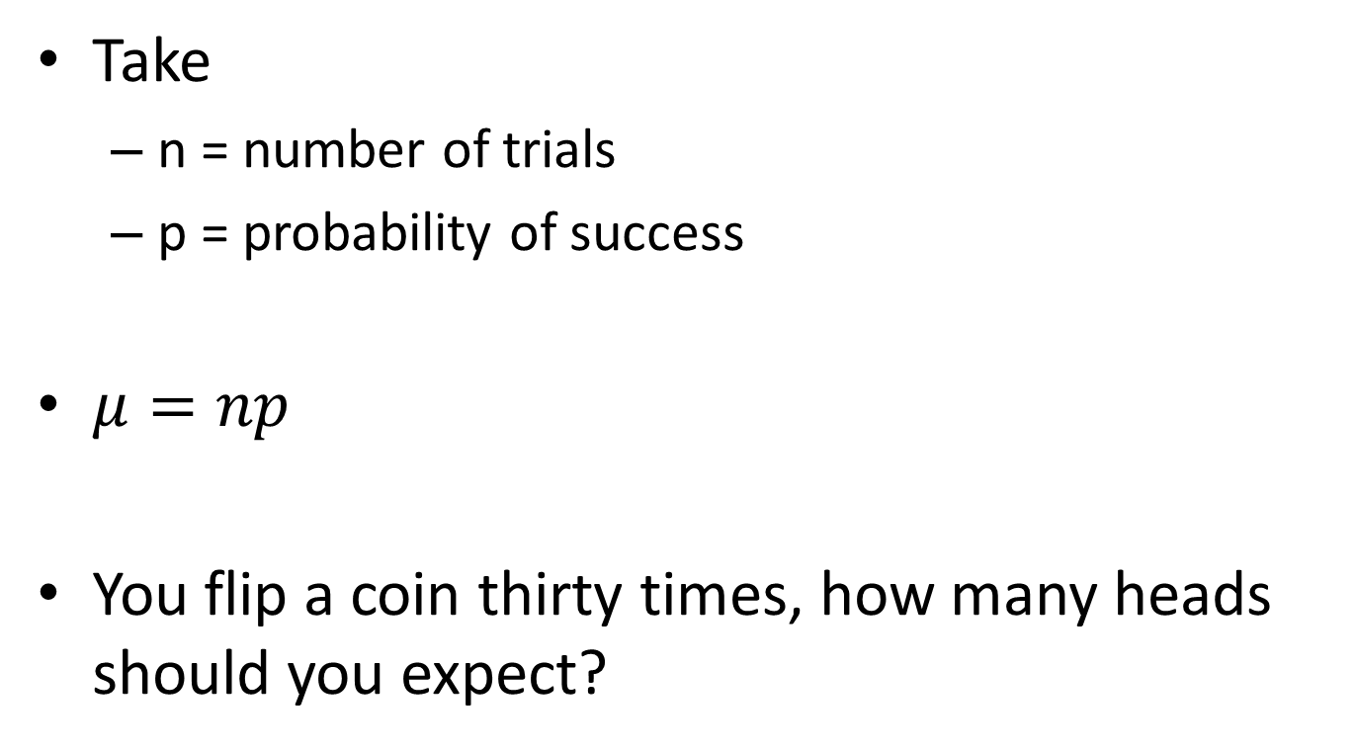
Example
Take
  n = number of trials
  p = probability of success
$μ=np$
You flip a coin thirty times, how many heads should you expect?

Slide 60
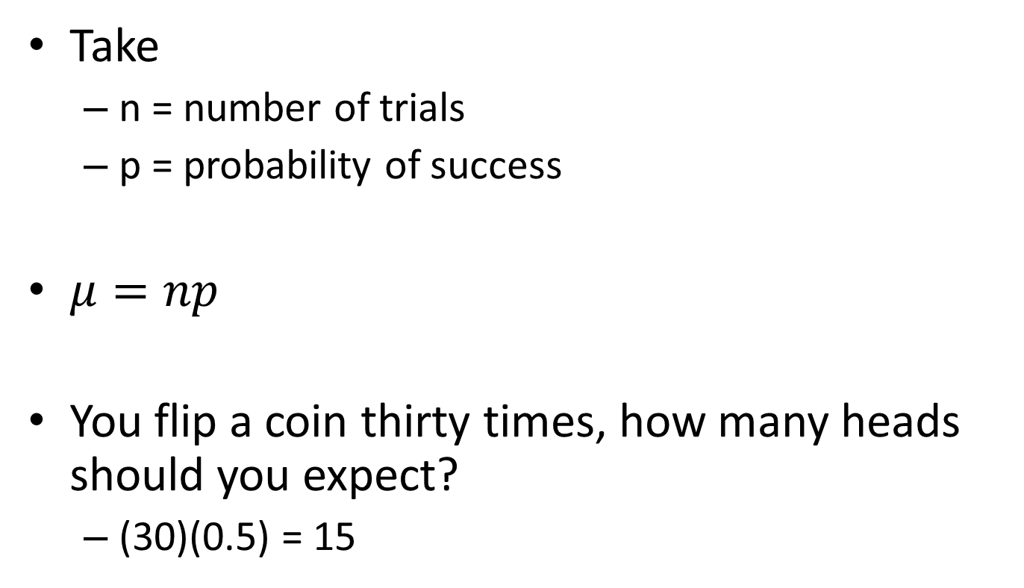
Example
Take
  n = number of trials
  p = probability of success
$μ=np$
You flip a coin thirty times, how many heads should you expect?
  (30)(0.5) = 15

Slide 61
You could have made a table… but it would have taken a while
Take
  n = number of trials
  p = probability of success
$μ=np$
You flip a coin thirty times, how many heads should you expect?
  (30)(0.5) = 15

Slide 62
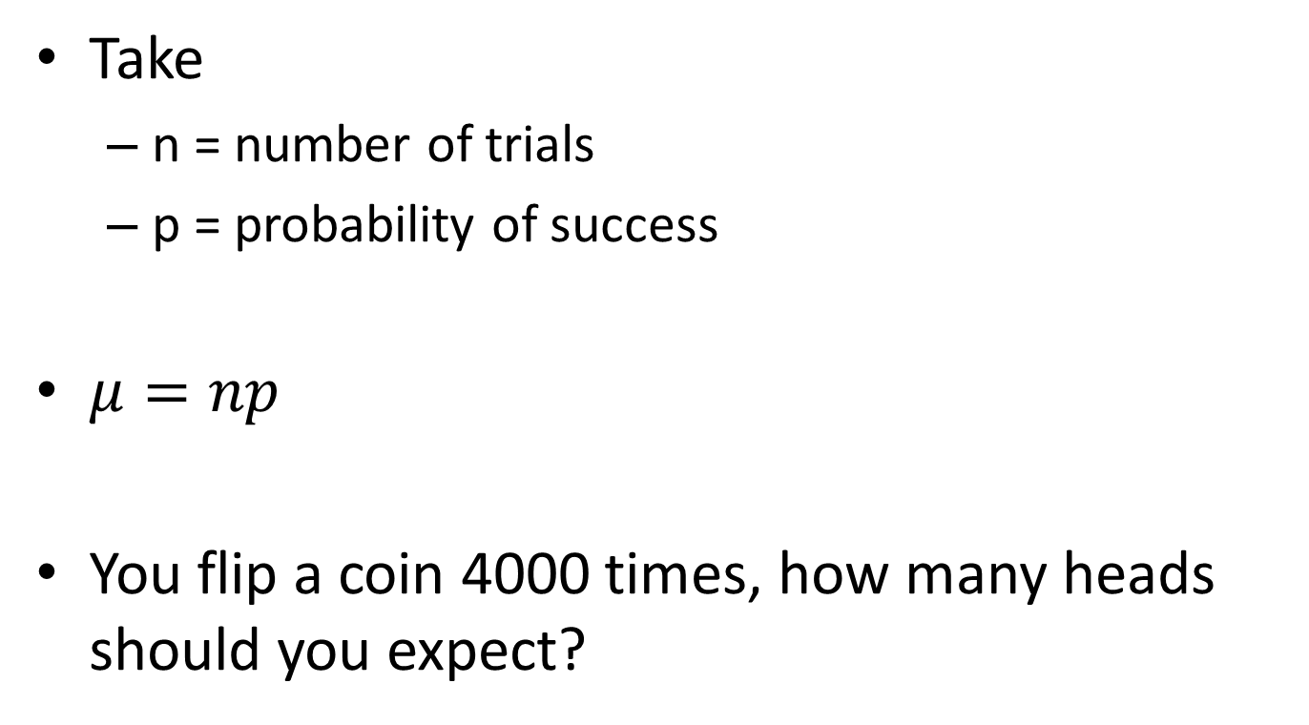
Example
Take
  n = number of trials
  p = probability of success
$μ=np$
You flip a coin 4000 times, how many heads should you expect?

Slide 63
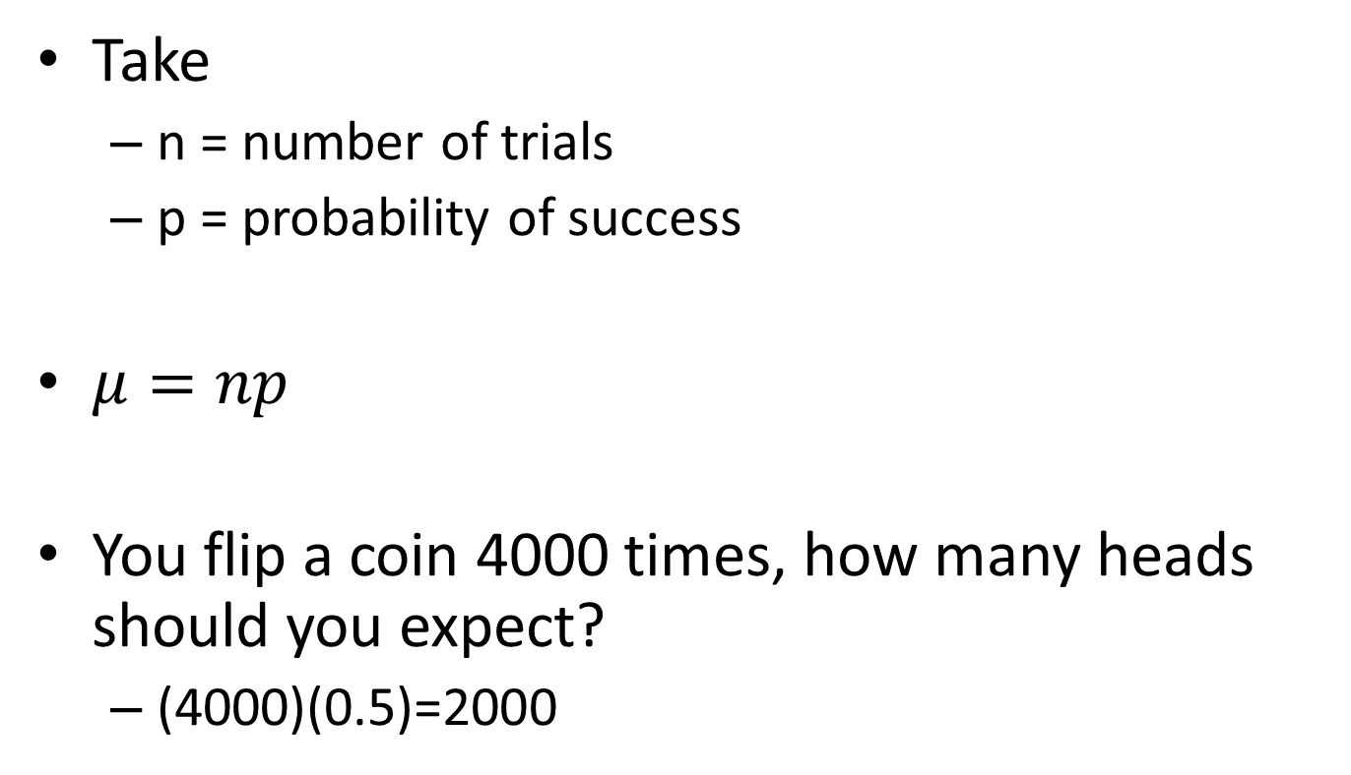
Example
Take
  n = number of trials
  p = probability of success
$μ=np$
You flip a coin 4000 times, how many heads should you expect?
  (4000)(0.5)=2000

Slide 64
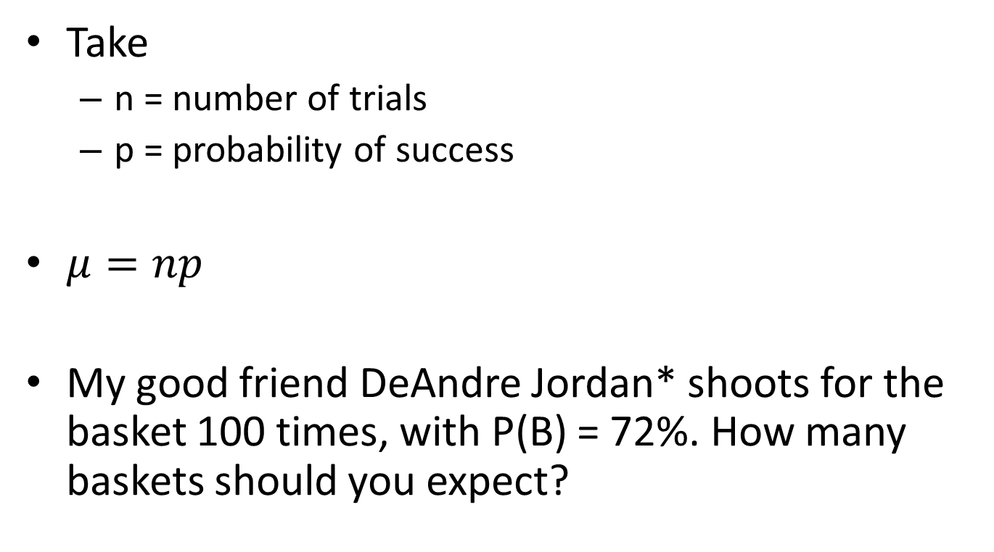
Example
Take
  n = number of trials
  p = probability of success
$μ=np$
My good friend DeAndre Jordan* shoots for the basket 100 times, with P(B) = 72%. How many baskets should you expect?

Slide 65
Example
Take
  n = number of trials
  p = probability of success
$μ=np$
My good friend DeAndre Jordan* shoots for the basket 100 times, with P(B) = 72%. How many baskets should you expect?
* -- Not actually my friend. I mean, we used to hang out together in the Old Neighborhood, you know, but he probably wouldn’t remember me or anything. And I crashed his car once. It was an accident, but still, he never really forgave me for that.

Slide 66
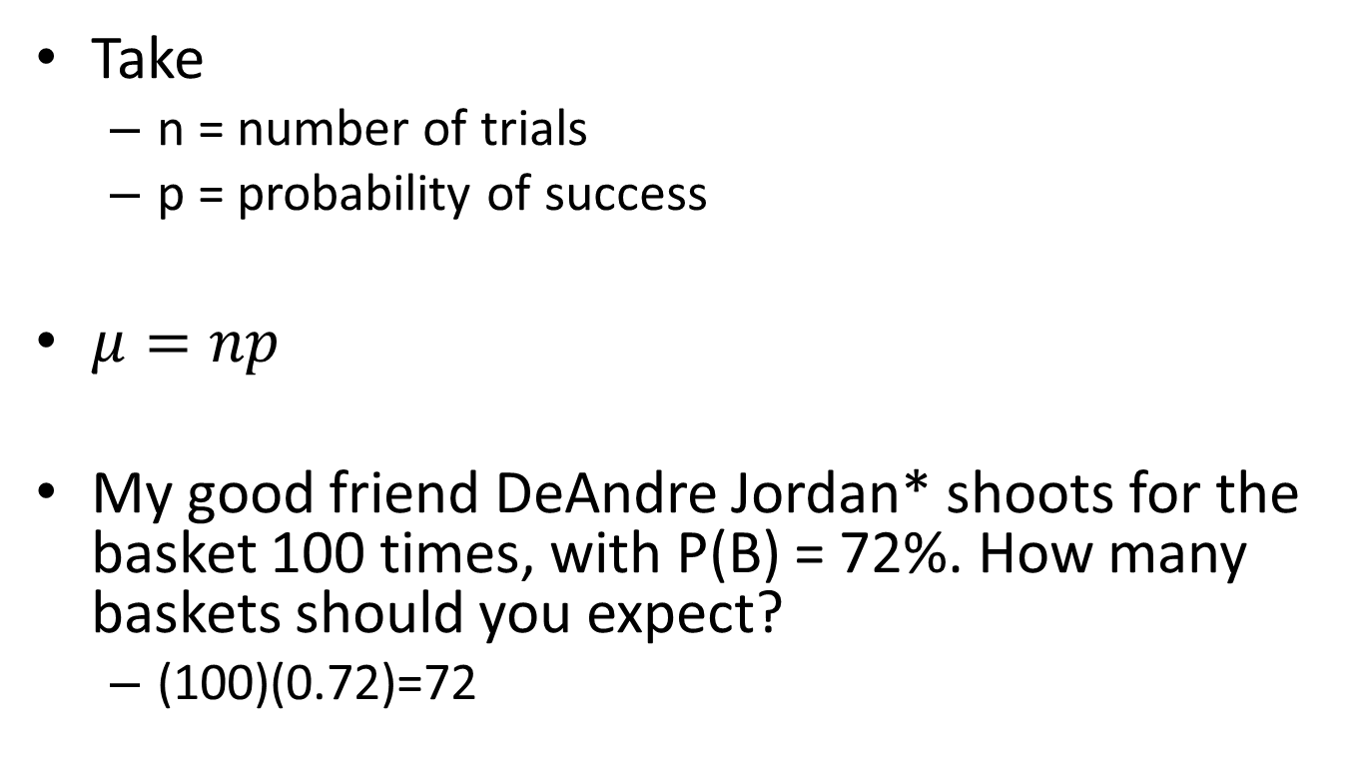
Example
Take
  n = number of trials
  p = probability of success
$μ=np$
My good friend DeAndre Jordan* shoots for the basket 100 times, with P(B) = 72%. How many baskets should you expect?
  (100)(0.72)=72

Slide 67
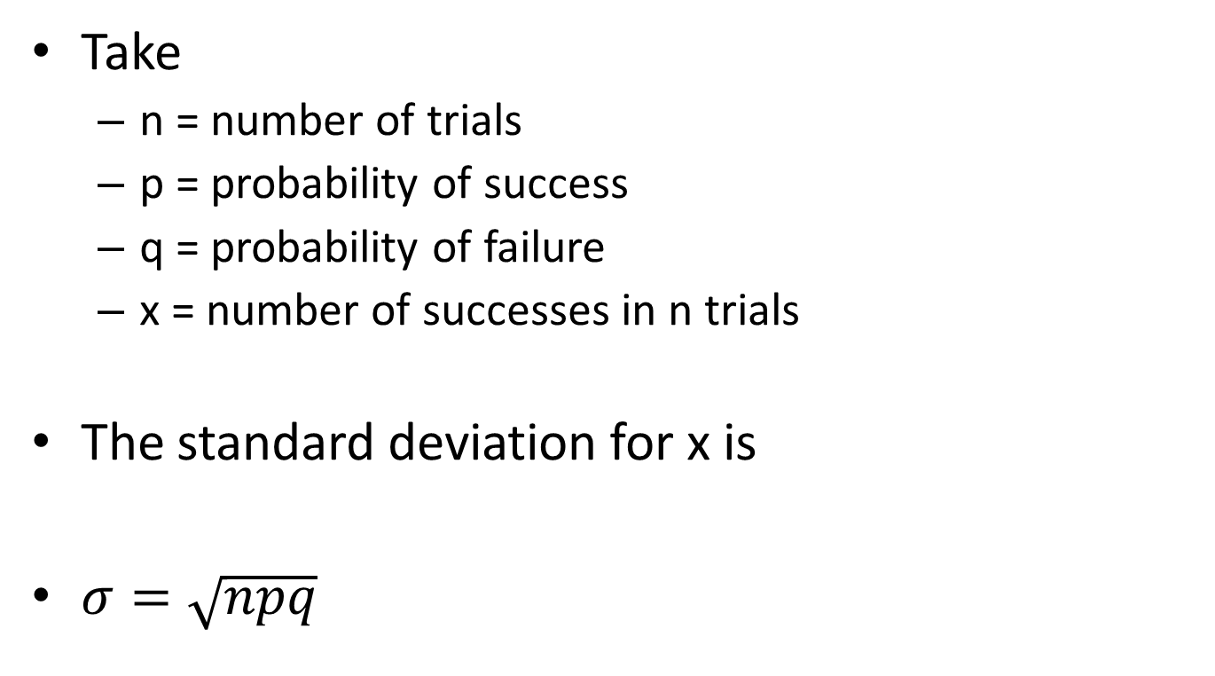
Computing the standard deviation
Take
  n = number of trials
  p = probability of success
  q = probability of failure
  x = number of successes in n trials
The standard deviation for x is
$σ=\sqrt{npq}$

Slide 68
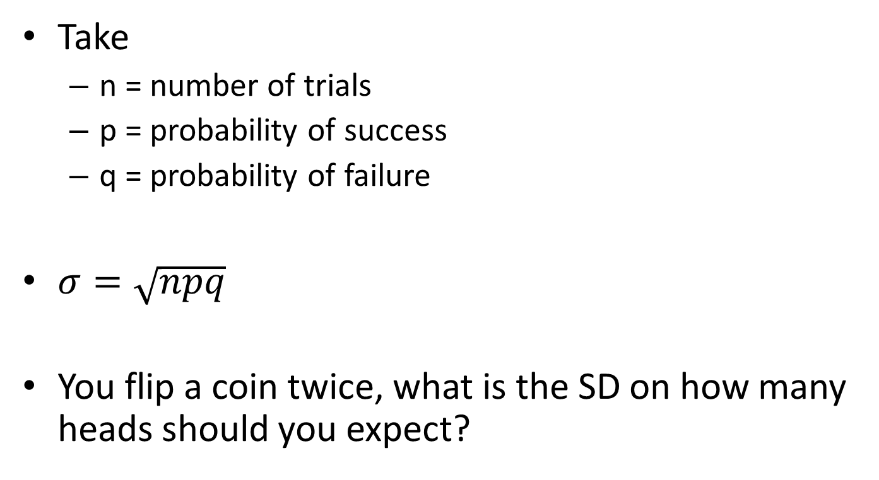
Example
Take
  n = number of trials
  p = probability of success
  q = probability of failure
$σ=\sqrt{npq}$
You flip a coin twice, what is the SD on how many heads should you expect?

Slide 69
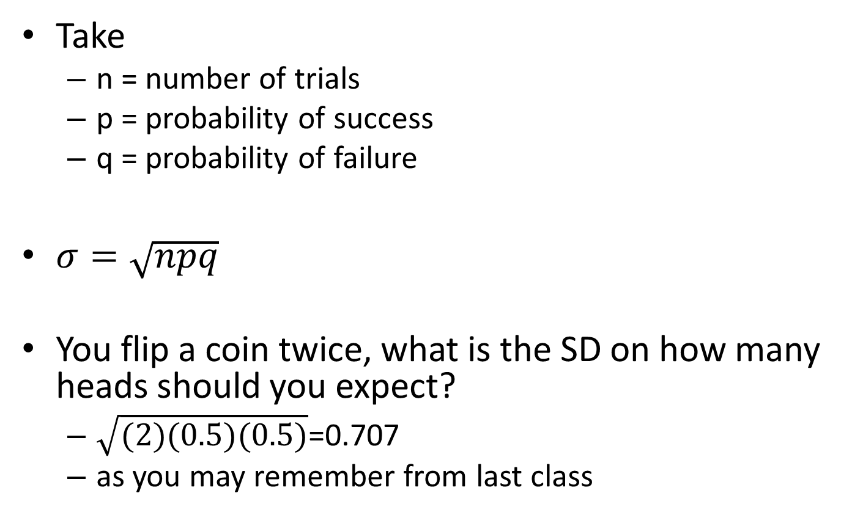
Example
Take
  n = number of trials
  p = probability of success
  q = probability of failure
$σ=\sqrt{npq}$
You flip a coin twice, what is the SD on how many heads should you expect?
  $\sqrt{(2)(0.5)(0.5)}$=0.707
  as you may remember from last class

Slide 70
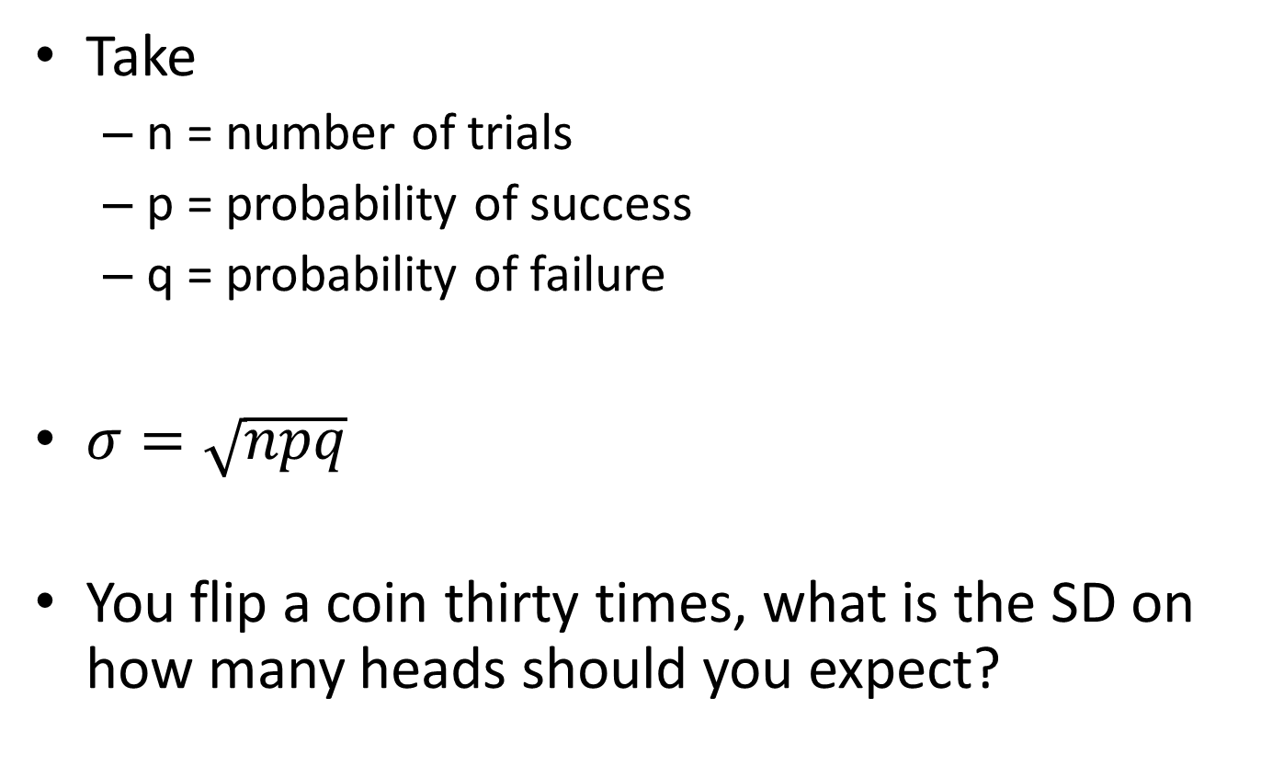
Example
Take
  n = number of trials
  p = probability of success
  q = probability of failure
$σ=\sqrt{npq}$
You flip a coin thirty times, what is the SD on how many heads should you expect?

Slide 71
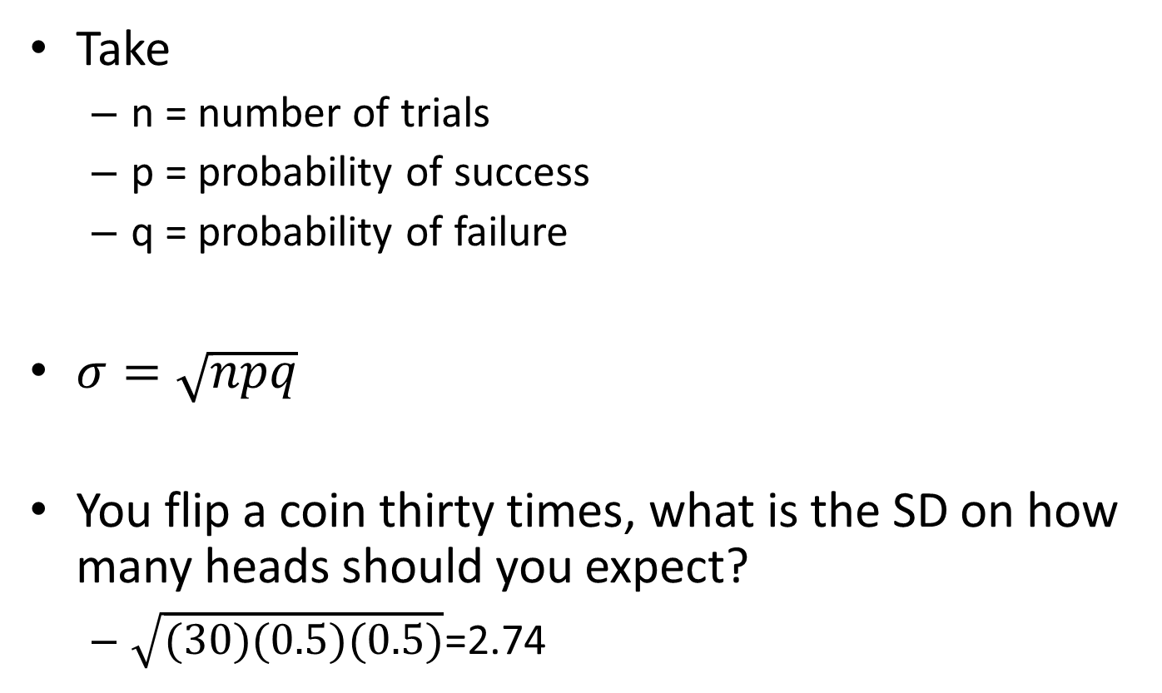
Example
Take
  n = number of trials
  p = probability of success
  q = probability of failure
$σ=\sqrt{npq}$
You flip a coin thirty times, what is the SD on how many heads should you expect?
  $\sqrt{(30)(0.5)(0.5)}$=2.74

Slide 72
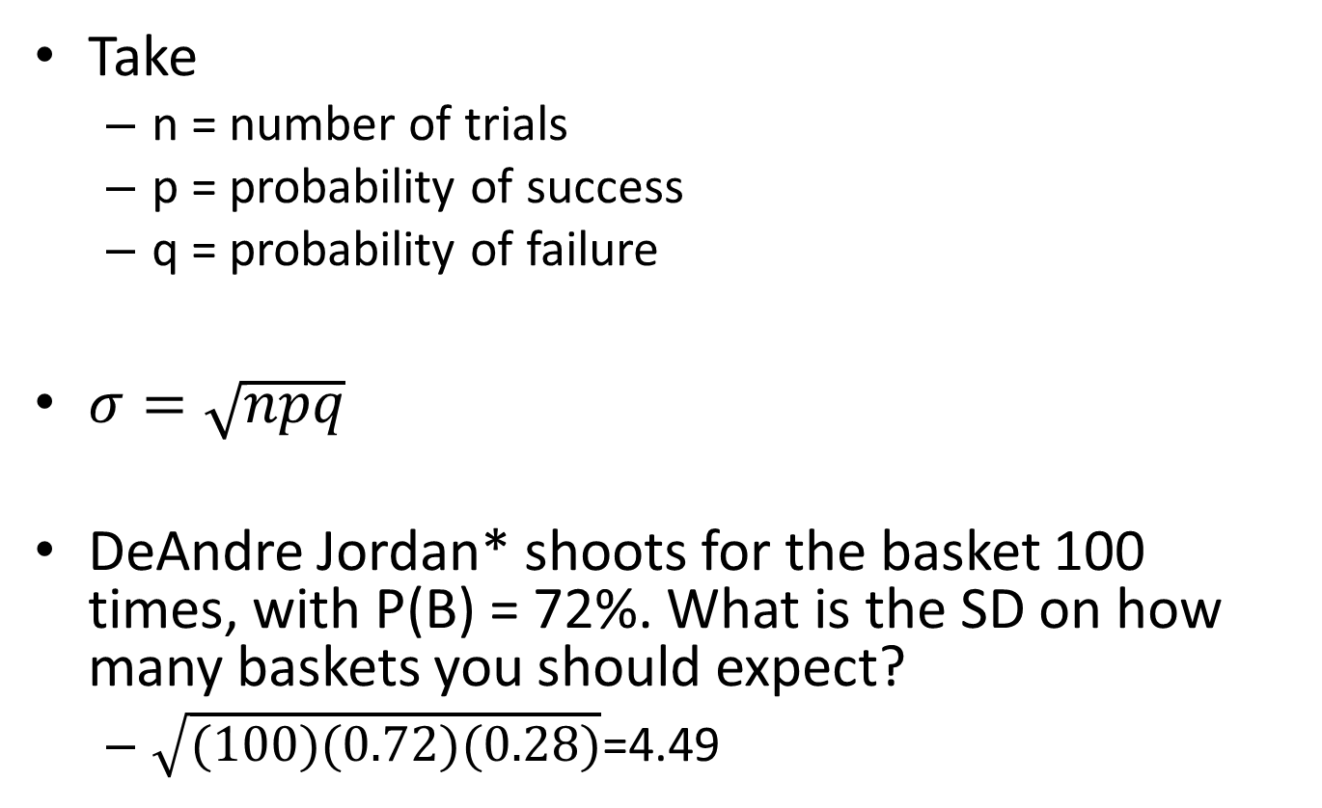
Example
Take
  n = number of trials
  p = probability of success
  q = probability of failure
$σ=\sqrt{npq}$
DeAndre Jordan* shoots for the basket 100 times, with P(B) = 72%. What is the SD on how many baskets you should expect?
  $\sqrt{(100)(0.72)(0.28)}$=4.49

Slide 73
Questions? Comments?

Slide 74
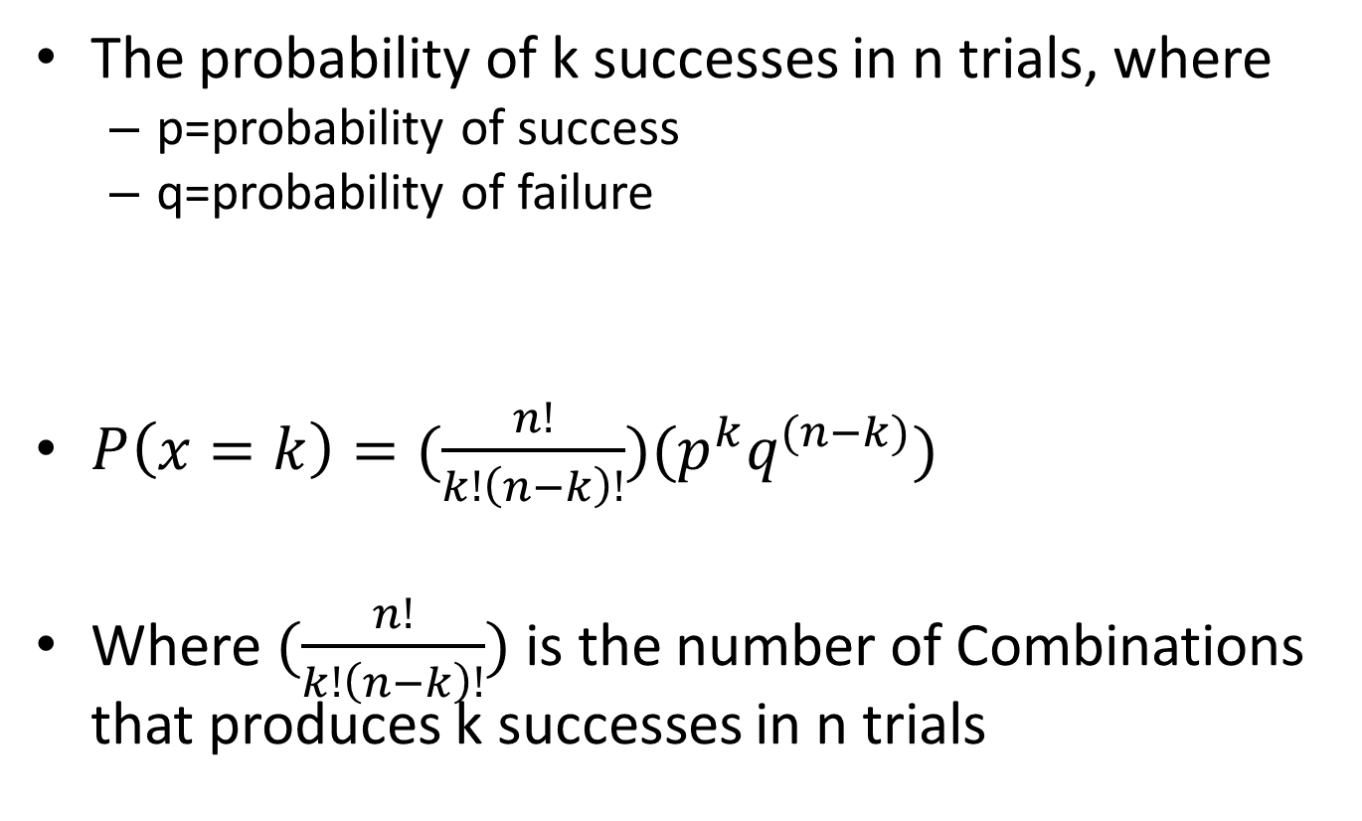
Computing the probability distribution
The probability of k successes in n trials, where
  p=probability of success
  q=probability of failure
$P\left(x=k\right)=(\frac{n!}{k!\left(n−k\right)!})(p^{k}q^{(n−k)})$
Where $(\frac{n!}{k!\left(n−k\right)!})$ is the number of Combinations that produces k successes in n trials

Slide 75
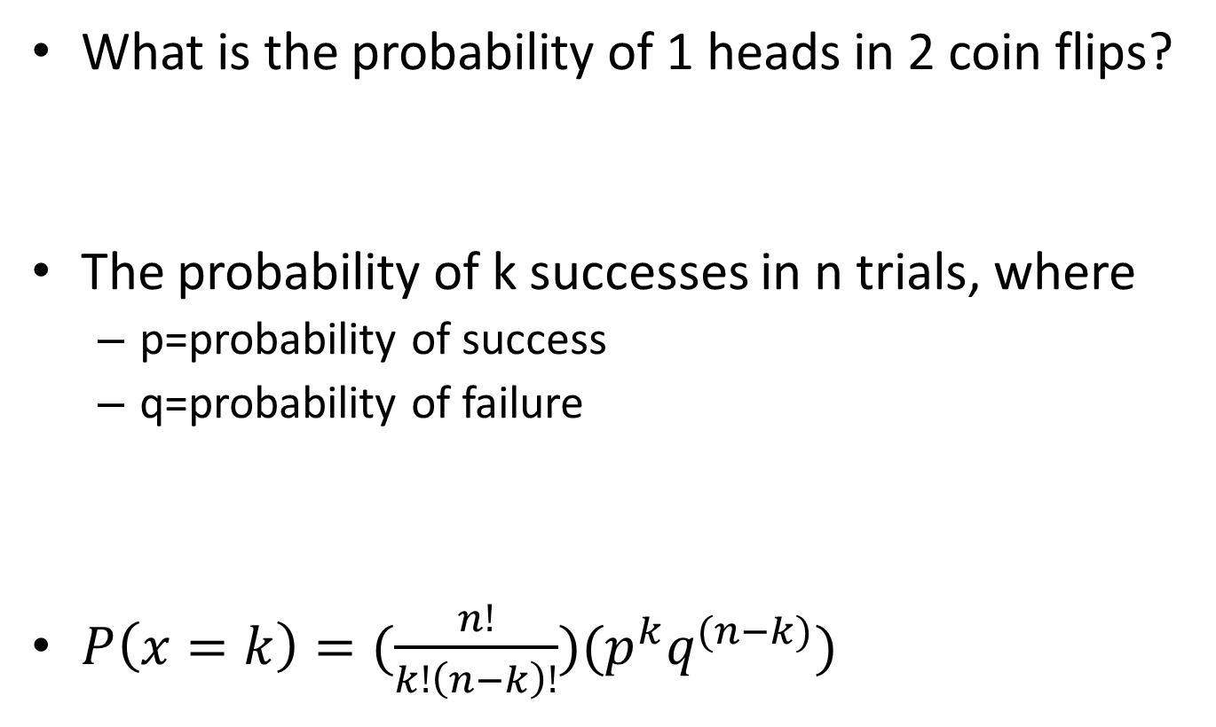
Example
What is the probability of 1 heads in 2 coin flips?
The probability of k successes in n trials, where
  p=probability of success
  q=probability of failure
$P\left(x=k\right)=(\frac{n!}{k!\left(n−k\right)!})(p^{k}q^{(n−k)})$

Slide 76
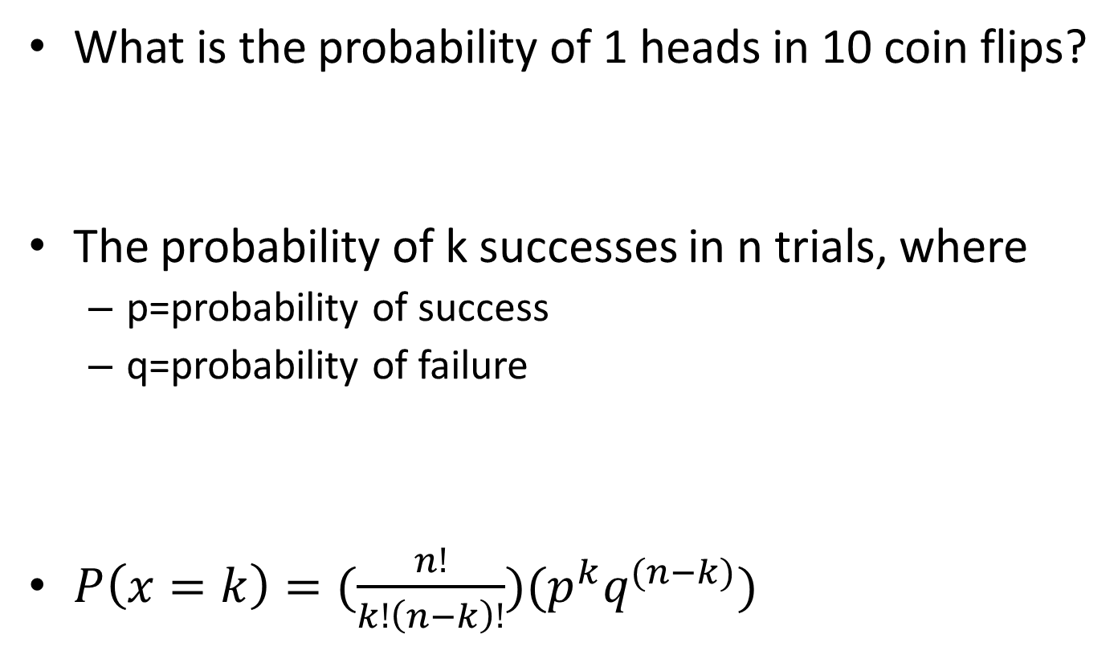
You Try It
What is the probability of 1 heads in 10 coin flips?
The probability of k successes in n trials, where
  p=probability of success
  q=probability of failure
$P\left(x=k\right)=(\frac{n!}{k!\left(n−k\right)!})(p^{k}q^{(n−k)})$

Slide 77
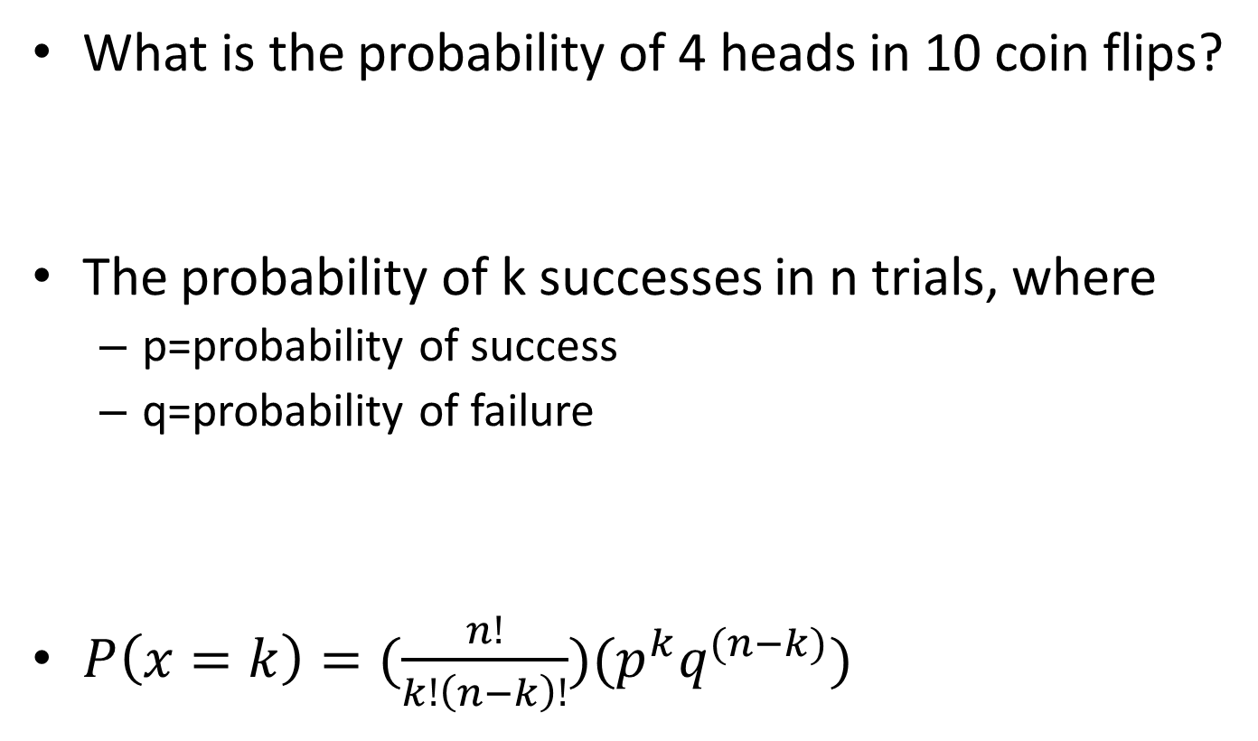
You Try It
What is the probability of 4 heads in 10 coin flips?
The probability of k successes in n trials, where
  p=probability of success
  q=probability of failure
$P\left(x=k\right)=(\frac{n!}{k!\left(n−k\right)!})(p^{k}q^{(n−k)})$

Slide 78
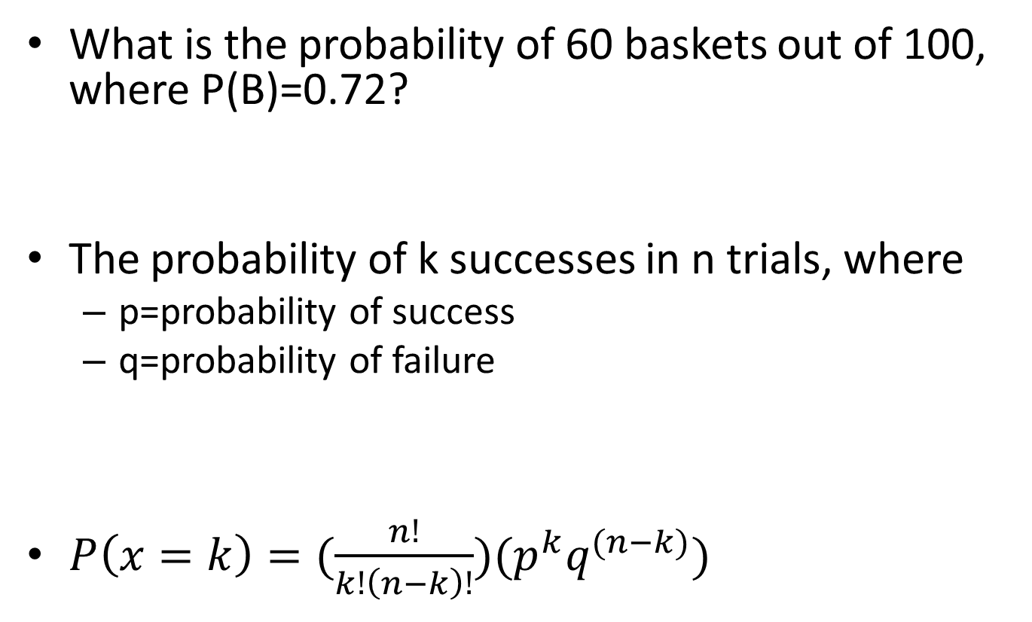
You Try It
What is the probability of 60 baskets out of 100, where P(B)=0.72?
The probability of k successes in n trials, where
  p=probability of success
  q=probability of failure
$P\left(x=k\right)=(\frac{n!}{k!\left(n−k\right)!})(p^{k}q^{(n−k)})$

Slide 79
Comments? Questions?

Slide 80

Cumulative Probability
P(X<=x)=$\sum_{i=1}^{x}{P(i)}$

Slide 81

For example
x | P(x)
0 | 0.25
1 | 0.5
2 | 0.25
P(X<=x)=$\sum_{i=1}^{x}{P(i)}$
P(x<=0)=0.25
P(x<=1)=0.75
P(x<=2)=1

Slide 82

You try it
x | P(x)
0 | 0.2
1 | 0.4
2 | 0.2
3 | 0.1
4 | 0.05
5 | 0.05
P(X<=x)=$\sum_{i=1}^{x}{P(i)}$
What is P(X<=3)?

Slide 83

You try it
x | P(x)
0 | 0.2
1 | 0.4
2 | 0.2
3 | 0.1
4 | 0.05
5 | 0.05
P(X<=x)=$\sum_{i=1}^{x}{P(i)}$
What is P(X>=3)?

Slide 84
Cumulative Probability
Why is this useful?
Because sometimes you want to know how often a set threshold will be reached

Slide 85
Challenge Problem
Bringing together both probability calculation and cumulative probability calculation…

Slide 86
Do this in solver-explainer pairs
You’ve developed a new math curriculum. But your friend thinks it’s ineffective. He hypothesizes that 50% of students will learn better with your new curriculum, and 50% will learn worse
You give the curriculum to 20 students
  18 learn more
  2 learn less
What is the probability that you would get 18 or more students learning better, if your friend was right, and learning is at chance levels?

Slide 87
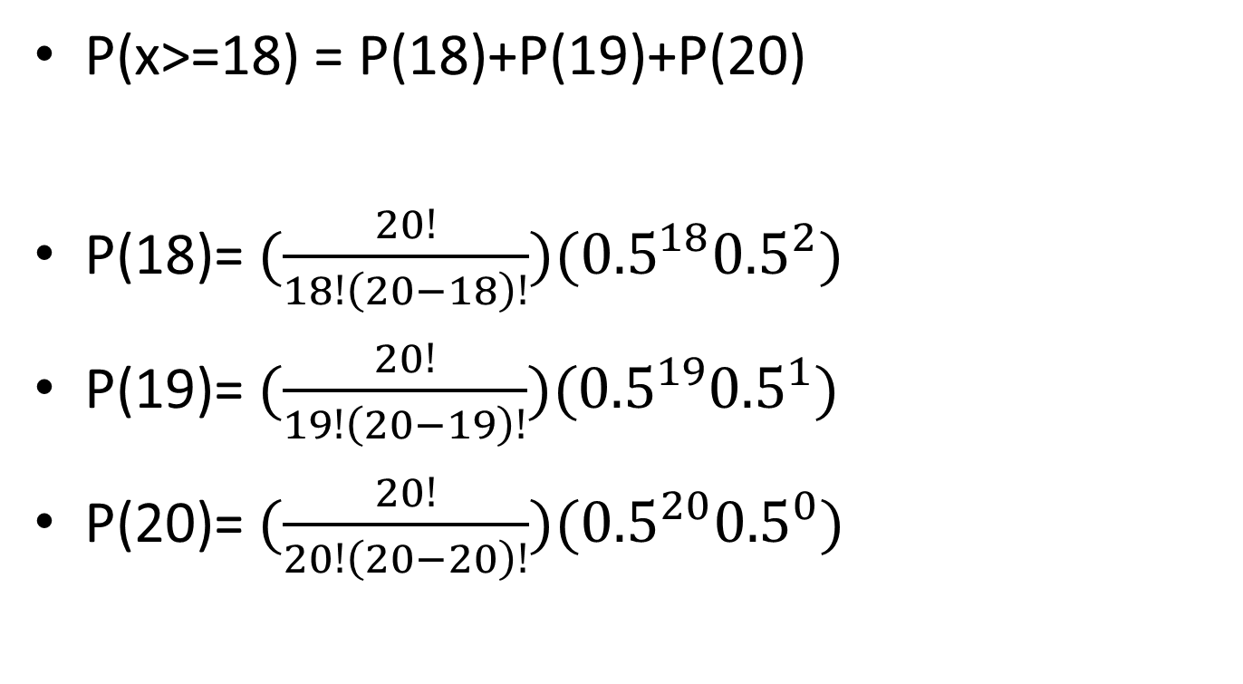
Solution
P(x>=18) = P(18)+P(19)+P(20)
P(18)=$(\frac{20!}{18!\left(20−18\right)!})({0.5}^{18}{0.5}^{2})$
P(19)=$(\frac{20!}{19!\left(20−19\right)!})({0.5}^{19}{0.5}^{1})$
P(20)=$(\frac{20!}{20!\left(20−20\right)!})({0.5}^{20}{0.5}^{0})$

Slide 88

Solution
P(18)=$(\frac{20!}{18!\left(2\right)!})({0.5}^{20})$
P(19)=$(\frac{20!}{19!\left(1\right)!})({0.5}^{20})$
P(20)=$(\frac{20!}{20!\left(0\right)!})({0.5}^{20})$

Slide 89

Solution
P(18)=$(\frac{20∗19}{\left(2\right)})({9.54∗10}^{−7})$
P(19)=$(\frac{20}{1 })({9.54∗10}^{−7})$
P(20)=$(\frac{20!}{20! })({9.54∗10}^{−7})$

Slide 90
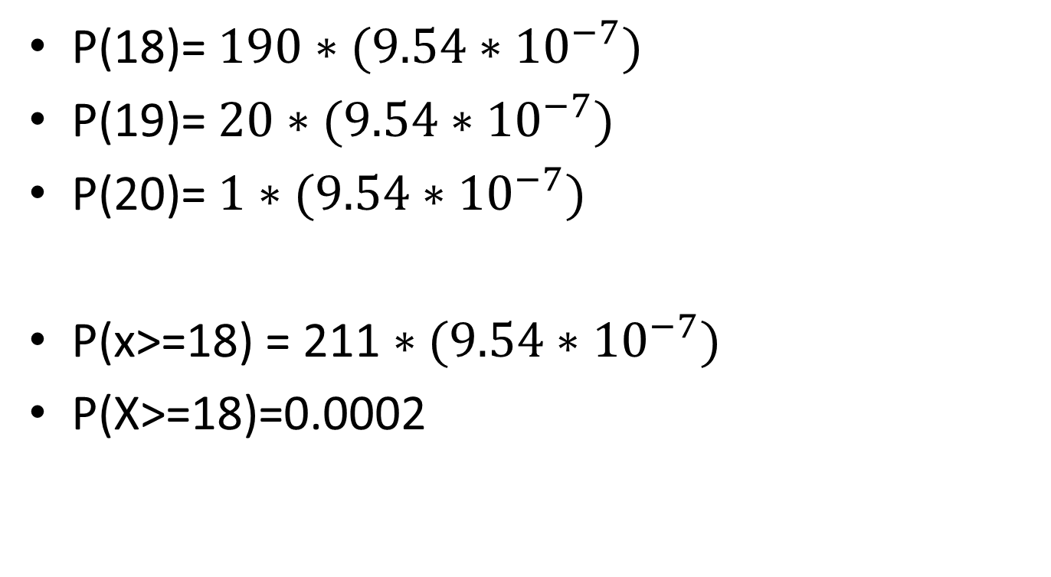
Solution
P(18)=$190∗({9.54∗10}^{−7})$
P(19)=$20∗({9.54∗10}^{−7})$
P(20)=$1∗({9.54∗10}^{−7})$
P(x>=18) = 211$∗({9.54∗10}^{−7})$
P(X>=18)=0.0002

Slide 91
So…
If your friend is right, and your curriculum doesn’t work
  a.k.a P(better learning) = 0.5
Then P(X>=18)=0.0002
Pretty unlikely, right?

Slide 92
What we just did is a simple statistical test
It’s a sign test
We’ll discuss statistical significance testing more after the midterm
Yes, a problem like the one you just did could indeed be on the midterm

Slide 93
Final questions or comments for the day?

Slide 94
Upcoming Classes
3/2 Normal Probability Distribution
  Schedule change: No Homework Due
3/4 Normal Probability Distribution part 2
and Review
  HW5 due
3/9 Exam 1

Slide 95
Homework 4
Due in 2 days
In the ASSISTments system

