Slide 1
HUDM4122 Probability and Statistical Inference
March 30, 2015

Slide 2
HW6
This was a difficult one

Slide 3
P1
Find P(z<= 1.64) for a normal distribution
Correct answer 0.9495
Common incorrect answer: 0.0505
Remember, the cumulative probability distribution in your table is from the left side to that Z value
Take the value for <
Take 1-value for >

Slide 4
P1
Find P(z<= 1.64) for a normal distribution
Correct answer 0.9495
Common incorrect answer: 0.0505
Remember, the cumulative probability distribution in your table is from the left side to that Z value
Take the value for <
Take 1-value for >
This difficulty persisted throughout the assignment, causing errors on P4, P5, and later…

Slide 5
Exercise Use your table to determine
P(Z< 1)
P(Z> 1)
P(Z> 1.52)
P(Z< -1.03)
P(Z< -0.55)
P(Z> -2.02)

Slide 6
P3
Find P(0<=z<=1.00)
Correct answer: 0.8413-0.5 = 0.3413
P(0<Z)=0.5
P(Z<1)=0.8413
Common wrong answer: 1
I see the logic here, but keep in mind that Z represents the normal distribution

Slide 7
P6
Which of the following is this study? (multiple of these may apply) 100 graduate students at Teachers College are randomly assigned to HUDM4122 using either ASSISTments homework or traditional paper homework. The students all take the same pre-test and post-test, and learning gains are compared between students who used ASSISTments and traditional homework. Correct answer: Experiment, Controlled Experiment

Slide 8
Why are these incorrect?
Which of the following is this study? (multiple of these may apply) 100 graduate students at Teachers College are randomly assigned to HUDM4122 using either ASSISTments homework or traditional paper homework. The students all take the same pre-test and post-test, and learning gains are compared between students who used ASSISTments and traditional homework. Correct answer: Experiment, Controlled Experiment Incorrect answers: Quota Sampling, Observational Study, Quasi-Experiment

Slide 9
This one depends on what the original research goal was
Which of the following is this study? (multiple of these may apply) 100 graduate students at Teachers College are randomly assigned to HUDM4122 using either ASSISTments homework or traditional paper homework. The students all take the same pre-test and post-test, and learning gains are compared between students who used ASSISTments and traditional homework. Correct answer: Experiment, Controlled Experiment Incorrect answers: Quota Sampling, Observational Study, Quasi-Experiment Possibly correct answers: Convenience Sampling

Slide 10
P7
Which of the following is this study? (multiple of these may apply)
100 graduate students at Teachers College individually choose to take Baker's section of HUDM4122 or another section of HUDM4122.
Students in Baker's section use ASSISTments homework; the other section uses traditional paper homework.
The students all take the same pre-test and post-test, and learning gains are compared between students who used ASSISTments and traditional homework.
Correct answer: Quasi-experiment

Slide 11
P7
Which of the following is this study? (multiple of these may apply)
100 graduate students at Teachers College individually choose to take Baker's section of HUDM4122 or another section of HUDM4122.
Students in Baker's section use ASSISTments homework; the other section uses traditional paper homework.
The students all take the same pre-test and post-test, and learning gains are compared between students who used ASSISTments and traditional homework.
Correct answer: Quasi-experiment
Sorta correct answers: Observational study (usually used to refer to cases where it isn’t possible to refer to it as quasi-experiment)

Slide 12
Why is this answer incorrect?
Which of the following is this study? (multiple of these may apply)
100 graduate students at Teachers College individually choose to take Baker's section of HUDM4122 or another section of HUDM4122.
Students in Baker's section use ASSISTments homework; the other section uses traditional paper homework.
The students all take the same pre-test and post-test, and learning gains are compared between students who used ASSISTments and traditional homework.
Correct answer: Quasi-experiment
Sorta correct answers: Observational study (usually used to refer to cases where it isn’t possible to refer to it as quasi-experiment)
Incorrect answers: Experiment

Slide 13
P9
According to the latest data, a study of 81 athletes using a new exercise regimen found that the athletes became able to run between 0 and 8 more miles.
The average runner becomes able to run 3 more miles. The standard deviation is 1 mile.
What is the probability that the sample average is under 2.5 miles? (give two digits after the decimal point)

Slide 14
Only 9% of you got this right, so let’s go over it together
According to the latest data, a study of 81 athletes using a new exercise regimen found that the athletes became able to run between 0 and 8 more miles.
The average runner becomes able to run 3 more miles. The standard deviation is 1 mile.
What is the probability that the sample average is under 2.5 miles? (give two digits after the decimal point)

Slide 15
Z = $\frac{(value−mean)}{SD}$
According to the latest data, a study of 81 athletes using a new exercise regimen found that the athletes became able to run between 0 and 8 more miles.
The average runner becomes able to run 3 more miles. The standard deviation is 1 mile.
What is the probability that the sample average is under 2.5 miles? (give two digits after the decimal point)

Slide 16
Z = $\frac{(value−mean)}{SD}$ But note, it’s the SD of the sample average
According to the latest data, a study of 81 athletes using a new exercise regimen found that the athletes became able to run between 0 and 8 more miles.
The average runner becomes able to run 3 more miles. The standard deviation is 1 mile.
What is the probability that the sample average is under 2.5 miles? (give two digits after the decimal point)

Slide 17
Z = $\frac{(value−mean)}{SD}$ But note, it’s the SD of the sample average which is the SE
According to the latest data, a study of 81 athletes using a new exercise regimen found that the athletes became able to run between 0 and 8 more miles.
The average runner becomes able to run 3 more miles. The standard deviation is 1 mile.
What is the probability that the sample average is under 2.5 miles? (give two digits after the decimal point)

Slide 18
SE = $\frac{s}{\sqrt{n}}= \frac{1}{\sqrt{81}}$ = $\frac{1}{9}=0.11$
According to the latest data, a study of 81 athletes using a new exercise regimen found that the athletes became able to run between 0 and 8 more miles.
The average runner becomes able to run 3 more miles. The standard deviation is 1 mile.
What is the probability that the sample average is under 2.5 miles? (give two digits after the decimal point)

Slide 19
Z = $\frac{(2.5−3)}{0.11}$ = $\frac{−0.5}{0.11}$ = -4.5
According to the latest data, a study of 81 athletes using a new exercise regimen found that the athletes became able to run between 0 and 8 more miles.
The average runner becomes able to run 3 more miles. The standard deviation is 1 mile.
What is the probability that the sample average is under 2.5 miles? (give two digits after the decimal point)

Slide 20
P(Z < -4.5) = 0.000003
According to the latest data, a study of 81 athletes using a new exercise regimen found that the athletes became able to run between 0 and 8 more miles.
The average runner becomes able to run 3 more miles. The standard deviation is 1 mile.
What is the probability that the sample average is under 2.5 miles? (give two digits after the decimal point)

Slide 21
Questions?

Slide 22
P12
6% of students game the system when using ASSISTments. If 100 students use ASSISTments, what is the standard error of the mean? SE = $\sqrt{\frac{pq}{n}}$ = $\sqrt{\frac{(0.06)(0.94)}{100}}$ = 0.023

Slide 23
P12
6% of students game the system when using ASSISTments. If 100 students use ASSISTments, what is the standard error of the mean? SE = $\sqrt{\frac{pq}{n}}$ = $\sqrt{\frac{(0.06)(0.94)}{100}}$ = 0.023749 Many people said 0.1 I couldn’t figure out where that came from?

Slide 24
P13
6% of students game the system when using ASSISTments. If a school has over 10% gaming the system, a giant siren goes off in Ryan's apartment at 3am. (His daughter put it there). If 100 students use ASSISTments in a school, what is the probability that the sample average is over 10%? (give two digits after the decimal point)

Slide 25
We know SE = 0.023749
6% of students game the system when using ASSISTments. If a school has over 10% gaming the system, a giant siren goes off in Ryan's apartment at 3am. (His daughter put it there). If 100 students use ASSISTments in a school, what is the probability that the sample average is over 10%? (give two digits after the decimal point)

Slide 26
Z = $\frac{(0.1−0.06)}{0.023749}=1.68$
6% of students game the system when using ASSISTments. If a school has over 10% gaming the system, a giant siren goes off in Ryan's apartment at 3am. (His daughter put it there). If 100 students use ASSISTments in a school, what is the probability that the sample average is over 10%? (give two digits after the decimal point)

Slide 27
P(Z>1.68) = 1 – P(Z<1.68)
6% of students game the system when using ASSISTments. If a school has over 10% gaming the system, a giant siren goes off in Ryan's apartment at 3am. (His daughter put it there). If 100 students use ASSISTments in a school, what is the probability that the sample average is over 10%? (give two digits after the decimal point)

Slide 28
1 – P(Z<1.68) = 1 – 0.9539 = 0.0461
6% of students game the system when using ASSISTments. If a school has over 10% gaming the system, a giant siren goes off in Ryan's apartment at 3am. (His daughter put it there). If 100 students use ASSISTments in a school, what is the probability that the sample average is over 10%? (give two digits after the decimal point)

Slide 29
Questions? Comments?

Slide 30
Any more questions
About the sampling distribution of the mean?
Or standard error?

Slide 31
Today
Chapter 8.1-8.5 in Mendenhall, Beaver, & Beaver
Statistical Inference and Confidence Intervals

Slide 32
Statistical Inference
I don’t much like the definition of this in MBB
In particular, because it uses the term parameter in a way that I think is confusing
So I will instead go with Wikipedia

Slide 33
Statistical Inference (Wikipedia)
Statistical inference is the process of deducing properties of an underlying distribution by analysis of data
Inferential statistical analysis infers properties about a population: this includes testing hypotheses and deriving estimates.
The population is assumed to be larger than the observed data set; in other words, the observed data is assumed to be sampled from a larger population

Slide 34
And…
The sample should not be biased
It should be selected, as much as possible, randomly (or in a stratified fashion) from your population of interest

Slide 35
So, in other words…
There is something you want to know about a population’s statistical properties
You take a sample

Slide 36
So, in other words…
You use that sample to validly answer a question about
Estimation: The value of some aspect of the population, such as its mean or standard deviation
Hypothesis testing: A hypothesis you have about the population

Slide 37
For any statistical problem
You need to measure the goodness of your answer
E.g. how accurate, precise, reliable, trustworthy, general, etc. is your answer

Slide 38
We’ve already been doing this
But in the remaining weeks we will formalize this process, and study how to answer further questions

Slide 39
MBB say
That a statistical procedure provides a numerical measure of an inference’s goodness

Slide 40
But I disagree a bit
A measure of goodness is a good thing
But several measures of goodness is an even better thing

Slide 41
Several measures of goodness
There is active debate right now in the broader scientific community, for example, about
Whether and when p values are appropriate
Which effect size measures should be used as complements to p values in which situations
R (correlation) is a popular option, for example
And indeed, where statistical significance testing should be used, and where other methods such as cross-validation are preferred

Slide 42
This class is not about these debates…
But I will try to bring them in, where relevant

Slide 43
Questions? Comments?

Slide 44
Types of estimation
Point estimation – a single number is calculated to estimate a statistic
Interval estimation – two numbers are calculated to give an upper and lower bound on a statistic, with a certain confidence

Slide 45
Showing an interval graphically
People often draw graphs with “standard error bars”
For example, let’s say that
$\overline{x}$ = 5
SE = 1
You can draw this as

Slide 46
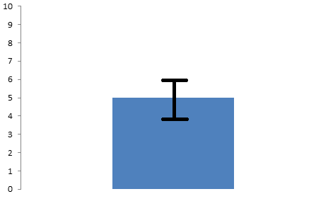
$\overline{x}$ = 5, SE = 1

Slide 47
Intervals
By convention, when people show intervals graphically, they typically use 1 SE bars
When people represents intervals numerically, they typically give 95% Confidence Intervals
These are, of course, magic numbers
There’s nothing inherently wrong with 0.75 SE bars, or 99% Confidence Intervals

Slide 48
Example
Point estimation – I believe that the average height of the class is 5’5”
Interval estimation – I believe that there is 95% confidence that the average height of the class is between 5’2” and 5’8”

Slide 49
Example
Point estimation – The standard deviation for height is 3”
Interval estimation – There is 95% confidence that the standard deviation for height is between 1.2” and 4.8”

Slide 50
Computing a 95% Confidence Interval
Assuming a normal distribution, and a sufficiently large sample
95% of the data will fall between -1.96 SE and +1.96 SE
(from 0.025 to 0.0975 on the cumulative normal distribution)

Slide 51
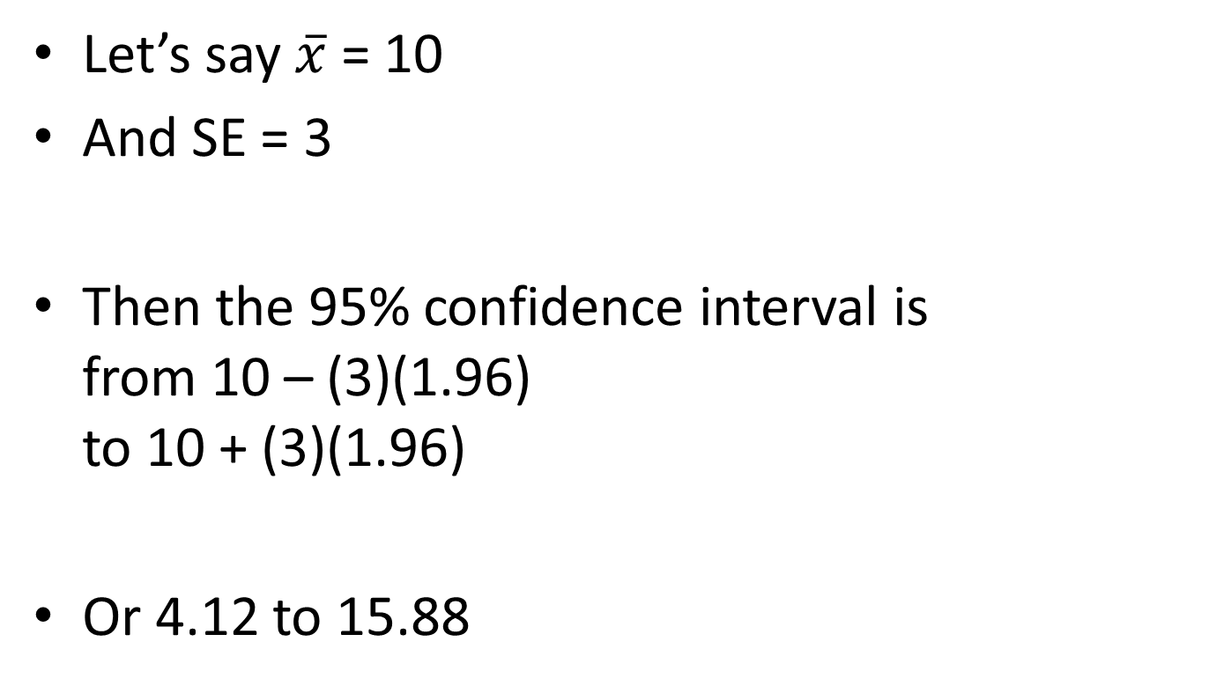
For example
Let’s say $\overline{x}$ = 10
And SE = 3
Then the 95% confidence interval is from 10 – (3)(1.96) to 10 + (3)(1.96)
Or 4.12 to 15.88

Slide 52
You try it
Let’s say $\overline{x}$ = 5
And SE = 1
What’s the 95% confidence interval?

Slide 53
You try it
Let’s say $\overline{x}$ = 5
And SE = 1
What’s the 95% confidence interval?
[5-1.96, 5+1.96]
[3.04, 6.96]

Slide 54
Connecting this to earlier skills – you try it
A TC professor is studying the grades on an exam taken by 49 students
The students get an average (sampled) grade of 80
The students get a standard deviation of 7
What is the 95% confidence interval for the average grade?

Slide 55
SE = $\frac{s}{\sqrt{n}}$
A TC professor is studying the grades on an exam taken by 49 students
The students get an average (sampled) grade of 80
The students get a standard deviation of 7
What is the 95% confidence interval for the average grade?

Slide 56
SE = $\frac{s}{\sqrt{n}}= \frac{7}{\sqrt{49}}$ = 1
A TC professor is studying the grades on an exam taken by 49 students
The students get an average (sampled) grade of 80
The students get a standard deviation of 7
What is the 95% confidence interval for the average grade?

Slide 57
-1.96SE = -1.96(1); +1.96SE = +1.96(1)
A TC professor is studying the grades on an exam taken by 49 students
The students get an average (sampled) grade of 80
The students get a standard deviation of 7
What is the 95% confidence interval for the average grade?

Slide 58
95% CI = [80-1.96, 80+1.96]
A TC professor is studying the grades on an exam taken by 49 students
The students get an average (sampled) grade of 80
The students get a standard deviation of 7
What is the 95% confidence interval for the average grade?

Slide 59
95% CI = [78.04, 81.96]
A TC professor is studying the grades on an exam taken by 49 students
The students get an average (sampled) grade of 80
The students get a standard deviation of 7
What is the 95% confidence interval for the average grade?

Slide 60
Connecting this to earlier skills – Example
A TC professor wants to know what percentage of students in NYC PS 24601 like their school
The professor surveys 16 students, and finds that 75% like their schools
What is the 95% Confidence Interval?

Slide 61
SE =$\sqrt{\frac{pq}{n}}$
A TC professor wants to know what percentage of students in NYC PS 24601 like their school
The professor surveys 16 students, and finds that 75% like their schools
What is the 95% Confidence Interval?

Slide 62
SE =$\sqrt{\frac{(0.8)(0.2)}{16}}$
A TC professor wants to know what percentage of students in NYC PS 24601 like their school
The professor surveys 16 students, and finds that 75% like their schools
What is the 95% Confidence Interval?

Slide 63
SE =$\sqrt{\frac{0.16}{16}}$
A TC professor wants to know what percentage of students in NYC PS 24601 like their school
The professor surveys 16 students, and finds that 75% like their schools
What is the 95% Confidence Interval?

Slide 64
SE =$\sqrt{0.01}$
A TC professor wants to know what percentage of students in NYC PS 24601 like their school
The professor surveys 16 students, and finds that 75% like their schools
What is the 95% Confidence Interval?

Slide 65
SE = 0.1
A TC professor wants to know what percentage of students in NYC PS 24601 like their school
The professor surveys 16 students, and finds that 75% like their schools
What is the 95% Confidence Interval?

Slide 66
95% CI = [$\overline{x}$-1.96*0.1, $\overline{x}$+1.96*0.1]
A TC professor wants to know what percentage of students in NYC PS 24601 like their school
The professor surveys 16 students, and finds that 75% like their schools
What is the 95% Confidence Interval?

Slide 67
95% CI = [$\overline{x}$-.196, $\overline{x}$+.196]
A TC professor wants to know what percentage of students in NYC PS 24601 like their school
The professor surveys 16 students, and finds that 75% like their schools
What is the 95% Confidence Interval?

Slide 68
95% CI = [$.75$-.196, .75+.196]=[.554,.946]
A TC professor wants to know what percentage of students in NYC PS 24601 like their school
The professor surveys 16 students, and finds that 75% like their schools
What is the 95% Confidence Interval?

Slide 69
95% CI = [$.75$-.196, .75+.196]=[.554,.946]
In other words, 50% is not in the 95% confidence interval for this proportion; it is likely to be greater than 50%

Slide 70
Connecting this to earlier skills – You Try It
You want to know whether ZYXKeyboard.com helps kids learn
According to one researcher, who studied 100 children, 60% of children learn
What is the 95% Confidence Interval for the proportion of students that learn?

Slide 71
SE =$\sqrt{\frac{pq}{n}}$
You want to know whether ZYXKeyboard.com helps kids learn
According to one researcher, who studied 100 children, 60% of children learn
What is the 95% Confidence Interval for the proportion of students that learn?

Slide 72
SE =$\sqrt{\frac{(0.6)(0.4)}{100}}$
You want to know whether ZYXKeyboard.com helps kids learn
According to one researcher, who studied 100 children, 60% of children learn
What is the 95% Confidence Interval for the proportion of students that learn?

Slide 73
SE =$\sqrt{\frac{0.24}{100}}$ = 0.05
You want to know whether ZYXKeyboard.com helps kids learn
According to one researcher, who studied 100 children, 60% of children learn
What is the 95% Confidence Interval for the proportion of students that learn?

Slide 74
95% CI = [$.6$-(1.96)(.05), .6+(1.96)(.05)]=[.504,.696]
You want to know whether ZYXKeyboard.com helps kids learn
According to one researcher, who studied 100 children, 60% of children learn
What is the 95% Confidence Interval for the proportion of students that learn?

Slide 75
95% CI = [$.6$-.05, .6+.05]=[.55,.65]
In other words, 50% is not in the 95% confidence interval for this proportion; the true value is likely to be greater than 50%

Slide 76
Maximum margin of error
For any given sample size, the maximum margin of error is reached when p = q = 0.5
When a polling agency says “margin of error”, they mean 95% CI for maximum margin of error

Slide 77
Example from the book
Gallup, Harris, and Roper polls use sample size of 1000
So, the margin of error is
$1.96\sqrt{\frac{(0.5)(0.5)}{1000}}$ = 0.031 or approximately 3%

Slide 78
Questions? Comments?

Slide 79
Final questions or comments for the day?

Slide 80
Upcoming Classes
4/1 Estimating Differences
4/6 Z tests
HW7 due
4/8 No class

