Slide 1
HUDM4122 Probability and Statistical Inference
April 1, 2015

Slide 2
First Announcement
HW8 will be due on April 15, rather than April 13
I don’t expect us to get through the entire lecture today, so I decided to delay the homework rather than splitting it

Slide 3
HW7

Slide 4
Q5
Take a variable with mean = 12 and SE = 6.
What is the variable's lower bound for its 90% Confidence Interval? (Give two digits after the decimal place)
Answers were all over the place, so let’s go over this together

Slide 5
Q6
You are testing a new brand of Moose Chow. You feed it to 25 meese.
The meese eat an average of 10 pounds of Moose Chow. The standard deviation for how much they eat is 1 pound. What is the upper bound of the 95% confidence interval for the average amount of Moose Chow a moose eats?
A lot of people got incorrect answer of 11.96, which comes from confusing standard deviation with standard error…
Let’s take a look

Slide 6
Q10
Your favorite sports team is already 25 games into their season, and has a win-loss record of 15-10 (0.6). What is the lower bound on the 95% confidence interval for what percentage of games they will win by the end of the season? (Give two digits after the decimal)
No common wrong answers, so let’s go over this together

Slide 7
Other questions/comments on the hw?

Slide 8
Statistical Significance Testing
The core of the traditional “frequentist” paradigm of statistics

Slide 9
Statistical Significance Testing
The core of the traditional “frequentist” paradigm of statistics
Determining what is “probably not not true”
Not the same as determining what is true!

Slide 10
Let’s unpack this

Slide 11
In statistical significance testing
We start with a hypothesis
Curriculum A is better than curriculum B

Slide 12
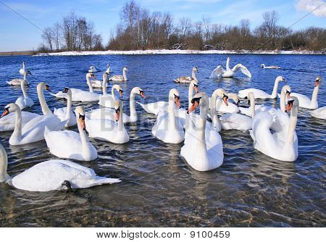
In statistical significance testing
We start with a hypothesis
All swans are white

Slide 13
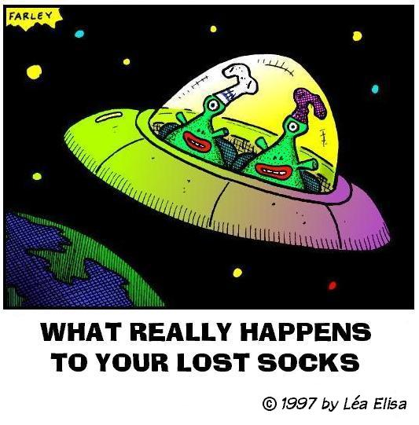
In statistical significance testing
We start with a hypothesis
My missing socks are due to aliens

Slide 14
We don’t try to prove that our hypothesis is true
It’s very difficult to prove something is true

Slide 15
We don’t try to prove that our hypothesis is true
I looked at 30 swans. They were all white. Therefore, all swans are white.
Insufficient evidence!

Slide 16
We don’t try to prove that our hypothesis is true
I looked at 30 swans. They were all white. Therefore, all swans are white.
Insufficient evidence! (Convenience sample?)

Slide 17
Instead, we try to look for evidence that our hypothesis is false

Slide 18
Instead, we try to look for evidence that our hypothesis is false
We create what is called a null hypothesis

Slide 19
Instead, we try to look for evidence that our hypothesis is false
We create what is called a null hypothesis
Which basically means that we say “nothing is going on here”

Slide 20
Instead, we try to look for evidence that our hypothesis is false
We create what is called a null hypothesis
Some swans are not white
My missing socks are due to some factor other than aliens
Curriculum A is not better than Curriculum B

Slide 21
And we refer to our original hypothesis as the alternative hypothesis

Slide 22
Example
Null Hypothesis: Some swans are not white
Alternative Hypothesis: All swans are white

Slide 23
You Try It
Null Hypothesis: My missing socks are due to some factor other than aliens
Alternative Hypothesis:

Slide 24
You Try It
Null Hypothesis: My missing socks are due to some factor other than aliens
Alternative Hypothesis: Aliens stole my socks

Slide 25
You Try It
Null Hypothesis: Curriculum A is not better than Curriculum B
Alternative Hypothesis:

Slide 26
Usually It’s Thought of as
Null Hypothesis: Curriculum A is not better than Curriculum B
Alternative Hypothesis: There is a difference between Curriculum A and Curriculum B
And we’ll get into why a little later

Slide 27
The Goal
Find evidence that will help you distinguish between the null hypothesis and the alternative hypothesis

Slide 28
So why…
Do we turn it around this way?

Slide 29
Again…
It’s hard to prove something is true
It’s not as hard to find evidence that there must be something going on

Slide 30
Again…
It’s hard to prove something is true
It’s not as hard to find evidence that there must be something going on
Determining what is “probably not” “not true”

Slide 31
Questions? Comments?

Slide 32
The conceptual structure of a statistical test
I assume that H₀ is true
What is the probability that I see the data I see, if H₀ is true?

Slide 33
Not the same
What is the probability that I see the data I see, if H₀ is true?
What is the probability that H₀ is true, if I see the data I see?

Slide 34
Example
If I want to study the difference between two curricula
I ask the question
What is the probability that I see the data I see, if there is no difference between curricula?

Slide 35
You try it
If you want to study whether Japanese high school students are off-task less than American high school students
What question do you ask?

Slide 36
You try it
If you want to study whether students who take your curriculum have an average learning gain greater than zero
What question do you ask?

Slide 37
Questions? Comments?

Slide 38
A statistical test of a hypothesis requires
A null hypothesis, H₀
A alternative hypothesis, H_{a}
An α value and tailedness
You then look at the data to compute
A p-value

Slide 39
We’ve already discussed the null and alternative hypotheses
The third part of the test is the alpha and tailedness, which come together to identify the rejection region

Slide 40
You may remember α from last class
α was the parameter we used to define the area outside the confidence interval
If α = 0.05, 95% CI region is [0.025, 0.975]
If α = 0.01, 99% CI region is [0.005, 0.995]
If α = 0.10, 9o% CI region is [0.05, 0.95]

Slide 41
When we are doing a statistical test
We are looking to see whether our probability is in the α range
Or in other words, whether p is less than α
Or in other other words, α is the probability that we will reject the null hypothesis, even when it is true

Slide 42
Remember from Confidence Intervals
A 95% Confidence Interval means
That given our data, the true value can be expected to be inside this range 95% of the time
And outside the range 5% of the time

Slide 43
Analogy
A 95% Confidence Interval means
That given our data, the true value can be expected to be inside this range 95% of the time
And outside the range 5% of the time
Similarly, with a statistical test and α = 0.05
We can trust that the null hypothesis is false 95% of the time
But 5% of the time we may be rejecting the null hypothesis even though it is true

Slide 44
Terminology
If a statistical test is such that p < α
Then we say the result is statistically significant

Slide 45
Questions? Comments?

Slide 46
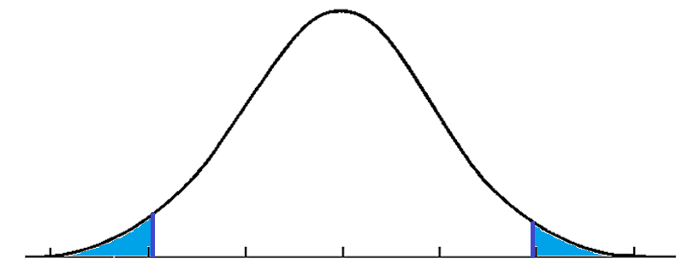
Now, for 95% CI, we used α symmetrically

Slide 47
There is another alternative

Slide 48
There is another alternative
Which I totally, totally, totally don’t recommend

Slide 49
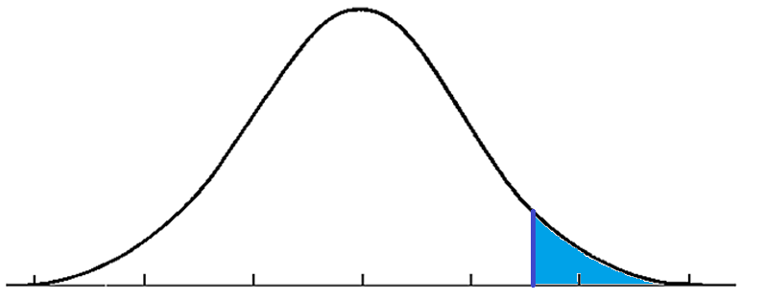
There is another alternative
Which I totally, totally, totally don’t recommend

Slide 50
One-tailed test
Which I totally, totally, totally don’t recommend

Slide 51
One-tailed
Two-tailed

Slide 52
The area in blue is called the “Rejection region”
One-tailed
Two-tailed

Slide 53
Rejection region
If our probability is in the rejection region
Then the null hypothesis appears to be false
There is something going on

Slide 54
Comments? Questions?

Slide 55
You don’t actually have a choice
Despite what textbooks will tell you
Everyone uses α = 0.05
Caveat: Sometimes people do refer to marginal significance, where they compare probabilities to α * 2 = 0.10
Everyone uses two-tailed tests

Slide 56
Why two-tailed tests?
Because one-tailed tests have a weird implication
It commits you to ignoring extreme findings in the unexpected direction
Actual finding
Highly improbable but we’ll ignore it

Slide 57
In practice
Considering marginal significance, where you compare probabilities to α * 2 = 0.10
Is the same level of stringency as doing a one-tailed test where α = 0.05

Slide 58
In practice
Considering marginal significance, where you compare probabilities to α * 2 = 0.10
Is the same level of stringency as doing a one-tailed test where α = 0.05
Never ever ever say “a marginally significant one-tailed test”
Your paper will be rejected

Slide 59
In practice
Never use one-tailed tests
Some reviewers are dogmatically opposed to them

Slide 60
Questions? Comments?

Slide 61
A statistical test of a hypothesis requires
A null hypothesis, H₀
A alternative hypothesis, H_{a}
An α value and tailedness
You then look at the data to compute
Whether the result is statistically significant
A p-value

Slide 62
One-sample Z-test
A statistical test involving the Z distribution
Which, yes, means that your sample should have N>30

Slide 63
The test
H₀ : The sample mean is no different than some known value
H_{a}: The sample mean is different than that known value
Calculate a Z value for the mean

Slide 64
Significance Criterion
For a two-tailed test, where α = 0.05
We consider the test significant if
$$Z< {−Z}_{∝/2}$$
$$Z> Z_{∝/2}$$

Slide 65
Significance Criterion
For a two-tailed test, where α = 0.05
We consider the test significant if
$$Z<−1.96$$
$$Z>1.96$$

Slide 66
Abstract Example
$\overline{x}$is 6, SE is 3
We want to know if M is greater than 0

Slide 67
Abstract Example
$\overline{x}$is 6, SE is 3
We want to know if M is greater than 0
Null hypothesis: M is not significantly different than 0

Slide 68
Abstract Example
$\overline{x}$is 6, SE is 3
We want to know if M is greater than 0
Null hypothesis: M is not significantly different than 0
$Z=\frac{6}{3}=2$Z > 1.96
So it is significant!

Slide 69
Concrete Example
36 students use a curriculum and take pre and post tests
The students average a gain of 10 points
The students get a standard deviation of 12
Do the students learn from this curriculum?

Slide 70
Hypotheses
Null hypothesis: The students’ learning gain is not significantly different from 0
Alternative hypothesis: The students’ learning gain is significantly different from 0

Slide 71
Z = $\frac{\overline{x}}{SE}$= $\frac{10}{\frac{12}{\sqrt{36}}}$ = $\frac{10}{\frac{12}{6}}$ = $\frac{10}{2}$= 5
36 students use a curriculum and take pre and post tests
The students average a gain of 10 points
The students get a standard deviation of 12
Do the students learn from this curriculum?

Slide 72
5> 1.96 It is statistically significant
36 students use a curriculum and take pre and post tests
The students average a gain of 10 points
The students get a standard deviation of 12
Do the students learn from this curriculum?

Slide 73
Class Ends
See next slide deck for continuation

Slide 74
Final questions or comments for the day?

Slide 75
Upcoming Classes
4/8 No class
4/13 Types of Errors
4/15 Statistical power
HW8 due

