Slide 1
Meta-Cognition, Motivation, and Affect
PSY504 Spring term, 2011
January 26, 2010

Slide 2
Help-Seeking

Slide 3
Model of Help-Seeking (Aleven et al., 2003)
1. Become aware of need for help
2. Decide to seek help
3. Identify potential helper(s)
4. Use strategies to elicit help
5. Evaluate help-seeking episode

Slide 4
Where do you agree and disagree with this model?
1. Become aware of need for help
2. Decide to seek help
3. Identify potential helper(s)
4. Use strategies to elicit help
5. Evaluate help-seeking episode

Slide 5
What would it mean for a student to fail at each of these steps?
1. Become aware of need for help
2. Decide to seek help
3. Identify potential helper(s)
4. Use strategies to elicit help
5. Evaluate help-seeking episode

Slide 6
Could a student succeed at each of these steps, and still fail to learn?
1. Become aware of need for help
2. Decide to seek help
3. Identify potential helper(s)
4. Use strategies to elicit help
5. Evaluate help-seeking episode

Slide 7
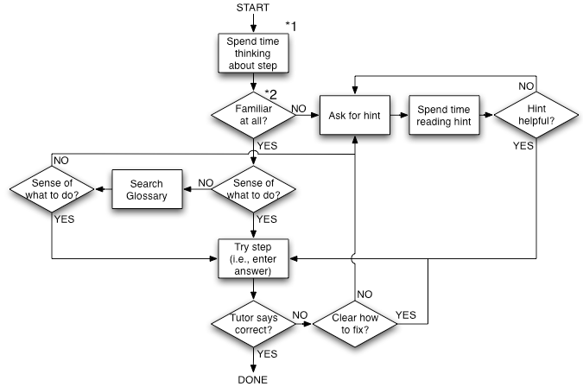
Model of Cognitive Tutor Help-Seeking (Aleven et al., 2006)

Slide 8
Where do you agree and disagree with this model?

Slide 9
What would it mean for a student to fail at each of these steps?

Slide 10
Could a student succeed at each of these steps, and still fail to learn?

Slide 11
Comments? Questions?

Slide 12
Impacts of Help-Seeking (Predicting Post-Test)
Negative
correlation between help-seeking and post-test (Aleven & Koedinger, 2001)
correlation between help-seeking and post-test for students with high prior knowledge (Wood & Wood, 1999)
Positive
correlation between help-seeking and post-test for students with low prior knowledge (Wood & Wood, 1999)
correlation between help-seeking and post-test (Bartholome et al., 2006)

Slide 13
Impacts of Help-Seeking (Predicting In-Tutor Behavior)
Negative
model of help use and future performance in tutor (Beck et al., 2008)
Positive
splitting help and non-help parameters in Bayesian model (Beck et al., 2008)

Slide 14
Which findings should we trust more?
Beck trusts the Bayesian Model more
Not entirely clear to me
Might not be worth going into the gory detail here… ☺

Slide 15
Inconsistent Relationships
Split Wood & Wood saw sometimes replicated, sometimes not…
More research needed…
And anyways, if there is a relationship,

Slide 16
Is it causal?
Help-Seeking
Learning

Slide 17
Is it causal?
Something about Student
Help-Seeking
Learning

Slide 18
Is it causal?
Something about Student
Help-Seeking
Learning
Even if you control for prior knowledge (which researchers generally do)
It doesn’t prove that there is no other student individual difference driving both

Slide 19
Another issue
Not all help-seeking is created equal

Slide 20
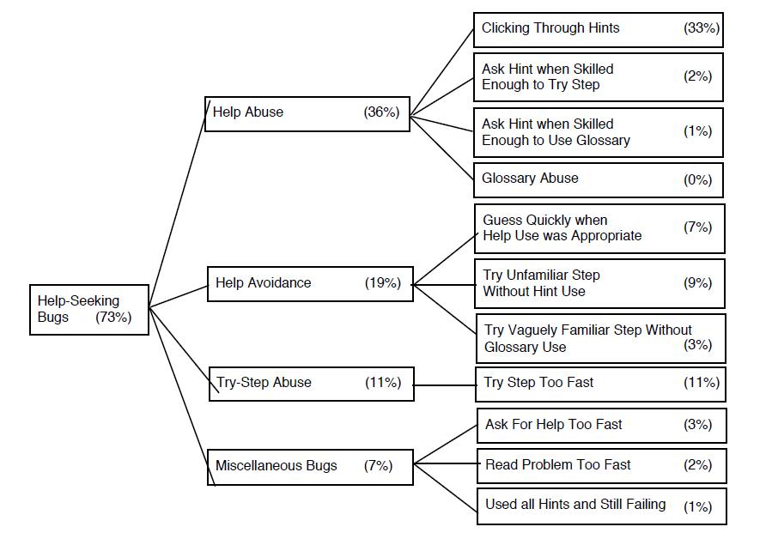
Aleven et al.’s help-seeking bugs
Gaming the System

Slide 21
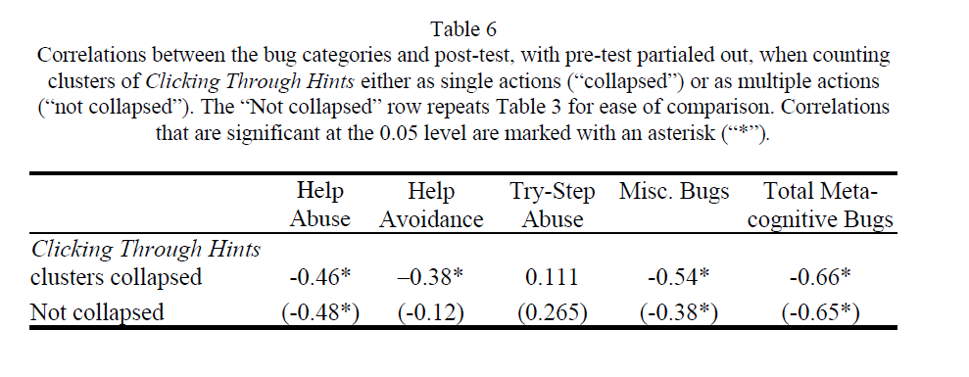
(Differential) Impacts of Help-Seeking (Aleven et al., 2006)

Slide 22
One issue (Aleven et al., 2006)
Help Avoidance may only have represented help avoidance within the tutor
Students may still have sought help from teacher or other students

Slide 23
Help-Seeking Behaviors
What help-seeking behaviors could be seen, beyond those in this model?
Both in the same kinds of environments he studied, and in other learning environments

Slide 24
Executive help-seeking
We will talk more about this in the ‘gaming the system’ lecture

Slide 25
Comments? Questions?

Slide 26
Factors driving help-seeking behaviors

Slide 27
Why do students fail to seek help, when needed?

Slide 28
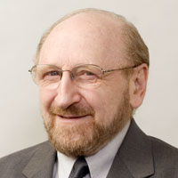
Why do students fail to seek help, when needed?
Fear of being seen as incompetent (Ryan et al., 2001)
Not realizing help is needed (Puustinen, 1998)
Performance goals (Karabenick, 2004)
Inexperience using help in tutors (hypothesis by Aleven et al., 2003)
Other possible factors?

Slide 29
Why do students seek different forms of help (glossary, on-demand hints, teacher, friend)?

Slide 30
Why do students seek different forms of help (glossary, on-demand hints, teacher, friend)?
Belief on effectiveness of resource (Nelson-LeGall, 1981) or person (Karabenick, 2004)
Social relationship with teacher or friend
Other possible factors?

Slide 31
Questions? Comments?

Slide 32
Measurement Methods
Field observation
Self-reports of help-seeking and help-seeking goals
Application of knowledge-engineered models to log data

Slide 33
Benefits/Drawbacks
Of each form of measurement

Slide 34
Thoughts on these types of measurement?
Any other plausible measurements?

Slide 35
Next Class
Monday, January 31
5pm-6:10pm
COURSE PROJECT PROPOSAL PRESENTATIONS

Slide 36
Survey
Please complete this survey, to help me make this class better

Slide 37
The End

Slide 38
Extra Slides

Slide 39
Learning Decomposition
Weight of h is positive or negative?

Slide 40
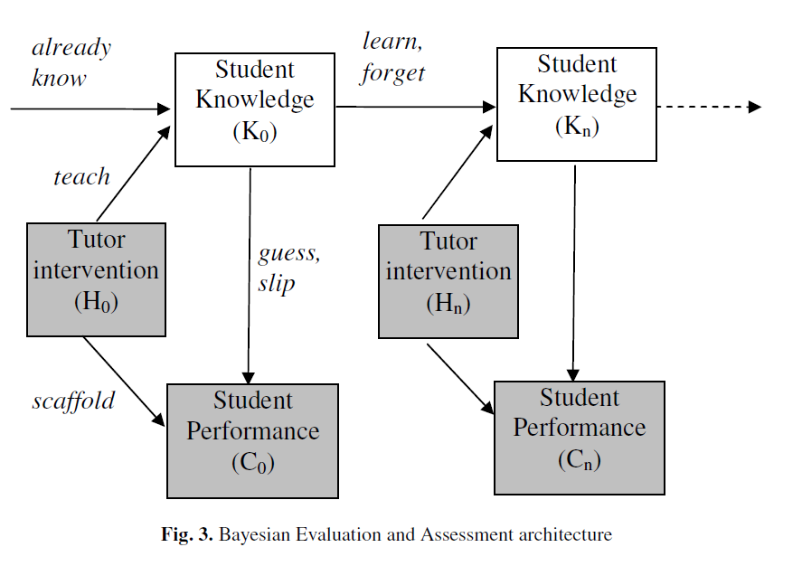
Bayesian Framework
Each parameter has help/no help version
P(T|Help)>P(T|~Help)

Slide 41
Some potential concerns…
Both models are over-parameterized
Model incorporating help did not predict future performance better than model without help (Beck et al., 2008)

