Slide 1
Meta-Cognition, Motivation, and Affect
PSY504 Spring term, 2011
February 2, 2010

Slide 2
Survey Responses
Thanks for your responses on the survey
This really helps me make the class better

Slide 3
Overall
How was today’s class (content)
8.00 (0.82)
Phew!

Slide 4
Overall
How was today’s class (discussion)
7.86 (1.35)
Phew!

Slide 5
Comments: Discussion
Best part of class: “We discussed and distinguished various subtopics and nuances within them”
Best part: “I enjoyed Andy’s comment…”
Best part: “Varying viewpoints of students & professor”
Best part: “… discussions.”
Best part: “Lots of in-depth discussion…”
Best part: “Discussion…”
Worst part of class: “In general, I think I would like to spend more time understanding an idea, its impact on the research community, before we go into a discussion…”
Worst part of class: “For this class in general, it can get off-topic…”

Slide 6
(first) Going Off-Topic
This is *always* a problem in discussion-based classes
I will try to be perceptive of off-topic discussions (including when I’m involved in them), and will try to be more aggressive about ending them
Please don’t be offended if I do this to you

Slide 7
Discussion Throughout, or Discussion Only After Summary

Slide 8
Options (Vote please)
Continue current practice
Change format to lecture, then discussion (e.g. I will summarize more, with low discussion, and then open up discussion)

Slide 9
How things fit
“It would be nice to explore how these constructs fit into current models of psychology”
“When there are a lot of similar interrelated concepts, I prefer having them in one big table or diagram and then compare and contrast them”

Slide 10
How things fit
I agree
We’ll do this next week for meta-cognition
The reason I didn’t do this from the start is that discussing how things inter-relate and fit in broader theory, before discussing the things themselves, can lead to unfocused discussion of those things

Slide 11
I wish you had talked more about
“Meta-cognitive agents”
Renkl

Slide 12
I wish you had talked more about
“Meta-cognitive agents” -- we’ll talk a little about this today; typically, agents are more common for motivational and affective goals
Add a pic and Aleven et al’s work *is* a meta-cognitive agent
Renkl

Slide 13
I wish you had talked more about
“Meta-cognitive agents” -- we’ll talk a little about this today; typically, agents are more common for motivational and affective goals
Add a pic and Aleven et al’s work *is* a meta-cognitive agent
Renkl
Fair enough. Next time I run the class I will substitute Renkl for one of the other readings. You can get them at:
http://www.sciencedirect.com/science?_ob=ArticleURL&_udi=B6VFW-44B29XT-1&_user=74021&_coverDate=10/31/2002&_rdoc=1&_fmt=high&_orig=search&_origin=search&_sort=d&_docanchor=&view=c&_searchStrId=1624032959&_rerunOrigin=scholar.google&_acct=C000005878&_version=1&_urlVersion=0&_userid=74021&md5=3b3b259f52c3b6fd70f230e3333c277c&searchtype=a
http://www.cs.pitt.edu/~chopin/references/tig/AtkinsonRenklM_03.pdf
http://www.iwm-kmrc.de/workshops/sim2004/pdf_files/Hilbert_et_al.pdf

Slide 14
Request
“Use blackboard or slides to keep track of important points outside scope of slides”
Let’s vote. Who wants me to do this?
Benefits: better organizer of key ideas
Costs: my attention may be divided

Slide 15
I liked
“Also thanks for photos of researchers so I don’t embarrass myself in conference.”

Slide 16
I liked
“Also thanks for photos of researchers so I don’t embarrass myself in conference.”
You’re welcome

Slide 17
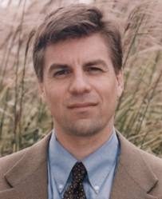
It’s clear that you know nothing about Koedinger’s work!

Slide 18
Um.

Slide 19
Metacognitive-SRL Scaffolding

Slide 20
Some background on scaffolding

Slide 21
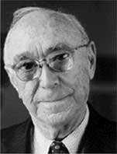
Scaffolding (Wood, Bruner, & Ross, 1976)

Slide 22
Scaffolding (Guzdial, 1994)
“The goal of scaffolding is
to enable students to achieve a process or goal which would not be possible without the support and
to facilitate learning to achieve without the support.”

Slide 23
What is the difference between
Scaffolding, as articulated by Wood et al and Guzdial
Vygotsky’s Zone of Proximal Development
?

Slide 24
Methods of scaffolding (Guzdial, 1994)
Communicating process:
Demonstrating the process with verbal annotation to highlight key points.
Coaching:
Watching and making comments, providing hints, reminding student of process previously communicated
Eliciting articulation
Essentially, requesting explanations

Slide 25
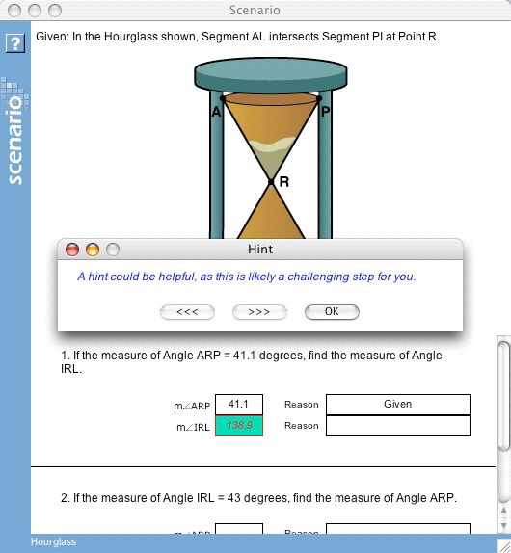
How does
Aleven et al’s Help Tutor map to Guzdial’s methods?

Slide 26
Adaptive Scaffolding of Error Detection/Correction (Mathan, 2003; Koedinger et al., 2009)

Slide 27
Adaptive Scaffolding of Error Detection/Correction (Mathan, 2003; Koedinger et al., 2009)

Slide 28
Adaptive Scaffolding of Error Detection/Correction (Mathan, 2003; Koedinger et al., 2009)
When the student makes an error in creating formula
System leads student through
realizing that formula is incorrect
inferring why the result is different than what was expected/desired
Scaffolding skill in error correction

Slide 29
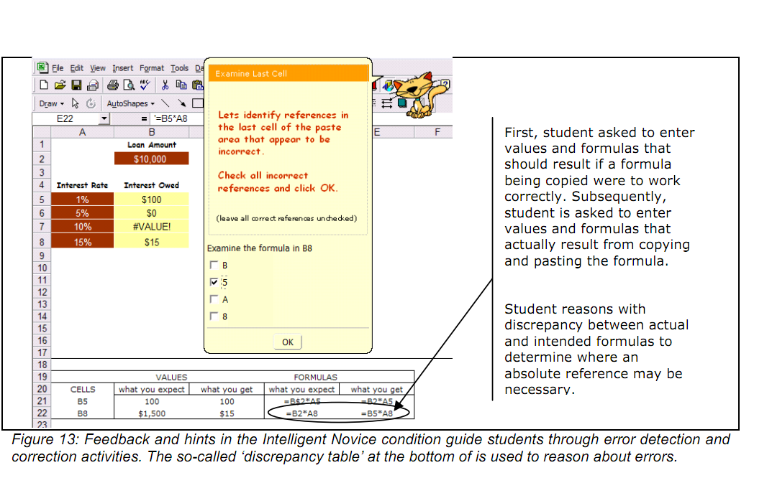

Slide 30
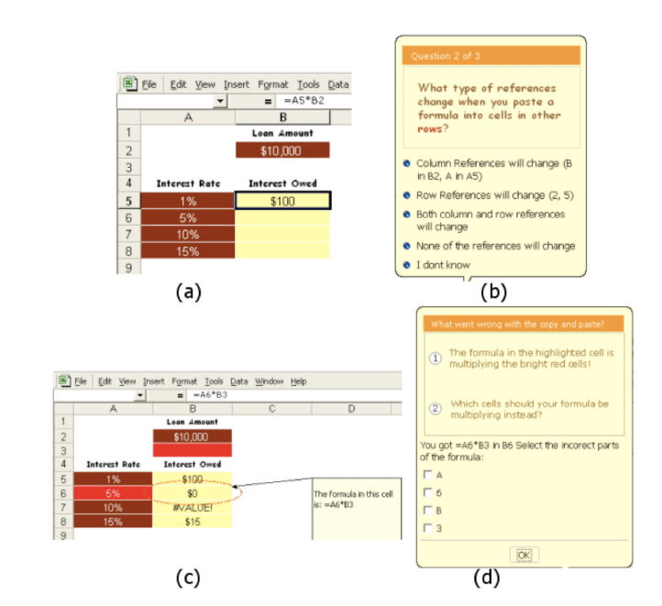

Slide 31
Results
Led to better learning, transfer, retention

Slide 32
How does
This scaffolding differ from Aleven et al’s scaffolding?
(at a conceptual level)

Slide 33
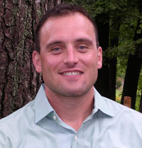
Adaptive Scaffolding of SRL (Azevedo et al., 2005)
A human tutor assists the learner in
planning their learning by having them activate prior knowledge
monitoring their emerging understanding by reporting FOK and JOL
monitoring their learning progress
use SRL strategies
hypothesizing, coordinating informational sources, inferencing, mnemonics, drawing, summarizing

Slide 34
Note
Azevedo et al refer to the conditions as fixed scaffolding, and adaptive scaffolding
But note that the fixed scaffolding was cognitive in nature, rather than being meta-cognitive/SRL
Sub-goals for learning

Slide 35
Results
Adaptive scaffolding led to
More sophisticated mental models (measured by essay on domain) and better performance on other post-test measures of learning
More use of meta-cognitive/SRL strategies (measured by think-alouds)

Slide 36
How does
This scaffolding differ from Aleven et al’s scaffolding, and Mathan & Koedinger’s scaffolding?

Slide 37
How could
Azevedo et al.’s scaffolding be realized in educational software?

Slide 38
Adapative and Non-Adaptive Scaffolding of SRL (Perry & Winne, 2006)
gStudy

Slide 39
Non-Adaptive Scaffolding of SRL (Perry & Winne, 2006)
Support for
annotating content while learning, and creating notes in sophisticated fashions

Slide 40
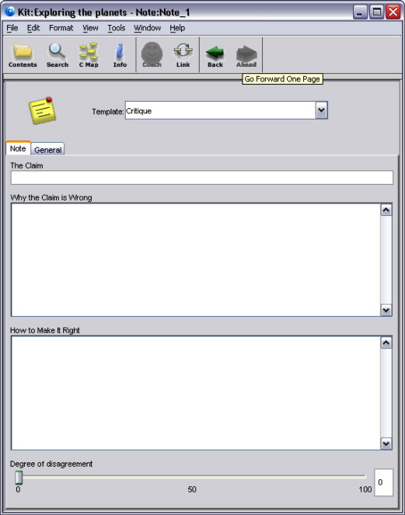

Slide 41
Non-Adaptive Scaffolding of SRL (Perry & Winne, 2006)
Support for
creating indexes and glossaries
creating concept maps

Slide 42
Non-Adaptive Scaffolding of SRL (Perry & Winne, 2006)
Support for
More effective chat and collaboration with fellow students, through scripts for how to collaborate

Slide 43
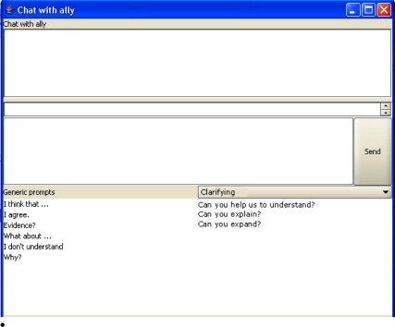

Slide 44
Adaptive Scaffolding of SRL (Perry & Winne, 2006)
Computerized coach gLiza which talks to student (via text) and
asks learner to judge whether learning and collaboration is being effective
semi-randomly suggests SRL strategies
uses expert system rules to suggest SRL and monitoring strategies
(I could not find a paper with concrete examples of interaction from gLiza)

Slide 45
Results
I’m not aware of any papers that compare behavior in gStudy to learning outcomes, or look at overall learning impacts for gStudy
There are several papers on student process within gStudy
Winne argues that gStudy is a research tool rather than an intervention

Slide 46
How does
gStudy differ from the other scaffolding we’ve discussed so far?

Slide 47
What is missing from “Methods of scaffolding (Guzdial, 1994)”?
Communicating process:
Demonstrating the process with verbal annotation to highlight key points.
Coaching:
Watching and making comments, providing hints, reminding student of process previously communicated
Eliciting articulation
Essentially, requesting explanations

Slide 48
Scaffold fading

Slide 49
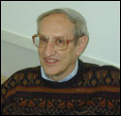
Scaffold fading
“Once the learner has a grasp of the target skill, the master reduces (or fades) his participation, providing only limited hints, refinements, and feedback to the learner, who practices successively approximating smooth execution of the whole skill” (Collins, Brown, & Newman, 1989)
“A critical piece to the concept of scaffolding is fading. If the scaffolding is successful, students will learn to achieve the action or goal without the scaffolding. For students to practice the action or goal without the scaffolding, the scaffolding must fade. However, scaffolding should not be all-or-nothing. Instead, scaffolding should be adapted to individual student needs, typically through gradual reductions in scaffolding. Students who are more capable (e.g., have more background knowledge, learn the action or goal faster) should have less scaffolding, that is, more fading of the provided scaffolding. The best scaffolding is maximally flexible—providing a continuous range of support.” (Guzdial, 1994)

Slide 50
Counter-point (Pea, 2004)
According to distributed cognition theory, scaffolding is omni-present in activities, artifacts, and social organization of activities – it never goes away, and doesn’t really need to go away

Slide 51
Thoughts? Comments?

Slide 52
Meta-cognitive Agents
Some of these systems had pictured agents
Some had chat agents
Some had no agents but popped up messages
Some just provided tools
Thoughts on the benefits of an agent for meta-cognition?
Motivation, affect are different issues

Slide 53
Next Monday
Metacognitive-SRL Theory
Where everything (so far) is “tied together”
Readings
Veenman, M.V.J., Van Hout-Wolters, B.H.A.M., Afflerbach, P. (2006) Metacognition and learning: conceptual and methodological considerations. Metacognition and Learning, 1, 3-14.
Butler, D.L., Winne, P. (1995) Feedback and Self-Regulated Learning: A Theoretical Synthesis. Review of Educational Resarch, 65, 3, 245-281.

