Slide 1
Meta-Cognition, Motivation, and Affect
PSY504 Spring term, 2011
February 9, 2010

Slide 2
Metacognitive-SRL Theory

Slide 3
Today we’ll discuss
Meta-cognitive/SRL models

Slide 4
What would characterize a “good” model?
Your thoughts on criteria?

Slide 5
What would characterize a “good” model?
Some of my thoughts
Completeness (includes all known phenomena in the domain)
Nothing False
Generativity (creates new predictions which can be tested)
Falsifiability (makes claims which, if false, require the model to be adjusted in fashions that are generative – cf. Lakatos, 1978)

Slide 6
Butler & Winne (1995)

Slide 7
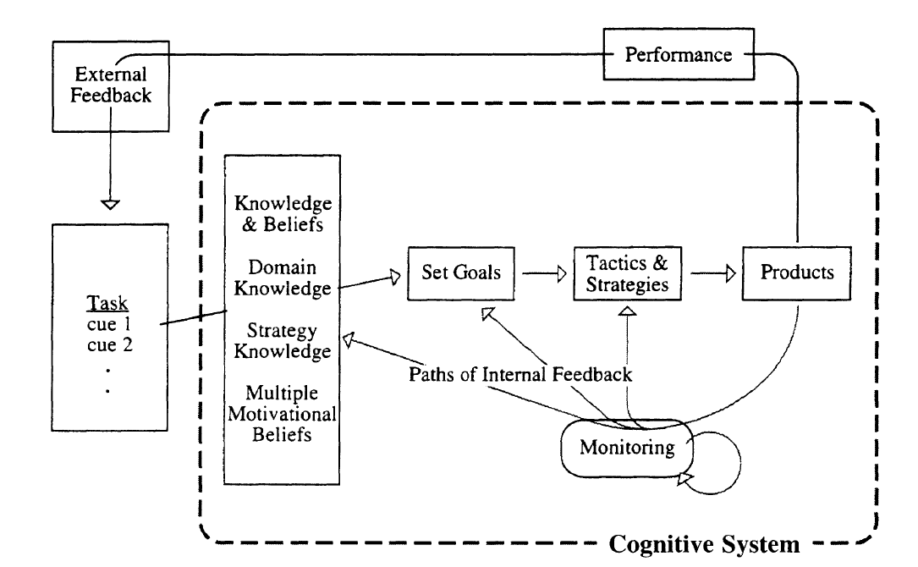

Slide 8
Your thoughts
What is good in this model?
What seems wrong in this model?
What is missing from this model?
Is this a “good” model, by our earlier criteria?

Slide 9
Winne & Hadwin (1998)

Slide 10
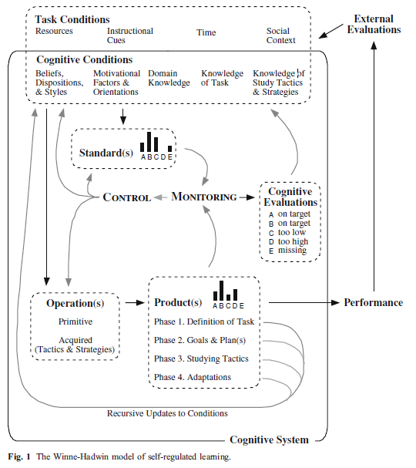

Slide 11
Winne & Hadwin (1998): Four Phases
Phase 1. Learners develop a model of the task by interpreting task conditions (contextual constraints and affordances that involve, for e.g., time limits, material resources, help available) and cognitive conditions (e.g., knowledge of the task domain, memories of challenges experienced with similar tasks and strategies that proved effective).

Slide 12
Winne & Hadwin (1998): Four Phases
Phase 2. Learners create goals relative to their model of the task (e.g., to increase knowledge about a particular topic). Then, they select cognitive operations operationalized as study tactics and learning strategies that they predict can contribute to achieving these goals.

Slide 13
Winne & Hadwin (1998): Four Phases
Phase 3. Learners engage in learning by applying their chosen tactics and strategies. As they do, chosen tactics and strategies create provisional updates to the initial knowledge and beliefs (e.g., Am I learning more about this topic? Is this strategy as helpful as I thought it would be), “steps” toward the ultimate goal of the task.

Slide 14
Winne & Hadwin (1998): Four Phases
Phase 4. Each cognitive operation a learner applies constructs products (knowledge, research reports, models or diagrams). When evaluations of products are available, either from the environment (e.g., a peer’s comment or a computer’s beep) or in the learner’s working memory, learners may choose to stay with or revise those products. As well, they may adjust their model of the task and adapt goals and strategies accordingly.

Slide 15
Winne & Hadwin (1998): What is needed for learning progress
Learners need an accurate model of the task and access to information they are supposed to learn.
Learners need expertise in a repertoire of effective study tactics and learning strategies to cope with challenges tasks present
Learners need to know or have access to standards for monitoring changes in subject matter knowledge, the fit of study tactics and learning strategies to tasks they are assigned, and properties of the cognitive operations that comprise study tactics and learning strategies
Learners need to be metacognitively active in monitoring and controlling (regulating) how they learn, that is, which study tactics they choose and patterns of tactics that comprise learning strategies.

Slide 16
Your thoughts
What is good in this model?
What seems wrong in this model?
What is missing from this model?
Is this a “good” model, by our earlier criteria?
Is this model an advance on Butler & Winne’s (1995) model? If so, how?

Slide 17
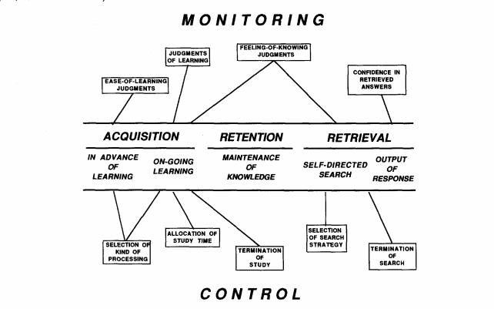
Metcalfe & Shimamura, 1994

Slide 18
Your thoughts
Does this model capture anything interesting missed in the other models?

Slide 19
Zimmerman & Campillo, 2003

Slide 20
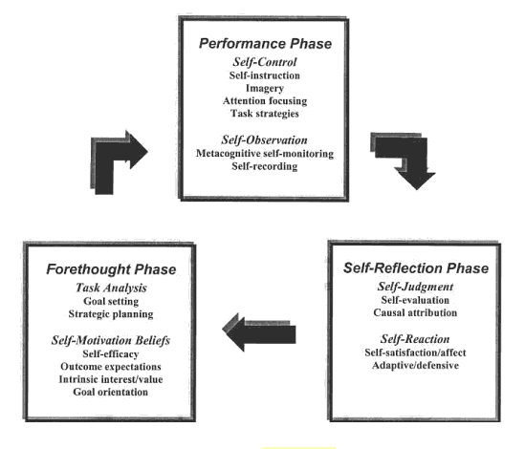

Slide 21
Your thoughts
Does this model capture anything interesting missed in the other models?

Slide 22
Open Issues in Meta-Cognition (Veenman et al., 2006)
Can we taxonomize/categorize meta-cognitive phenomena better? And can we model inter-relationships better?
What distinguishes conscious meta-cognition from un-conscious meta-cognition; what are the important differences?
Which aspects of meta-cognition are domain-general and which are domain-specific?
Through what processes does meta-cognition develop?
How can we promote the development of meta-cognition?

Slide 23
Open Issues in Meta-Cognition (Veenman et al., 2006)
Good places to do a dissertation, or 5 years of post-doc research…
Or quagmires with no escape…

Slide 24
Next Monday
Expectancy-Value Theories
Taught by Dovan Rai
Readings
Wigfield, A., Eccles, J.S. (2000) Expectancy-Value Theory of Achievement Motivation. Contemporary Educational Psychology, 25, 65-81.
Schunk, D.L., Pintrich, P.R., Meece, J.L. (2009) Motivation in Education: Theory, Research, and Applications. Ch.2, Expectancy-Value Theories of Motivation, pp. 43-78.

