Slide 1
Evaluation Metrics II
February 12, 2010

Slide 2
Today’s Class
Evaluation Metrics I
Last Week’s Probing Question
Evaluation Metrics II
Next Friday’s Probing Question
Assignments

Slide 3
Preparation for Future Learning
Can a student learn a new skill or concept better, based on their previous experience?

Slide 4
Preparation for Future Learning
What might be some ways to measure that the learning on the new task is “better”?

Slide 5
Preparation for Future Learning
What might be some ways to measure that the learning on the new task is “better”?
Better performance on new task after learning
Faster learning on new task (“Accelerated future learning”)

Slide 6
Advantages/Disadvantages of PFL

Slide 7
Advantages/Disadvantages of PFL
Gets at not just skill, but sophisticated conceptual understanding that can be utilized in new contexts
High vulnerability to second learning task
If the task is too easy or too hard, you won’t learn anything
Requires really understanding your domain
Most people aren’t good at learning fast
Requires running longer, more complex study OR
Picking relatively easy second learning tasks

Slide 8
Comments? Questions?

Slide 9
Last Week’s Probing Question
Should state/national/international assessments of learning (like the MCAS) have Preparation for Future Learning items? Why or why not?
First, who is in favor? Who is against?

Slide 10
Last Week’s Probing Question
Should state/national/international assessments of learning (like the MCAS) have Preparation for Future Learning items? Why or why not?
Reasons in favor? Reasons against?

Slide 11
“Robust Learning”
The “Robust Learning” movement argues that we should test “robust learning”, which is learning that
is retained
can transfer
prepares students for future learning
(VanLehn, 2005; Corbett et al, in preparation)

Slide 12
“Robust Learning”
Other researchers believe that these are distinct ways that learning can be “robust”, and that there is no single “robust learning” construct
E.g. you can remember something forever but be unable to transfer it
E.g. you can understand something flexibly and be prepared for future learning, but only for a couple of weeks before you forget it
What do you think?

Slide 13
An empirical question…
Ongoing research into this

Slide 14
Today’s Class
Evaluation Metrics I
Last Week’s Probing Question
Evaluation Metrics II
Next Friday’s Probing Question
Assignments

Slide 15
More Evaluation Metrics
Motivation
Attitudes
Affect
Behavior

Slide 16
Motivation & Attitudes
What kind of constructs might you want to measure?
And what could you make conclusions about, by measuring them?

Slide 17
Motivation & Attitudes
Grit
Self-Handicapping
Self-Efficacy
Goal Orientation
Intrinsic Motivation
Extrinsic Motivation
Disliking Domain
Disliking Computers
Disliking Your Software
Theory of Intelligence
Perception of Usefulness
Self-Concept
Cognitive Interest
Situational Interest
Vocational Interest

Slide 18
Currently Fashionable
Grit
Self-Handicapping
Self-Efficacy
Goal Orientation
Intrinsic Motivation
Extrinsic Motivation
Disliking Domain
Disliking Computers
Disliking Your Software
Theory of Intelligence
Perception of Usefulness
Self-Concept
Cognitive Interest
Situational Interest
Vocational Interest

Slide 19
Fashionable in 1980s-1990s
Grit
Self-Handicapping
Self-Efficacy
Goal Orientation
Intrinsic Motivation
Extrinsic Motivation
Disliking Domain
Disliking Computers
Disliking Your Software
Theory of Intelligence
Perception of Usefulness
Self-Concept
Cognitive Interest
Situational Interest
Vocational Interest

Slide 20
Never Fashionable ☺
Grit
Self-Handicapping
Self-Efficacy
Goal Orientation
Intrinsic Motivation
Extrinsic Motivation
Disliking Domain
Disliking Computers
Disliking Your Software
Theory of Intelligence
Perception of Usefulness
Self-Concept
Cognitive Interest
Situational Interest
Vocational Interest

Slide 21
Usually measured using questionnaires

Slide 22
Using questionnaires
Making your own items
Using someone else’s items

Slide 23
Making your own items
Definitely not trivial
Really easy to design items that are biased, or uninterpretable for students
The chapters you read have some suggestions about how to do this right

Slide 24
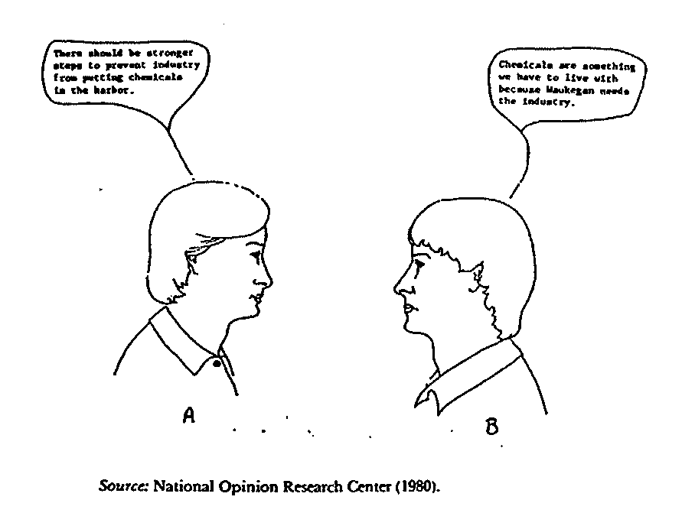
Mind you, nobody does this anymore

Slide 25
What’s wrong with the following items?

Slide 26
What’s wrong with these items? (real item!)
“Do you think women and children should be given the first available flu shots?”

Slide 27
What’s wrong with these items?
“Do you prefer the Democratic health plan, or do you prefer for children to die of easily treatable diseases?”

Slide 28
What’s wrong with these items?
“Do you prefer the Democratic health plan, or do you prefer lower health care costs?”

Slide 29
What’s wrong with these items? (real item!)
“When you think of Kai Tak airport what are the 3 big mistakes you think of?”

Slide 30
What’s wrong with these items? (real item!)
“Do you think that the software agent is genuinely concerned about your well-being?”

Slide 31
What’s wrong with these items? (real item!)
“Have you ever cheated on a test?”

Slide 32
What’s wrong with these items?
“Do Science ASSISTments improve your meta-cognitive understanding of control of variables strategy?”

Slide 33
What’s wrong with these items?
“How much do you like DrScheme?”
1 2 3 4 5

Slide 34
Ways to mess up items
What are some other ways that you could mess up your items?

Slide 35
Comments? Questions?

Slide 36
The One-Coin-Toss Sampling Technique
Let’s say that you want to ask a question with two answers, where one of the answers is socially stigmatized
Example: “Have you ever cheated on a test?”

Slide 37
The One-Coin-Toss Sampling Technique
Let’s say that you want to ask a question with two answers, where one of the answers is socially stigmatized
Example: “Have you ever cheated on a test?”
and others that are much more amusing, but which discussing in class might get me fired at my first-year review…

Slide 38
The One-Coin-Toss Sampling Technique
Let’s say that you want to ask a question with two answers, where one of the answers is socially stigmatized
Example: “Have you ever cheated on a test?”

Slide 39
The One-Coin-Toss Sampling Technique
You ask the participant to flip a coin where you can’t see it
If it is heads, they give the stigmatized answer, no matter what the truth is
If it is tails, they answer honestly

Slide 40
The One-Coin-Toss Sampling Technique
I know that no one carries change anymore, so I’ve brought some, courtesy of my mom
Take a coin

Slide 41
The One-Coin-Toss Sampling Technique
Flip your coin where no one can see, and remember the result

Slide 42
The One-Coin-Toss Sampling Technique
Flip your coin where no one can see, and remember the result
If it’s heads, say “YES”
If it’s tails, tell me, have you ever cheated on a test?

Slide 43
Math
Reported rate (R) of cheating on a test:
Actual rate of cheating:
R – (N/2)
(N/2)

Slide 44
Statistical tests…
There is added noise, so you need about double the sample to get significance

Slide 45
Comments? Questions?

Slide 46
“Lie Scale” Items
Items which no one answering carefully and honestly would give a certain answer
Used to test whether subject is answering carefully and honestly

Slide 47
“Lie Scale” Items
“I never worry what other people think of me”
TRUE/FALSE
“I have never told a lie in my life”
TRUE/FALSE

Slide 48
“Lie Scale” Items
These items have been very successful on tests with adults, particularly personality exams
My experience administering them with middle school students is that I get significantly over 50% lying
May be due to adminsitration out of context, an issue we’ll talk about later

Slide 49
Comments? Questions?

Slide 50
If you make your own items…
Step 1: pre-test them with members of the target population for understandability

Slide 51
If you make your own items…
Step 1: pre-test them with members of the target population for understandability
By having them explain to you what the item means

Slide 52
One volunteer please

Slide 53
Please explain the meaning of
Overall, how would you rate the quality of your loved one’s dying? (Circle one
number)
Terrible Almost Perfect
0 1 2 3 4 5 6 7 8 9 10
(yes, this is from a real questionnaire)

Slide 54
Please explain the meaning of
Overall, how would you rate the quality of your loved one’s dying? (Circle one
number)
Terrible Almost Perfect
0 1 2 3 4 5 6 7 8 9 10
(yes, this is from a real questionnaire – Quality of Death and Dying Questionnaire for Family Members, University of Washington Medical School)

Slide 55
If you make your own items…
Step 2: if you really want to know that the items are testing what you think they are testing
It is recommended to create several items, administer them together (with other items)
And see if they correlate, using Cronbach’s α
A lot of work!

Slide 56
Using someone else’s items
Advantages?
Disadvantages?

Slide 57
Advantage
Someone else has done the hard work of pre-testing the items and finding out what they correlate to

Slide 58
Disadvantage
Many times, the items do not match exactly to what you need
“I think that the tutor software is fun”
(But you’re not studying tutor software!)

Slide 59
It has been argued…
That it is usually safe to change the subject of a question, or to change grammatical tense
“I think that Mily’s World is fun”
But it is usually not safe to make further changes, without re-testing

Slide 60
Disadvantage
Many times, items come in huge inventories that are too time-consuming to administer as a whole
The MMPI-2 clinical psychology exam has 567 questions
Taking the items out of context may change how they are read and responded to
Particularly for lie scale items
Often validation focuses on validity of entire scale, not of individual items

Slide 61
Solutions
Use items designed to be given singly
For instance, individually-assigned items tested for correlation to scales
Not common, but not unheard of either
Use entire sub-scale of questionnaire
Find item(s) reported to be particularly central to the scale of interest in validation paper
Use single item and hope for the best
Particularly when you can’t give large numbers of items

Slide 62
Comments? Questions?

Slide 63
If you are paying attention
Raise your hand in the next 5 seconds!

Slide 64
Behavior & Affect
As discussed on Jan. 20…

Slide 65
Behavior & Affect
Measured in learning sciences with
observational methods (Jan. 20)
text replays (Jan. 20)
EDM models (Mar. 3)
Experience sampling method
aka popup questions

Slide 66
Experience sampling method (Csikszentmihalyi & Larson, 1987)
A participant does their normal task
At regular (or semi-random) intervals the individual is interrupted
Classically with a beep, although these days with computerized administration pop-up questions are just as common
And asked one or more questions

Slide 67
Experience sampling method
Are you currently zoned-out? (Schooler et al, 2004)
What are you doing right now?
Socializing, Seatwork, Listening to Teacher, …
(Csikszentmihalyi & Larson, 1984)
Are you bored?
(Larson & Richards, 1991)

Slide 68
Advantages/Disadvantages?
Field observations versus experience sampling method

Slide 69
Comments? Questions?

Slide 70
Today’s Class
Evaluation Metrics I
Last Week’s Probing Question
Evaluation Metrics II
Next Friday’s Probing Question
Assignments

Slide 71
Probing Question
Let’s say you wanted to do a large-scale research study on boredom
Under what conditions would it be preferable to use
Questionnaire items
Experience sampling method
Quantitative field observations

Slide 72
Today’s Class
Evaluation Metrics I
Last Week’s Probing Question
Evaluation Metrics II
Next Friday’s Probing Question
Assignments

Slide 73
Assignment #4
Any questions?

