Slide 1
Week 1, Video 5
Case Study – Zhang et al.

Slide 2
Case Study of Classification
With educational data
Thousands of examples to choose from
This example is one I know particularly well
For another great example (an older one), see previous versions of this course

Slide 3
Case Study of Classification
Zhang, J., Andres, J.M.A.L., Hutt, S., Baker, R.S., Ocumpaugh, J., Mills, C., Brooks, J., Sethuraman, S., Young, T. (2022) Detecting SMART Model Cognitive Operations in Mathematical Problem-Solving Process. Proceedings of the International Conference on Educational Data Mining.

Slide 4
Research Goal
Build detectors that can infer behaviors associated with self-regulation
Grounded in SMART model of self-regulated learning (Winne & Hadwin, 1998)
Searching
Monitoring
Assembling
Rehearsing
Translating

Slide 5
Why?
Embed in interventions that can make recommendations to students about strategies they are not currently using
Reports for teachers on strategies to emphasize to the class
Asset-based reports for teachers on what strategies their students are using

Slide 6
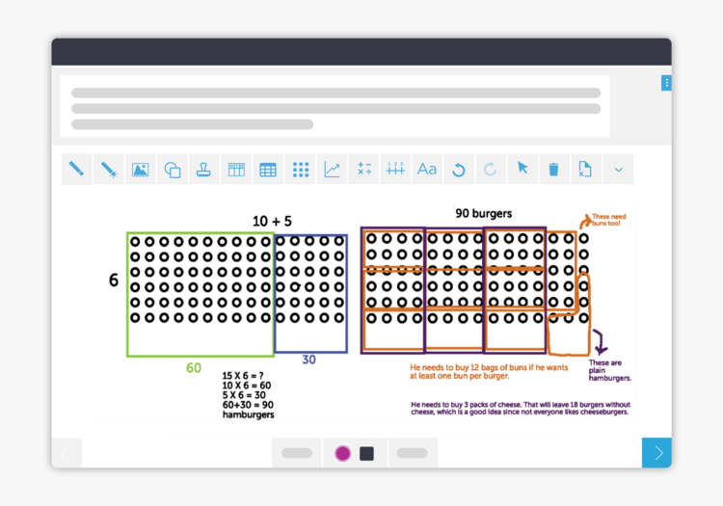
Context: CueThink

Slide 7
Current Study
We built automated detectors of SRL constructs from a theory-driven lens.
Model Performance
Label
5 SRL Indicators
Build Automated Detectors
&
&
SMART Model
Algorithmic Bias

Slide 8
CueThink’s Phases: Designed Using Theory From (Winne & Hadwin, 1995)
Understand Phase
What do you notice?
What do you wonder?
Estimate your answer
Plan Phase
Choose your strategies
Planning journal
Solve Phase
Video creation tools
Review Phase
Check your math
Check your recording
Review your estimate
Final answer
Screenshot from: https://www.cuethink.com/
Notes:
Sao Pedro, M. A., Baker, R.S.J.d., Montalvo, O., Nakama, A., Gobert, J.D. (2010) Using Text Replay Tagging to Produce Detectors of Systematic Experimentation Behavior Patterns. Proceedings of the 3rd International Conference on Educational Data Mining, 181-190. [pdf]
Baker, R.S.J.d., de Carvalho, A. M. J. A. (2008) Labeling Student Behavior Faster and More Precisely with Text Replays. Proceedings of the 1st International Conference on Educational Data Mining, 38-47.[pdf]

Slide 9
Building Detectors
Construct operationalization
Coding the data
Feature distillation
Training models

Slide 10
Building Detectors – Construct Operationalization
SMART*
Framework
Assembling
Translating
Cognitive Operations
Numerical Representation
Contextual Representation
Strategy Orientation
Outcome Orientation
Data Transformation
SRL Indicators
*Winne, P.H. and Hadwin, A.F. 1998. Studying as Self-Regulated Learning. Metacognition in Educational Theory and Practice. (1998), 277–304.

Slide 11
Building Detectors – Construct Operationalization
SMART
Framework
Searching
Monitoring
Assembling
Rehearsing
Translating
Cognitive Operations

Slide 12
Building Detectors – Construct Operationalization
SMART
Framework
Assembling
Translating
Cognitive Operations

Slide 13
Building Detectors – Construct Operationalization
SMART
Framework
Assembling
Translating
Cognitive Operations
Numerical Representation
Contextual Representation
Strategy Orientation
Outcome Orientation
Data Transformation
SRL Indicators

Slide 14
Building Detectors – Construct Operationalization
SMART
Framework
Assembling
Translating
Cognitive Operations
Numerical Representation
Contextual Representation
Strategy Orientation
Outcome Orientation
Data Transformation
SRL Indicators
represents problems with numerical components and demonstrates a level of understanding of how the numerical values are used
Represents
the problem includes contextual details relating to the setting/ characters/ situations

Slide 15
Building Detectors – Construct Operationalization
SMART
Framework
Assembling
Translating
Cognitive Operations
Numerical Representation
Contextual Representation
Strategy Orientation
Outcome Orientation
Data Transformation
SRL Indicators
states a plan for how they will find the answer
provides only a numerical estimate of the final answer

Slide 16
Building Detectors – Construct Operationalization
SMART
Framework
Assembling
Translating
Cognitive Operations
Numerical Representation
Contextual Representation
Strategy Orientation
Outcome Orientation
Data Transformation
SRL Indicators
The learner manipulates the ways information is represented to them in the problem

Slide 17
Building Detectors – Construct Operationalization
SMART
Framework
Assembling
Translating
Cognitive Operations
Numerical Representation
Contextual Representation
Strategy Orientation
Outcome Orientation
Data Transformation
SRL Indicators
represents problems with numerical components and demonstrates a level of understanding of how the numerical values are used
Represents
the problem includes contextual details relating to the setting/ characters/ situations
states a plan for how they will find the answer
provides only a numerical estimate of the final answer
The learner manipulates the ways information is represented to them in the problem

Slide 18
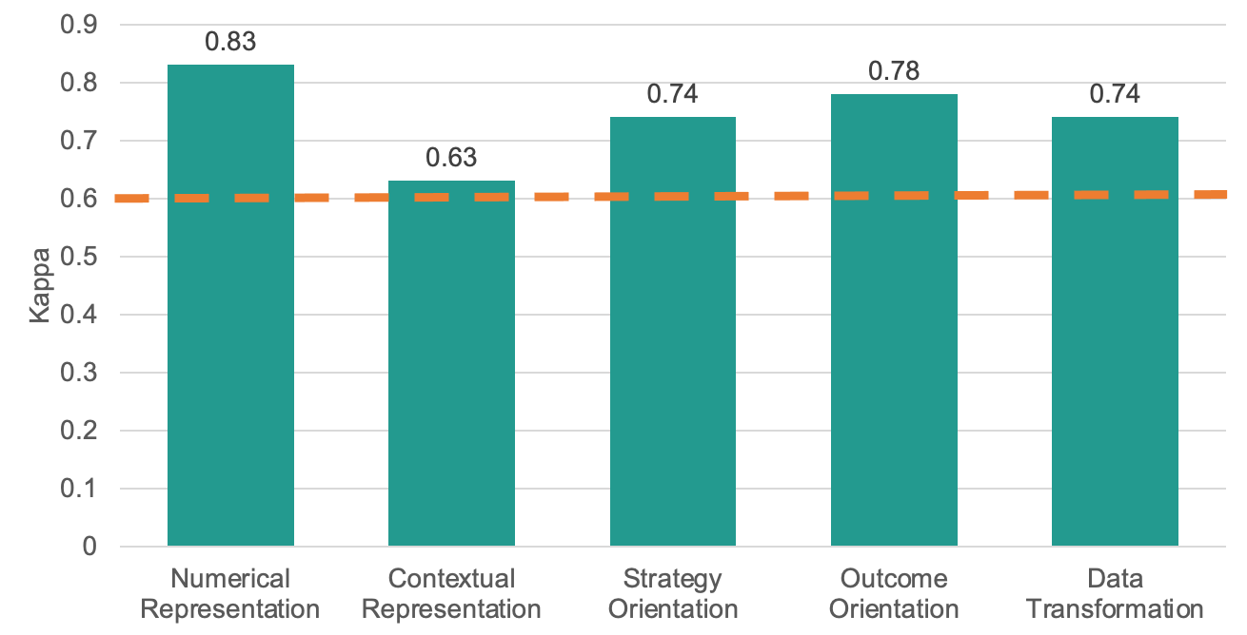
Building Detectors – Coding the Data
Cohen’s Kappa (next week)
Preliminary coding
Separate coding (Interrater)
Individual coding
Notes:
In total, we coded 349 Thinklets.

Slide 19
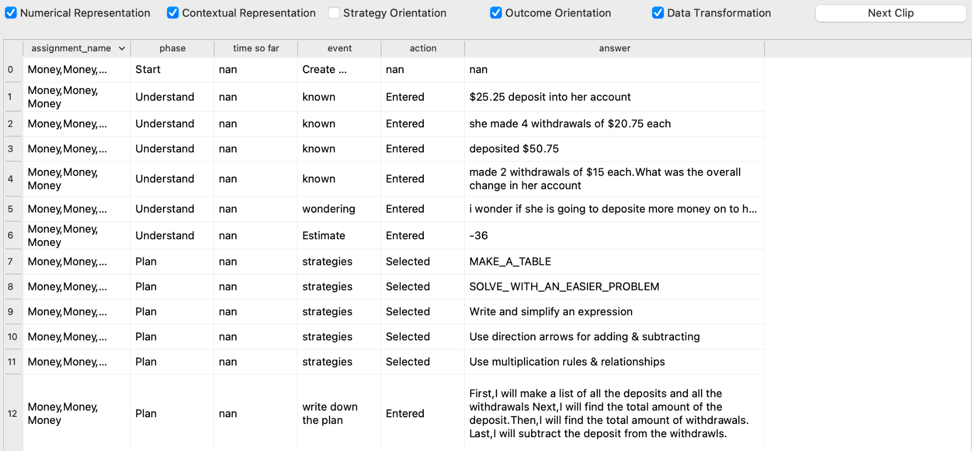
Building Detectors – Feature Engineering
100 features extracted from each Thinklet
Feature set 1 (Thinklet level)
# questions answered in a Thinklet
# questions answered in each phase
Etc…
Feature set 2 (phase level)
# words,
# nouns,
# verbs,
Contains numerical values
Contains keywords
Etc…

Slide 20
Building Detector – Training Models
Used the ground truth data from 182 Thinklets and features distilled from the same set of data
Trained models using XGBoost to predict the presence of the 5 SRL indicators
Evaluated the model performance using 10-fold student-level Cross-Validation (we will discuss next week)
Computed the average AUC ROC (we will discuss next week) of each model

Slide 21
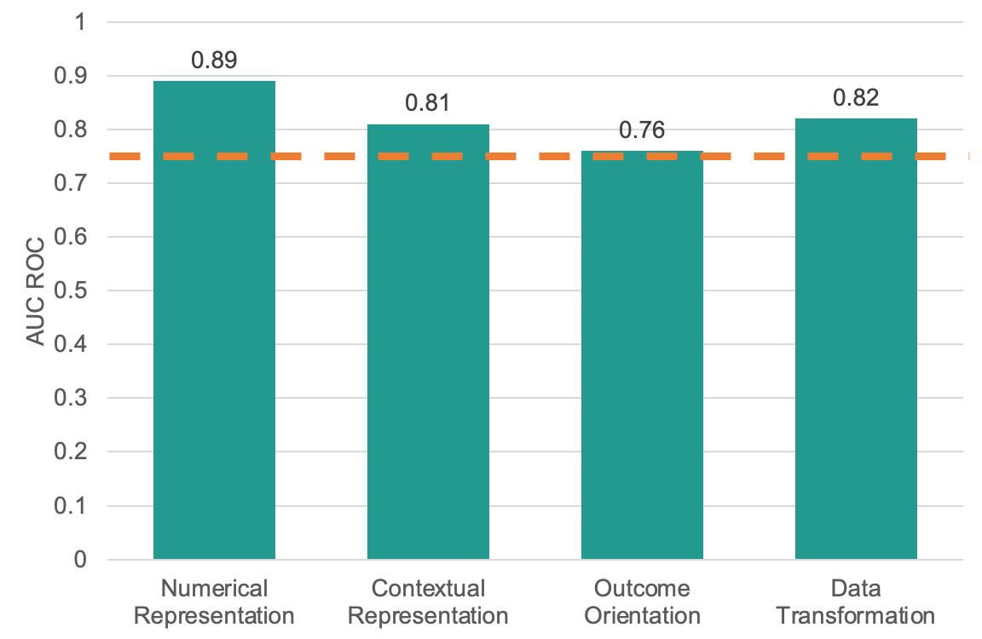
Results -- Model Performance
A model could not be built for Strategy Orientation
The other models reached an AUC ROC above 0.75

Slide 22
Results -- Feature Importance
Calculated SHapley Additive exPlanations (SHAP) value (we will discuss later this week) of each feature in each model
Reported the most important 5 features in each model

Slide 23
Results -- Feature Importance
We found:
Most of the features are from the Understand and the Plan phase

Slide 24
Results -- Feature Importance
We found:
Most of the features are from the Understand and the Plan phase
Numerical Representation Use of numerical values Similarity measure

Slide 25
Results -- Feature Importance
We found:
Most of the features are from the Understand and the Plan phase
Numerical Representation Use of numerical values Similarity measure
Contextual Representation Use of keywords Length of the responses

Slide 26
Results -- Feature Importance
We found:
Most of the features are from the Understand and the Plan phase
Numerical Representation Use of numerical values Similarity measure | Outcome Orientation Use of keywords Use of numerical values
Contextual Representation Use of keywords Length of the responses

Slide 27
Results -- Feature Importance
We found:
Most of the features are from the Understand and the Plan phase
Numerical Representation Use of numerical values Similarity measure | Outcome Orientation Use of keywords Use of numerical values
Contextual Representation Use of keywords Length of the responses | Data Transformation Strategy selection Length of the responses

Slide 28
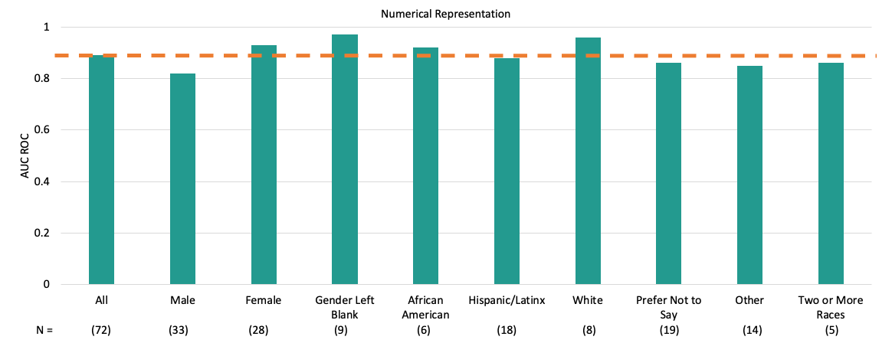
Results -- Algorithmic Bias (we will discuss next week)
In each detector, relatively small differences in AUC ROC were observed across gender and racial/ethnic groups

Slide 29
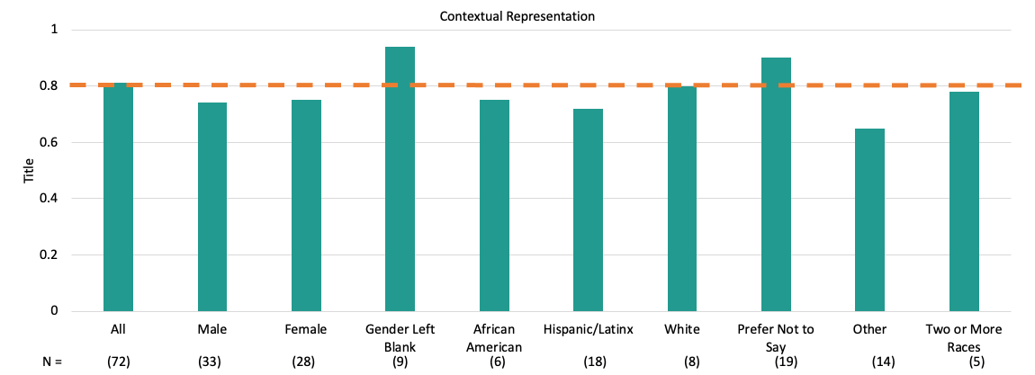
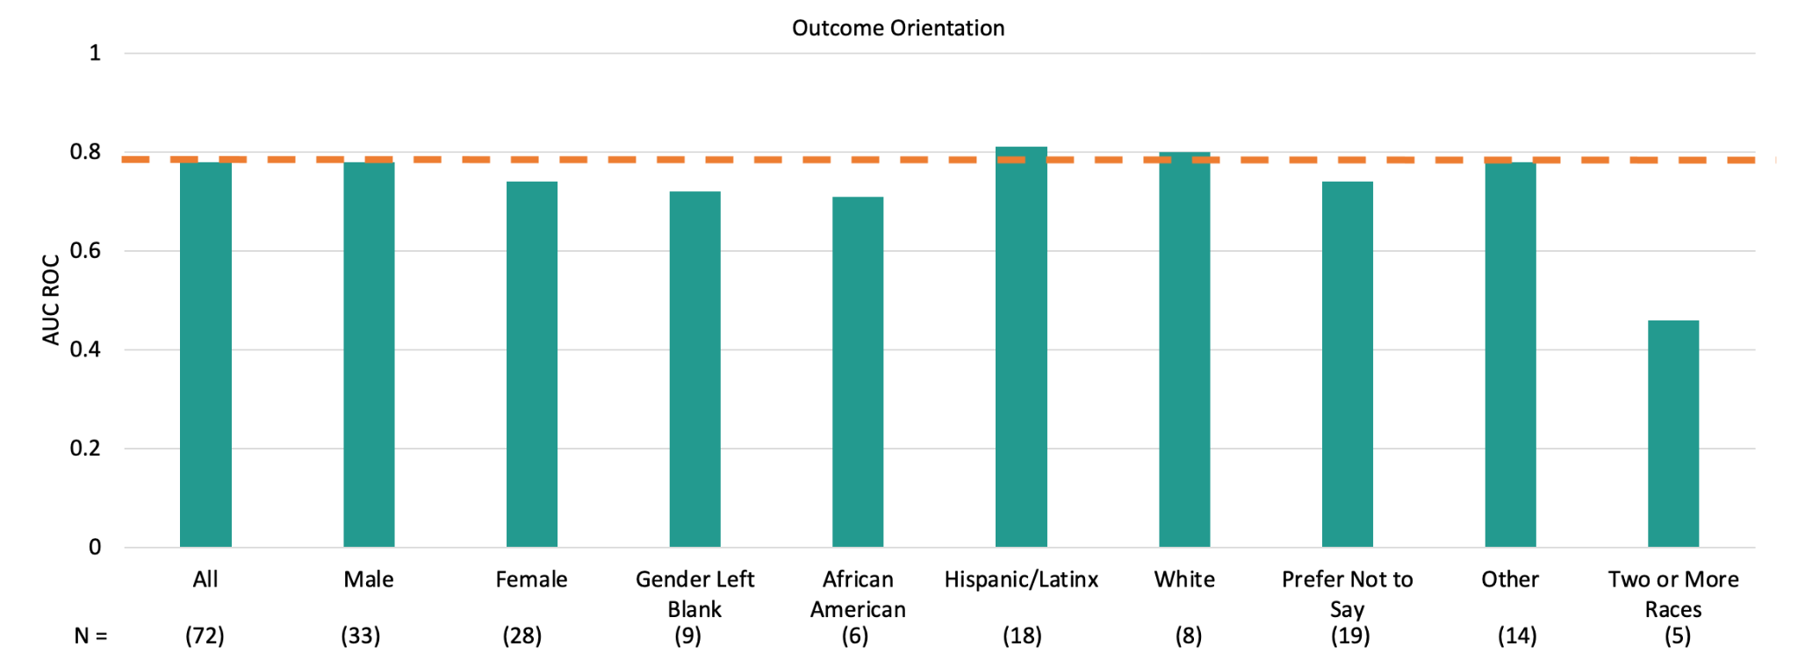
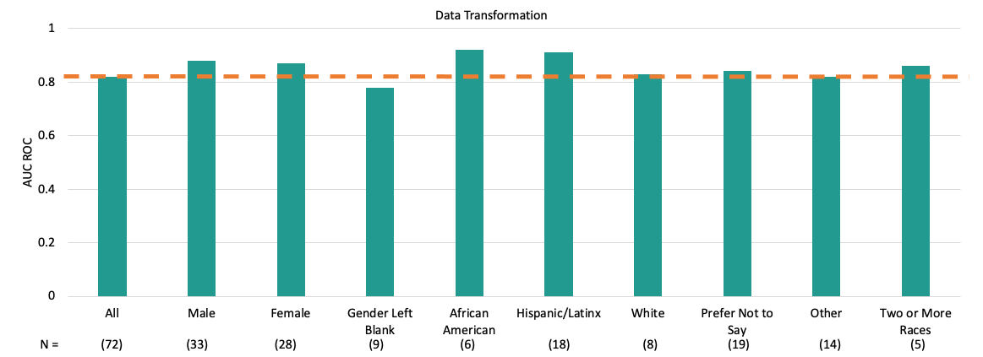
Results -- Algorithmic Bias
Contextual Representation
Outcome Orientation
Data Transformation

Slide 30
Results -- Algorithmic Bias
No student group (either gender or racial/ethnic group) consistently had the best-performing detectors

Slide 31
As you can see
Hard to discuss an example in detail without getting ahead of ourselves

Slide 32
Why this example?
Theoretically-grounded constructs
Theoretically-grounded feature engineering
Validated training labels
Modern classifier
Appropriate validation approach and metrics
Attention to interpretation
Attention to algorithmic bias

Slide 33
Next Lecture
Neural Networks

