Slide 1
Week 3 Video 5
Knowledge Engineering

Slide 2
Knowledge Engineering
Where your model is created by a smart human being, rather than an exhaustive computer

Slide 3
Knowledge Engineering
Also called
Rational modeling
Cognitive modeling

Slide 4
Knowledge Engineering at its best
Knowledge engineering is the art of a human being
Becoming deeply familiar with the target construct
Carefully studying the data, including possibly process data (such as think-alouds)
Understanding the relevant theory and how it applies
Thoughtfully crafting an excellent model

Slide 5
Knowledge Engineering at its best
In its classical version
A knowledge engineer and a domain expert work together to model the construct
Through an iterative process
Where the knowledge engineer interviews the expert, creates models, goes through the model and its implications with the expert, gets feedback, enhances the models, and repeats the process
Until both the knowledge engineer and domain expert believe the model has fully captured the expert’s reasoning

Slide 6
Knowledge Engineering at its best
Achieves higher construct validity than data mining
Achieves comparable performance in data
And can transfer better to new data in some cases, by capturing more general aspects of the construct (Paquette et al., 2015)
One case where a knowledge engineered model transferred between learning systems (Paquette & Baker, 2019)

Slide 7
Example of excellent knowledge engineering
Aleven et al.’s (2004, 2006) help-seeking model

Slide 8
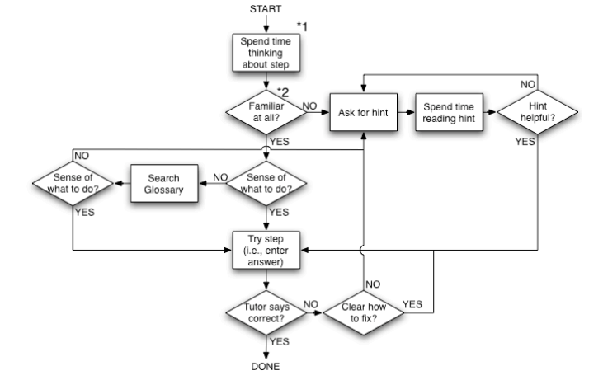
A prescriptive model of good help-seeking behavior in an online tutor

Slide 9
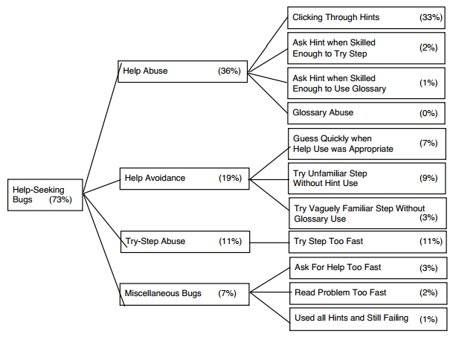
With a taxonomy of errors in student help-seeking

Slide 10
Developed based on
Thorough study of dozens of scientific articles
Years of experience in designing online learning environments
Intensive study of log files of student interaction with learning system
Plus experience watching kids use educational software in real classrooms

Slide 11
Resultant models
Predictive of student learning (Aleven et al., 2004, 2006) and preparation for future learning (Baker et al., 2011)
Specific aspects of model correlate to data-mined detectors of same constructs, and improve data-mined models if added to them (Roll et al., 2005)

Slide 12
Knowledge Engineering at its worst
Knowledge engineering (and the other terms) are sometimes used to refer to
Someone making up a simple model very quickly
And then calling the resultant construct by a well-known name
And not testing on data in any way
And asserting that their model is the construct, despite having no evidence

Slide 13
Knowledge Engineering at its worst
Achieves poorer construct validity than data mining
Predicts desired constructs poorly, sometimes even worse than chance
Due to over-simplifying a complex construct
Or even failing to match it
Can slow scientific progress by introducing false results
Can hurt student outcomes by intervening at the wrong times

Slide 14
How can you tell if knowledge engineering is bad
If a data mining model is bad
It’s usually relatively easy to identify, from the features, the validation procedure, or the goodness metrics
Telling top-notch knowledge engineering from junk is a little harder
The hard work is in the researcher’s brain, and the process is usually invisible
But… look for very simple models of complex constructs

Slide 15
Whether You Use Knowledge Engineering or Data Mining…
You should be testing your models on data in some fashion
Even if you can’t get a direct measure (training labels)
You can usually get some kind of indirect measure (predicting student learning, for example)

Slide 16
It’s not an either-or…
Feature engineering is very closely related to knowledge engineering
Careful study of a construct will lead to better features and ultimately to better models

Slide 17
It’s not an either-or…
Using knowledge-engineered models as features in data mining models can be a powerful tool

Slide 18
It’s not an either-or…
Some research has used knowledge engineering to discover what basic operators domain experts think in terms of
And then re-combine those operators in a broader range of ways (Paquette et al., 2014)

Slide 19
It’s not an either-or…
Knowledge-engineered models sometimes depend on cut-offs or numerical parameters that are hard to determine rationally
These parameters can be empirically fit using data
Some variants of Aleven et al.’s model do this
As does Bayesian Knowledge Tracing (next week)

