Slide 1
Epistemic Network Analysis
Week 5 Video 6

Slide 2
Today’s Class
Epistemic Network Analysis

Slide 3
Epistemic Network Analysis (ENA) (Shaffer, 2017)
Studying relationships between elements in coded data
Lots of applications
Conference founded around this method (in large part)
International Conference on Quantitative Ethnography

Slide 4
Nodes and links
Nodes = occurrences of the codes
Links = co-occurrences of the codes

Slide 5
Let’s start with an example
Chosen primarily because I understand it well

Slide 6
Analyzing Quitting Behavior (Karumbaiah et al., 2019)
Comparing students who quit a level in the game Physics Playground to students who do not quit a game level
In terms of the gameplay actions each group of students makes

Slide 7
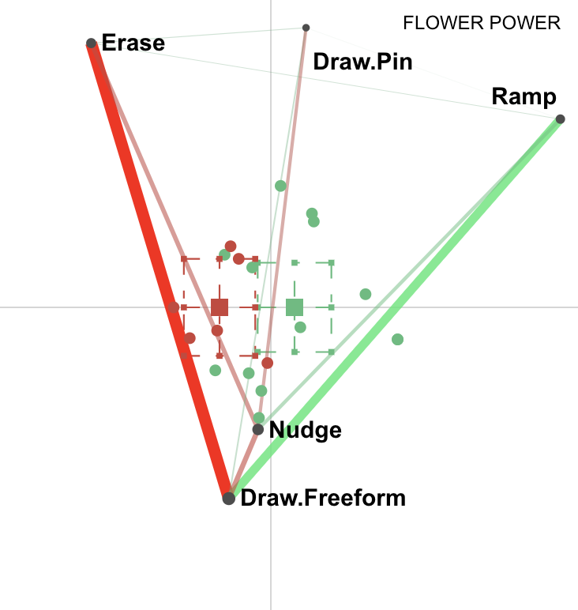
Nodes and links
Nodes are behaviors
Links represent when a player demonstrates both behaviors in one session playing one level

Slide 8
Nodes and links
When red students draw.freeform, they also erase
Less commonly, when they draw.freeform, they also nudge
When green students draw.freeform, they also ramp
Less commonly, when they nudge, they also ramp

Slide 9
Comparing groups in data
In this case, red= people who quit a game green = people who do not quit

Slide 10
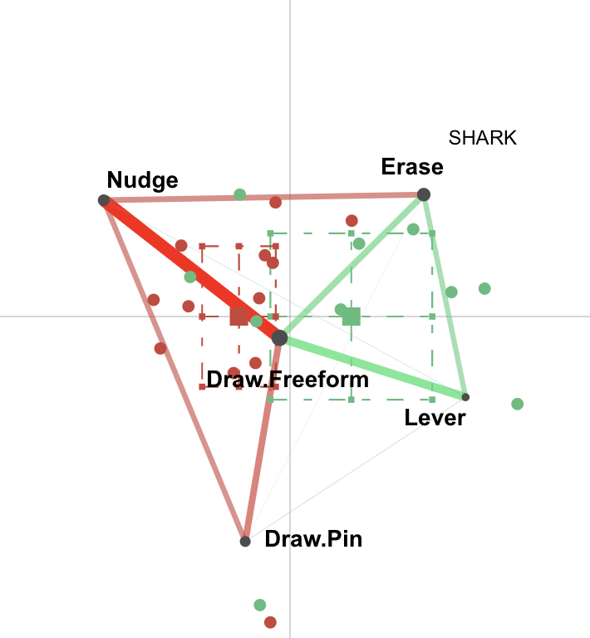
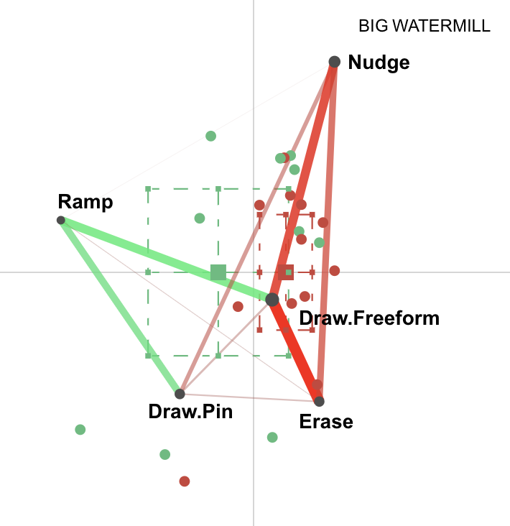
Can Compare Graphs Between Contexts (here: game levels)

Slide 11
Interpreting the graphs in (Karumbaiah et al., 2019)
Can seem tricky
Very powerful when you dig into the graphs

Slide 12
Key Themes identified by Karumbaiah et al. (2019)
Identifying Key Action
Missing Identification of Supporting Objects
Over-reliance on Nudge
Limited Early Action Expansion and Later Action Convergence

Slide 13
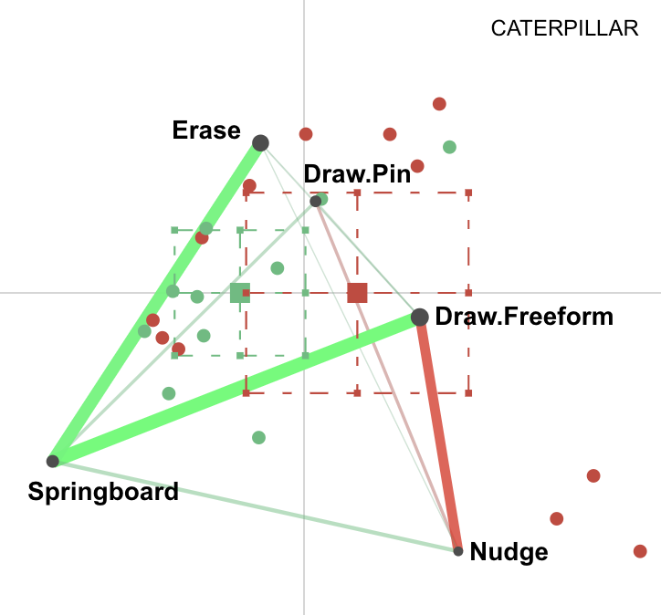
Identifying Key Action
Indicates their lack of conceptual understanding of Physics

Slide 14
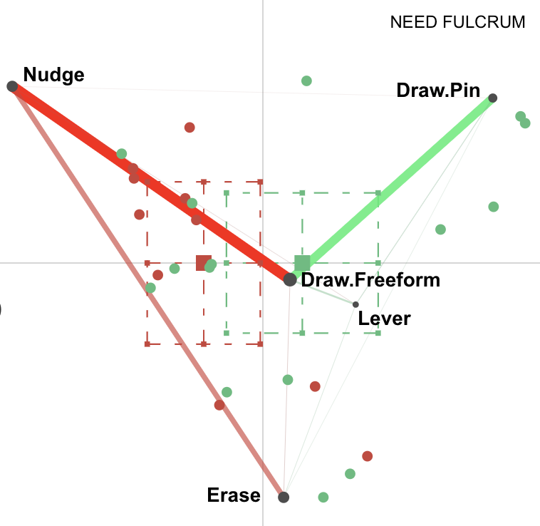
Missing Identification of Supporting Objects

Slide 15
Over-reliance on Nudge
Indicates potential wheel spinning tendencies

Slide 16
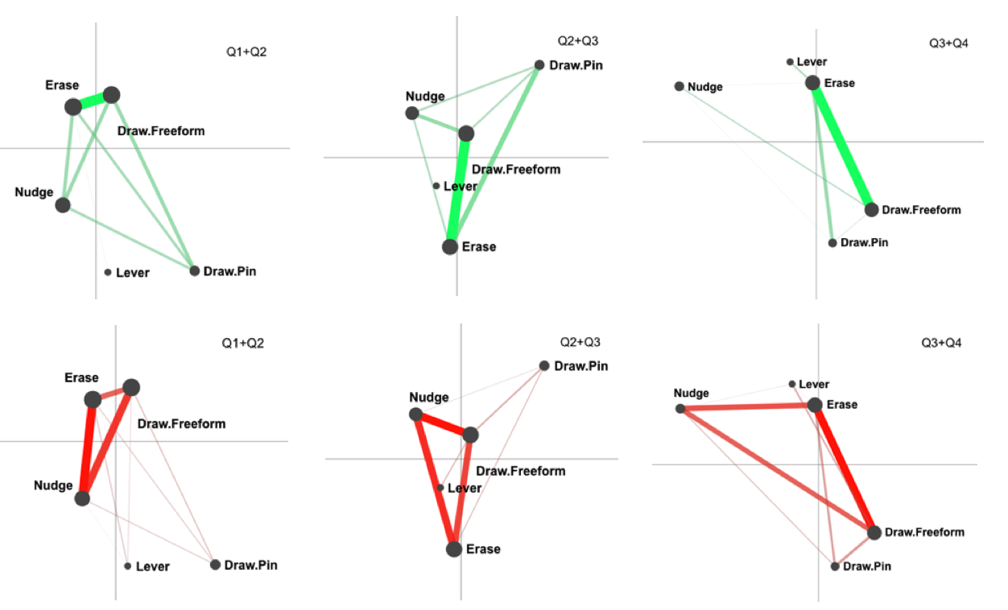
Limited Early Action Expansion and Later Action Convergence
Need Fulcrum

Slide 17
Note
We looked at these graphs qualitatively, but statistical analysis of differences is possible too
Is link A stronger than link B?
Is link Q stronger in group R or group S?

Slide 18
Other examples

Slide 19
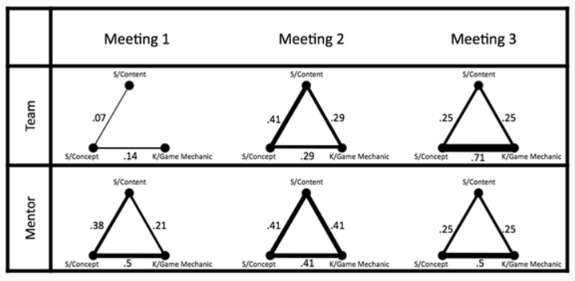
Studying connections between topics in meetings over time (Nash & Shaffer, 2013)

Slide 20
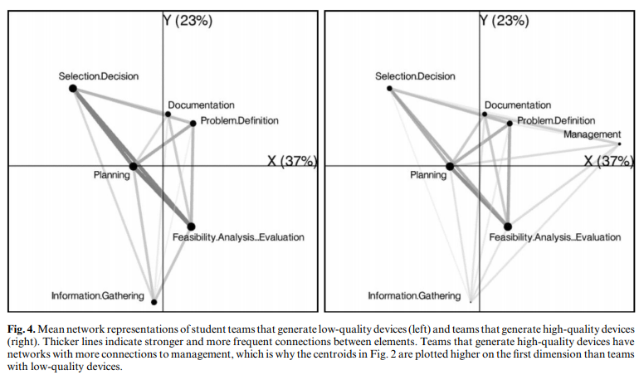
Studying Process of Successful and Unsuccessful Teams (Arastoopour et al., 2016)

Slide 21
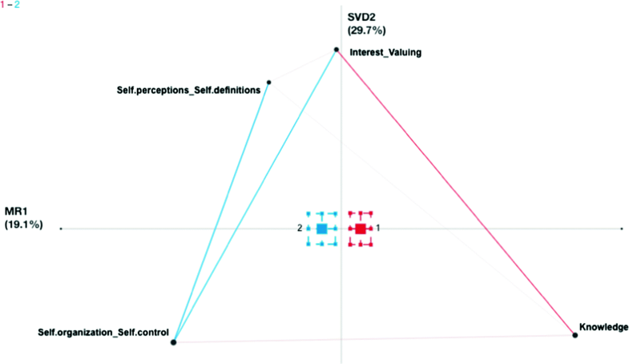
Exploring Shifts in Student Identity over Time (Barany & Foster, 2019)

Slide 22
Important setup questions
What makes a relationship “stronger”?

Slide 23
Important setup questions
What are your codes?
How did you derive those codes?
Behaviors in data
Text mining
Hand coding
Hand coding THEN text mining (nCoder+) (Cai et al., 2019)
Collaborative mixed-initiative human-machine coding (Codey) (Choi et al., 2022)

Slide 24
Important setup questions
Which codes do you display?
What are your aggregation units (stanzas)?
Everything a learner does together
Everything a learner does on a specific level together
Everyone in a group of learners/team
Everything in a piece of content
Everything in a meeting

Slide 25
Referred to as Stanza-Based Interaction Data (Shaffer et al., 2016)
A set of objects
The way they relate to each other
Grouped into a set of stanzas
That reveal evidence about the relationships between the objects

Slide 26
Important setup questions
One-directional relationships or bi-directional relationships?
Usually bi-directional, but some work looks at one-directional relationships over time (Karumbaiah & Baker, 2020)

Slide 27
Important setup questions
What do the X and Y axes mean?
Typically determined empirically by collapsing the feature space using SVD, singular value decomposition
Similar to factor analysis (week 7)
This approach can make X and Y hard to interpret but best splits out the variables visually

Slide 28
ENA
Important method, growing in scope and community applying it

Slide 29
Knowledge Graphs/Spaces
Another key application of network analysis
We will discuss next week

Slide 30
Next week
Structure Discovery

