Slide 1
Week 7 Video 2
Clustering
Validation and Selection of K

Slide 2
How do we choose?
A value for k
Which set of clusters to use, after 17 randomized restarts

Slide 3
First…
Let’s take the case where we have 17 randomized restarts, each involving the same number of clusters

Slide 4
Distortion (Also called Mean Squared Deviation)
Take each point P
Find the centroid of P’s cluster C
Find the distance D from C to P
Square D to get D’
Sum all D’ to get Distortion

Slide 5
Distance
Usually Euclidean distance
Distance from A to B in two dimensions
(Ax-Bx)²+(Ay-By)²

Slide 6
Distance
Euclidean distance can be computed for an arbitrary number of dimensions
Σ(Ai-Bi)²

Slide 7
Distortion
Works for choosing between randomized restarts
Does not work for choosing cluster size

Slide 8
Why not?
More clusters almost always leads to smaller Distortion
Distance to nearest cluster center should almost always be smaller with more clusters
It only isn’t when you have bad luck in your randomization

Slide 9
Cross-validation can’t solve this problem
A different problem than prediction modeling
You’re not trying to predict specific values
You’re determining whether any center is close to a given point
More clusters cover the space more thoroughly
So Distortion will often be smaller with more clusters, even if you cross-validate

Slide 10
An Example
14 centers, ill-chosen (you might get this by conducting cross-validation with too many centers)
2 centers, well-chosen (you might get this by conducting cross-validation with not enough centers)

Slide 11
+3
0
-3
time
0 1
pknow

Slide 12
+3
0
-3
time
0 1
pknow

Slide 13
An Example
The ill-chosen 14 centers will achieve a better Distortion than the well-chosen 2 centers

Slide 14
Solution
Penalize models with more clusters, according to how much extra fit would be expected from the additional clusters
You can use the Bayesian Information Criterion or Akaike Information Criterion from week 2
Not just the same as cross-validation for this problem!

Slide 15
Using an Information Criterion
Assess how much fit would be spuriously expected from a random N centroids (without allowing the centroids to move)
Assess how much fit you actually had
Find the difference

Slide 16
So how many clusters?
Try several values of k
Find “best-fitting” set of clusters for each value of k
Choose k with best value of BiC (or AIC)

Slide 17
Silhouette Analysis (Rousseeuw, 1987; Kaufman & Rousseeuw, 1990)
An increasingly popular method for determining how many clusters to use

Slide 18
Silhouette Analysis
Silhouette plot shows how close each point in a cluster is to points in adjacent clusters
Silhouette values scaled from -1 to 1
Close to +1: Data point is far from adjacent clusters
Close to 0: Data point is at boundary between clusters
Close to -1: Data point is closer to other cluster than its own cluster

Slide 19
Silhouette Formula
For each data point i
A(i) = average distance of i from all other data points in same cluster C
C* = cluster with lowest average distance of i from all other data points in cluster c*
B(i) = average dissimilarity of i from all other data points in cluster C*
$S\left(i\right)= \frac{B\left(i\right)−A(i)}{max⁡\{A\left(i\right), B(i)}$

Slide 20
Example from http://scikit-learn.org/ stable/auto_examples/cluster/ plot_kmeans_silhouette_analysis.html

Slide 21
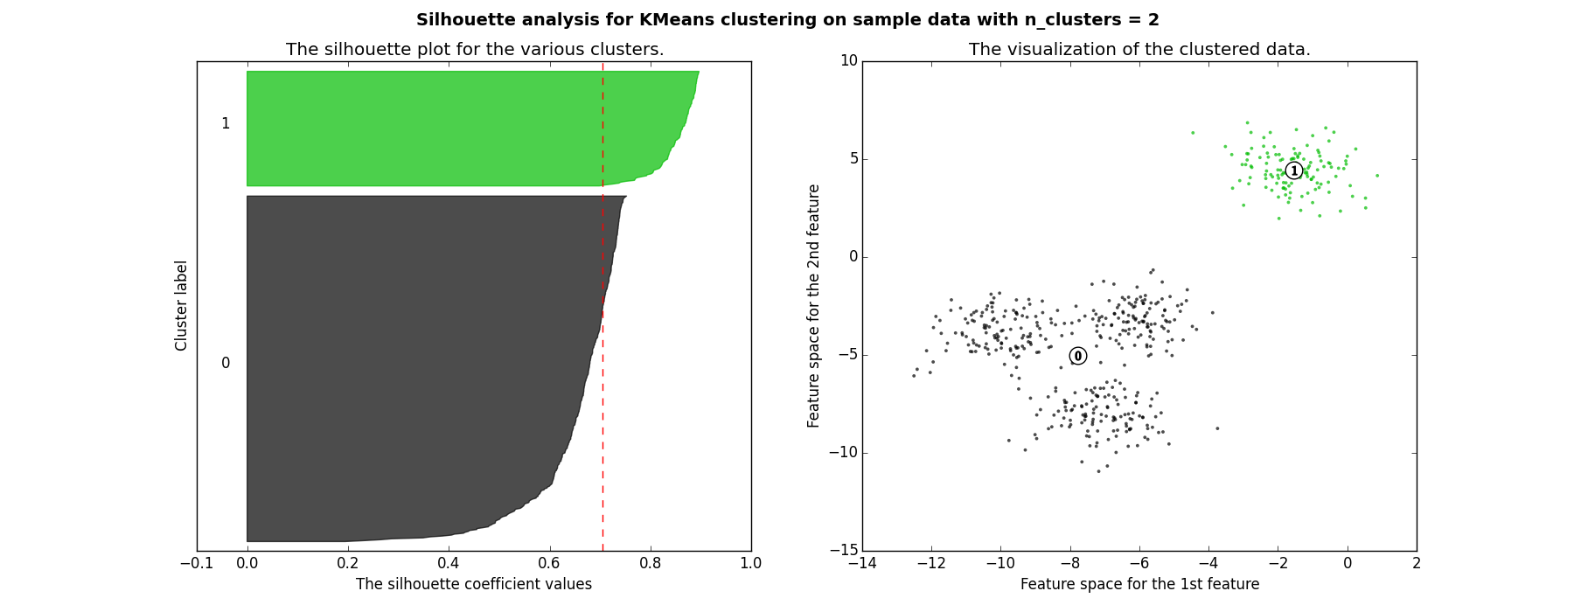
Good clusters

Slide 22
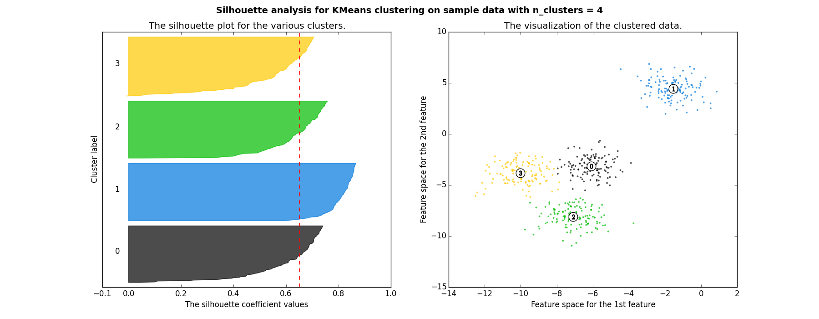
Good clusters

Slide 23
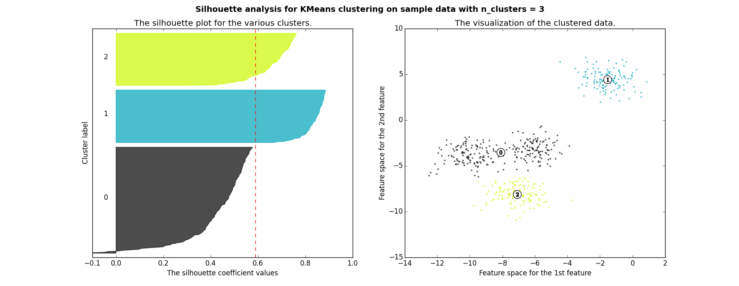
Bad clusters

Slide 24
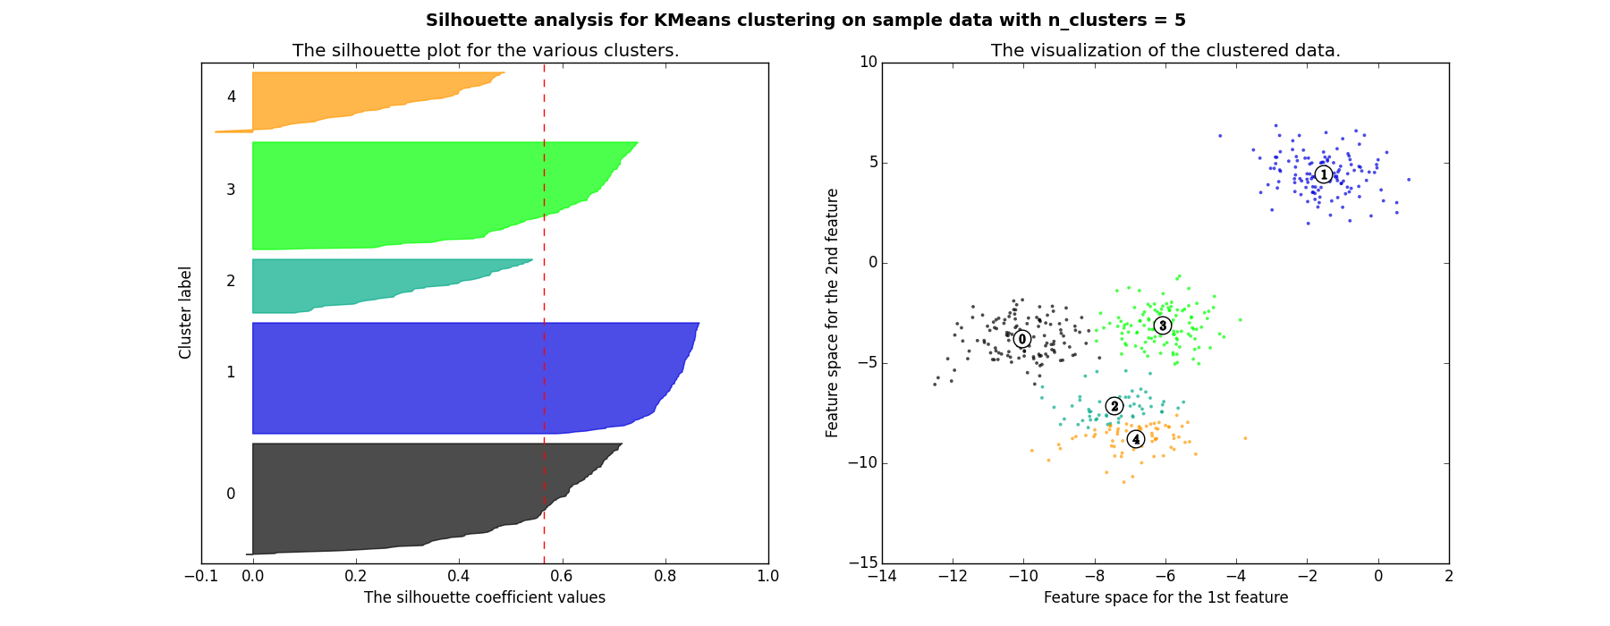
Bad clusters

Slide 25
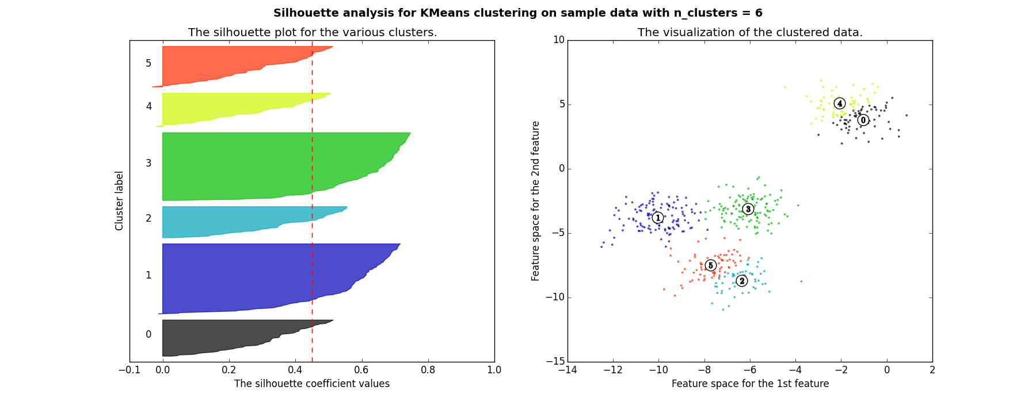
Bad clusters

Slide 26
So in this example
2 and 4 clusters are reasonable choices
3, 5, and 6 clusters are not good choices

Slide 27
Eigengap
In spectral clustering there is also the option of choosing the number of clusters that maximizes the eigengap (difference between consecutive eigenvalues)

Slide 28
Alternate approach
One question you should ask when choosing the number of clusters is – why am I conducting cluster analysis?
If your goal is to just discover qualitatively interesting patterns in the data, you may want to do something simpler than using an information criterion
Add clusters until you don’t get interesting new clusters anymore

Slide 29
Next lecture
Clustering – Advanced clustering algorithms

