Slide 1
Big Data, Education, and Society
February 21, 2018

Slide 2
Parent reporting

Slide 3
Parent reporting
What parents usually get
Subject-level grades
Percentile scores for subjects overall
Uninterpretable competencies with 1-3 scores

Slide 4
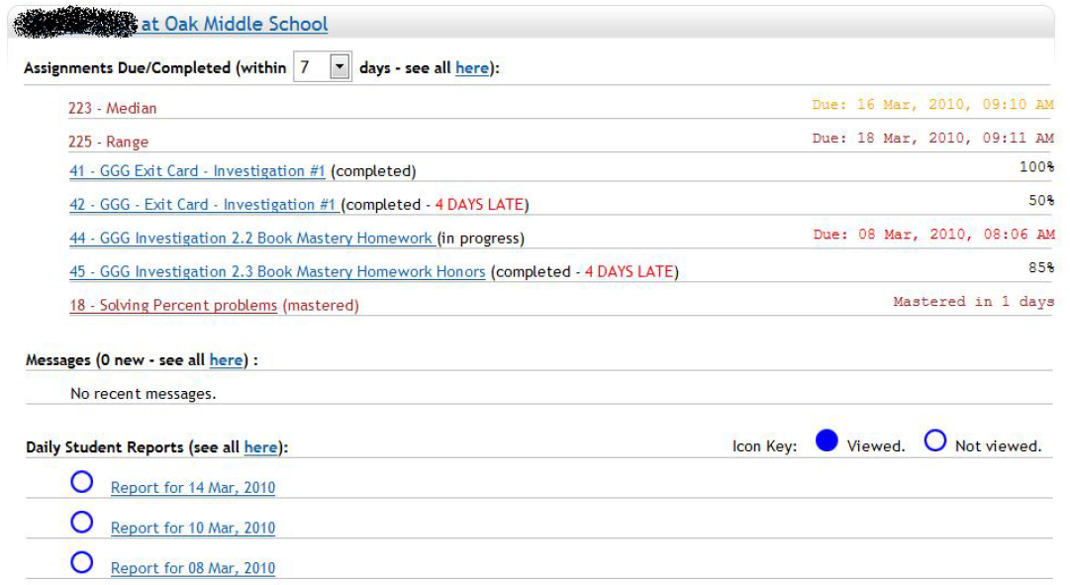
Parent reporting (Broderick et al.)

Slide 5
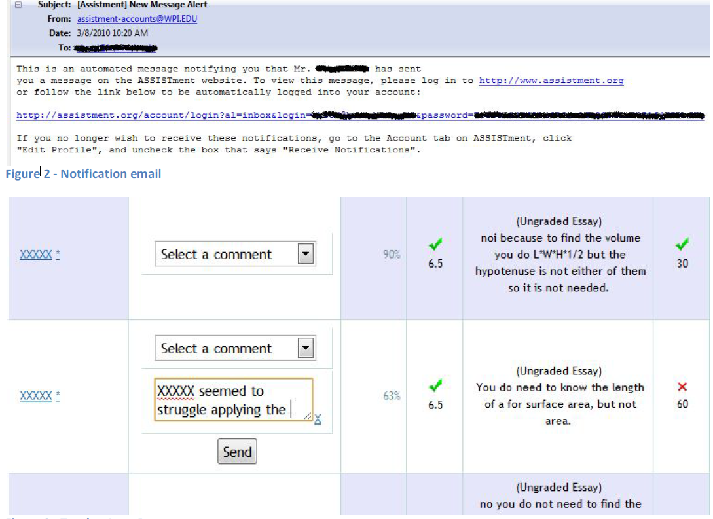

Slide 6
Parent reporting (Broderick et al.)
Explicitly designed at teacher request not to allow parent to communicate through reports, to reduce parent communication to them

Slide 7
Parent reporting (Broderick et al.)
Limited use by parents
Mildly positive responses on parent survey
More parents felt like they understood what was being covered in math class, and how their student was performing

Slide 8
Questions? Comments?

Slide 9
Parent reporting (Bergman)
Emails and text messages to parents informing them when assignment not handed in
Significant though small positive impact on student GPA

Slide 10
Questions? Comments?

Slide 11
What are the features of a good parent report?

Slide 12
What are some things to avoid in designing a parent report?

Slide 13
Please assemble into groups of 3-4
Then we will count off groups

Slide 14
Design a report
For teachers of students using an adaptive homework system for math
For teachers of students using an adaptive flash card system for a foreign language
For parents of students using a blended learning system in math class
For teachers of students using a history game (such as Civilization) in class

Slide 15
Design a report
5. For parents of students at an alternative school for children with behavioral problems
6. For teachers of students doing a computer-mediated programming project at home (group project in Scratch)
7. For the parents of students practicing tae kwon do in a dojo
8. For teachers of undergraduates doing a group creative writing project (in a system where drafts are instrumented)

Slide 16
Now send an ambassador to another group
And present/critique the designs

Slide 17
Questions? Comments?

Slide 18
Any questions or concerns regarding assignment?
Due Tuesday!

Slide 19
Upcoming office hours
2/28 9a-10a

