Slide 1
Big Data, Education, and Society
February 19, 2020

Slide 2
Questions about assignment?
Due this Friday 9am
Post on discussion forum
Do not forget to post in response to your classmates in the following four days

Slide 3
Parent reporting

Slide 4
Parent reporting
What do parents usually get from schools?

Slide 5
Parent reporting
Subject-level grades
Percentile scores for subjects overall
Uninterpretable competencies with 1-3 scores

Slide 6
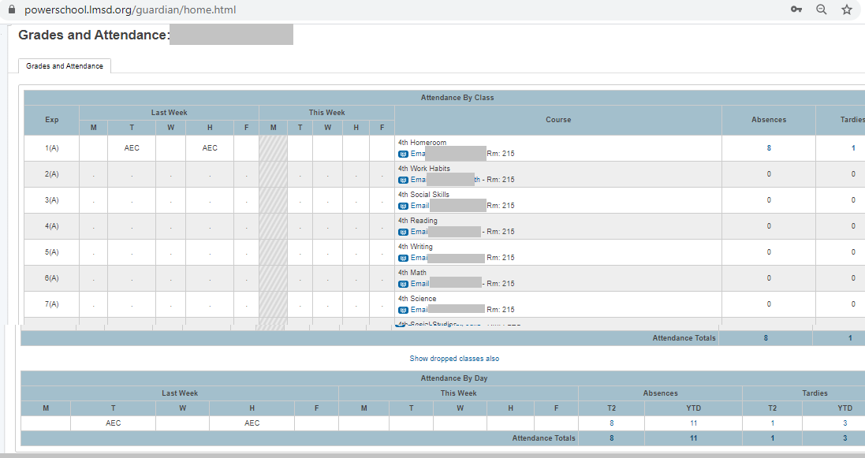
PowerSchool

Slide 7
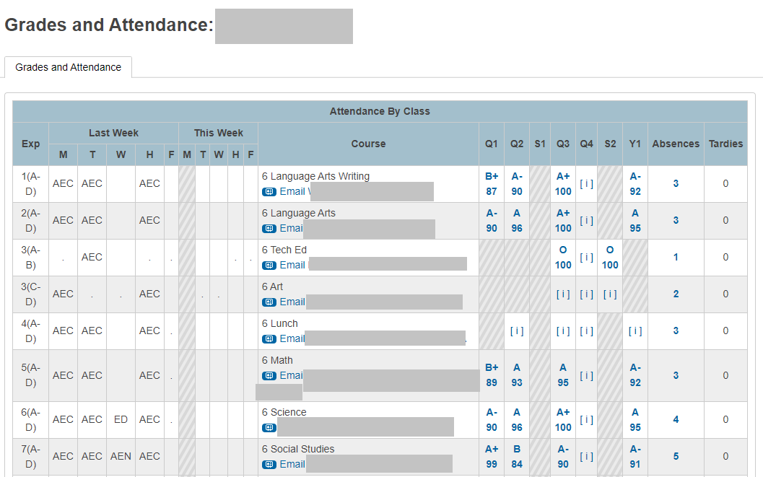
PowerSchool

Slide 8
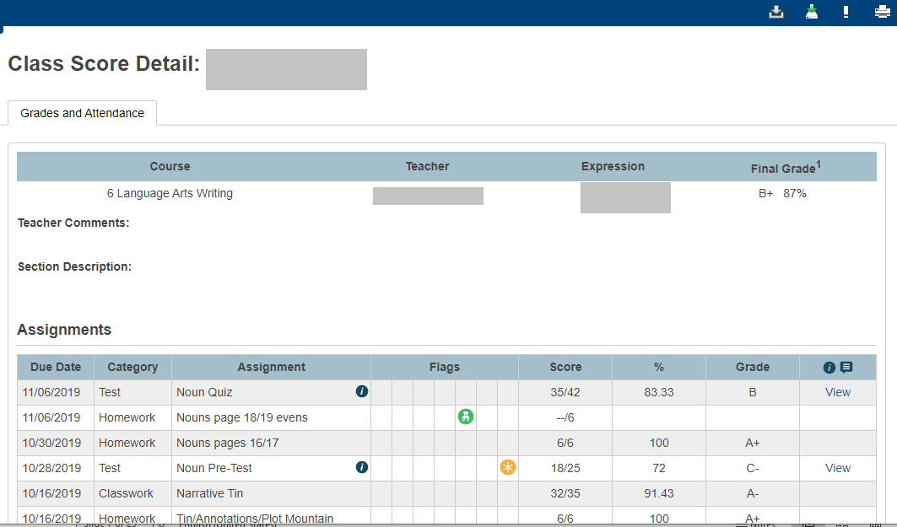
PowerSchool

Slide 9
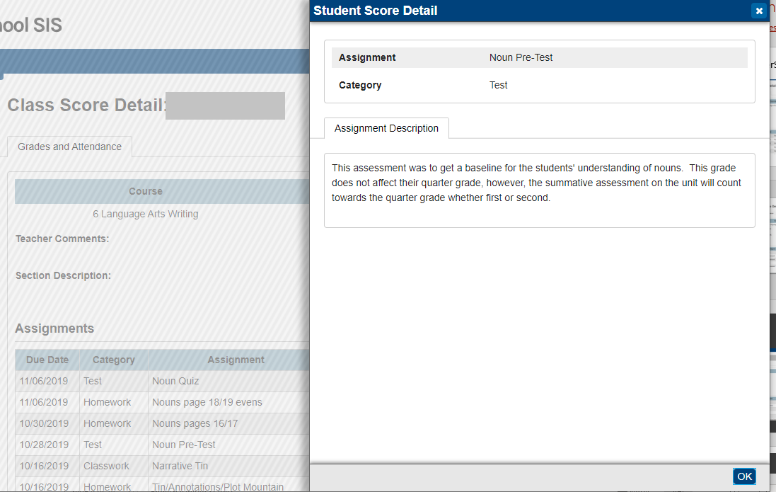
PowerSchool

Slide 10
What’s a parent to do?
With this information

Slide 11
What’s a parent to do?
With this information
Little Fnordkin got a C- on the test, but what options do the parents have?

Slide 12
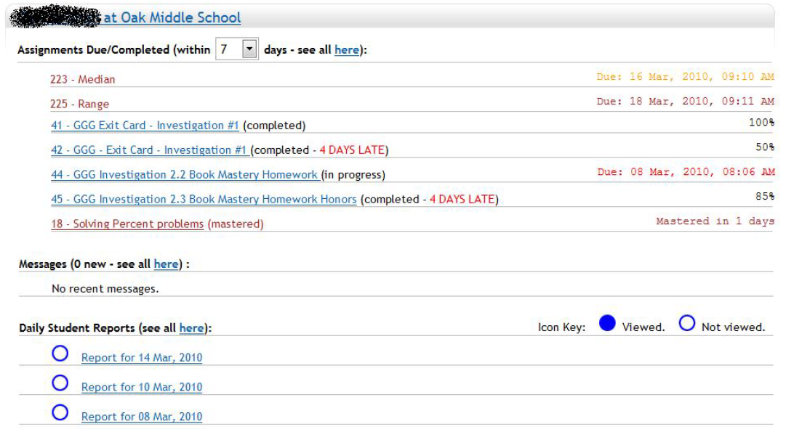
Parent reporting (Broderick et al.)

Slide 13
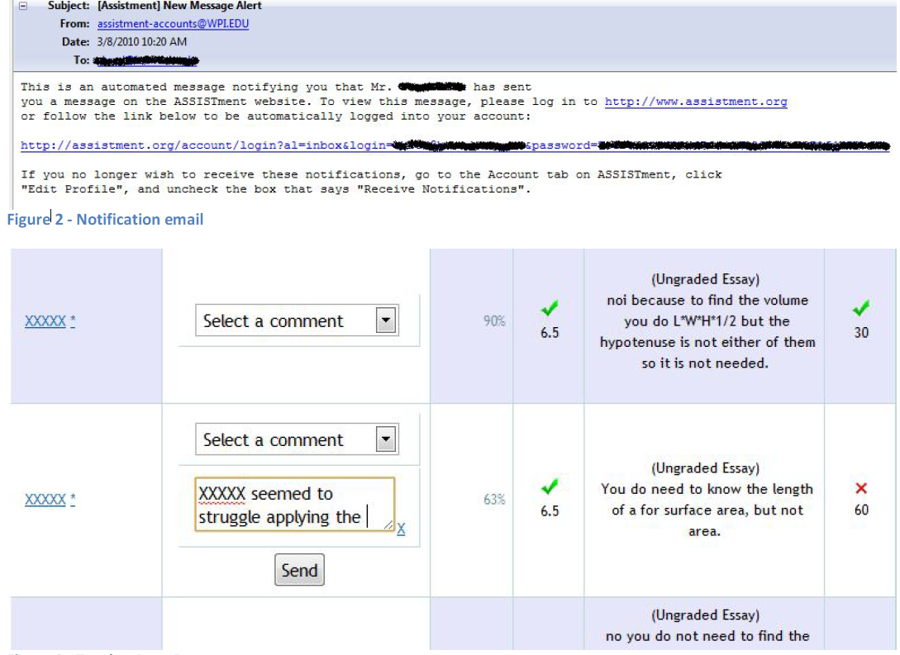

Slide 14
Parent reporting (Broderick et al.)
Explicitly designed at teacher request not to allow parent to communicate through reports, to reduce parent communication to them

Slide 15
Parent reporting (Broderick et al.)
Explicitly designed at teacher request not to allow parent to communicate through reports, to reduce parent communication to them
What are your opinions of this decision?

Slide 16
Parent reporting (Broderick et al.)
Limited use by parents
Mildly positive responses on parent survey
More parents felt like they understood what was being covered in math class, and how their student was performing

Slide 17
Questions? Comments?

Slide 18
Parent reporting (Bergman)
Emails and text messages to parents informing them when assignment not handed in
Significant though small positive impact on student GPA

Slide 19
Questions? Comments?

Slide 20
What are the features of a good parent report?

Slide 21
What are some things to avoid in designing a parent report?

Slide 22
Please assemble into groups of 3-4
Then we will count off groups

Slide 23
Design a report
For teachers of students using an adaptive homework system for math
For teachers of students using an adaptive flash card system for a foreign language
For parents of students using a blended learning system in math class
For teachers of students using a history game (such as Civilization) in class

Slide 24
Design a report
5. For parents of students at an alternative school for children with behavioral problems
6. For teachers of students doing a computer-mediated programming project at home (group project in Scratch)
7. For the parents of students practicing tae kwon do in a dojo
8. For teachers of undergraduates doing a group creative writing project (in a system where drafts are instrumented)

Slide 25
Now send an ambassador to another group
And present/critique the designs

Slide 26
Questions? Comments?

Slide 27
How are your designs different than your teacher reports?
(Full class discussion)

Slide 28
Further comments/discussion?

