Slide 1
Special Topics in Educational Data Mining
HUDK5199 Spring term, 2013
February 25, 2013

Slide 2
Today’s Class
Feature Engineering and Distillation - What

Slide 3
Special Rules for Today
Everyone Votes
Everyone Participates

Slide 4
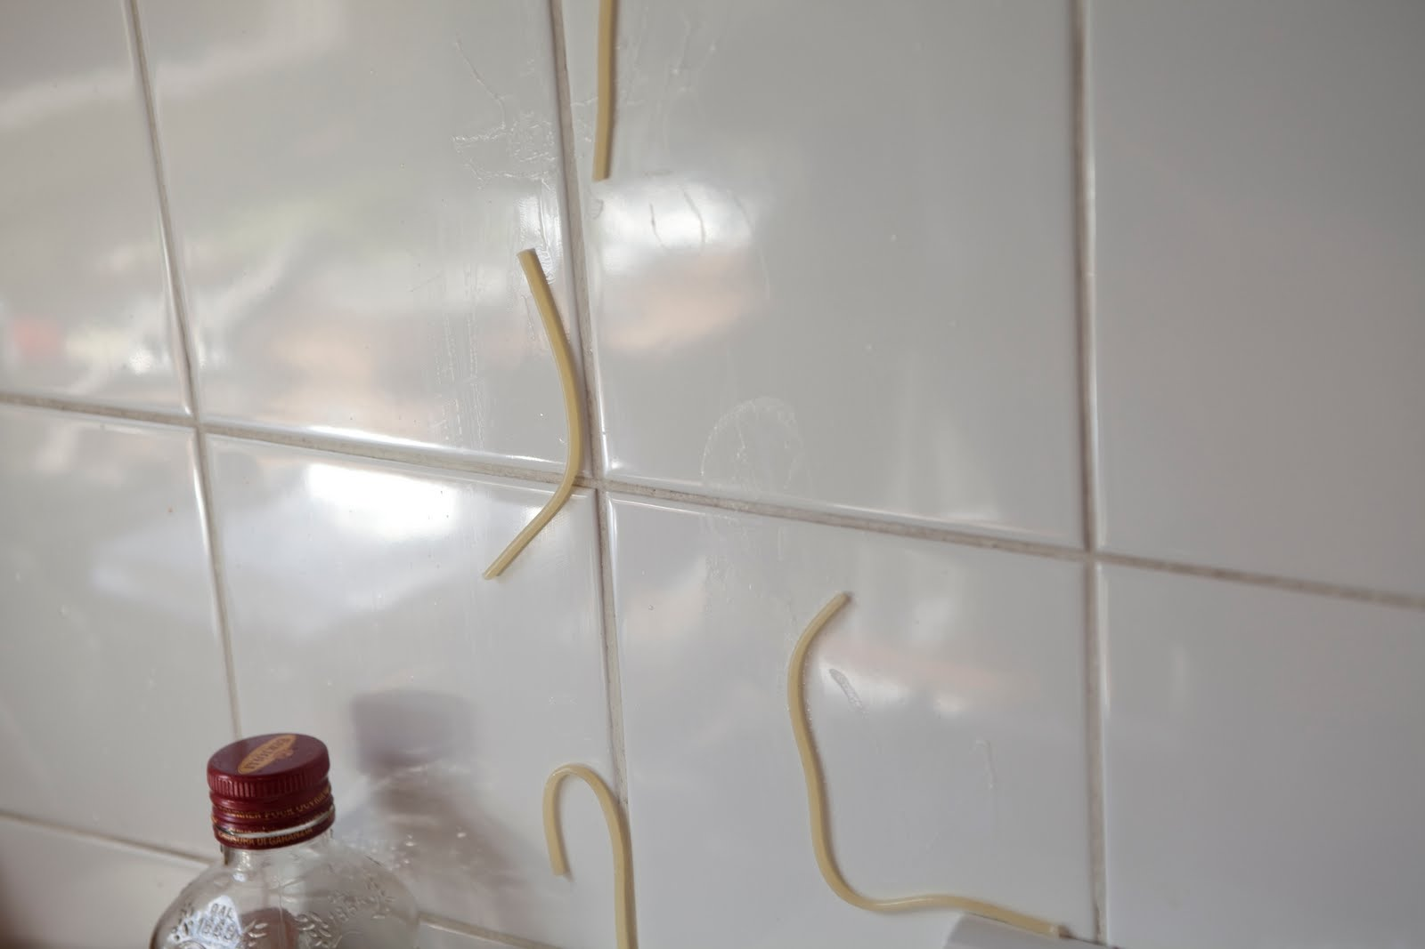
Feature Engineering
Not just throwing spaghetti at the wall and seeing what sticks

Slide 5
Construct Validity Matters!
Crap features will give you crap models
Crap features = reduced generalizability/more over-fitting
Nice discussion of this in Sao Pedro paper I assigned

Slide 6
What’s a good feature?
A feature that is potentially meaningfully linked to the construct you want to identify

Slide 7
Let’s look at some features used in real models
Split into groups of 3-4
Take a sheet of features
Which features (or combinations) can you come up with “just so” stories for why they might predict the construct?
Are there any features that seem utterly irrelevant?

Slide 8
Each group
Tell us what your construct is
Tell us your favorite “just so story” (or two) from your features
Tell us which features look like junk
Everyone else: you have to give the feature a thumbs-up or thumbs-down

Slide 9
Now…
Let’s take a break

Slide 10
I need 3 volunteers

Slide 11
Volunteers
#1, #2: “Wee dee dee dee”
#3: “Weema wompa way”

Slide 12
Everyone else
Has to sing a verse of “In the jungle…”
With an animal that no one else has mentioned yet

Slide 13
In the jungle….

Slide 14
Now that we’re all feeling creative

Slide 15
Now that we’re all feeling creative
Break into *different* 3-4 person groups than last time

Slide 16
Now that we’re all feeling creative
Make up features for Assignment 4
You need to
Come up with a new feature
Justify how you can would it from the data set
Justify why it would work

Slide 17
I need a volunteer

Slide 18
I need a volunteer
Your task is to write down the features suggested
And the counts for thumbs up/thumbs down

Slide 19
Now…
Each group needs to read their favorite feature to the class and justify it
Who thinks this feature will improve prediction of off-task behavior?
Who doesn’t?
Thumbs up, thumbs down!

Slide 20
Comments or Questions
About Assignment 4?

Slide 21
Special Request
Bring a print-out of your Assignment 4 solution to class

Slide 22
Next Class
Monday, February 27
Feature Engineering and Distillation – HOW
Assignment Due: 4. Feature Engineering

Slide 23
Excel
Plan is to go as far as we can by 5pm
We will continue after next class session
Vote on which topics you most want to hear about

Slide 24
Topics
Using average, count, sum, stdev (asgn. 4 data set)
Relative and absolute referencing (made up data)
Copy and paste values only (made up data)
Using sort, filter (asgn. 4 data set)
Making pivot table (asgn. 4 data set)
Using vlookup (Jan. 28 class data set)
Using countif (asgn. 4 data set)
Making scatterplot (Jan. 28 class data set)
Making histogram (asgn. 4 data set)
Equation Solver (Jan. 28 class data set)
Z-test (made up data)
2-sample t-test (made up data)
Other topics?

Slide 25
The End

