Slide 1
Core Methods in Educational Data Mining
HUDK4050 Fall 2014

Slide 2
Any questions about Classical BKT? (Corbett & Anderson, 1995)
P(G)
P(S)
Unknown
P(T)
Known
P(~L_{n})
P(L_{n})

Slide 3
In the video lecture, I discussed four ways of extending BKT

Slide 4
Advanced BKT: Lecture
Beck’s Help Model
Individualization of L_{o}
Contextual Guess and Slip
Moment by Moment Learning

Slide 5
Advanced BKT
Beck’s Help Model
Relaxes assumption of one P(T) in all contexts

Slide 6
Beck et al.’s (2008) Help Model
p(T|H)
Not learned
p(T|~H)
Learned
p(L₀|H),
p(L₀|~H)
p(G|~H), p(G|H)
1-p(S|~H)
1-p(S|H)
correct
correct

Slide 7
Note
Did not lead to better prediction of student performance
How might it still be useful?

Slide 8
Questions? Comments?

Slide 9
Advanced BKT
Moment by Moment Learning
Relaxes assumption of one P(T) in all contexts
More general than Help model
Can adjust P(T) in several ways
Switches from P(T) to P(J)

Slide 10
Moment-By-Moment Learning Model (Baker, Goldstein, & Heffernan, 2010)
Probability you Just Learned
p(J)
Not learned
p(T)
Learned
p(L₀)
p(G)
1-p(S)
correct
correct

Slide 11
P(J)
P(T) = chance you will learn if you didn’t know it
P(T) = P(L_{n+1} | ~L_{n} )
P(J) = probability you JustLearned
P(J) = P(~L_{n} ^ T)
P(J) = P(~L_{n} ^ L_{n+1} )

Slide 12
P(J) is distinct from P(T)
For example:
P(L_{n}) = 0.1
P(T) = 0.6
P(J) = 0.54
P(L_{n}) = 0.96
P(T) = 0.6
P(J) = 0.02
Learning!
Little Learning

Slide 13
Do people want to go through the calculation process?
Up to you…

Slide 14
Alternative way of computing P(J) (van de Sande, 2013; Pardos & Yudelson, 2013)
Assume learning occurs exactly once in sequence (at most)
Compute probability for each of the possible points, in the light of the entire sequence
May be more precise
Needs all the data to compute
Can’t account for cases where there is improvement twice

Slide 15
Using P(J)
Model can be used to create Moment-by-Moment Learning Graphs (Baker et al., 2013)

Slide 16
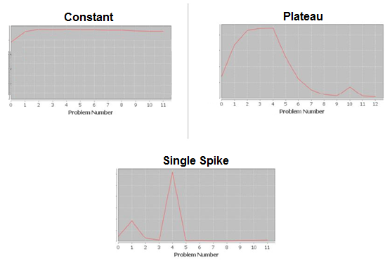

Slide 17
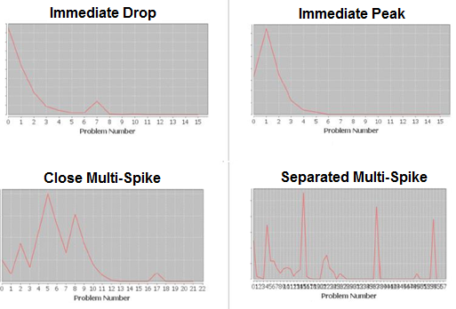

Slide 18
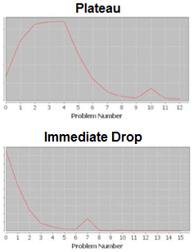
Can predict Preparation for Future Learning (Baker et al., 2013)
Patterns correlate to PFL!
r = -0.27, q<0.05
r = 0.29, q<0.05

Slide 19
Data-Mined Combination of Features
Can predict student PFL very effectively (Hershkovitz et al., 2013)
Better than BKT or metacognitive features

Slide 20
Work to study
What student behavior precedes eureka moments
Moments with top 1% of P(J)
Moore et al. (in preparation)

Slide 21
Predicting Eureka Moments: Top Feature
Number of attempts during problem step
A’ = 0.735
1% Mean = 3.7 (SD = 4.6)
99% Mean = 1.9 (SD = 2.6)

Slide 22
Predicting Eureka Moments: #2 Feature
Asking for help (regardless of what you do afterwards)
A’ = 0.677
1% Mean = 0.38 (SD = 0.33)
99% Mean = 0.16 (SD = 0.29)

Slide 23
Predicting Eureka Moments: #3 Feature
Time > 10 Seconds and Previous Action Help or Bug
A’ = 0.635
1% Mean = 0.23 (SD = 0.30)
99% Mean = 0.10 (SD = 0.25)

Slide 24
Not so predictive
Receiving a Bug Message
A’ = 0.584
Help Avoidance
A’ = 0.570
Number of Prob. Steps Completed So Far on Current Skill
A’ = 0.502

Slide 25
Questions? Comments?

Slide 26
Advanced BKT
Individualization of L_{o}
Relaxes assumption of one P(L_{o}) for all students

Slide 27
BKT-Prior Per Student
p(L₀) = Student’s average correctness on all prior problem sets
Not learned
p(T)
Learned
p(G)
1-p(S)
correct
correct

Slide 28
BKT-Prior Per Student
Much better on
ASSISTments (Pardos & Heffernan, 2010)
Cognitive Tutor for genetics (Baker et al., 2011)
Much worse on
ASSISTments (Pardos et al., 2011)

Slide 29
Advanced BKT
Contextual Guess and Slip
Relaxes assumption of one P(G), P(S) in all contexts

Slide 30
Contextual Guess and Slip model
Not learned
p(T)
Learned
p(L₀)
p(G)
1-p(S)
correct
correct

Slide 31
Do people want to go through the calculation process?
Up to you…

Slide 32
Contextual Guess and Slip model
Effect on future prediction: very inconsistent
Much better on Cognitive Tutors for middle school, algebra, geometry (Baker, Corbett, & Aleven, 2008a, 2008b)
Much worse on Cognitive Tutor for genetics (Baker et al., 2010, 2011) and ASSISTments (Gowda et al., 2011)

Slide 33
But predictive of longer-term outcomes
Average contextual P(S) predicts post-test (Baker et al., 2010)
Average contextual P(S) predicts shallow learners (Baker, Gowda, Corbett, & Ocumpaugh, 2012)
Average contextual P(S) predicts college attendance, selective college attendance, college major (San Pedro et al., 2013, 2014, in preparation)

Slide 34
Other Advanced BKT

Slide 35
Advanced BKT
Relaxing assumption of binary performance
Turns out to be trivial to accommodate in existing BKT paradigm
(Sao Pedro et al., 2013)

Slide 36
Advanced BKT
Relaxing assumption of no forgetting
There are variants of BKT that incorporate forgetting (e.g. Chang et al., 2008)
General probability P(F) of going from learned to unlearned, in all situations
But typically handled with memory decay models rather than BKT (e.g. Pavlik & Anderson, 2008)
No reason memory decay algorithms couldn’t be integrated into contextual P(F)
But no one has done it yet

Slide 37
Advanced BKT
Relaxing assumption of one skill per item
Compensatory Model (Pardos et al., 2008)
Conjunctive Model (Pardos et al., 2008)
PFA

Slide 38
Advanced BKT
What other assumptions could be relaxed?

Slide 39
Other questions or comments?

Slide 40
Assignment C3
Any questions?

Slide 41
Next Class
Monday, November 3
Assignment C3 due
Baker, R.S. (2014) Big Data and Education. Ch. 7, V6, V7.
Desmarais, M.C., Meshkinfam, P., Gagnon, M. (2006) Learned Student Models with Item to Item Knowledge Structures. User Modeling and User-Adapted Interaction, 16, 5, 403-434.
Barnes, T. (2005) The Q-matrix Method: Mining Student Response Data for Knowledge. Proceedings of the Workshop on Educational Data Mining at the Annual Meeting of the American Association for Artificial Intelligence.
Cen, H., Koedinger, K., Junker, B. (2006) Learning Factors Analysis - A General Method for Cognitive Model Evaluation and Improvement. Proceedings of the International Conference on Intelligent Tutoring Systems, 164-175.
Koedinger, K.R., McLaughlin, E.A., Stamper, J.C. (2012) Automated Student Modeling Improvement. Proceedings of the 5th International Conference on Educational Data Mining, 17-24.

Slide 42
The End

