Slide 1
Core Methods in Educational Data Mining
HUDK4050 Fall 2015

Slide 2
Quick question
I’m now going to be in NY the first week of December
I was thinking of un-cancelling class on 12/1, in exchange for 12/8
What do people prefer? Let’s take a vote

Slide 3
Assignment B7

Slide 4
Any questions about k-Means in the homework?

Slide 5
Any questions about expectation maximization in the homework?

Slide 6
Any questions about agglomerative clustering in the homework?

Slide 7
Any questions?

Slide 8
Any general questions about k-Means?

Slide 9
Let’s play with clustering a bit
Apply k-means using the following points and initial centroids
I need 5 volunteers!

Slide 10
+3
0
-3
time
0 1
pknow

Slide 11
+3
0
-3
time
0 1
pknow

Slide 12
+3
0
-3
time
0 1
pknow

Slide 13
+3
0
-3
time
0 1
pknow

Slide 14
+3
0
-3
time
0 1
pknow

Slide 15
Any comments on exercise?

Slide 16
Why
Is distortion/MSD good for choosing between randomized restarts
But bad for choosing cluster size?

Slide 17
Why
Isn’t cross-validated distortion/MSD good for choosing cluster size?
Why doesn’t cross-validation fix the issue?

Slide 18
What
Is the solution?

Slide 19
Is there a better way
To choose the number of clusters
Than just the adjusted fit?

Slide 20
Silhouette Analysis
An increasingly popular method for determining how many clusters to use (Rousseeuw, 1987; Kaufman & Rousseeuw, 1990)

Slide 21
Silhouette Analysis
Silhouette plot shows how close each point in a cluster is to points in adjacent clusters
Silhouette values scaled from -1 to 1
Close to +1: Data point is far from adjacent clusters
Close to 0: Data point is at boundary between clusters
Close to -1: Data point is closer to other cluster than its own cluster

Slide 22
Silhouette Formula
For each data point i
A(i) = average distance of i from all other data points in same cluster C
C* = cluster with lowest average distance of i from all other data points in cluster c*
B(i) = average dissimilarity of i from all other data points in cluster C*
$S\left(i\right)= \frac{B\left(i\right)−A(i)}{max⁡\{A\left(i\right), B(i)}$

Slide 23
Example from http://scikit-learn.org/ stable/auto_examples/cluster/ plot_kmeans_silhouette_analysis.html

Slide 24
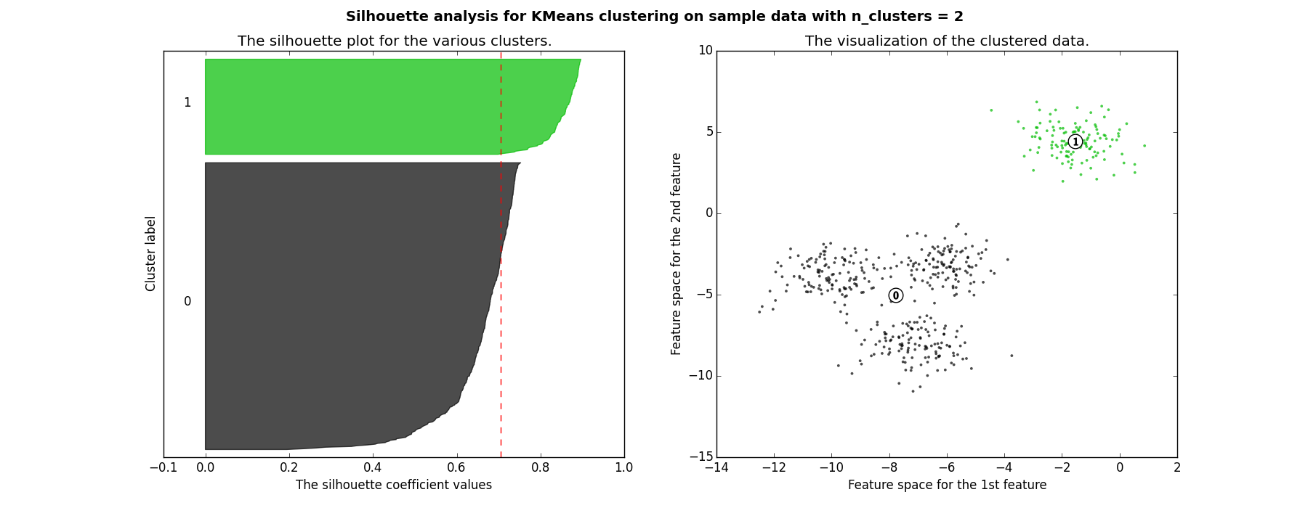
Good clusters

Slide 25
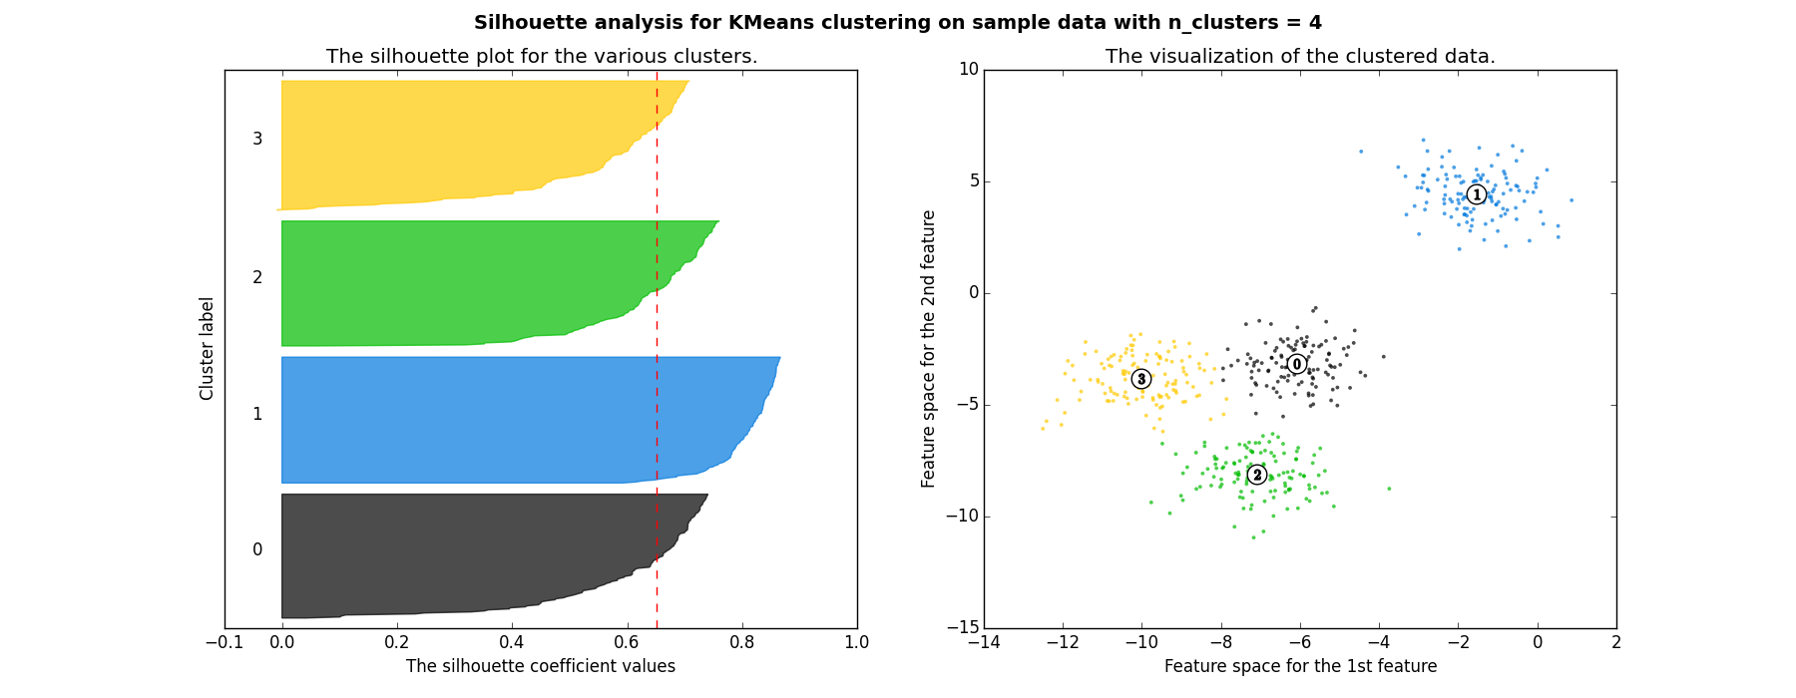
Good clusters

Slide 26
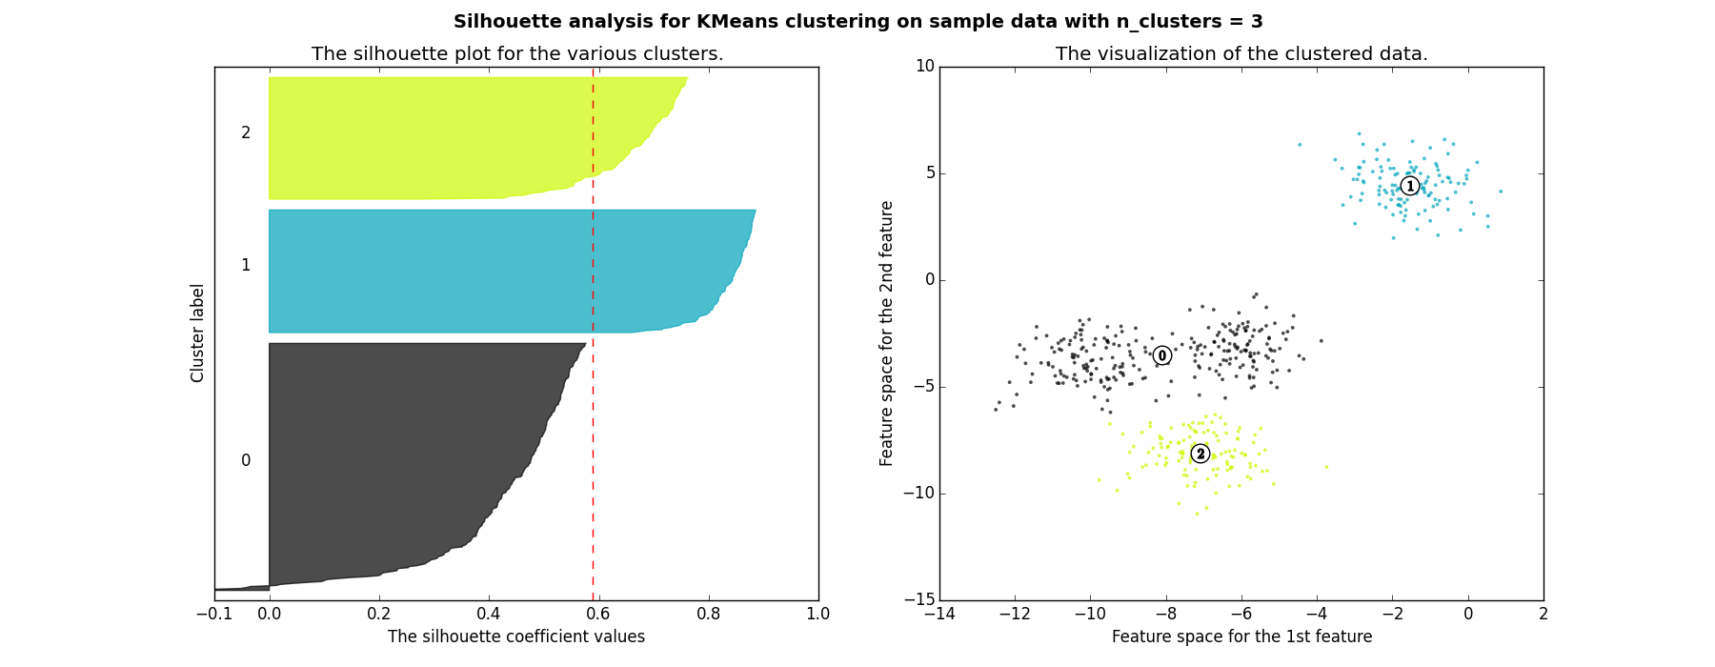
Bad clusters

Slide 27
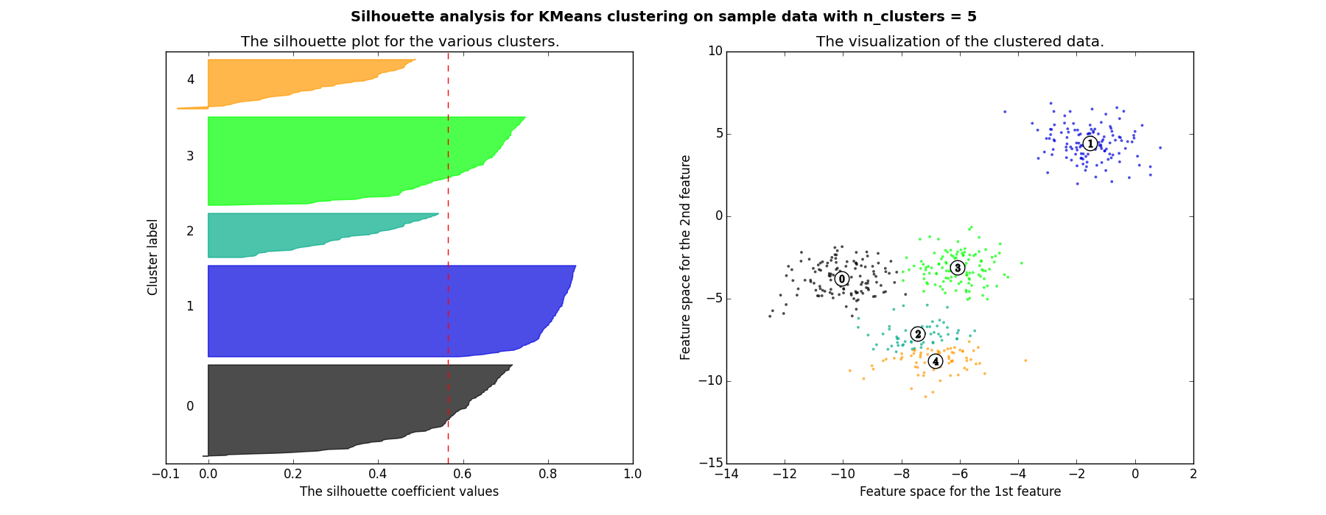
Bad clusters

Slide 28
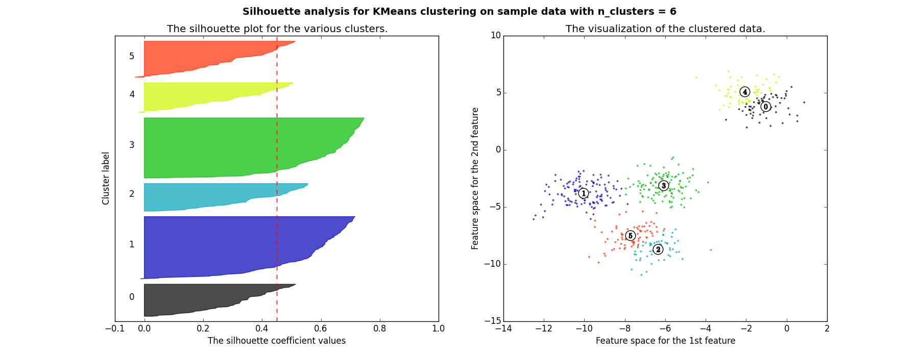
Bad clusters

Slide 29
So in this example
2 and 4 clusters are reasonable choices
3, 5, and 6 clusters are not good choices

Slide 30
Questions? Comments?

Slide 31
What are the advantages?
Of Gaussian Mixture Models

Slide 32
What are the advantages?
Of Gaussian Mixture Models
Why not use them all the time?

Slide 33
What are the advantages?
Of Spectral Clustering

Slide 34
What are the advantages?
Of Spectral Clustering
Why not use it all the time?

Slide 35
What are the advantages?
Of Hierarchical Clustering

Slide 36
What are the advantages?
Of Hierarchical Clustering
Why not use it all the time?

Slide 37
Clustering: Any Questions?

Slide 38
Factor Analysis .vs. Clustering
What’s the difference?

Slide 39
Factor Analysis: Any Questions?

Slide 40
What…
Are the general advantages of structure discovery algorithms (clustering, factor analysis)
Compared to supervised/prediction modeling methods?

Slide 41
What…
Are the general advantages of structure discovery algorithms (clustering, factor analysis)
Compared to supervised/prediction modeling methods?
What are the disadvantages?

Slide 42
Important point…
If you cluster in a well-known domain, you are likely to obtain well-known findings

Slide 43
Because of this…
Clustering is relatively popular
But somewhat prone to uninteresting papers in education research
Where usually a lot is already known
So be thoughtful…

Slide 44
Amershi & Conati (2009)
Any questions?

Slide 45
Bowers (2010)
Any questions?

Slide 46
Any other questions?

Slide 47
Assignment B8
Sequential Pattern Mining
Due next Tuesday

Slide 48
Next Class
Wednesday, November 19: Association Rule Mining
Readings
Baker, R.S. (2015) Big Data and Education. Ch. 5, V3.
Merceron, A., Yacef, K. (2008) Interestingness Measures for Association Rules in Educational Data. Proceedings of the 1st International Conference on Educational Data Mining,57-66.
Bazaldua, D.A.L., Baker, R.S., San Pedro, M.O.Z. (2014) Combining Expert and Metric-Based Assessments of Association Rule Interestingness. Proceedings of the 7th International Conference on Educational Data Mining.

Slide 49
The End

