Slide 1
Core Methods in Educational Data Mining
HUDK4050 Fall 2014

Slide 2
Welcome
Welcome back to the 2nd class session

Slide 3
Administrative Stuff
Is everyone signed up for class?
If not, and you want to receive credit, please talk to me after class

Slide 4
Other administrative questions?

Slide 5
Continuing from first class

Slide 6
Data Used to Be
Dispersed
Hard to Collect
Small-Scale
Collecting sizable amounts of data required heroic efforts

Slide 7
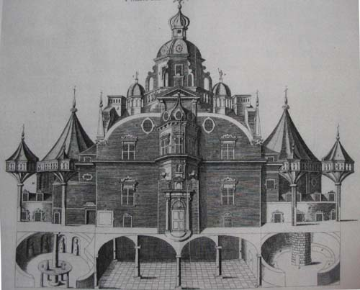
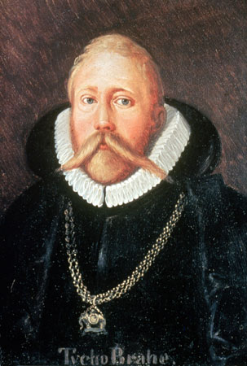
Tycho Brahe
Spent 24 years observing the sky from a custom-built castle on the island of Hven

Slide 8
Johannes Kepler
Had to take a job with Brahe to get Brahe’s data

Slide 9
Johannes Kepler
Had to take a job with Brahe to get Brahe’s data
Only got unrestricted access to data…

Slide 10
Johannes Kepler
Had to take a job with Brahe to get Brahe’s data
Only got unrestricted access to data… when Brahe died

Slide 11
Johannes Kepler
Had to take a job with Brahe to get Brahe’s data
Only got unrestricted access to data… when Brahe died
and Kepler stole the data and fled to Germany

Slide 12
Alex Bowers Teachers College, Columbia University
“For my dissertation I wanted to collect all of the data for all of the assessments (tests and grades and discipline reports, and attendance, etc.) for all of the students in entire cohorts from a school district for all grade levels, K-12. To get the data, the schools had it as the students' "permanent record", stored in the vault of the high school next to the boiler, ignored and unused. The districts would set me up in the nurse's office with my laptop and I'd trudge up and down the stairs into the basement to pull 3-5 files at a time and I'd hand enter the data into SPSS. Eventually I got fast enough to do about 10 a day, max.”

Slide 13
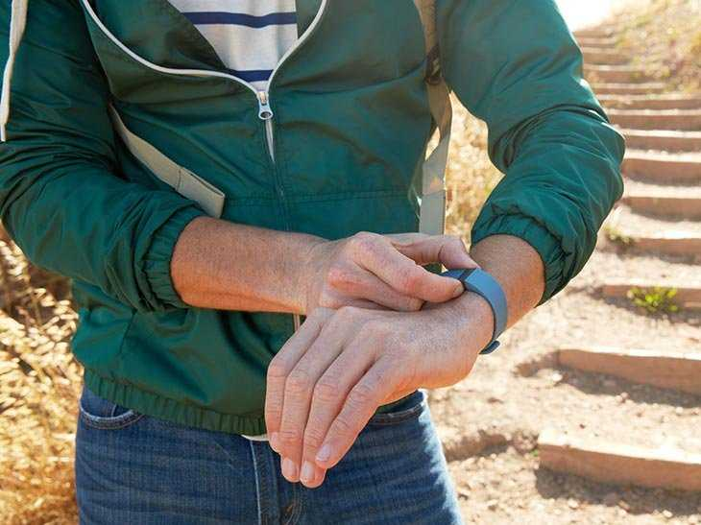
Data Today
Notes:
Every day, every one of us generates lots of data, with almost everything we do.

Slide 14
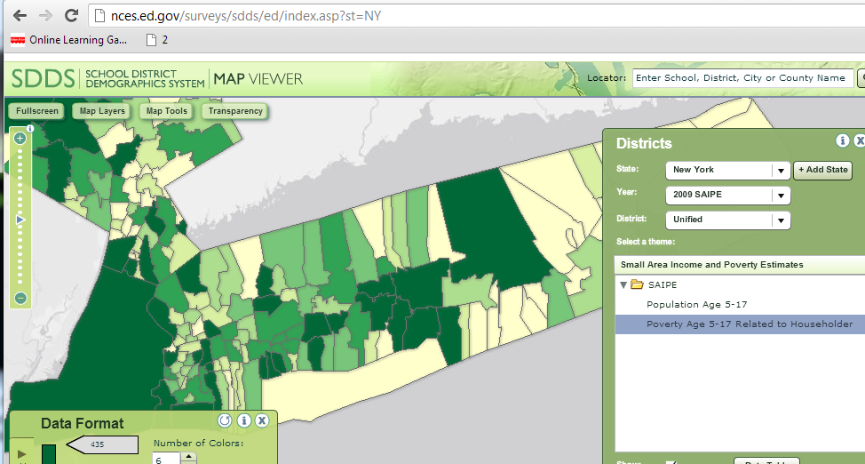
Data Today

Slide 15
Data Today

Slide 16
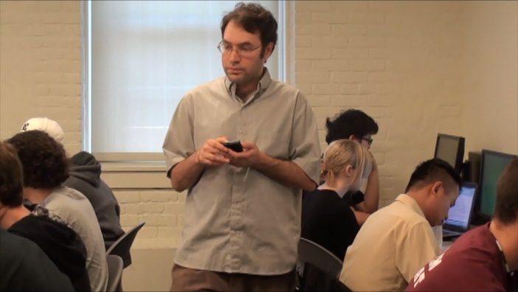
Data Today

Slide 17
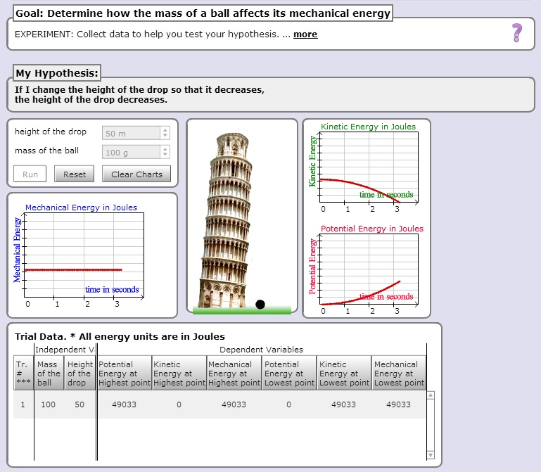
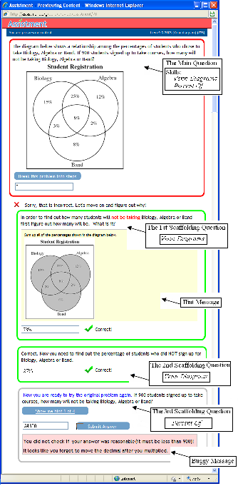
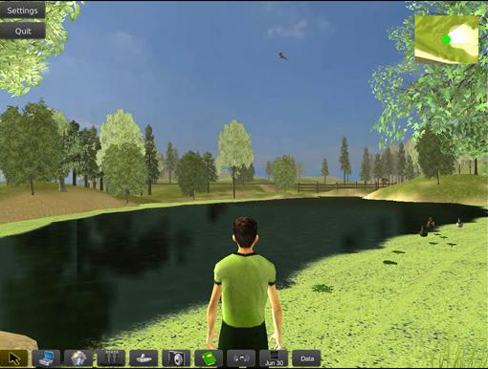
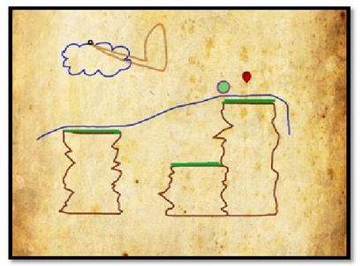
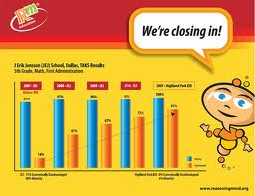
Data Today
Notes:
As more learning takes place within educational software and online learning environments of various types, it becomes much easier to gather very rich data on individual students’ learning and engagement within specific subjects. For example, a student might use a science simulation like the Inq-ITS, to learn science content and inquiry skills. Or they might learn scientific inquiry skill and content within a virtual environment like EcoMUVE. They might learn math skill in an action game like Zombie Division – the student has a set of weapons with numbers associated with them, a 2 for a sword, or a 5 for a gauntlet, and they can divide a skeleton if the weapon divides the number on the skeleton’s chest. Or they might learn math in a conceptual story-based learning environment like Reasoning Mind… or by doing math problems in a workbook-like environment like ASSISTments. All of these environments generate rich data streams that have been used in EDM analyses. And this kind of software in becoming more widespread every day. Systems like the Cognitive Tutor, or ASSISTments, or Reasoning Mind, are used by tens or hundreds of thousands of students, one or two days a week.

Slide 18
Student Log Data
*000:22:297 READY
.
*000:25:875 APPLY-ACTION
WINDOW; LISP-TRANSLATOR::AUTHORINGTOOL-TRANSLATOR,
CONTEXT; 3FACTOR-CROSS-XPL-4,
SELECTIONS; (GROUP3_CLASS_UNDER_XPL),
ACTION; UPDATECOMBOBOX,
INPUT; "Two crossover events are very rare.",
.
*000:25:890 GOOD-PATH
.
*000:25:890 HISTORY
P-1; (COMBOBOX-XPL-TRACE SIMBIOSYS),
.
*000:25:890 READY
.
*000:29:281 APPLY-ACTION
WINDOW; LISP-TRANSLATOR::AUTHORINGTOOL-TRANSLATOR,
CONTEXT; 3FACTOR-CROSS-XPL-4,
SELECTIONS; (GROUP4_CLASS_UNDER_XPL),
ACTION; UPDATECOMBOBOX,
INPUT; "The largest group is parental since crossovers are uncommon.",
.
*000:29:281 GOOD-PATH
.
*000:29:281 HISTORY
P-1; (COMBOBOX-XPL-TRACE SIMBIOSYS),
.
*000:29:281 READY
.
*001:20:733 APPLY-ACTION
WINDOW; LISP-TRANSLATOR::AUTHORINGTOOL-TRANSLATOR,
CONTEXT; 3FACTOR-CROSS-XPL-4,
SELECTIONS; (ORDER_GENES_OBS_XPL),
ACTION; UPDATECOMBOBOX,
INPUT; "The Q and q alleles have interchanged between the parental and SCO genotypes.",
.
*001:20:733 SWITCHED-TO-EDITOR
.
*001:20:748 NO-CONFLICT-SET
.
*001:20:748 READY
.
*001:32:498 APPLY-ACTION
WINDOW; LISP-TRANSLATOR::AUTHORINGTOOL-TRANSLATOR,
CONTEXT; 3FACTOR-CROSS-XPL-4,
SELECTIONS; (ORDER_GENES_OBS_XPL),
ACTION; UPDATECOMBOBOX,
INPUT; "The Q and q alleles have interchanged between the parental and DCO genotypes.",
.
*001:32:498 GOOD-PATH
.
*001:32:498 HISTORY
P-1; (COMBOBOX-XPL-TRACE SIMBIOSYS),
.
*001:32:498 READY
.
*001:37:857 APPLY-ACTION
WINDOW; LISP-TRANSLATOR::AUTHORINGTOOL-TRANSLATOR,
CONTEXT; 3FACTOR-CROSS-XPL-4,
SELECTIONS; (ORDER_GENES_UNDER_XPL),
ACTION; UPDATECOMBOBOX,
INPUT; "In the DCO group BOTH outer genes cross over so the interchanged gene is the middle one.",
.
*001:37:857 GOOD-PATH
Notes:
For example, as a student uses one of these interactive learning environments, the student will make hundreds of meaningful actions each hour – pausing and thinking before making an incorrect answer, asking for help, rapidly changing settings on a simulation, running away from a skeleton. When the data is logged, these behaviors provide us with incredibly rich detail about learning and engagement, that we can analyze.

Slide 19
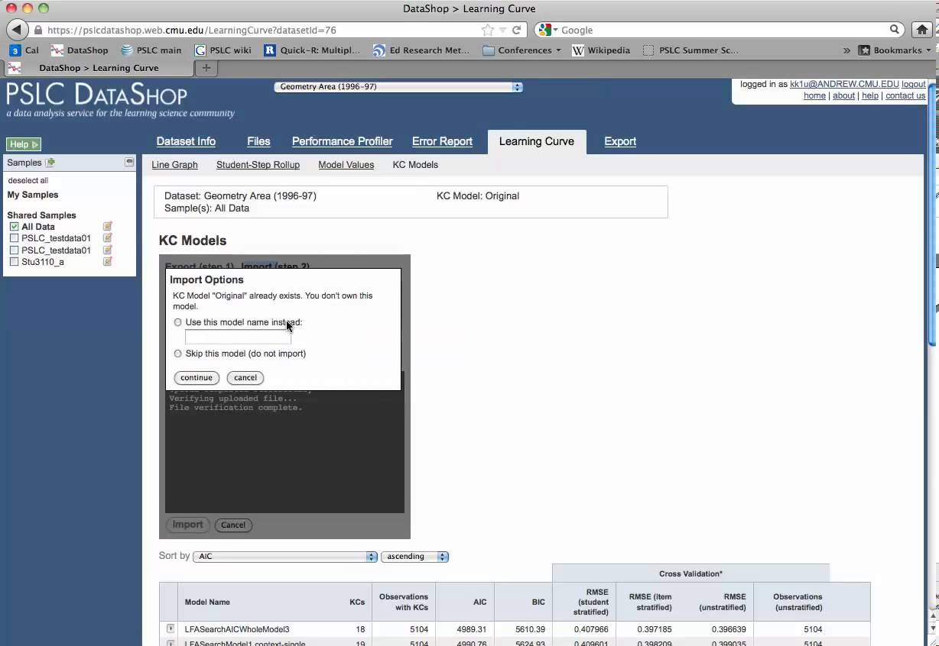
PSLC DataShop (Koedinger et al, 2008, 2010)
>250,000 hours of students using educational software within LearnLabs and other settings
>30 million student actions, responses & annotations

Slide 20
How much data is big data?

Slide 21
2004 and 2014
2004: I reported a data set with 31,450 data points. People were impressed.

Slide 22
2004 and 2014
2004: I reported a data set with 31,450 data points. People were impressed.
2014: A reviewer in an education journal criticized me for referring to 817,485 data points as “big data”.

Slide 23
What’s does it mean to call data “big data”?
Any thoughts?

Slide 24
Some definitions
“Big data” is data big enough that traditional statistical significance testing becomes useless
“Big data” is data too big to input into a traditional relational database
“Big data” is data too big to work with on a single machine

Slide 25
What do you do when you have big data?

Slide 26
Analytics/Data Mining

Slide 27
Learning Analytics
EDM and LA are closely related communities

Slide 28
Two communities
Society for Learning Analytics Research
First conference: LAK2011
Publishing JLA since 2014
International Educational Data Mining Society
First event: EDM workshop in 2005 (at AAAI)
First conference: EDM2008
Publishing JEDM since 2009

Slide 29
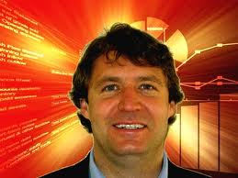
Key Distinctions (Siemens & Baker, 2012)

Slide 30
Key Distinctions: Origins
LAK
Semantic web, intelligent curriculum, social networks, outcome prediction, and systemic interventions
EDM
Educational software, student modeling, course outcomes

Slide 31
Key Distinctions: Modes of Discovery
LAK
Leveraging and supporting human judgment is key; automated discovery is a tool to accomplish this goal
Information distilled and presented to human decision-maker
EDM
Automated discovery is key; leveraging human judgment is a tool to accomplish this goal
Humans provide labels which are used in classifiers

Slide 32
Key Distinctions: Guiding Philosophy
LAK
Stronger emphasis on understanding systems as wholes, in their full complexity
“Holistic” approach
EDM
Stronger emphasis on reducing to components and analyzing individual components and relationships between them

Slide 33
Key Distinctions: Adaptation and Personalization
LAK
Greater focus on informing and empowering instructors and learners and influencing the design of the education system
EDM
Greater focus on automated adaption (e.g. by the computer with no human in the loop) and influencing the design of interactions

Slide 34
To Learn More About LA versus EDM
Take HUDK4051: Learning Analytics: Process and Theory
Spring 2016

Slide 35
Questions? Comments?

Slide 36
Tools
There are a bunch of tools you can use in this class
I don’t have strong requirements about which tools you choose to use
We’ll talk about them throughout the semester
You may want to think about downloading or setting up accounts for
RapidMiner (I prefer 5.3. 6.0 is fine, I just will not be able to give as much tech support)
Python SciPy and NumPY; iPython Notebook
SAS OnDemand for Academics
Weka
Microsoft Excel
Java
Matlab
No hurry, but keep it in mind…

Slide 37
Today’s Readings
First, a no-penalty-or-punishment survey question

Slide 38
Today’s Readings
Who read the Witten & Frank?
Who watched the BDE video?

Slide 39
Questions? Comments? Concerns?

Slide 40
What is a prediction model?

Slide 41
What is a regressor?

Slide 42
What are some things you might use a regressor for?
Bonus points for examples other than those in the BDE video

Slide 43
Let’s do an example
Numhints = 0.12*Pknow + 0.932*Time – 0.11*Totalactions
Skill pknow time totalactions numhints
COMPUTESLOPE 0.2 7 3 ?

Slide 44
Which of the variables has the largest impact on numhints? (Assume they are scaled the same)

Slide 45
However…
These variables are unlikely to be scaled the same!
If Pknow is a probability
From 0 to 1
And time is a number of seconds to respond
From 0 to infinity
Then you can’t interpret the weights in a straightforward fashion
What could you do?

Slide 46
Let’s do another example
Numhints = 0.12*Pknow + 0.932*Time – 0.11*Totalactions
Skill pknow time totalactions numhints
COMPUTESLOPE 0.2 2 35 ?

Slide 47
Is this plausible?

Slide 48
What might you want to do if you got this result in a real system?

Slide 49
Transforms
In the video, we talked about variable transforms
Who here has transformed a variable (for an actual analysis)?
What did you transform and why did you do it?

Slide 50
Variable Transformation: EDM versus statistics
Statistics: fit data better AND avoid violating assumptions
EDM: fit data better

Slide 51
Why don’t violations of assumptions matter in EDM?
At least not the way they do in statistics…

Slide 52
Interpreting Regression Models
Example from the video

Slide 53
Example of Caveat
Let’s graph the relationship between number of graduate students and number of papers per year

Slide 54
Data

Slide 55
Model
Number of papers = 4 + 2 * # of grad students - 0.1 * (# of grad students)²
But does that actually mean that (# of grad students)² is associated with less publication?
No!

Slide 56
Example of Caveat
(# of grad students)² is actually positively correlated with publications!
r=0.46

Slide 57
Example of Caveat
The relationship is only in the negative direction when the number of graduate students is already in the model…

Slide 58
How would you deal with this?
How can we interpret individual features in a comprehensive model?

Slide 59
Other questions, comments, concerns about lecture?

Slide 60
RapidMiner 5.3
Who has gotten RapidMiner 5.3 installed?
Who has completed a RapidMiner tutorial?
Who has completed the RapidMiner walkthrough?

Slide 61
RapidMiner 5.3 exercise
Go to the course website and download
Sep10dataset.csv
Data on the probability that a student error is careless
Calculated as in (Baker, Corbett, & Aleven, 2008)
Try to predict from other variables

Slide 62
RapidMiner tasks
Build regressor to predict P(SLIP|TRIO)
Look at model goodness
Look at model
Look at actual data and refine model
Look at model goodness
Build flat cross-validation
Look at model goodness
Build student-level cross-validation
Look at model goodness

Slide 63
Questions? Comments? Concerns?

Slide 64
Questions about Basic HW 1?

Slide 65
Reminders
You don’t have to do it perfectly, you just have to do it
If you run into trouble, feel free to email me or, better yet, use the moodle discussion forum

Slide 66
Questions? Concerns?

Slide 67
Other questions or comments?

Slide 68
Next Class
Monday, September 10
Classification Algorithms
Baker, R.S. (2015) Big Data and Education. Ch. 1, V3, V4, RapidMiner Walkthrough.
Witten, I.H., Frank, E. (2011) Data Mining: Practical Machine Learning Tools and Techniques. Ch. 4.6, 6.1, 6.2, 6.4
Hand, D. J. (2006). Classifier technology and the illusion of progress. Statistical science, 21(1), 1-14.
Pardos, Z.A., Baker, R.S.J.d., Gowda, S.M., Heffernan, N.T. (2011) The Sum is Greater than the Parts: Ensembling Models of Student Knowledge in Educational Software. SIGKDD Explorations, 13 (2), 37-44.
Basic HW 1 due

Slide 69
The End

