Slide 1
Core Methods in Educational Data Mining
HUDK4050 Fall 2015

Slide 2
Textbook/Readings

Slide 3
Detector Confidence
Any questions about detector confidence?

Slide 4
Detector Confidence
What is a detector confidence?

Slide 5
Detector Confidence
What are the pluses and minuses of making sharp distinctions at 50% confidence?

Slide 6
Detector Confidence
Is it any better to have two cut-offs?

Slide 7
Detector Confidence
How would you determine where to place the two cut-offs?

Slide 8
Cost-Benefit Analysis
Why don’t more people do cost-benefit analysis of automated detectors?

Slide 9
Detector Confidence
Is there any way around having intervention cut-offs somewhere?

Slide 10
Goodness Metrics

Slide 11
Exercise
 | Detector Academic Suspension | Detector No Academic Suspension
Data Suspension | 2 | 3
Data No Suspension | 5 | 140
What is accuracy?

Slide 12
Exercise
 | Detector Academic Suspension | Detector No Academic Suspension
Data Suspension | 2 | 3
Data No Suspension | 5 | 140
What is kappa?

Slide 13
Accuracy
Why is it bad?

Slide 14
Kappa
What are its pluses and minuses?

Slide 15
ROC Curve

Slide 16
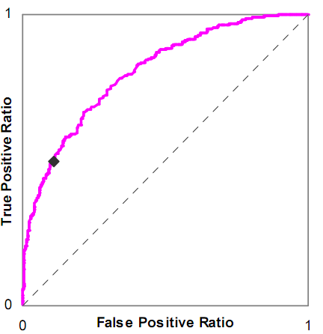
Is this a good model or a bad model?

Slide 17
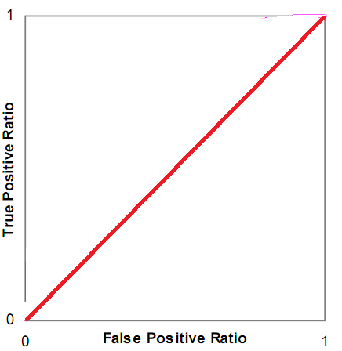
Is this a good model or a bad model?

Slide 18
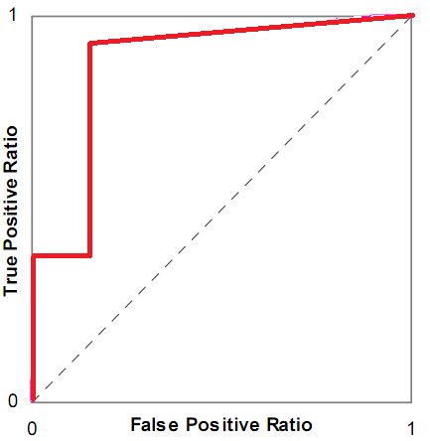
Is this a good model or a bad model?

Slide 19
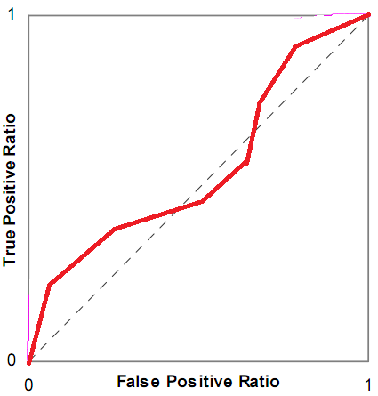
Is this a good model or a bad model?

Slide 20
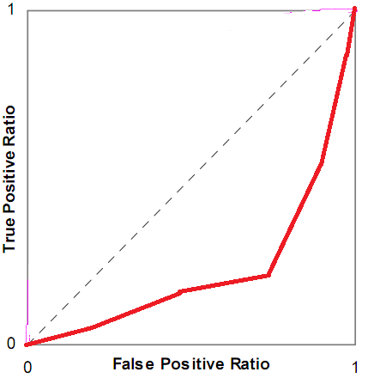
Is this a good model or a bad model?

Slide 21
ROC Curve
What are its pluses and minuses?

Slide 22
A’
What are its pluses and minuses?

Slide 23
Any questions about A’?

Slide 24
Precision and Recall
Precision = TP
TP + FP
Recall = TP
TP + FN

Slide 25
Precision and Recall
What do they mean?

Slide 26
What do these mean?
Precision = The probability that a data point classified as true is actually true
Recall = The probability that a data point that is actually true is classified as true

Slide 27
Precision and Recall
What are their pluses and minuses?

Slide 28
Correlation vs RMSE
What is the difference between correlation and RMSE?
What are their relative merits?

Slide 29
What does it mean?
High correlation, low RMSE
Low correlation, high RMSE
High correlation, high RMSE
Low correlation, low RMSE

Slide 30
AIC/BIC vs Cross-Validation
AIC is asymptotically equivalent to LOOCV
BIC is asymptotically equivalent to k-fold cv
Why might you still want to use cross-validation instead of AIC/BIC?
Why might you still want to use AIC/BIC instead of cross-validation?

Slide 31
AIC vs BIC
Any comments or questions?

Slide 32
LOOCV vs k-fold CV
Any comments or questions?

Slide 33
Other questions, comments, concerns about textbook?

Slide 34
Thoughts on the Knowles reading?

Slide 35
Other questions or comments?

Slide 36
Next Class
Tuesday, September 22
Feature Engineering -- What
Baker, R.S. (2014) Big Data and Education. Ch. 3, V3
Sao Pedro, M., Baker, R.S.J.d., Gobert, J. (2012) Improving Construct Validity Yields Better Models of Systematic Inquiry, Even with Less Information. Proceedings of the 20th International Conference on User Modeling, Adaptation and Personalization (UMAP 2012),249-260.
HW Basic 2 Due

Slide 37
The End

