Slide 1
Core Methods in Educational Data Mining
HUDK4050 Fall 2014

Slide 2
Basic Assignment 2
Any questions about any metrics?
Does anyone want to go through any of the problems together?

Slide 3
Textbook

Slide 4
Pelanek example
W002V004v5
Who would like me to review this?

Slide 5
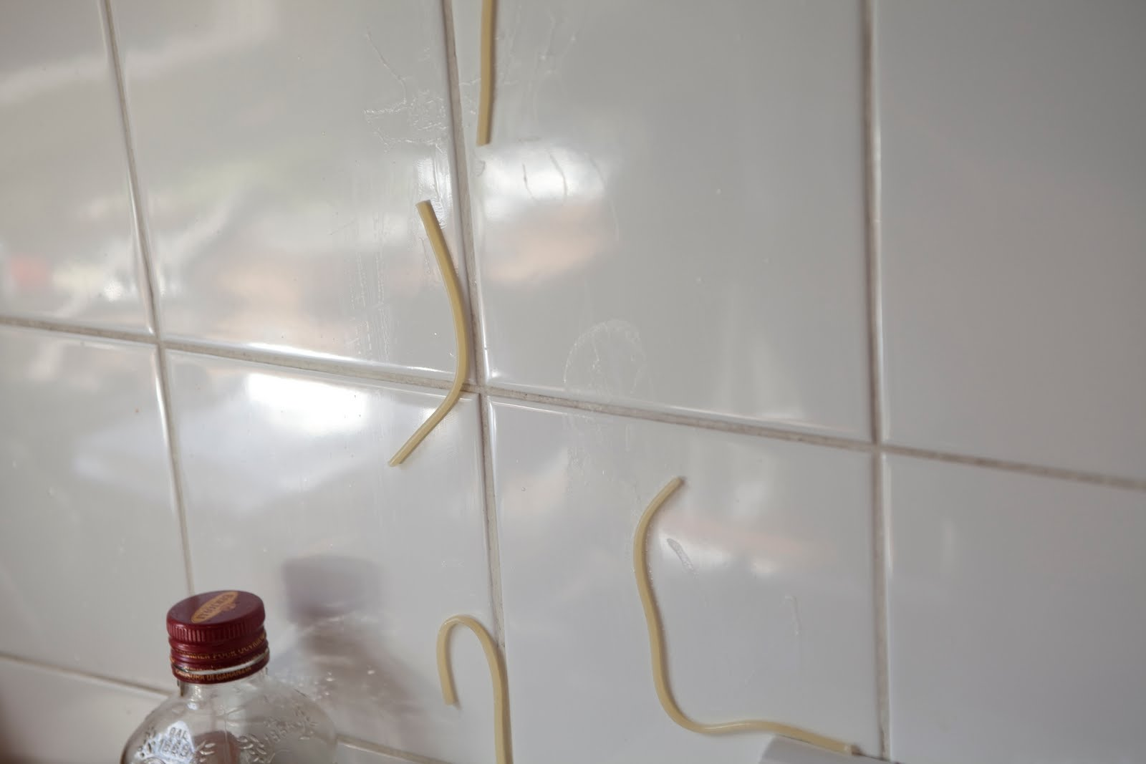
Feature Engineering
Not just throwing spaghetti at the wall and seeing what sticks

Slide 6
Construct Validity Matters!
Crap features will give you crap models
Crap features = reduced generalizability/more over-fitting
Nice discussion of this in the Sao Pedro paper

Slide 7
What’s a good feature?
A feature that is potentially meaningfully linked to the construct you want to identify

Slide 8
Baker’s feature engineering process
Brainstorming features
Deciding what features to create
Creating the features
Studying the impact of features on model goodness
Iterating on features if useful
Go to 3 (or 1)

Slide 9
What’s useful?
Brainstorming features
Deciding what features to create
Creating the features
Studying the impact of features on model goodness
Iterating on features if useful
Go to 3 (or 1)

Slide 10
What’s missing?
Brainstorming features
Deciding what features to create
Creating the features
Studying the impact of features on model goodness
Iterating on features if useful
Go to 3 (or 1)

Slide 11
How else could it be improved?

Slide 12
IDEO tips for Brainstorming
1. Defer judgment
2. Encourage wild ideas
3. Build on the ideas of others
4. Stay focused on the topic
5. One conversation at a time
6. Be visual
7. Go for quantity
http://www.openideo.com/fieldnotes/openideo-team-notes/seven-tips-on-better-brainstorming

Slide 13
Your thoughts?

Slide 14
Deciding what features to create
Trade-off between the effort to create a feature and how likely it is to be useful
Worth biasing in favor of features that are different than anything else you’ve tried before
Explores a different part of the space

Slide 15
General thoughts about feature engineering?

Slide 16
Other questions, comments, concerns about textbook?

Slide 17
Activity

Slide 18
Special Rules for Today
Everyone Votes
Everyone Participates

Slide 19
Let’s look at some features used in real models

Slide 20
Let’s look at some features used in real models
Split into 6 groups
Take a sheet of features
Which features (or combinations) can you come up with “just so” stories for why they might predict the construct?
Are there any features that seem utterly irrelevant?

Slide 21
Each group
Tell us what your construct is
Tell us your favorite “just so story” (or two) from your features
Tell us which features look like junk
Everyone else: you have to give the feature a thumbs-up or thumbs-down

Slide 22
Special Request
Bring a print-out of your Assignment C2 solution to class on the day it’s due
Next Tuesday

Slide 23
Next Class
Thursday, September 24
Feature Engineering – How
Baker, R.S. (2014) Big Data and Education. Ch. 3, V4, V5.
vlookup Tutorial 1
vlookup Tutorial 2
Pivot Table Tutorial 1
Pivot Table Tutorial 2

Slide 24
Special Session
Thursday 9/24 3pm-430pm, Grace Dodge Hall 545
An Inappropriately Brief Introduction to Frequentist Statistics

Slide 25
What if you can’t attend?
Email me; I will send you the slides

Slide 26
Should you attend?
Not mandatory
Not necessary if you’ve taken a stats class that covers topics like Z, F, and Chi-squared tests

Slide 27
The End

