Slide 1
Core Methods in Educational Data Mining
EDUC691 Spring 2019

Slide 2
Assignment B8

Slide 3
Any questions about the assignment?

Slide 4
Who were?
12345
24601

Slide 5
Connections
When 12345 posts 12 times in response to 24601
Is this 12 connections?

Slide 6
Connections
When 12345 posts 12 times in response to 24601
Is this 12 connections?
In Social Network Theory, it isn’t
It’s a connection with a strength of 12

Slide 7
What are other ways connection strength could be conceptualized, in an online course?

Slide 8
In the text, I described several types of nodes
In a graph of classroom interactions, there could be several different types of nodes
Teacher
TA
Student
Project Leader
Project Scribe

Slide 9
What could the node types be, in an online course?

Slide 10
In the text, I described several types of links
In a graph of classroom interactions, there could be several types of links
Leadership role (X leads Y)
Working on same learning resource
Helping act
Criticism act
Insult
Note that links can be directed or undirected

Slide 11
What could the link types be, in an online course?

Slide 12
Four types of centrality
Can anyone name all 4?

Slide 13
Four types of centrality
Degree centrality
Closeness centrality
Betweeness centrality
Eigenvector centrality

Slide 14
What does each one mean mathematically?
Degree centrality
Closeness centrality
Betweeness centrality
Eigenvector centrality

Slide 15
What does each one mean conceptually?
Degree centrality
Closeness centrality
Betweeness centrality
Eigenvector centrality

Slide 16
Let’s take a look at an example
https://astroeringrand.shinyapps.io/edm5/

Slide 17
Questions or comments?

Slide 18
Network Analysis
The most common use of network analysis is for social networks
When else might it apply?

Slide 19
Epistemic Network Analysis
Is anyone here familiar with ENA?
What is it?

Slide 20
Epistemic Network Analysis
Is anyone here familiar with ENA?
What is it?
Studying relationships between elements in coded data

Slide 21
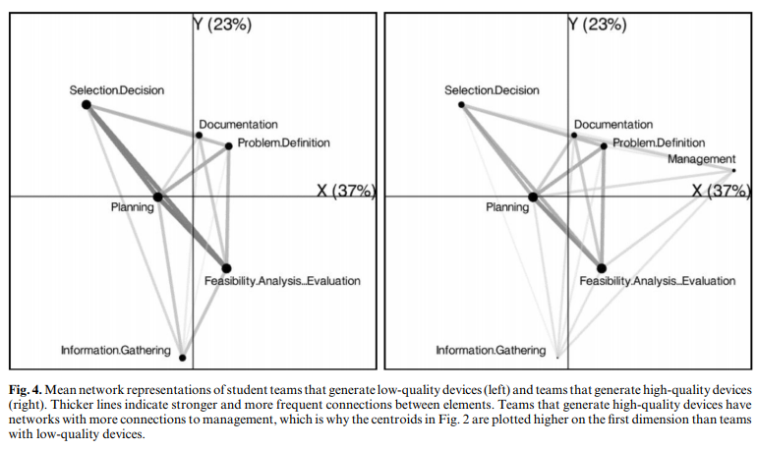
Studying Process of Successful and Unsuccessful Teams (Arastoopour et al., 2016)

Slide 22
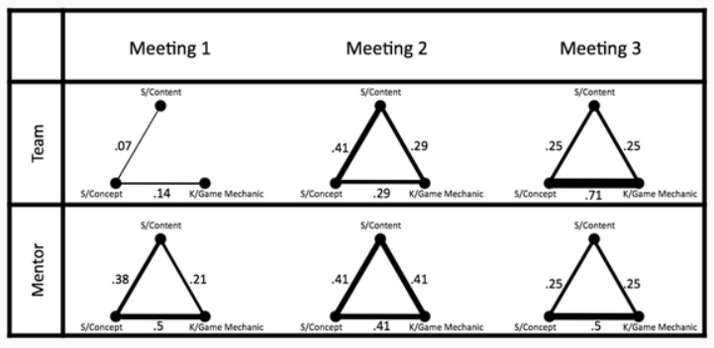
Studying connections between topics in meetings over time (Nash & Shaffer, 2013)

Slide 23
Network Analysis
Let’s make a list of networks we could model

Slide 24
Let’s break into groups
Each group takes a type of network
One group per network type
Define what the meaning in this network would be (or could be) for
Node types, links, link types, link strength
Density
Reachability, Geodesic Distance, Flow
Centrality (in its four forms)
Other measures that might be particularly relevant for your type of network

Slide 25
Now reconvene
Who wants to share
What their network type is
Node types, links, link types, link strength
Anything else that’s interesting

Slide 26
Other questions or comments?

Slide 27
To learn more about SNA…
Take Manuel Gonzalez Canche’s SNA course

Slide 28
Final Presentations
Be mindful of time limits!

Slide 29
The End

