Slide 1
Core Methods in Educational Data Mining
EDUC691 Spring 2019

Slide 2
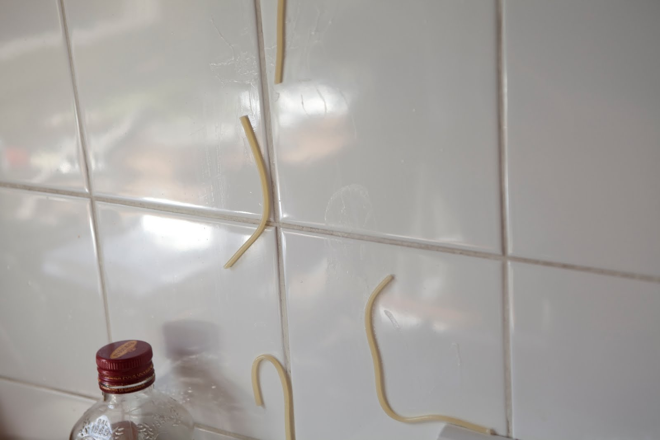
Feature Engineering
Not just throwing spaghetti at the wall and seeing what sticks

Slide 3
Construct Validity Matters!
Crap features will give you crap models
Crap features = reduced generalizability/more over-fitting
Nice discussion of this in the Sao Pedro paper

Slide 4
What’s a good feature?
A feature that is potentially meaningfully linked to the construct you want to identify

Slide 5
Assignment C2

Slide 6
What tools did you use?
Packages (e.g., Excel, Python)
Features of Packages (e.g., Pivot Tables)

Slide 7
Let’s…
Form groups of 3
What features did you generate?
How did you generate them?
Did it end up in your final model?
In what direction?
Choose 2 features per group that are the coolest/most interesting/most novel
Be ready to share with rest of class
Notes:
Does this match the class’s overall intuition?

Slide 8
Let’s…
Go through how you created some features
Actually do it… Re-create it in real-time, or show us your code…
We’ll have multiple volunteers
One feature per customer, please…
Notes:
Does this match the class’s overall intuition?

Slide 9
Was feature engineering beneficial?

Slide 10
What was your process for feature engineering for CA2?
How did you decide what features to create?

Slide 11
Baker’s feature engineering process
Brainstorming features
Deciding what features to create
Creating the features
Studying the impact of features on model goodness
Iterating on features if useful
Go to 3 (or 1)

Slide 12
What’s useful?
Brainstorming features
Deciding what features to create
Creating the features
Studying the impact of features on model goodness
Iterating on features if useful
Go to 3 (or 1)

Slide 13
What’s missing?
Brainstorming features
Deciding what features to create
Creating the features
Studying the impact of features on model goodness
Iterating on features if useful
Go to 3 (or 1)

Slide 14
How else could it be improved?

Slide 15
IDEO tips for Brainstorming
1. Defer judgment
2. Encourage wild ideas
3. Build on the ideas of others
4. Stay focused on the topic
5. One conversation at a time
6. Be visual
7. Go for quantity
http://www.openideo.com/fieldnotes/openideo-team-notes/seven-tips-on-better-brainstorming

Slide 16
Your thoughts?

Slide 17
Deciding what features to create
Trade-off between the effort to create a feature and how likely it is to be useful
Worth biasing in favor of features that are different than anything else you’ve tried before
Explores a different part of the space

Slide 18
General thoughts about feature engineering?

Slide 19
Automated Feature Generation
What are the advantages of automated feature generation, as compared to feature engineering?
What are the disadvantages?

Slide 20
Automated Feature Selection
What are the advantages of automated feature selection, as compared to having a domain expert decide? (as in Sao Pedro paper from Monday)
What are the disadvantages?

Slide 21
A connection to make

Slide 22
A connection to make
Correlation filtering
Eliminating collinearity in statistics
In this case, increasing interpretability and reducing over-fitting go together
At least to some positive degree

Slide 23
Outer-loop forward selection
What are the advantages and disadvantages to doing this?

Slide 24
Knowledge Engineering
What is knowledge engineering?

Slide 25
Knowledge Engineering
What is the difference between knowledge engineering and EDM?

Slide 26
Knowledge Engineering
What is the difference between good knowledge engineering and bad knowledge engineering?

Slide 27
Knowledge Engineering
What is the difference between (good) knowledge engineering and EDM?
What are the advantages and disadvantages of each?

Slide 28
How can they be integrated?

Slide 29
FCBF: What Variables will be kept? (Cutoff = 0.65)
What variables emerge from this table?
 | G | H | I | J | K | L | Predicted
G |  | .7 | .8 | .8 | .4 | .3 | .72
H |  |  | .8 | .7 | .6 | .5 | .38
I |  |  |  | .8 | .3 | .4 | .82
J |  |  |  |  | .8 | .1 | .75
K |  |  |  |  |  | .5 | .65
L |  |  |  |  |  |  | .42

Slide 30
Other questions, comments, concerns about textbook?

Slide 31
Next Class
Clustering
Wednesday, March 20
Baker, R.S. (2018) Big Data and Education. Ch. 7, V1, V2, V3, V4, V5.
Bowers, A.J. (2010) Analyzing the Longitudinal K-12 Grading Histories of Entire Cohorts of Students: Grades, Data Driven Decision Making, Dropping Out and Hierarchical Cluster Analysis. Practical Assessment, Research & Evaluation (PARE), 15(7), 1-18.
Lee, J., Recker, M., Bowers, A.J., Yuan, M. (2016). Hierarchical Cluster Analysis Heatmaps and Pattern Analysis: An Approach for Visualizing Learning Management System Interaction Data. Poster presented at the annual International Conference on Educational Data Mining (EDM).

Slide 32
The End

