Slide 1
Feature Engineering Studio Special Session
October 23, 2013

Slide 2
Today’s Special Session
Prediction Modeling

Slide 3
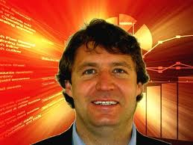
Types of EDM method (Baker & Siemens, in press)
Prediction
Classification
Regression
Latent Knowledge Estimation
Structure Discovery
Clustering
Factor Analysis
Domain Structure Discovery
Network Analysis
Relationship mining
Association rule mining
Correlation mining
Sequential pattern mining
Causal data mining
Distillation of data for human judgment
Discovery with models

Slide 4
Necessarily a quick overview
For a better review of prediction modeling
Core Methods in Educational Data Mining
Fall 2014

Slide 5
Prediction
Pretty much what it says
A student is using a tutor right now. Is he gaming the system or not?
A student has used the tutor for the last half hour.
How likely is it that she knows the skill in the next step?
A student has completed three years of high school.
What will be her score on the college entrance exam?

Slide 6
Classification
There is something you want to predict (“the label”)
The thing you want to predict is categorical
The answer is one of a set of categories, not a number
CORRECT/WRONG (sometimes expressed as 0,1)
This is what is used in Latent Knowledge Estimation
HELP REQUEST/WORKED EXAMPLE REQUEST/ATTEMPT TO SOLVE
WILL DROP OUT/WON’T DROP OUT
WILL SELECT PROBLEM A,B,C,D,E,F, or G

Slide 7
Regression in Prediction
There is something you want to predict (“the label”)
The thing you want to predict is numerical
Number of hints student requests
How long student takes to answer
What will the student’s test score be

Slide 8
Regression in Prediction
A model that predicts a number is called a regressor in data mining
The overall task is called regression
Regression in statistics is not the same as regression in data mining
Similar models
Different ways of finding them

Slide 9
Where do those labels come from?
Field observations
Text replays
Post-test data
Tutor performance
Survey data
School records
Where else?
Other examples in your projects?

Slide 10
Regression
Associated with each label are a set of “features”, which maybe you can use to predict the label
Skill pknow time totalactions numhints
ENTERINGGIVEN 0.704 9 1 0
ENTERINGGIVEN 0.502 10 2 0
USEDIFFNUM 0.049 6 1 3
ENTERINGGIVEN 0.967 7 3 0
REMOVECOEFF 0.792 16 1 1
REMOVECOEFF 0.792 13 2 0
USEDIFFNUM 0.073 5 2 0
….

Slide 11
Regression
The basic idea of regression is to determine which features, in which combination, can predict the label’s value
Skill pknow time totalactions numhints
ENTERINGGIVEN 0.704 9 1 0
ENTERINGGIVEN 0.502 10 2 0
USEDIFFNUM 0.049 6 1 3
ENTERINGGIVEN 0.967 7 3 0
REMOVECOEFF 0.792 16 1 1
REMOVECOEFF 0.792 13 2 0
USEDIFFNUM 0.073 5 2 0
….

Slide 12
Linear Regression
The most classic form of regression is linear regression

Slide 13
Linear Regression
The most classic form of regression is linear regression
Numhints = 0.12*Pknow + 0.932*Time – 0.11*Totalactions
Skill pknow time totalactions numhints
COMPUTESLOPE 0.544 9 1 ?

Slide 14
Linear Regression
Linear regression only fits linear functions (except when you apply transforms to the input variables, which most statistics and data mining packages can do for you…)

Slide 15
Non-linear inputs
Y = X²
Y = X³
Y = sqrt(X)
Y = 1/x
Y = sin X
Y = ln X

Slide 16
Linear Regression
However…
It is blazing fast
It is often more accurate than more complex models, particularly once you cross-validate
Caruana & Niculescu-Mizil (2006)
It is feasible to understand your model (with the caveat that the second feature in your model is in the context of the first feature, and so on)

Slide 17
Example of Caveat
Let’s study a classic example

Slide 18
Example of Caveat
Let’s study a classic example
Drinking too much prune nog at a party, and having to make an emergency trip to the Little Researcher’s Room

Slide 19
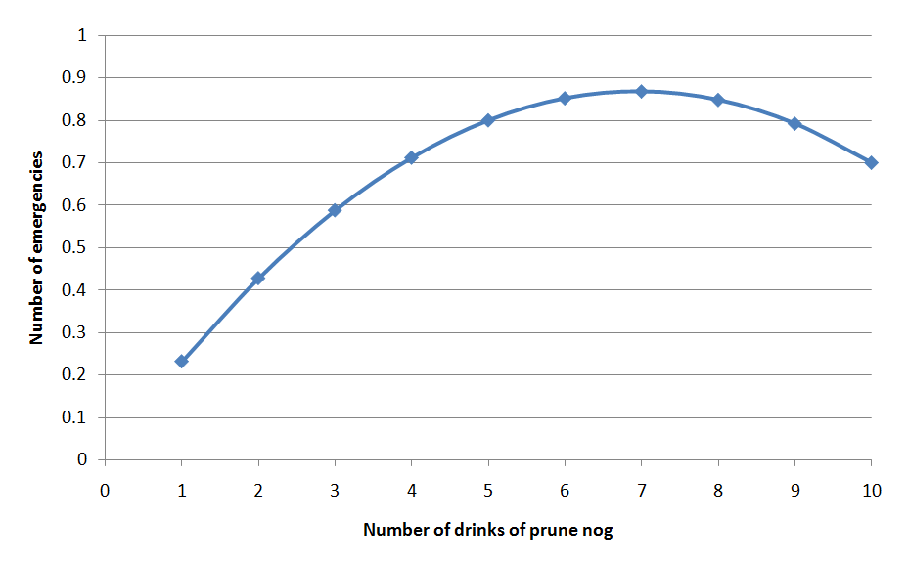
Data

Slide 20
Data
Some people are resistent to the deletrious effects of prunes and can safely enjoy high quantities of prune nog!

Slide 21
Learned Function
Probability of “emergency”= 0.25 * # Drinks of nog last 3 hours - 0.018 * (Drinks of nog last 3 hours)²
But does that actually mean that (Drinks of nog last 3 hours)² is associated with less “emergencies”?

Slide 22
Learned Function
Probability of “emergency”= 0.25 * # Drinks of nog last 3 hours - 0.018 * (Drinks of nog last 3 hours)²
But does that actually mean that (Drinks of nog last 3 hours)² is associated with less “emergencies”?
No!

Slide 23
Example of Caveat
(Drinks of nog last 3 hours)² is actually positively correlated with emergencies!
r=0.59

Slide 24
Example of Caveat
The relationship is only in the negative direction when (Drinks of nog last 3 hours) is already in the model…

Slide 25
Example of Caveat
So be careful when interpreting linear regression models (or almost any other type of model)

Slide 26
Comments? Questions?

Slide 27
Regression Trees

Slide 28
Regression Trees (non-linear; RepTree)
If X>3
Y = 2
else If X<-7
Y = 4
Else Y = 3

Slide 29
Linear Regression Trees (linear; M5’)
If X>3
Y = 2A + 3B
else If X< -7
Y = 2A – 3B
Else Y = 2A + 0.5B + C

Slide 30
Create a Linear Regression Tree to Predict Emergencies

Slide 31
Model Selection in Linear Regression
Greedy – simplest model
M5’ – in between (fits an M5’ tree, then uses features that were used in that tree)
None – most complex model

Slide 32
Greedy
Also called Forward Selection
Even simpler than Stepwise Regression
Start with empty model
Which remaining feature best predicts the data when added to current model
If improvement to model is over threshold (in terms of SSR or statistical significance)
Then Add feature to model, and go to step 2
Else Quit

Slide 33
Some algorithms you probably don’t want to use
Support Vector Machines
Conducts dimensionality reduction on data space and then fits hyperplane which splits classes
Creates very sophisticated models
Great for text mining
Great for sensor data
Usually pretty lousy for educational log data

Slide 34
Some algorithms you probably don’t want to use
Genetic Algorithms
Uses mutation, combination, and natural selection to search space of possible models
Obtains a different answer every time (usually)
Seems really awesome
Usually doesn’t produce the best answer

Slide 35
Some algorithms you probably don’t want to use
Neural Networks
Composes extremely complex relationships through combining “perceptrons”
Usually over-fits for educational log data

Slide 36
Note
Support Vector Machines and Neural Networks are great for some problems
I just haven’t seen them be the best solution for educational log data

Slide 37
In fact
The difficulty of interpreting Neural Networks is so well known, that they put up a sign about it on the Belt Parkway in Brooklyn

Slide 38
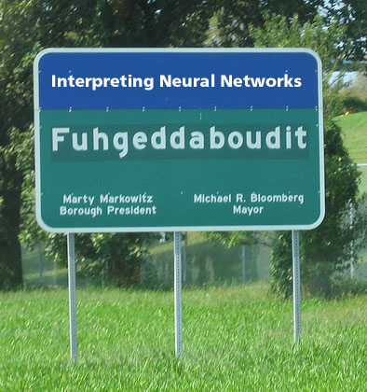

Slide 39
Other specialized regressors
Poisson Regression
LOESS Regression (“Locally weighted scatterplot smoothing”)
Regularization-based Regression (forces parameters towards zero)
Lasso Regression (“Least absolute shrinkage and selection operator”)
Ridge Regression

Slide 40
How can you tell if a regression model is any good?

Slide 41
How can you tell if a regression model is any good?
Correlation/r²
RMSE/MAD
What are the advantages/disadvantages of each?

Slide 42
Classification
Associated with each label are a set of “features”, which maybe you can use to predict the label
Skill pknow time totalactions right
ENTERINGGIVEN 0.704 9 1 WRONG
ENTERINGGIVEN 0.502 10 2 RIGHT
USEDIFFNUM 0.049 6 1 WRONG
ENTERINGGIVEN 0.967 7 3 RIGHT
REMOVECOEFF 0.792 16 1 WRONG
REMOVECOEFF 0.792 13 2 RIGHT
USEDIFFNUM 0.073 5 2 RIGHT
….

Slide 43
Classification
The basic idea of a classifier is to determine which features, in which combination, can predict the label
Skill pknow time totalactions right
ENTERINGGIVEN 0.704 9 1 WRONG
ENTERINGGIVEN 0.502 10 2 RIGHT
USEDIFFNUM 0.049 6 1 WRONG
ENTERINGGIVEN 0.967 7 3 RIGHT
REMOVECOEFF 0.792 16 1 WRONG
REMOVECOEFF 0.792 13 2 RIGHT
USEDIFFNUM 0.073 5 2 RIGHT
….

Slide 44
Some algorithms you might find useful
Step Regression
Logistic Regression
J48/C4.5 Decision Trees
JRip Decision Rules
K* Instance-Based Classifier
There are many others!

Slide 45
Logistic Regression

Slide 46
Logistic Regression
Fits logistic function to data to find out the frequency/odds of a specific value of the dependent variable
Given a specific set of values of predictor variables

Slide 47
Logistic Regression
m = a0 + a1v1 + a2v2 + a3v3 + a4v4…

Slide 48
Logistic Regression

Slide 49
Parameters fit
Through Expectation Maximization

Slide 50
Relatively conservative
Thanks to simple functional form, is a relatively conservative algorithm
Less tendency to over-fit

Slide 51
Good for
Cases where changes in value of predictor variables have predictable effects on probability of predictor variable class

Slide 52
Good when multi-level interactions are not particularly common
Can be given interaction effects through automated feature distillation
RapidMiner GenerateProducts
But is not particularly optimal for this

Slide 53
Step Regression

Slide 54
Step Regression
Fits a linear regression function
with an arbitrary cut-off
Selects parameters
Assigns a weight to each parameter
Computes a numerical value
Then all values below 0.5 are treated as 0, and all values >= 0.5 are treated as 1

Slide 55
Example
Y= 0.5a + 0.7b – 0.2c + 0.4d + 0.3
Cut-off 0.5
a | b | c | d
1 | 1 | 1 | 1
0 | 0 | 0 | 0
-1 | -1 | 1 | 3

Slide 56
Parameters fit
Through Iterative Gradient Descent
This is a simple enough model that this approach actually works…

Slide 57
Good for
Cases where relationships between predictor and predicted variables are relatively linear

Slide 58
Good when multi-level interactions are not particularly common
Can be given interaction effects through automated feature distillation
But is not particularly optimal for this

Slide 59
Feature Selection
Greedy – simplest model
M5’ – in between
None – most complex model

Slide 60
Decision Trees

Slide 61
Decision Tree
PKNOW
<0.5
>=0.5
TIME
TOTALACTIONS
<6s.
>=6s.
<4
>=4
RIGHT
WRONG
RIGHT
WRONG
Skill pknow time totalactions right
COMPUTESLOPE 0.544 9 1 ?

Slide 62
Decision Tree Algorithms
There are several
I usually use J48, which is an open-source re-implementation of C4.5 (Quinlan, 1993)
Relatively conservative, good performance for educational data

Slide 63
Good when data has natural splits

Slide 64
Good when multi-level interactions are common

Slide 65
Good when same construct can be arrived at in multiple ways
A student is likely to drop out of college when he
Starts assignments early but lacks prerequisites
OR when he
Starts assignments the day they’re due

Slide 66
Decision Rules

Slide 67
Many Algorithms
Differences are in terms of what metric is used and how rules are generated
Most popular subcategory (including JRip and PART) repeatedly creates decision trees and distills best rules

Slide 68
Relatively conservative
Leads to simpler models than most decision trees
Less tendency to over-fit

Slide 69
Very interpretable model
Unlike most other approaches

Slide 70
Example (Baker & Clarke-Midura, 2013)
1. IF the student spent at least 66 seconds reading the parasite information page, THEN the student will obtain the correct final conclusion (confidence = 81.5%)
2. IF the student spent at least 12 seconds reading the parasite information page AND the student read the parasite information page at least twice AND the student spent no more than 51 seconds reading the pesticides information page, THEN the student will obtain the correct final conclusion (confidence = 75.0%)
3. IF the student spent at least 44 seconds reading the parasite information page AND the student spent under 56 seconds reading the pollution information page, THEN the student will obtain the correct final conclusion (confidence = 68.8%)
4. OTHERWISE the student will not obtain the correct final conclusion (confidence = 89.0%)

Slide 71
Good when multi-level interactions are common

Slide 72
Good when same construct can be arrived at in multiple ways
A student is likely to drop out of college when he
Starts assignments early but lacks prerequisites
OR when he
Starts assignments the day they’re due

Slide 73
K*

Slide 74
Instance-Based Classifier
Takes a data point to predict
Looks at the full data set and compares the point to predict to nearby points
Closer points are weighted more strongly

Slide 75
Good when data is very divergent
Lots of different processes can lead to the same result
Impossible to find general rules
But data points that are similar tend to be from the same class

Slide 76
Big Drawback
To use the model, you need to have the whole data set

Slide 77
Big Advantage
Sometimes works when nothing else works
Has been useful for my group in affect detection

Slide 78
Comments? Questions?

Slide 79
Confidences
Each of these approaches gives not just a final answer, but a confidence (or pseudo-confidence)
Many applications of confidences!
Out of scope for today, though…

Slide 80
Leveraging Detector Confidence
A lot of detectors are better at relative confidence than at being right about whether a student is above or below 50% confidence
E.g. A’ is substantially higher than Kappa
If a student is 48% likely to be off-task, treat them differently if they are 3% likely or 98% likely
Strong interventions near 100%
“Fail-soft interventions” near 50%
No intervention near 0%

Slide 81
Leveraging Detector Confidence
In using detectors in discovery with models analyses (where you use a detector’s predictions in another analysis)
Always use detector confidence
Why throw out information?

Slide 82
If we have time…

Slide 83
Some Validity Questions

Slide 84
For what uses is my model valid?
For what users will it work?
For what contexts will it work?
Is it valid for moment-to-moment assessment?
Is it valid for overall assessment?
If I intervene based on this model, will it still work?

Slide 85
Multi-level cross-validation
When you cross-validate, software tools like RapidMiner allow you to choose the batch (level) that you cross-validate on
What levels might be useful to cross-validate on?

Slide 86
Multi-level cross-validation
Action
Student
Lesson
School
Demographic
Software Package

Slide 87
What people actually do (2013)
Action
Student
Lesson
School
Demographic
Software Package

Slide 88
Lack of testing across populations is a real problem!

Slide 89
Why?

Slide 90
Medicine
Medical drug testing has had a history of testing only on white males (Dresser, 1992; Shavers-Hornaday, 1997; Shields et al., 2005)
Leading to medicines being used by women and members of other races despite lack of evidence for efficacy

Slide 91
We…
Are in danger, as a field, of replicating the same mistakes!

Slide 92
Settings
A lot of student modeling research is conducted in
suburban schools (mostly white and Asian populations, higher SES)
elite universities (mostly white and Asian populations, higher SES)
In wealthy countries…

Slide 93
Settings
Some research is conducted in
urban schools in wealthy countries (mostly minority groups, lower SES)

Slide 94
Settings
Almost no research is conducted in
rural schools in wealthy countries (mostly white populations in the US, lower SES)
community colleges and HBCUs/HHSCUs/TCUs (mostly African-American and Latino and indigenous populations, lower SES)
developing countries (there are notable exceptions, including Didith Rodrigo’s group in the Philippines)

Slide 95
Why not?

Slide 96
Challenges
There are often significant challenges in conducting research in these settings
Uncooperative city school IRBs
Parents and community leaders who do not support research – partly out of legitimate historically-driven cynicism about the motives and honesty of University researchers (Tuhiwai Smith, 1999)
Inconvenient locations
Outdated computer equipment
Physical danger for researchers

Slide 97
However
If we ignore these populations
Our research may serve to perpetuate and actually increase inequalities

Slide 98
However
If we ignore these populations
Our research may serve to perpetuate and actually increase inequalities
Effective educational technology for everyone?
Effective educational technology for a few?
Or effective educational technology for a few, and unexpectedly ineffective educational technology for everyone else?

Slide 99
The End

