Slide 1
Feature Engineering Studio
March 30, 2015

Slide 2
Iterative Feature Refinement

Slide 3
Who here
Used the Excel Equation Solver
Did not use the Excel Equation Solver

Slide 4
Excel Equation Solver Users
Sort yourself by the town you were born in (in Roman letters)

Slide 5
Excel Equation Solver Users
Pick one feature
What feature did you improve?
What parameter did you adjust?
What was the original and final value?
How big an improvement did you obtain?
Did this process change the meaning of the feature?

Slide 6
Everyone Else
Sort yourself by the town you were born in (in Roman letters)

Slide 7
Everyone Else
Pick one feature
What feature did you improve?
What parameter did you adjust?
What values did you try?
How big an improvement did you obtain?
Did this process change the meaning of the feature?

Slide 8
Comments? Questions? Thoughts?

Slide 9
Question
Is the excel equation solver likely to change the meaning of the feature more than hand processes?

Slide 10
Question
Is it a good thing or a bad thing, when your feature changes meaning due to refinement?

Slide 11
Feature Parameter Space
I need a volunteer who had a final best feature that was quite different from their original feature

Slide 12
One interesting exercise
I need a volunteer who had a final best feature that was quite different from their original feature
Please bring up your laptop or a flash drive with your data set

Slide 13
Making…
A line graph
X axis – parameter value
Y axis – model goodness

Slide 14
Another volunteer?
Would anyone else like to look at their feature this way?
Multiple volunteers are welcome

Slide 15
What does it mean?

Slide 16
Questions? Comments? Thoughts?

Slide 17
EDM Workbench
http://penoy.admu.edu.ph/~alls/downloads
Tool to address the bottleneck in labeling data and simple feature distillation
Currently allows learning scientists to
Label previously collected data
Collaborate with others in labeling data
Distill additional features from log files

Slide 18
Log import
Allows importation of CSV and DataShop text files.
Allows importation of batches of files

Slide 19
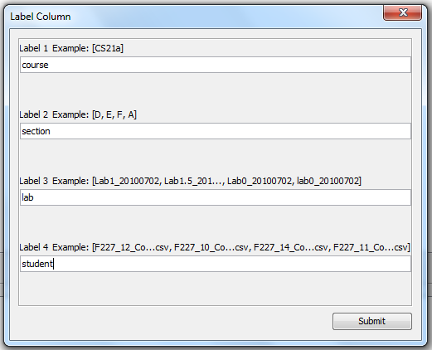
Batch importation

Slide 20
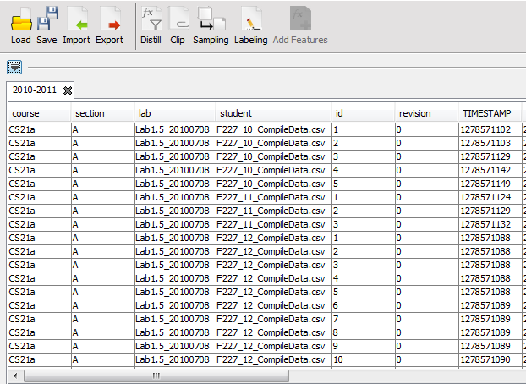
Batch importation

Slide 21
Feature distillation
Automatically distills 26 features based on the work of (Baker, et al., 2008 and others)
Adding to these features requires modification of the EDM Workbench config file
21 operations defined in the program
Any new feature has to be defined in terms of a subset of the 21 operations

Slide 22
EDM Workbench config file
<feature_set> <timeSD> <group_col>Step Name</group_col> <range_col>Duration</range_col> <out>timeSD</out> </timeSD> <sumLastN> <sort_col>Row</sort_col> <group_col>Anon Student Id</group_col> <group_col>Problem Name</group_col> <range_col>timeSD</range_col> <n>3</n> <out>timelastnSD</out> </sumLastN> </feature_set>
Feature
timeSD
Feature
timelastnSD

Slide 23
Clip generation
Clip: subsets of student-tutor interactions
Defined by the user based on time intervals (Baker & de Carvalho, 2008), number of actions (Lee et al., 2011), or “begin” and “end” events (Sao Pedro, et al., 2013).

Slide 24
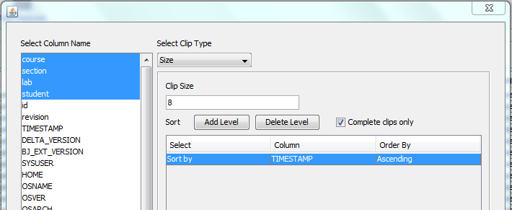
Clip generation

Slide 25
Sampling
Supports both stratified and random sampling

Slide 26
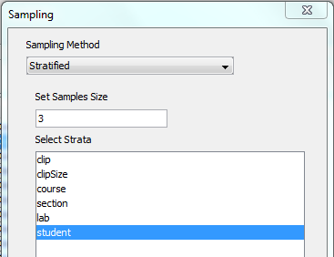
Sampling

Slide 27
Labeling
Allows the user to specify
Features will be displayed
Labels to use
Displays text replays (Baker & de Carvalho, 2008) of clips together with labeling options
Coder selects from the labels
Work can be saved and resumed

Slide 28
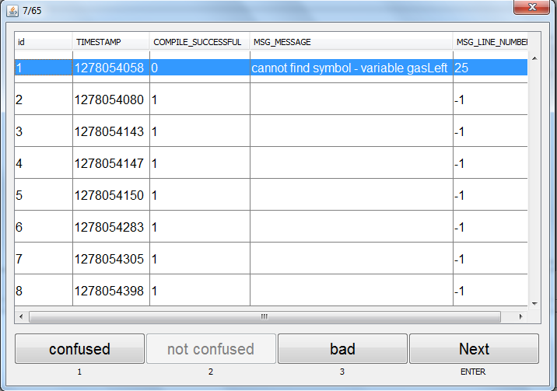
Labeling

Slide 29
Adding features at the clip level
Once labeling is complete, clip-level features can be generated
Limited set of functions, e.g. maximum, minimum, average, standard deviation

Slide 30
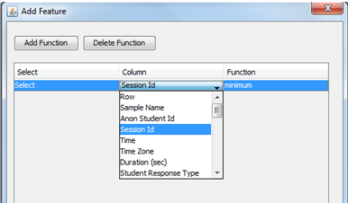
Adding features at the clip level

Slide 31
Data export
Labeled data can be exported in CSV format

Slide 32
Questions? Comments?

Slide 33
GoogleRefine (now OpenRefine)

Slide 34
GoogleRefine (now OpenRefine)
Mostly just an Excel clone, abandoned in favor of the fully-online Google Towels Sheets
But some nice additional functionality

Slide 35
GoogleRefine (now OpenRefine)
Functionality to make it easy to regroup and transform data
Find similar names
Connect names
Bin numerical data
Mathematical transforms showing resultant graphs
Text transforms and column creation

Slide 36
GoogleRefine (now OpenRefine)
Functionality for finding anomalies/outliers

Slide 37
GoogleRefine (now OpenRefine)
Functionality for automatically repeating the same process on a new data set
*Really* nice for cases where you complete a complex process and want to repeat it
Replicates a really good logbook, which most data analysts don’t keep
Now seen in other tools like iPython Notebook
Still not in Excel, but Excel has been stagnant for years

Slide 38
GoogleRefine (now OpenRefine)
Functionality for connecting your data set to web services to get additional relevant info

Slide 39
GoogleRefine (now OpenRefine)
Can load in and export common but hard-to-work-with data types
JSON and XML

Slide 40
GoogleRefine (now OpenRefine)
Some videos you should watch later
http://www.youtube.com/watch?v=B70J_H_zAWM
http://www.youtube.com/watch?v=cO8NVCs_Ba0
http://www.youtube.com/watch?v=5tsyz3ibYzk

Slide 41
Questions? Comments?

Slide 42
Upcoming Classes
4/1 Lab Session: Building Predictive Models
Come to this if you want to learn more about the theory behind building predictive models; how to do it effectively and appropriately (beyond just the how)
You don’t need to come to this if you’ve taken Core Methods or Big Data and Education
4/6 Brainstorming
Read Kelley (2001)
Do Assignment 7

Slide 43
Next week
Kelley, T. (2001) The Art of Innovation: Lessons in Creativity from IDEO, America’s Leading Design Firm.
A lot of reading (more than the rest of the semester put together)
You can focus on the parts about brainstorming if you want, although the whole book is fun and interesting
Heck, you can just skim the parts about brainstorming if you want
I assume you’ve all gotten yourself a copy of the book?
If not, e-books are available immediately from Amazon…

Slide 44
Assignment 7: Brainstorming
Write a 1-page essay (longer is also fine)

Slide 45
Assignment 7: Brainstorming
Write a 1-page essay (longer is also fine)
I know, an essay

Slide 46
Assignment 7: Brainstorming
Write a 1-page essay (longer is also fine)
I know, an essay
I’ll be grading based on your thoughts, not grammar, writing style, writing ability, etc.
Just get your thoughts down on a page
It doesn’t even have to look like an essay. Bulleted lists are fine (although in that case, make it longer than a page)

Slide 47
Assignment 7: Brainstorming
The essay should be about
Your past experience with brainstorming (if you’ve never brainstormed, think about any time you’ve come up with ideas with a group of friends or colleagues for a project)
What went wrong with brainstorming you’ve done in the past?
Do you think the ideas in this book about how to brainstorm are good in general? What’s good in specific? What’s bad in specific?

Slide 48
Questions? Comments?

